Slide 1

Battle Creek High School
CURRICULUM GUIDE
& COURSE CATALOG

Slide 2


School Administration
Mr. Mike Kinnard, Principal
mkinnard@mauryk12.org
School Counselor
Ms. Lyndsey Spain
LSpain@mauryk12.org

Slide 3

Contents | Page
Scheduling Guidelines and Policies | 4
High School Graduation Requirements | 7
Grading Policies | 9
Graduation Recognitions | 10
Tennessee Ready Graduate | 11
Course Catalog | 12
Core Academic Courses | 13
Advanced Academics | 19
AP Access Online Courses | 21
Elective Courses | 22
Testing and Assessment | 32
TN State Scholarship Programs | 34
Collegiate Athletics Eligibility | 35

Slide 4



Class Schedule
BCHS offers 7-class periods each day. Students can earn 7 credits in a school year. 1 credit classes are year-long and ½ credit classes are one semester in length.
Course Registration/Requests
There will be an 8th Grade night for students/parents. Course request sheets will be provided for students at that time.
We will be meeting with current 9th graders at SHHS on April 9th and current 9th graders at CHS at a later date.
New students can request courses once the enrollment process is complete.
Students will pick 7 classes and alternates.
If there is a scheduling conflict between one or more classes the student requests or if a requested class does not end up being offered, alternates are used based on priority set by the student during course registration.
Official Student Schedules
Schedules are not official until the first day of the school year.
Schedules will be posted in StudentVue. Class periods and staffing are subject to change throughout the summer, so schedules often go through multiple iterations before they are finalized.
4

Slide 5
Reasons a student does not get a requested class
BCHS was not able to offer the class on the master schedule.
There is a scheduling conflict among classes the student chose.
The class was full.
The student did not take/pass the required pre-requisite class.
The student did not meet the eligibility requirements to take the class.
When one of the above reasons occur, the student's schedule is filled with the student's alternate requests.
SCHEDULE CHANGES
Schedule changes made after the start of the school year will only be made for limited, approved reasons. BCHS reserves the right to deny a request to drop a course the student requested.
Students are expected to stay in the classes they requested since this is how we create our master schedule and hire/assign school staff. ​There is not enough space in other classes to accommodate widespread changes for unnecessary reasons.
Schedule changes will ONLY be made for the following reasons:
The school needs to balance class sizes or make adjustments to the master schedule due to staffing changes.
The student did not pass a class that was a prerequisite for another class.
The student has been scheduled into a course out of sequence.
The student has already taken AND passed the course.

Slide 6
Schedule Change Request Process:
While we understand every circumstance is different, it is important for students and parents to know that there are many reasons schedule changes during the school year are not permitted. However, if the student believes a change is necessary, we encourage the student to follow the process outlined below.
The request should be made BY THE STUDENT. The student should stop by the guidance office or email/TEAMS chat his or her counselor to make an appointment to discuss the issues.
At the appointment, the student will be given steps to be taken by the student in order to be considered for a schedule change. Additionally, there is a process for dropping an advanced course.
Final approval to drop an advanced course will come from a school administrator.
Requests that are automatically denied:​
The student is no longer interested in subject.
The student would like a different lunch period.
The student wants to be in a different class period.
Reasons a schedule change may not occur:
The student is failing the course, wants to bring up their GPA, or thinks the class is too hard.
The student is having a conflict with a teacher.
The student is having conflicts with another student.

Slide 7

TN HIGH SCHOOL GRADUATION REQUIREMENTS (MINIMUM OF 22 CREDITS)
TN Graduation Requirements: 22 Credits
ENGLISH (4 Credits) | MATH (4 Credits) | SCIENCE (3 Credits) | SOCIAL STUDIES (3 Credits)
ENGLISH I | ALGEBRA I | CHEMISTRY | WORLD HISTORY
ENGLISH II | GEOMETRY | BIOLOGY | AMERICAN HISTORY
ENGLISH III | ALGEBRA II | ANOTHER LAB SCIENCE | US GOVERNMENT (.5 credit)
ENGLISH IV | 4TH MATH COURSE |  | ECONOMICS (.5 credit)
FINE ART (1 Credit)
WORLD LANGUAGE (2 Credits)
Personal Finance (.5 Credit)
Wellness and PE (1.5 Credits)
LIFE WELLNESS (1 credit)
PE (.5 credit)
ELECTIVE FOCUS (3 Credits)
-AP (ADVANCED PLACEMENT)
-CTE (CAREER AND TECHNICAL EDUCATION)
-DE (DUAL ENROLLMENT)
-FINE ARTS (4 credits total)
-HUMANITIES
NOTES:
Math-Students need 4 credits in math AND must be enrolled in a math course every year of high school. Students who take high school math for credit in 8th grade will have 5+ math credits at graduation. The 4th Math credit must be in a course that is a higher level than Algebra II.
Beginning with students enrolling in 9th grade in 2024-2025, students must earn a high school computer science credit. Students may substitute computer science for 4th math, 3rd science, or an elective focus credit.
Science: All science courses at BCHS are Lab Science Courses.
Foreign Language- The two required credits must be in the same language.
PE- Life Wellness is a year-long PE/Health course required for all 9th graders.
An additional semester of PE is required unless the student is on a sports team or in marching band.
Note: The State Board of Education requires all students to complete an elective focus program of study with no less than three credits to prepare for postsecondary study and lifelong learning. Elective focus selection must be finalized by the end of the sophomore year.

Slide 8
TN HIGH SCHOOL GRADUATION REQUIREMENTS Credit Substitutions
Credit Substitutions
Economics- Marketing I
English III- DE English 1010
English IV- DE English 1010 or DE 1 English 1020
Fine Art- Digital Arts I
Life Wellness- JROTC (1 year)
PE- JROTC (2 years), Marching Band, or School Sports team
Personal Finance OR US Gov- JROTC (3 years)
World History-AP Human Geography
All Honors/Pre-AP/ SDC/AP cover the standard course requirement
Not all DE credits cover the standard course requirement- check with the counselor
Home School/Online School Credits
For students to receive graduation credit for high school courses taken online or from a homeschool program, the courses must be taken from a nationally or regionally accredited program.
Early Graduation
Students may apply to graduate 1 semester early if they meet their graduations requirements by December of their senior year. Students should work with their counselor the spring of their junior year and apply at the beginning of their senior year. The request will be approved or denied by Maury County Board of Education.
Students interested in graduating before their senior year must do so through the Tennessee Move on When Ready program and meet with their counselor by the end of their 10th grade year. Students must meet the TN MOWR requirements to be eligible.

Slide 9
GRADING POLICIES
MCPS follows the Tennessee Uniform Grading Policy (3.301). Grade Point Average (GPA) is not weighted. However, the numerical grade earned in advanced courses are weighted based on the difficulty level of the course. At BCHS, grades are posted to student transcripts each semester, awarding a ½ credit for each passing course. The grades on the student’s transcript make up the student’s GPA.
Grade | Percentage
A | 90-100
B | 80-89
C | 70-79
D | 60-69
F | 0-59
Course Type | Percentage Points Added for Course Difficulty
Honors | +3 added to the semester grade
State Dual Credit (SDC) Dual Enrollment (DE) Industry Certification (IC) | +4 added to the semester grade
Advanced Placement (AP) | + 5 added to the first semester grade +5 added to the second semester grade for students that take the AP exam.
Classification of Students
At the conclusion of each school year, students are classified by grade level for the upcoming school year based on the number of years in high school and units of credit.
Failed Courses
Students who do not earn credit for a course required for graduation have 1 semester after the end of the failed semester to bring the grade to passing. After that, the student must either retake the course or repeat the course in Credit Recovery. To be eligible for Credit Recovery, the student must earn a grade above a 50. Students that score below 50 must retake the course in the classroom.
Freshman | 0 – 4 ½
Sophomore | 5 – 9 ½
Junior | 10 – 14 ½
Senior | 15 or more

Slide 10

Graduation Recognitions
Graduation with Honors- Student graduates with a 3.0+ GPA
Graduation with State Honors- Student meets all ACT benchmarks
  English: 18
  Math: 22
  Reading: 21
  Science: 24
Graduation with Distinction- Student graduates with a 3.0 + GPA and satisfies one of the following:
  Participate in Governor's School
  Participate in a TN All State Musical Organization
  Be a National Merit Finalist or Semi Finalist (Based on PSAT Score)
  Composite Score of 31 on ACT
  Score 3 or higher on two AP Exams
  Earn 12 or more college credits (Dual Enrollment Classes)
  Earn a nationally recognized industry certification

Slide 11
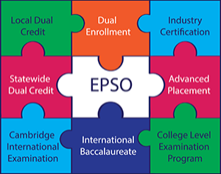
TENNESSEE READY GRADUATE is a distinction for high school graduates who demonstrate readiness for meaningful postsecondary education, a training program, and/or workforce entry.
Early postsecondary opportunities (EPSO) allow students to:​
earn postsecondary credits while in high school.​
become familiar with postsecondary rigor and expectations.​
develop confidence and skills for success in postsecondary learning.​
make informed postsecondary and career decisions.​
decrease the time and cost of completing a certificate or degree.
To be considered a READY GRADUATE,
a student must fulfill one of the following measures:
Earn a composite score of 21 or higher on the ACT or a 1060 or higher on the SAT
Complete four early postsecondary opportunities (EPSOs)
Complete two EPSOs + earn an industry certification
Complete two EPSOs + earn a score of 31*on the Armed Services Vocational Aptitude Battery (ASVAB)

Slide 12

Battle Creek High School
Course Catalog
Course State Standards and Descriptions​
AP Course Descriptions

Slide 13
Math Courses
Algebra I
Algebra I Honors (Must have an 85+ in 8th grade Math)
Geometry (Pre-Requisite: Algebra I)
Geometry Honors (Pre-Requisite: 85+ in Algebra I )
Algebra II (Pre-Requisite: Algebra I)
Algebra II Honors (Pre-Requisite: 85+ in Algebra I or Geometry)
AP Pre-Calculus (Pre-Requisite: Algebra II)
AP Calculus AB (Pre-Requisite: Pre- Calculus)
AP Physics (Co-Requisite: Pre- Calculus)
Core Academic Courses: Math
NOTE: Students wishing to take Calculus Senior year will need to double up on Geometry and Algebra II Sophomore year.

Slide 14
English
English I (9th Grade)
English I Honors (Pre-Requisite: 85+ in 8th grade ELA)
English I Pre-AP (Pre-Requisite: 85+ in 8th grade ELA)
English II (10th Grade)
English II Honors (Pre-Requisite: 85+ in English I)
English II Pre-AP (Pre-Requisite: 85+ in English I)
English III (11th Grade)
AP English III Language and Comp (11th Grade)
English IV (12th Grade)
AP English IV Literature and Comp (12th Grade)
Core Academic Courses: English
NOTE: When selecting between Honors or Pre-AP courses, select Pre-AP if you are planning to take AP or Dual Enrollment for 11th and 12th grade.

Slide 15
Core Academic Courses:
Social Studies
Social Studies
World History & Geography (9th)
World History Honors (9th)
Elective: AP European History (10th, 11th, or 12th)
US History (11th Only)
AP U.S. History (11th Only)
US Government (semester) (12th Only)
Economics (semester) (12th Only)

Slide 16
Core Academic Courses:
Science
Science
Physical Science (9th)
Physical Science Honors
Biology I (10th)
Honors Biology I (9th or 10th)
Chemistry I ( 11th)
Chemistry I Honors (10th or 11th)
Elective: AP Environmental Science (10th, 11th, or 12th)
Note: If you are planning to take higher level science courses, it is recommended that you take Biology I Honors in 9th grade and Chemistry Honors in 10th grade.

Slide 17

World Languages
Spanish I & II​
French II

Slide 18

PHYSICAL EDUCATION
CLASSES
Lifetime Wellness
PE 1
PE2 Weightlifting

Slide 19

Advanced Academics at BCHS
Honors/Pre-AP
3 Points added to final semester grade
These courses are high school courses that provide additional rigor and substantially exceed the academic standards approved by the State Board of Education. Teachers of honors courses will model instructional approaches that facilitate maximum interchange of ideas among students: independent study, self-directed research and learning, and appropriate use of technology. All honors courses shall include multiple assessments exemplifying coursework. The courses should be taken in preparation for SDC, DE, and AP courses.
​Advanced Placement (AP)
5 points added to final semester grade ​
AP courses are nationally standardized, college-level course designed by the College Board (SAT exam). These courses are taught by AP certified teachers and are the most rigorous course available to a high school student. ​

Slide 20
Advanced Academics at BCHS
State Dual Credit (SDC)
4 points added to final semester grade ​
SDC courses are high school course that incorporates postsecondary learning objectives and is aligned with an approved dual credit challenge exam. Students who pass the SDC Challenge Exam will earn college credit accepted by all Tennessee public postsecondary institutions.
Dual Enrollment (DE)
4 points added to final semester grade
DE courses are taught by postsecondary faculty for postsecondary credit that is also recognized by a local education agency for high school credit. Dual enrollment courses may be taught at a postsecondary institution, at a high school, or online.

Slide 21
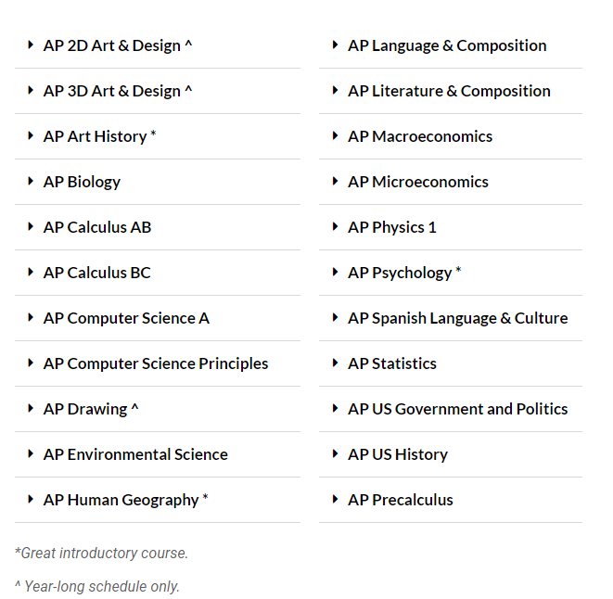

Qualified students can take AP classes online for free through a grant from the State of Tennessee. ​
The course is scheduled on the student's schedule and the student will complete the course during the school year in a study hall.​
Sophomores must have a freshman GPA of 3.5 . Juniors and Seniors must have taken a prior AP course to qualify. ​
https://tnapaccessforall.org/students/

Slide 22


ELECTIVE
COURSES
**Career and Technical Education electives must be taken in sequence.

Slide 23




Business Management
Level 1: Introduction to Business & Marketing
Level 2: Business Communications
Level 3: SDC Introduction to Business
Level 4: Business & Entrepreneurship Practicum
Business Management WBL
Click Here for More Info

Slide 24

Criminal Justice & Correction Services
Level 1: Criminal Justice I
Level 2: Criminal Justice II
Level 3: SDC Criminal Justice
Level 4: Criminal Justice Practicum
Criminal Justice & Correction Services WBL
Click here for more information

Slide 25



Digital Arts & Design
Level 1: Digital Arts & Design I ​
Level 2: Digital Arts & Design II​
DE Digital Arts & Design II​
Level 3: Digital Arts & Design III​
DE Arts & Design III​
Level 4: Applied Arts Practicum​
Digital Arts & Design WBL​
Click here for more info

Slide 26
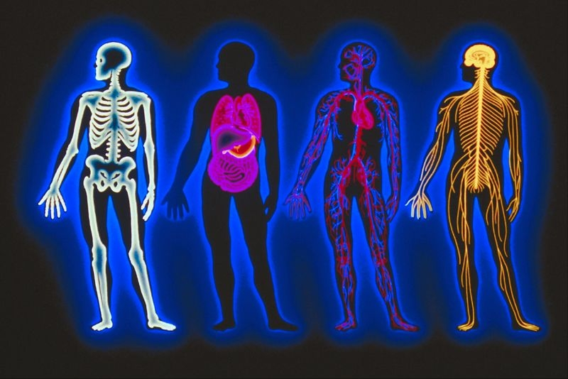
Health Science
Students wishing to begin the Health Science track during their 10th grade year may double up and take both Health Science Education and Anatomy & Physiology.
Click here for more info
Health Science Education (Level 1)
Anatomy and Physiology (Level 2)
Medical Therapeutics (Level 3)
Emergency Medical Services OR Nursing Education (Level 4)
Career Practicum (Level 4)
It is recommended for students who wish to complete this pathway to enroll in Biology Honors for 9th grade and Chemistry Honors for 10th grade.

Slide 27

Marketing Management
Level 1: Introduction to Business & Marketing​
Level 2: Marketing & Management I Principles​
Level 3: SDC Principles of Marketing​
Level 4: Business & Entrepreneurship Practicum​
Marketing Management WBL​
This Photo by Unknown author is licensed under CC BY-NC.
Click here for more info

Slide 28

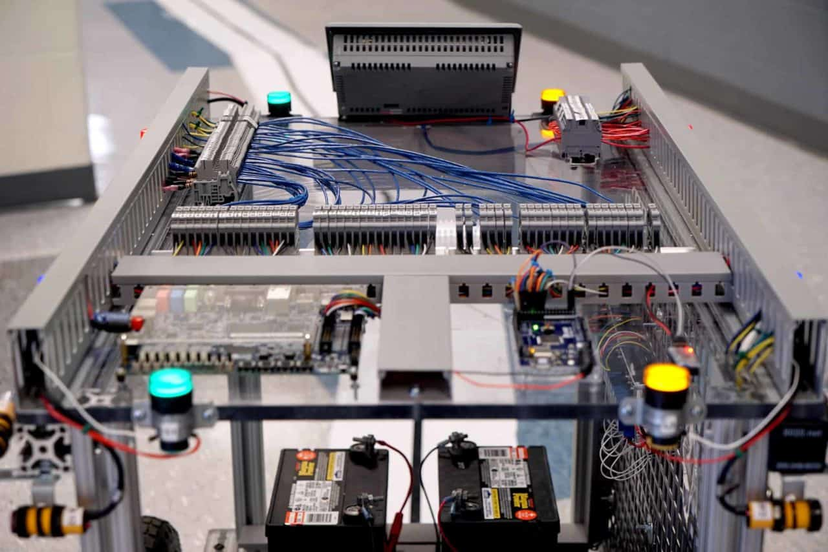
Mechatronics
Level 1: Principles of Manufacturing
Level 2: Robotics & Automated Systems
Level 3: Mechatronics 1
Level 4: Mechatronics 2
Level 4: Manufacturing Practicum
*If you took Principles of Engineering Technology at SHHS, you may sign up for Level 2: Robotics & Automated Systems.
Click here for more info

Slide 29


VISUAL ARTS
Visual Art I
Visual Arts II
Visual Arts III
Visual Arts IV

Slide 30
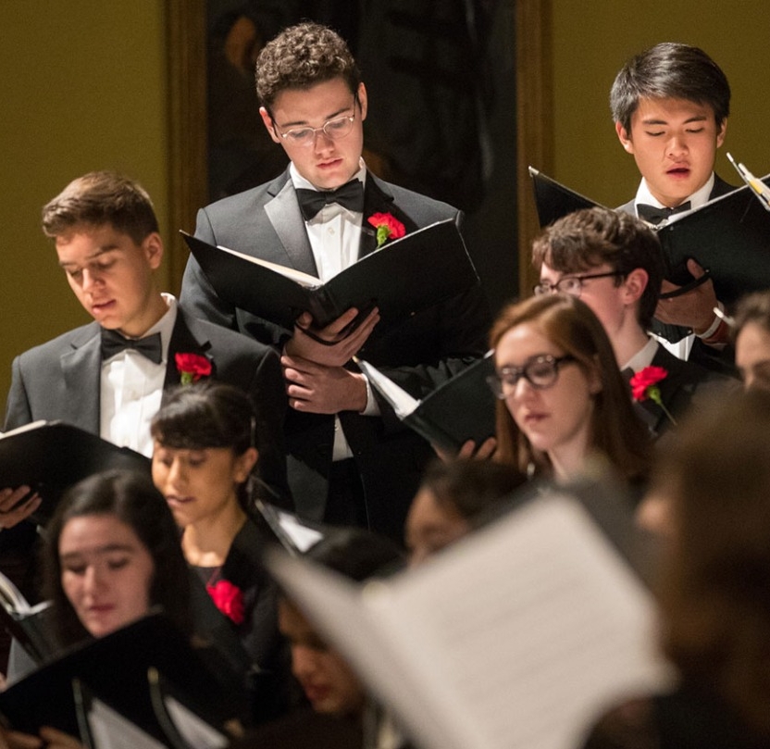

Music & Band Electives
General Music
Chorus
Band
Introductory Band
Music Theory

Slide 31
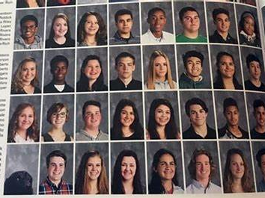
Journalism: Yearbook

Slide 32
Required Testing & Assessments
END OF COURSE (EOC) EOC exams are required for students taking English I, English II, Algebra I, Algebra IB, Geometry, Geometry B, Algebra II, US History, and Biology. Students take the test at the end of the school year and the grade is factored into their semester 2 average.
CIVICS EXAM All students must participate in the United States citizenship and immigration test during the student’s high school career. Students take their exam in US Government. Students are required to pass the exam with an 80% to graduate.
SDC CHALLENGE EXAM Students enrolled in SDC courses at BCHS will take this exam at the end of school year. Students that earn a passing score may earn credit for the course at a public TN college.
ACT is a college admissions test which is required by most community colleges, colleges and universities. The state of Tennessee requires all students to take the ACT as a graduation requirement. The ACT will be given to ALL 11th graders free during a school day in March.

Slide 33
Additional Testing Opportunities
ACT Students are encouraged to take the ACT as many times as they like on any of the national test dates; colleges will accept the best score. Students can register and pay to take the ACT on a national test date at www.act.org.
AP TESTING is available to all students enrolled in AP courses. Taking the AP test is voluntary, yet strongly encouraged. The test occurs at the end of the school year and the testing fee is the responsibility of the student.
ASVAB is given annually to all 11th grade students. These scores are used primarily for a career interest survey, but it also helps predict future academic and occupational success in the military.
Industry Certification Exams Industry certifications (IC) exams are taken through several CTE courses at BCHS. These exams aligned with postsecondary and employment opportunities and with the competencies and skills that students should have acquired through their chosen programs of study. Students can take the exam towards the end of their program of study and will learn more about the available certifications through level 1 CTE courses.
PSAT/NMSQT is offered in October each year to sophomores and juniors. Juniors wanting to be considered for the National Merit Scholarship should take this test. Interested students should sign up and pay for the exam in the guidance office starting in late August/Early September.
SAT is a college admissions test which may be required by some colleges and universities. BCHS does not offer this exam on campus. To register and pay for an exam, students should visit https://collegereadiness.collegeboard.org/sat

Slide 34


TENNESSEE SCHOLARSHIP PROGRAMS
The HOPE Scholarship
Students must graduate high school with a 3.0+ GPA and/or 21+ ACT
2-year colleges: $3,200/yr
4-year colleges
1st & 2nd Year: $4,500/yr
3rd & 4th Year: $5700/yr
The Tennessee PROMISE Scholarship
Students must graduate from high school and complete multiple steps throughout their Senior year and first two years of college.
Covers tuition after all state and federal scholarship dollars are applied.
The state of Tennessee offers many more college scholarships.
Visit https://www.tn.gov/collegepays for a full listing of state scholarships.
For more information about paying for college, visit our school counseling page for Scholarships and Financial aid located under the access tab of the BCHS website.​

Slide 35


Collegiate Athletics Eligibility
Students who plan to enroll in college and participate in athletics in an NCAA or NAIA school must be certified by the appropriate eligibility center.
Students should begin to meet with their school counselor as early as their sophomore year to ensure they are taking appropriate courses to meet eligibility criteria.
Student athletes should apply for certification at the end of the junior year. Athletes and their parents should review the eligibility center websites.

