Slide 1
2023-2024
Cookies and Curriculum
Annual Title I &
Family Engagement Meeting
Joseph Brown Elementary School
August 17, 2023
Mr. Nick Davis
August 5, 2023

Slide 2
Why are we here?
The “Every Student Succeeds Act” (ESSA) requires that each Title I school hold an annual meeting of Title I families in order to:
      inform you of your school’s participation in Title I
      explain the requirements of Title I
      explain your rights as parents and family members to be involved

Slide 3
What will I learn?
What is a Title I school?
What are my rights?
What can Title I funds be used for?
How does our school use Title I funds?
What is the SIP?
What are our schoolwide program goals?
How is parent and family engagement funded?
What is the Parent and Family Engagement Policy?
What is the School-Family Compact?
What curriculum does our school use?
What tests will my child be taking?
How can I be involved?
Who can I contact for help?
Who are our local community sponsors?

Slide 4
What is a Title I school?
Title I was passed in 1965 under the Elementary and Secondary Education Act (ESEA). It is the largest federal assistance program for our nation’s schools.
Title I schools receive extra funding (Title I dollars) from the federal government. These dollars are used to:
    identify students experiencing academic difficulties and provide assistance to help these students;
    purchase additional staff, programs, materials, and/or supplies; and
    conduct parent and family engagement meetings, trainings, events, and/or activities.

Slide 5
What is our school’s designation status?
In accordance with Tennessee’s accountability system, the Tennessee Department of Education (TDOE) determines designations for all public schools. Designations include:
    Reward Schools - Reward schools include the top 10 percent of schools.
    Priority Schools - Priority schools are the 5 percent of schools with the lowest success rates (using up to three years of data) in the state.
    Focus Schools - Focus schools are the 10 percent of schools identified through one of three pathways:
          Graduation Rate Pathway - High schools with an average graduation rate of less than 60 percent.
          Subgroup Pathway - Any subgroup with a success rate of less than ten percent.
          Gap Pathway - Schools with the largest gaps between selected groups.
Notes:
OPTIONAL SLIDE
For more information see: https://www.tn.gov/education/data/accountability/2017-school-accountability.html

Slide 6
What is the State Report Card?
TDOE releases an annual Report Card on Tennessee schools.
This report displays state-, district-, and school-level data for each school year.
It includes information on demographics, achievement, academic growth, attendance, graduation rate and more.
You can view the data statewide, or you can choose a specific district or school.
You can view the report card here:
      https://tdepublicschools.ondemand.sas.com/state/assessment
Notes:
OPTIONAL SLIDE

Slide 7
What are my rights?
The families and parents of Title I students have a right, by law, to:
    be involved in decisions made at both the school and district level;
    be provided with information on your child’s level of achievement on tests in reading/language arts, writing, mathematics, and science;
    request and receive information on the qualifications of your child’s teacher and paraprofessionals who are working with your child. You can contact the school to receive this information;
    request opportunities for regular meetings to formulate suggestions and to participate, as appropriate, in decisions about the education of your child. The school is required to respond to any such suggestions as soon as practicably possible.

Slide 8
What can Title I funds be used for?
In general, Title I funds may be used for:
      smaller class sizes,
      additional teachers and paraprofessionals,
      additional training for school staff,
      extra time for instruction (before and/or after school programs),
      parent and family engagement activities, and/or
      a variety of supplemental teaching materials, equipment, and technology.

Slide 9
How does our school use Title I funds?
In 2023-2024, our school was allotted approximately $478,981 in Title I funding.
We are a Schoolwide Program, which means we plan to spend our funds on the following:
      Supplemental staff:
        Facilitator, Educational Assistants, Interventionists
      Programs/Materials/Supplies:
        Planbook
        Classroom materials/supplies
      Teacher Professional Development:
        RTI2B
        Tier I Math and ELA

Slide 10
What is the SIP?
The SIP is the School Improvement Plan. It includes:
      the identification of the school planning team and how they will be engaged in the planning process;
      a needs assessment and summary of academic and non-academic data;
      prioritized goals, strategies, and action steps to help address the academic and non-academic needs of students;
      teacher and staff professional development needs; and
      budgets and the coordination of resources.
The school must include family representatives on our school planning team.

Slide 11
What are our schoolwide program goals?
Reading –
For grades K-2, on the universal screener, JBES will increase the percentage of students scoring above/mid grade level from 38.9% to 46.6%.
JBES will increase students testing on-track or exceeding expectations in Reading and Language Arts on TN Ready to the following:
For 3rd grade, from 29% to 37.9%.
For 4th grade, from 19% to 29.1%.
Math –
For grades K-2, on the universal screener, increase the percentage of students testing mid/above grade level in math from 26.3% to 35%.
For grades 3-4 TN Ready, increase the percentage of students who meet and exceed expectations from 29% to 37.9%
For Black and African American students, increase the percentage of students who meet and exceed expectations from 17% to 27.4%.
For ELL students, increase the percentage of students who meet and exceed expectations from 18% to 28.3%.

Slide 12
What are our schoolwide program goals?
Social – Emotional Learning (SEL) –
Close gaps in out of school suspensions for all students to reduce overall out of school suspensions and decrease missed instruction from 4.5% to 3%.
Data pulled from Student Information System will show an increase in RTI-B placement indicating the implementation of strategies used that promote restorative practices to increase in-class and out-of-class interventions pertaining to major behaviors requiring the school level disposition given by administration pertaining to out of school suspensions; additional data from RTI-B (Response to Intervention) meetings showing positive Tier movement across all grades and subgroups.
Chronic Absenteeism (Attendance)–
JBES recognizes the importance of attendance to instruction. The school will establish clear school-wide expectations of student attendance to families.
Reduce the percentage of students who are chronically absent by 5% from 19.3% to 14.3%

Slide 13
How is parent and family engagement funded?
Any district with a Title I allocation exceeding $500,000 is required by law to set aside 1% of its Title I allocation for parent and family engagement.
Of that 1%, 10% may be reserved at the district for system-wide initiatives related to parent and family engagement. The remaining 90% must be allocated to all Title I schools in the district.
You, as Title I parents and family members, have the right to be involved in how this money is spent.

Slide 14
How is parent and family engagement funded?
In 2023-2024, we received approximately $4,000 in parent and family engagement funding. We plan to use these funds for:
    Parent and Family Engagement Meetings and Events
      Annual Title I Meeting
      Reading Night
      Math Night
      STEM Night
      Kindergarten and 4th grade promotion
    Materials/Supplies
      supplies for meetings and events
We want your input on what is needed and helpful!

Slide 15
What is a Parent and Family Engagement Policy?
These plans address how the district and school will implement the parent and family engagement requirements of ESSA. Components should include:
      how parents and families can be involved in decision-making and activities;
      how parent and family engagement funds are being used;
      how information and training will be provided to families; and
      how the school will build capacity in families and staff for strong parent and family engagement.
You, as a Title I parent or family member, have the right to be involved in the development of these plans.

Slide 16
What is a Parent and Family Engagement Policy?
The Maury County district Parent and Family Engagement Policy can be found here:
      On our website
      Facebook
      https://www.mauryk12.org/Page/144
    The J. Brown Parent and Family Engagement Policy will be shared by August 12 through Class Dojo and our Social Media accounts. In addition, the policy can be found here:
      https://bit.ly/3BIC5Pg

Slide 17
What is a School-Family Compact?
The school-Family compact will be sent home with students by August 12.
In addition, the compact can be found on Facebook, Class Dojo, and the school website.

Slide 18
What is a School-Family Compact?
A school-family compact is a written commitment that outlines how the entire school community – teachers, families, and students will share the responsibility for improved academic achievement.
The compact must describe how the school will:
      provide high-quality curriculum and instruction;
      hold parent-teacher conferences, annually in elementary schools;
      provide parents with reports on their child’s progress;
      provide parents reasonable access to staff.
      provide parents opportunities to volunteer; and
      ensure regular two-way meaningful communication between family members and staff, to the extent practicable, in a language family members can understand.
You, as a Title I parent or family member, have the right to be involved in the development of the compact.

Slide 19
What curriculum does our school use?
The Tennessee Academic Standards provide a common set of expectations for what students will know and be able to do at the end of a grade for each subject area.
Tennessee's academic standards form the framework for everything taught at Joseph Brown Elementary School.
For more information about Tennessee’s academic standards, see:
      https://www.tn.gov/education/districts/academic-standards.html

Slide 20
What tests will my child be taking?
Progress monitoring on AimsWeb in the fall
iReady Math and Reading (Fall, Winter, Spring) - above the 25th percentile
TCAP (Spring) – On-track
Classroom Assessments
Running records
Phonological Awareness Screener (Kindergarten)
Phonics screeners (1-4)
Case benchmark assessment

Slide 21
How can I be involved?
We need you! Research has proven that family engagement in education has more impact on student achievement than any other factor.
To get involved with the SIP, you can email
  Stephen Richardson, strichardson@mauryk12.org
  Mr. Davis, ndavis@mauryk12.org
  Mrs. Jones, jjones1@mauryk12.org
To get involved with the Parent and Family Engagement Policy, email Stephen Richardson, strichardson@mauryk12.org
To get involved with the School – Family Compact, you can email Stephen Richardson, strichardson@mauryk12.org

Slide 22
What is parent and family engagement?
Family engagement is a shared responsibility in which schools and other community agencies and organizations are committed to reaching out to engage families in meaningful ways and in which families are committed to actively supporting their children's learning and development.
Family engagement is continuous across a child’s life and entails enduring commitment but changing family roles as children mature into young adulthood.
Effective family engagement cuts across and reinforces learning in the multiple settings where children learn – at home, in pre-kindergarten programs, in school, in after-school programs, in faith-based institutions, and in the community.
Source: The National Association for Family, School, and Community Engagement (https://nafsce.site-ym.com/page/definition)
Notes:
OPTIONAL SLIDE

Slide 23
What is parent and family engagement?
“Through effective communication with parents, teachers can have the greatest impact on their day-to-day success with students. With parents on their side, teachers can more effectively manage most academic and behavioral issues that arise. When the most important adults in a child’s life are working together, students benefit enormously.”
                —Lee and Marleen Canter
Source: Parents on your Side: A Teacher’s Guide to Creating Positive Relationships with Parents
Notes:
OPTIONAL SLIDE

Slide 24
What are the benefits of family engagement?
For students:
Higher grades and test scores
Better attendance
More positive attitudes and better behavior
Higher graduation rates
Greater enrollment in postsecondary education
For Parents and Families:
More confidence and trust in the school
Increased confidence in their parenting skills
Creates a home environment that encourages learning
Encourages families to form stronger relationships with teachers and other families
For Schools and Teachers:
Improved teacher and staff morale
Higher ratings of schools and teachers by families
More support from families
Higher student achievement
Increased and improved relationships within the community
Notes:
OPTIONAL SLIDE

Slide 25
How can I be involved?
Encourage attendance
  “The beautiful thing about learning is no one can take it away from you.”
Monitor grades and schoolwork on ParentVUE
  Please let us know if you need information.
Attend family events and meetings
  Math Night
  Reading Night
  STEAM Night
  Kindergarten and 4th grade promotion;
Observe, substitute, or volunteer in classrooms
Join Parent Vols
  Participate in their events
Communicate with teachers
Read classroom newsletters, Title I Smore, information on school website, social media pages, and Class Dojo that contain examples of learning activities families can do with students at home.

Slide 26
Who can I contact for help?
For general questions, call the front office at: (931) 388-3601
To reach the principal, Nick Davis, call: (931) 388-3601 ext. 6010
To reach the assistant principal, Jennifer Jones, call: (931) 388-3601 ext. 6050
To reach the Title I Facilitator, Stephen Richardson,
call (931) 388-3601 ext. 6072
To reach the school counselor, Heather Adams, call: (931) 388-3601 ext. 6100
For family resource support, call Stephen Richardson, call (931) 388-3601 ext. 6072
To reach your child’s teacher, call the front office or view our staff directory at: https://www.mauryk12.org/bres

Slide 27
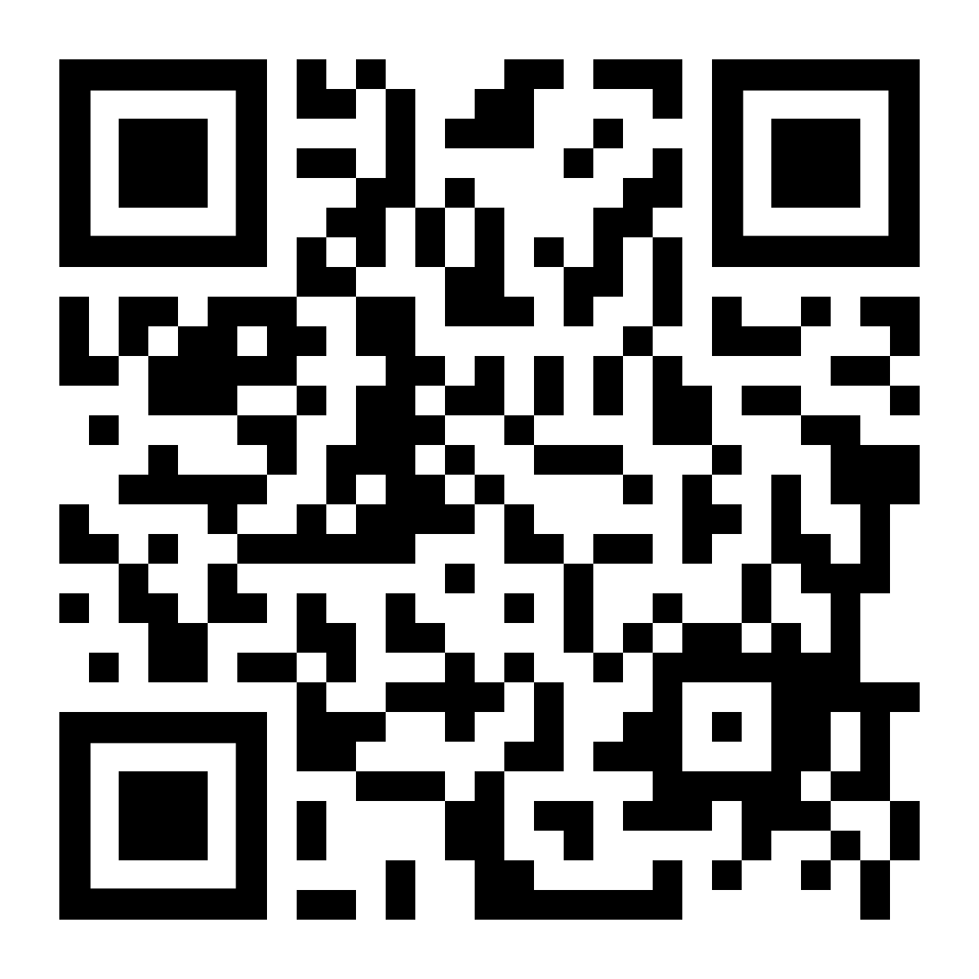
WE JUST WANT TO SAY…
THANK YOU!
Survey
Notes:
Be sure to thank families for their time.
Move this slide to the end if additional slides are added.

