Slide 1
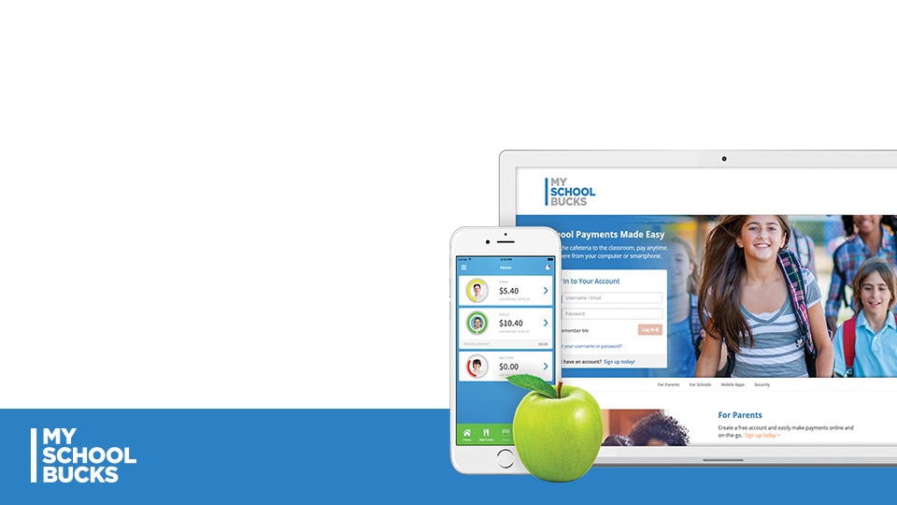



Marble Falls ISD partners with MySchoolBucks to allow you to easily make student meal payments!
Simple, secure & easy-to-use
Low balance alerts
Automatic payments

Slide 2
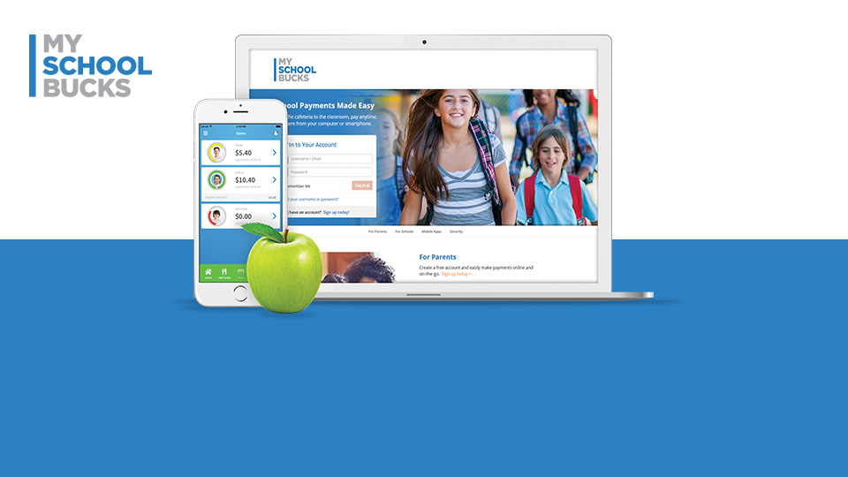



Visit MySchoolBucks.com or Download the App
Create your account, Add [DISTRICT NAME] & Add your students
Pay with your credit/debit card

