Slide 1

Marble Falls High School
Course Registration for 2023-2024

Slide 2
How do I make my schedule?
Review Graduation Requirements.
Look at credits earned on Skyward and Xello. Use that information to make sure you have earned credit in all required classes.
Check to see what required courses you need to take next year.
Use the course catalog to ensure you complete your chosen endorsement, as an endorsement is required to graduate.
Enter your choices in Xello! Choices 1-8 will complete your schedule. You must also choose alternates.
If you do not pick classes, including alternates, they will be selected for you and you will be stuck in those classes next year.

Slide 3
Check your transcript!
Counselors will do this with you individually prior to the end of school and verify the courses you choose.
Look for required credits that you need to graduate, including credits you did not earn because of failing grades or because you owe hours.
You can complete credit for failed courses through Odyssey, long-averaging, summer school, or re-taking the course next year.

Slide 4
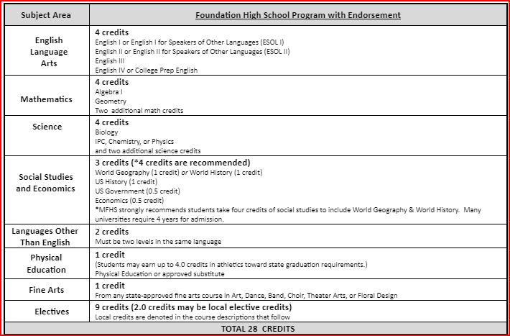
Graduation Requirements:
Red (recommneded) - Colleges may require these courses
Algebra 2
Recommend including Chem., Physics and 4th science
Recommend World Geography AND World History (all 4 credits of Social Studies)
Some colleges view 3 years of a Foreign language as a plus!

Slide 5
Important Elective Information
Some electives have pre-requisites. Pre-requisites are courses that you must complete or take concurrently while you are in that class. Courses with pre-requisites should not be available for you to choose in Xello.
Never select a class that you already have credit for on your transcript!
Some electives require an application. Courses are indicated in Xello.
Some courses are 2 periods in your schedule.
Consider weighted courses for GPA boosts (Honors/AP/DC or On Ramps)!
Check the MFHS/Guidance and Counseling website for applications and course information!

Slide 6
Distinguished Level of Achievement
Complete the Foundation Requirements
Complete Algebra 2
Earn an endorsement
Required for top 10% automatic admission to Texas public colleges.

Slide 7
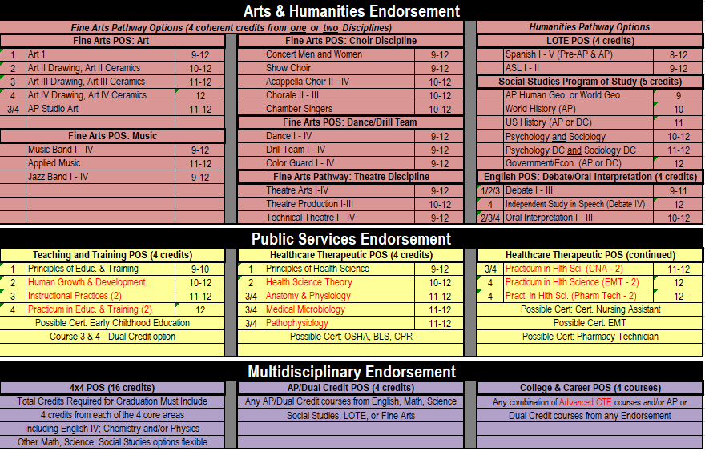
Endorsements:

Slide 8
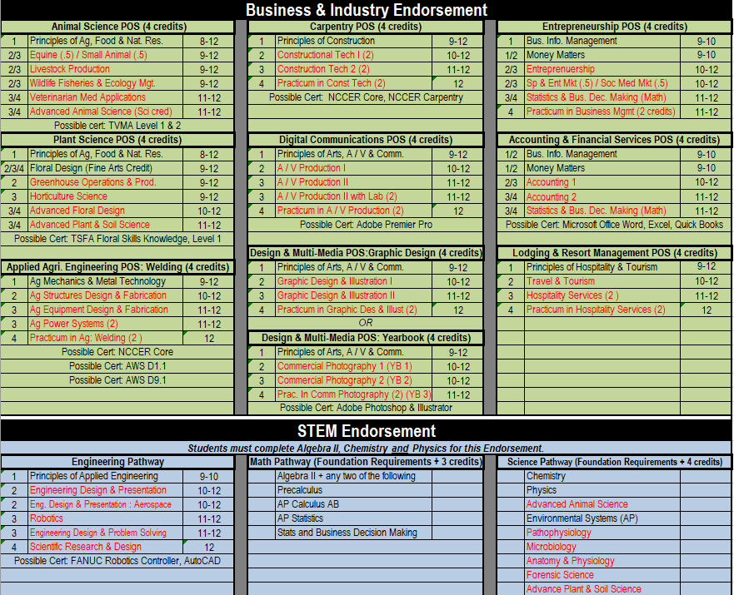

Slide 9
How do I make my schedule?
Review Graduation Requirements.
Review credits earned through Xello or Skyward.
Complete choices for your 4-year plan that meet all graduation requirements (this can be adjusted each year).
Go to the MFHS Counseling website and click on Scheduling tab – Use the course catalog to ensure you complete your chosen endorsement or use the Xello Course Guide to find pathways. An endorsement is required to graduate.
Enter your choices in Xello! Your 9th grade choices will complete your course requests for 9th grade. Choices 1-8 will be your requested courses. You must also choose alternates.
If you do not pick classes, including alternates, they will be selected for you and may not be able to change!

Slide 10
Log-in to Xello
Log-in to “Single Sign-on”.
Click on Xello. Log-in.
Click on the “Course Planning” link.
Select your classes to complete your 4 year plan as we guide you through the process!

Slide 11
How to fill out your Course Requests
  Stay with me and we will fill it out together.
  Review credits needed to graduate and plan your course requests accordingly.
  Click on each required credit (English, Math, etc.) and options will come up to pick from that required credit.
  You will choose courses to fill 8 academic hours and you will choose alternates.

Slide 12
Choose your English course for next year:
English 1 Regular or Honors | English 2 Regular Honors | English 3 Regular, Dual Credit or UT OnRamps | English 4 Regular, Dual Credit or AP English 4

Slide 13
Pick your English courses!
Pick your English course for next year.
If you failed a previous English course, you will be required to make that course up to graduate. You may select it here and/or see your counselor for more options.

Slide 14
Recommended Course Sequence for Math
9th Grade
10th Grade
11th Grade
12th Grade
Algebra 1
Geometry
Math Models
Algebra 2
Algebra 1
Geometry
Regular
Honors
Pre-Calculus
Regular or Honors
or
Another 4th math
Algebra 2
Regular
OnRamps
Geometry Honors
Algebra 2
OnRamps
Pre-Calculus
Honors
AP Statistics,
AP Calculus

Slide 15
Pick your math course for next year:
Pick your math course for next year.
2. If you failed Algebra 1 or Geometry, you will be required to make that
course up to graduate. You may select it here and/or see your counselor
for more options.

Slide 16
Course Sequence for Science
9th Grade
10th Grade
11th Grade
12th Grade
Biology
IPC
Chemistry
Physics or 4th Science
Biology
Chemistry
3rd Science
4th Science
Biology
Chemistry
4th Science
Physics
Biology Honors
Chemistry Honors
Physics, or Physics On-Ramps
4th Science
*3rd and 4th year science course options are on the next slide, or in your course guide on the MFHS Counseling website.

Slide 17
Pick your Science courses:
Students must pass Biology, and either IPC, Chemistry or Physics.
Students should have 4 science credits to graduate.
If you are graduating with Multidisciplinary as your endorsement, you must take Chemistry or Physics.

Slide 18
Course Sequence for Social Studies
9th Grade
10th Grade
11th Grade
12th Grade
World History or
World History AP
US History or
OnRampusUS Hist.
Government and Economics
Reg. or Advanced
World Geography
or
AP Human Geography

Slide 19
Pick your Social Studies courses:
Pick your Social Studies course!
Requirements: World Geography or World History, US History, Economics, and Government are required to graduate.
If you failed one of your previous Social Studies courses, you may select it here or see your counselor for more options.

Slide 20
Elective requirements to graduate
You must have:
  2 credits of the same foreign language
  1 credit of fine arts
  1 credit of PE or PE Equivalent
  1 Endorsement – see endorsements in course catalog

Slide 21
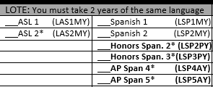
Foreign Language
Students are required to have 2 years of the same foreign language to graduate.

Slide 22
Spanish Proficiency Exam
Students who plan to register for a Spanish course and already have some knowledge and skills in the language have the opportunity to advance to the upper level Spanish courses. Marble Falls ISD offers a proficiency and placement exam to determine knowledge and skill level required for entry into an upper Spanish course. A student may place out of courses based on the outcome of the exam, which includes an objective exam, writing, and speaking sample. Credits for courses placed out of may be awarded through the exam.
A student may also receive credit for Levels 1 and 2 by taking AP Spanish IV and receiving a score of 3 or better on the AP Spanish Language exam.
The Proficiency Exam is offered several times a year. To register for the exam, please see your counselor.

Slide 23
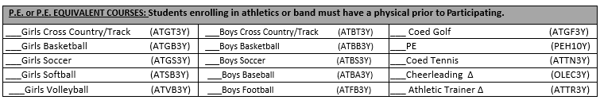
PE or PE Equivalent
1 credit required to graduate

Slide 24
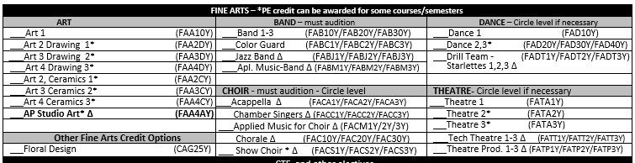
Fine Arts
1 required to graduate

Slide 25
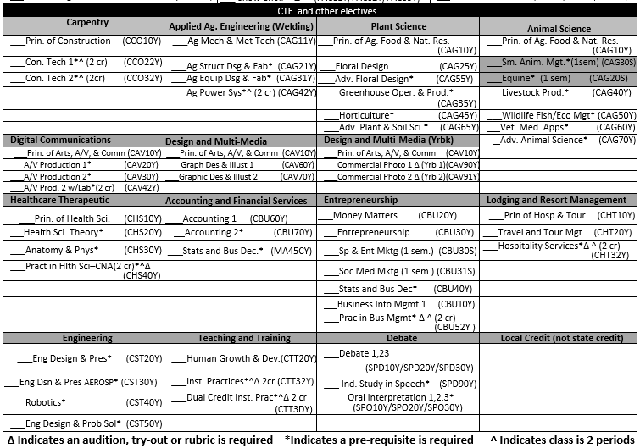
CTE and other electives
Complete your endorsement!

Slide 26
Something to think of for next year! Juniors can now have off campus.
Juniors who meet specific criteria would be allowed 1 off campus period (either 1st or 8th period).
Criteria includes:
Must have earned 16 or more credits.
Must have never been filed on for truancy court.
Must be on track to earn an endorsement.
No DAEP during high school career.
Must have passed: English 1, English 2, Algebra, and Biology EOC (Must achieve “Meets Grade Level” in at least one of the EOC courses).

Slide 27
Check for accuracy
Make SURE you have 8 academic hours selected. Make SURE you have alternates in the order of preference. If you do not, we will select them for you.
Xello can be used at home to show parents your choices. You can make changes yourself until the deadline. After the deadline, you must contact your counselor to request any changes.
MAY 5 is the last day to submit ANY changes to your requests.

Slide 28

Questions?

