Slide 1

Marble Falls High School
Course Registration for 2023-2024

Slide 2
How do I make my schedule?
Review Graduation Requirements.
Look at credits earned on Skyward and Xello. Use that information to make sure you have earned credit in all required classes.
Check to see what required courses you need to take next year.
Use the course catalog to ensure you complete your chosen endorsement, as an endorsement is required to graduate.
Enter your choices in Xello! Choices 1-8 will complete your schedule. You must also choose alternates.
If you do not pick classes, including alternates, they will be selected for you and you will be stuck in those classes next year.

Slide 3
Check your transcript!
Counselors will do this with you individually prior to the end of school and verify the courses you choose.
Look for required credits that you need to graduate, including credits you did not earn because of failing grades or because you owe hours.
You can complete credit for failed courses through credit recovery, long-averaging, summer school, or re-taking the course next year.

Slide 4
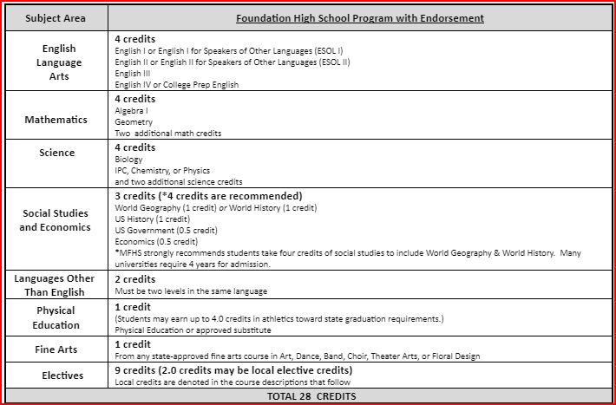
Graduation Requirements:
Red (recommneded) - Colleges may require these courses
Algebra 2
Recommend including Chem., Physics and 4th science
Recommend World Geography AND World History (all 4 credits of Social Studies)
Some colleges view 3 years of a Foreign language as a plus!

Slide 5
Dual Credit – may have a cost to enroll.
Dual Credit is a college course that is taught on this campus.
The college credit will count at TEXAS PUBLIC UNIVERSITIES.
You will begin building your college transcript so it is extremely important that you PASS. Failing courses may effect future college financial aid.
There are strict dates for dropping or withdrawing from the course in order to avoid GPA or financial aid issues.
One point is added to your GPA for passing grades in Dual Credit.

Slide 6
Dual Credit
You must pass the appropriate TSI or equivalent test to be considered college ready. TSI will be given to all Juniors. Listen for announcements for testing dates!
To take dual credit courses, you must apply online to the appropriate college and complete all registration forms for that college. Signing up in Xello does NOT sign you up for dual credit courses.
Dual Credit registration forms are due in the counseling office by mid-April. Please see Mr. Teets to get all required registration forms for the appropriate college.

Slide 7
Advanced Classes Presentation
Meeting for parents will be scheduled soon!
An email will be sent out with the date and time.
Check your email!

Slide 8
Advanced Courses Comparison: All advanced course may have a cost to enroll or test.
AP Courses
On Ramps – through UT
High school credit
Public universities award credit for exam score of 3 or higher in Texas schools
College Board curriculum
2 points added to passing grades for GPA
Can be dropped at 4 weeks and semester only
High school AND college credit with option to decline college grade
Will receive a grade for HS AND separate college grade
UT curriculum
2 points added for GPA
Can be dropped at semester only

Slide 9
Important Elective Information
Some electives have pre-requisites. Pre-requisites are courses that you must complete or take concurrently while you are in that class. Courses with pre-requisites should not be available for you to choose in Xello.
Never select a class that you already have credit for on your transcript!
Some electives require an application. Courses are indicated in Xello.
Some courses are 2 periods in your schedule.
Consider weighted courses for GPA boosts (Honors/AP/DC or On Ramps)!
Check the MFHS/Guidance and Counseling website for applications and course information!

Slide 10
Distinguished Level of Achievement
Complete the Foundation Requirements
Complete Algebra 2
Earn an endorsement
Required for top 10% automatic admission to Texas public colleges.

Slide 11
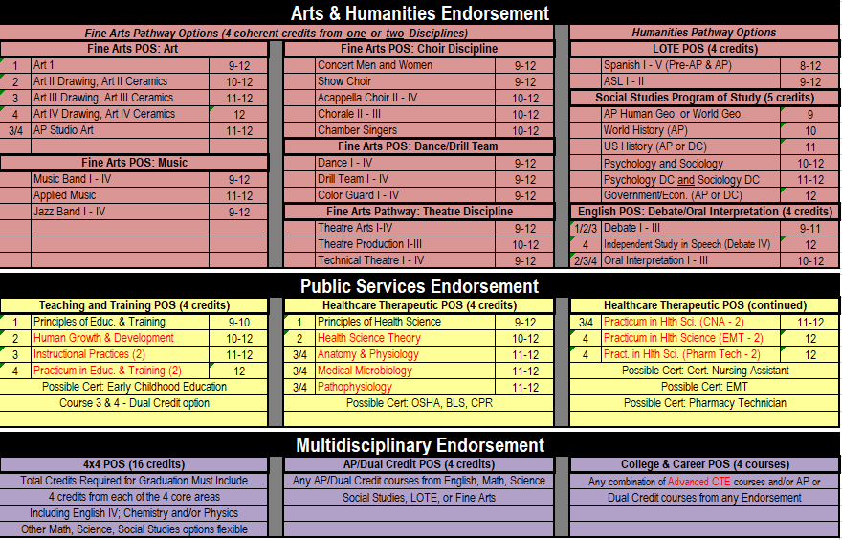
Endorsements:

Slide 12
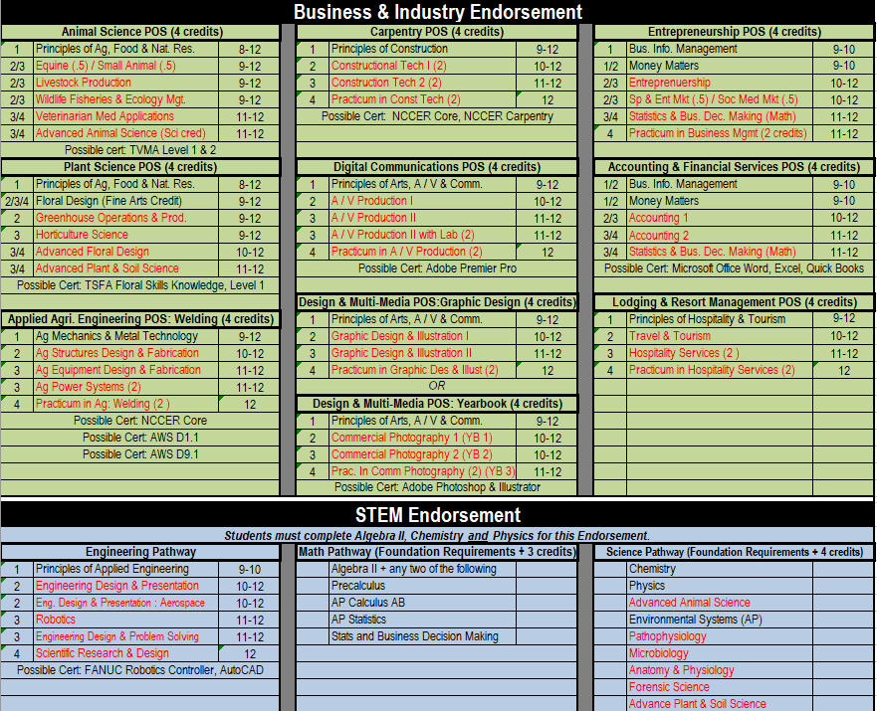

Slide 13
How do I make my schedule?
Review Graduation Requirements.
Review credits earned through Xello or Skyward.
Complete choices for your 4-year plan that meet all graduation requirements (this can be adjusted each year).
Go to the MFHS Counseling website and click on Scheduling tab – Use the course catalog to ensure you complete your chosen endorsement or use the Xello Course Guide to find pathways. An endorsement is required to graduate.
Enter your choices in Xello! Your 9th grade choices will complete your course requests for 9th grade. Choices 1-8 will be your requested courses. You must also choose alternates.
If you do not pick classes, including alternates, they will be selected for you and may not be able to change!

Slide 14
Log-in to Xello
Log-in to “Single Sign-on”.
Click on Xello. Log-in.
Click on the “Course Planning” link.
Select your classes to complete your 4 year plan as we guide you through the process!

Slide 15
How to fill out your Course Requests
  Stay with me and we will fill it out together.
  Review credits needed to graduate and plan your course requests accordingly.
  Click on each required credit (English, Math, etc.) and options will come up to pick from that required credit.
  You will choose courses to fill 8 academic hours and you will choose alternates.

Slide 16
Choose your English course for next year:
English 1 Regular or Honors | English 2 Regular Honors | English 3 Regular, UT OnRamps | English 4 Regular, Dual Credit or AP English 4
*Students interested in dual credit courses must fill out the required paperwork, pass the TSI and register for those classes through the college. See Mr. Teets or your counselor for more information.

Slide 17
Pick your English courses!
Pick your English course for next year.
If you failed a previous English course, you will be required to make that course up to graduate. You may select it here and/or see your counselor for more options.

Slide 18
Recommended Course Sequence for Math
9th Grade
10th Grade
11th Grade
12th Grade
Algebra 1
Geometry
Math Models
Algebra 2
Algebra 1
Geometry
Regular
Honors
Pre-Calculus
Regular or Honors
or
Another 4th math
Algebra 2
Regular
OnRamps
Geometry Honors
Algebra 2
OnRamps
Pre-Calculus
Honors
AP Statistics,
AP Calculus

Slide 19
Pick your math course for next year:
Pick your math course for next year.
2. If you failed Algebra 1 or Geometry, you will be required to make that
course up to graduate. You may select it here and/or see your counselor
for more options.

Slide 20
Course Sequence for Science
9th Grade
10th Grade
11th Grade
12th Grade
Biology
IPC
Chemistry
Physics or 4th Science
Biology
Chemistry
3rd Science
4th Science
Biology
Chemistry
4th Science
Physics
Biology Honors
Chemistry Honors
Physics, or Physics On-Ramps
4th Science
*3rd and 4th year science course options are on the next slide, or in your course guide on the MFHS Counseling website.

Slide 21
3rd or 4th Year Science Options
If you failed Biology, IPC, Chemistry or Physics, you may be required to make that course up to graduate. See your counselor for options.
REGULAR COURSES
ADVANCED (weighted) COURSES
Environmental Systems
Medical Microbiology (every other year)
Pathophysiology (every other year)
Advanced Animal Science
Forensics
Anatomy and Physiology
Advanced Plant & Soil Science
Engineer. design & Prob. Solving
Sci. Research & Design
Biology AP
Physics OnRamps - 1
Chemistry OnRamps - 1
Environmental Science AP (every other year)

Slide 22
Pick your Science courses:
Students must pass Biology, and either IPC, Chemistry or Physics.
Students should have 4 science credits to graduate.
If you are graduating with Multidisciplinary as your endorsement, you must take Chemistry or Physics.

Slide 23
Course Sequence for Social Studies
9th Grade
10th Grade
11th Grade
12th Grade
World History or
World History AP
US History or
OnRampusUS Hist.
Government and Economics
Reg. or Advanced
World Geography
or
AP Human Geography

Slide 24
Pick your Social Studies courses:
Pick your Social Studies course!
Requirements: World Geography or World History, US History, Economics, and Government are required to graduate.
If you failed one of your previous Social Studies courses, you may select it here or see your counselor for more options.

Slide 25
Elective requirements to graduate
You must have:
  2 credits of the same foreign language
  1 credit of fine arts
  1 credit of PE or PE Equivalent
  1 Endorsement – see endorsements in course catalog

Slide 26
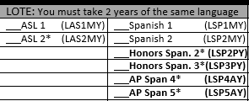
Foreign Language
Students are required to have 2 years of the same foreign language to graduate.

Slide 27
Spanish Proficiency Exam
Students who plan to register for a Spanish course and already have some knowledge and skills in the language have the opportunity to advance to the upper level Spanish courses. Marble Falls ISD offers a proficiency and placement exam to determine knowledge and skill level required for entry into an upper Spanish course. A student may place out of courses based on the outcome of the exam, which includes an objective exam, writing, and speaking sample. Credits for courses placed out of may be awarded through the exam.
A student may also receive credit for Levels 1 and 2 by taking AP Spanish IV and receiving a score of 3 or better on the AP Spanish Language exam.
The Proficiency Exam is offered several times a year. To register for the exam, please see your counselor.

Slide 28
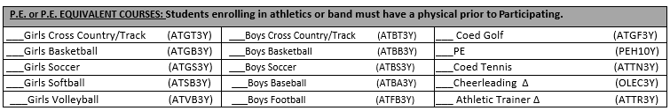
PE or PE Equivalent
1 credit required to graduate

Slide 29
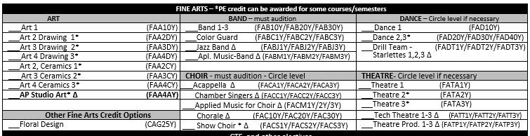
Fine Arts
1 required to graduate

Slide 30
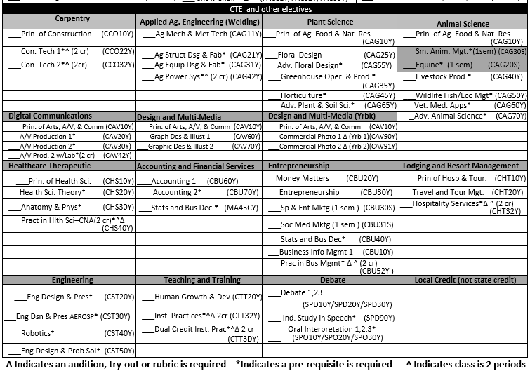
CTE and other electives
Complete your endorsement!

Slide 31
Juniors can have off campus!
Juniors who meet specific criteria may be allowed an one off campus period. Either 1st or 8th period.
Criteria includes:
1. Must have earned 16 or more credits before their Junior year.
2. Must have never been filed on for truancy court.
3. Must be on track to earn an endorsement.
4. No DAEP during high school career.
5. Must have passed: English 1, English 2, Algebra, and Biology EOC’s
6. Must achieve “Meets Grade Level” in at least one of the EOC courses).
7. Must provide your own transportation. You cannot remain on campus during an off period.

Slide 32
Check for accuracy
Make SURE you have 8 academic hours selected. Make SURE you have alternates in the order of preference. If you do not, we will select them for you.
Xello can be used at home to show parents your choices. You can make changes yourself until the deadline. After the deadline, you must contact your counselor to request any changes.
MAY 5 is the last day to submit ANY changes to your requests.

Slide 33

Questions?

