Slide 1

Marble Falls High School
Four Year Plans
High School Registration for the Class of 2027

Slide 2
Topics
Graduation Requirements
Honors/AP Courses
Dual Credit Courses and UT On-Ramps
Endorsements & Programs of Study

Slide 3
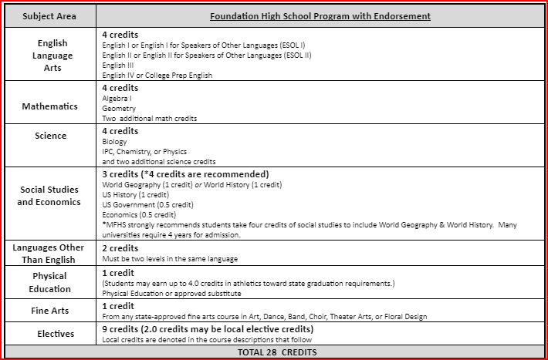
Graduation Requirements:
Red (recommneded) - Colleges may require these courses
Algebra 2
Recommend including Chem., Physics and 4th science
Recommend World Geography AND World History (all 4 credits of Social Studies)
Some colleges view 3 years of a Foreign language as a plus!

Slide 4
GRADUATION PLANS
  Distinguished Level of Achievement
  Foundation w/ Endorsement

Slide 5
Distinguished Level of Achievement
Complete the Foundation Requirements
Complete Algebra 2
Earn an endorsement

Slide 6
Top 10% Automatic Admissions
Only students completing the Distinguished level are eligible for college admission under the Top 10% automatic admissions provision.
Texas public colleges - Top 10% ranked automatically admitted, except UT is top 6% (for this year’s Seniors)

Slide 7
Dual Credit/OnRamps vs. Honors/AP Courses
Dual Credit: 1 point GPA addition
UT OnRamps:
2 point GPA addition
Grade earned on college transcript
Good for students that do well in the classroom
Honors: 1 point GPA addition
AP: 2 point GPA addition, accepted by more private colleges, rigorous, college level course
Good for students that are good test takers

Slide 8
Spanish Proficiency Exam
Students who plan to register for a Spanish course and already have some knowledge and skills in the language have the opportunity to advance to the upper level Spanish courses. Marble Falls ISD offers a proficiency and placement exam to determine knowledge and skill level required for entry into an upper Spanish course. A student may place out of courses based on the outcome of the exam, which includes an objective exam, writing, and speaking sample. Credits for courses placed out of may be awarded through the exam.
A student may also receive credit for Levels 1 and 2 by taking AP Spanish IV and receiving a score of 3 or better on the AP Spanish Language exam.
The Proficiency Exam is offered several times a year. To register for the exam, please see your counselor.

Slide 9
How do I make my schedule?
Review Graduation Requirements.
Review credits earned in 8th grade through Xello or Skyward. You cannot take the same class twice!
Complete choices for your 4-year plan that meet all graduation requirements (this can be adjusted each year).
Go to the MFHS Counseling website and click on Scheduling tab – Use the course catalog to ensure you complete your chosen endorsement or use the Xello Course Guide to find pathways. An endorsement is required to graduate.
Enter your choices in Xello! Your 9th grade choices will complete your course requests for 9th grade. Choices 1-8 will be your requested courses. You must also choose alternates.
If you do not pick classes, including alternates, they will be selected for you and may not be able to change!

Slide 10
Log-in to Xello
Log-in to “Single Sign-on”.
Click on Xello. It should log you in.
Click on the “Course Planning” link.
Select your classes to complete your 4 year plan as we guide you through the process!
Do NOT hit the submit button!

Slide 11
How to fill out your course requests
  Stay with me and we will fill it out together!
  Review credits needed to graduate and plan your course requests accordingly.
  Click on each required credit (English, Math, etc.) and options will come up to pick from that required credit.
  You will choose courses to fill 8 academic hours and you will choose alternates.

Slide 12
Choose your English courses:
English 1 Regular or Honors | English 2 Regular Honors | English 3 Regular, Dual Credit or UT OnRamps | English 4 Regular, Dual Credit or AP English 4

Slide 13
Recommended Course Sequence for Math
9th Grade
10th Grade
11th Grade
12th Grade
Algebra 1
Geometry
Math Models
Algebra 2
Algebra 1
Geometry
Regular
Honors
Pre-Calculus
Regular or Honors
or
Another 4th math
Algebra 2
Regular
OnRamps
Geometry Honors
Algebra 2
OnRamps
Pre-Calculus
Honors
AP Statistics,
AP Calculus

Slide 14
Course Sequence for Science
9th Grade
10th Grade
11th Grade
12th Grade
Biology
IPC
Chemistry
Physics or 4th Science
Biology
Chemistry
3rd Science
4th Science
Biology
Chemistry
4th Science
Physics
Biology Honors
Chemistry Honors
Physics, or Physics On-Ramps
4th Science
*3rd and 4th year science course options are on the next slide, or in your course guide on the MFHS Counseling website.

Slide 15


Slide 16
Course Sequence for Social Studies
9th Grade
10th Grade
11th Grade
12th Grade
World History or
World History AP
US History
DC US Hist.
AP US Hist.
Government and Economics
Reg. , AP, or Dual Credit
World Geography
or
AP Human Geography

Slide 17
Programs of Study by Endorsement
Arts & Humanities
Fine Arts POS - Art
Fine Arts POS - Music
Fine Arts POS - Choir
Fine Arts POS - Theatre
Fine Arts POS - Dance/Drill Team
Fine Arts POS - LOTE
Fine Arts POS - Social Studies
Fine Arts POS - English/Debate
Public Services
Teaching & Training POS
Healthcare Therapeutic POS
Multi-Disciplinary
4x4 POS
AP/Dual Credit POS
College & Career POS
Business & Industry
Animal Science POS
Plant Science POS
Applied Agriculture Engineering POS (Welding)
Carpentry POS (Construction)
Digital Communications POS (A/V)
Design & Multi-Media POS (Graphic Design)
Design & Multi-Media POS(Yearbook)
Entrepreneurship POS
Accounting & Financial Services POS
Lodging & Resort Management POS
STEM
Engineering POS
Math POS
Science POS

Slide 18
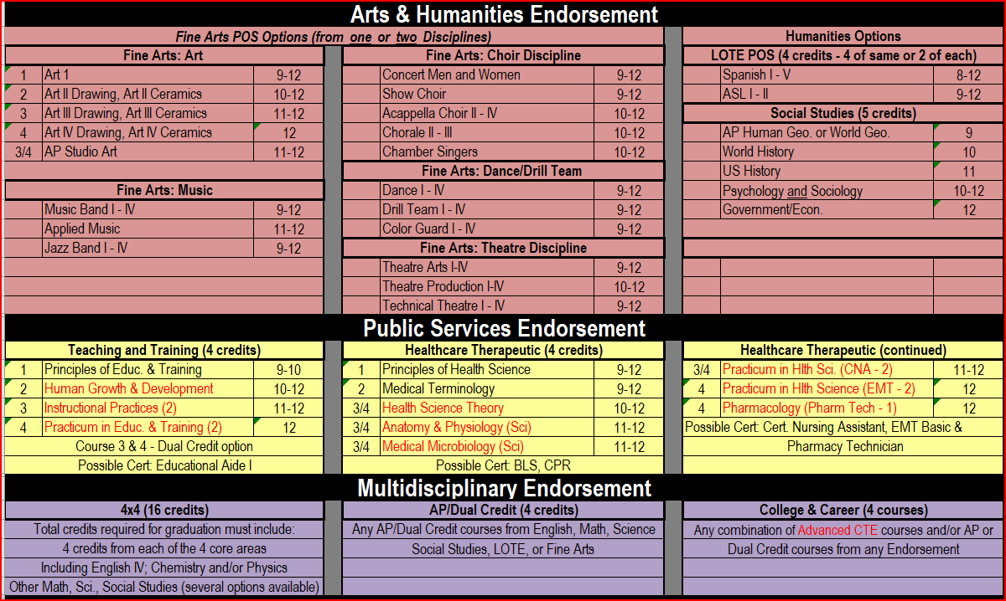
Endorsements:

Slide 19
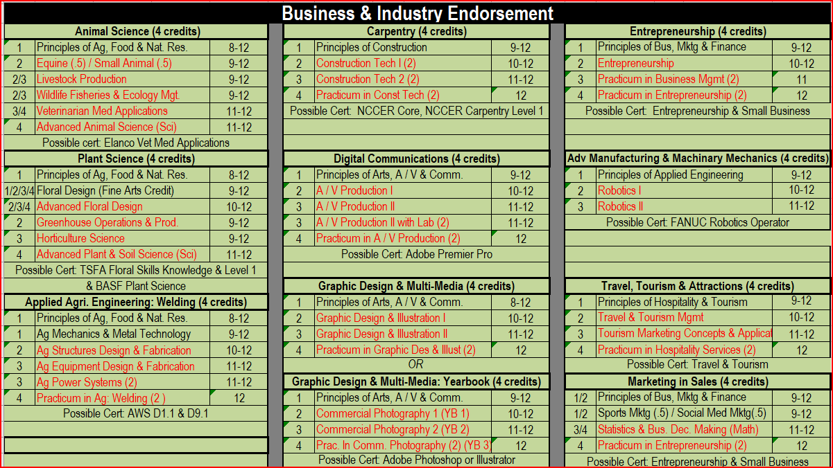
Endorsements

Slide 20
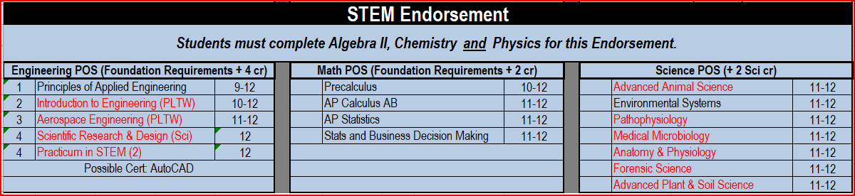
Endorsements

Slide 21
Elective requirements to graduate
It is recommended that you complete the elective requirements in your first years of high school, because you will have more electives your Jr./Sr. year to choose from, but these must be completed to graduate.
You must get credits for the following courses to graduate:
2 credits of the same foreign language
1 credit of fine arts
1 credit of PE or PE Equivalent
1 Endorsement (usually 4 electives to complete)

Slide 22
Next Steps:
Make sure that you have completed your 4-year plan (all classes and alternates).
Review your choices with your parents! They can make changes up until we meet with you in the hallway. After that, all changes must go through your high school counselor.
Look at the Marble Falls High School Counseling website to learn about electives and graduation requirements!
Counselors will come back to sit with each student individually to review your 4-year plan and confirm next year’s course choices.
The last deadline to make changes to your choices is May 5, 2022!

Slide 23
Contact Information
Molly Heath, Counselor (A-G)
mheath@mfisd.txed.net
Shay Bolm, Counselor (H-P)
sbeeman@mfisd.txed.net
Duane Teets, Counselor (Q-Z)
dteets@mfisd.txed.net
Sherry Warren, Admin. Assistant
(830) 798-3592
swarren@mfisd.txed.net

