Slide 1

National Honor Society
December 2024 - 3rd Meeting

Slide 2
Leadership Contact
President: Urvi Mysore urvirm@madisoncity.k12.al.us
Vice President: Reese Freeman reesemf@madisoncity.k12.al.us
Sponsor: Mr. Thomas jlthomas@madisoncity.k12.al.us

Slide 3
Officers
Secretary: Lily Arnold - lilyba@madisoncity.k12.al.us
Parliamentarian: Vineet Vadrevu - vineetnv@madisoncity.k12.al.us
Treasurer: Luke Alverson - lukesa@madisoncity.k12.al.us
Historian: Kinsley Hardy - kinsleymh@madisoncity.k12.al.us

Slide 4
NHS Oath
I pledge to maintain high scholastic standing,
To endeavor intelligently and courageously to be a leader,
To give of myself freely in service to others,
And to hold as fundamental and worthy an untarnished character.
In so doing, I shall prove myself worthy
Of a place in the National Honor Society

Slide 5
Membership Requirements
Complete 20 service hours by April
  Save all physical copies of completed service hour sheets to turn in by April
  Scan and keep duplicate copies of your original service hour sheets to have for proof if the original copies get lost in the submitting process.
Maintain a weighted 3.7 GPA throughout the school year
Attend the mandatory monthly meetings
  Attendance QR code is the last slide of every meeting
  2 excused absences allowed
    Complete the Absence Form that is sent out in the GroupMe

Slide 6
Community Service
Must be unpaid volunteer work that helps the community
  What DOES NOT count: paid work, tutoring and/or babysitting a family member
Double-dipping allowed for this year
Hours will NOT be accepted without proper documentation!
Keep all original service hour record sheets and their duplicate copies in a safe place until the April deadline.

Slide 7
Service Hours Guidelines:
Hold on to your service hour forms - You will turn in all your forms in April.
20 Service hours must be completed by the first week of April
10 hour caps are placed upon the following service activities:
  Summer Hours (June-July)
  Weekly Religious Events
  Donations
You must utilize the Service Hour Form on the JC Website
  Hours not documented with supervisor signature will not be counted!

Slide 8
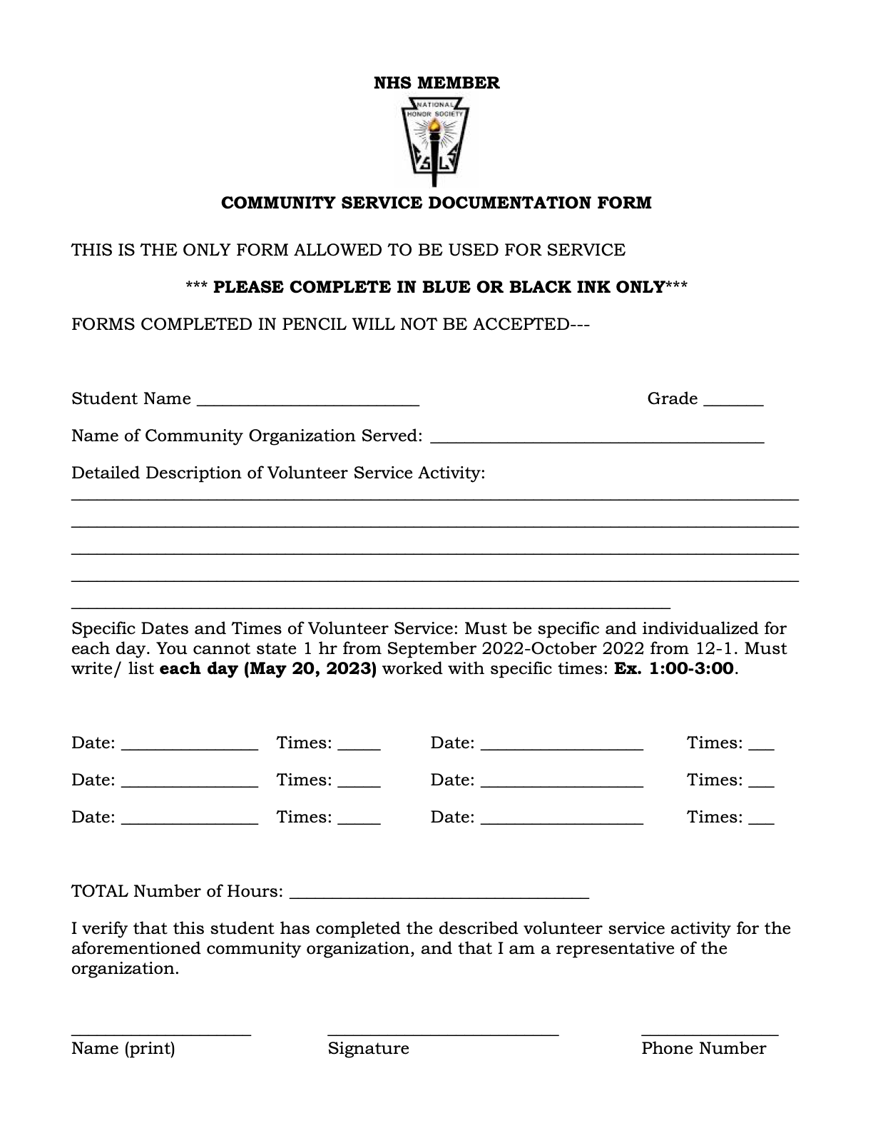
Community Service Form:
Linked on the JC website → Clubs and Organizations → NHS

Slide 9
#1 Nights of Santa - Earlyworks
Dates and times- Thu, Dec 5th- Mon, Dec 23rd, 4:30-9:00 pm
Jobs include Elf stations and costume characters. Spots are going fast!
Link to sign up: https://dash.pointapp.org/events/105512

Slide 10
#2 Cavalry Hill Tree Planting
Volunteer with the Operation Green Team Foundation
Join the Green Team at Cavalry hill to plant trees in the area.
No experience needed and all ages and groups are welcome to come at any time throughout the event.
When: Saturday, December 7th, 10 AM - 12 PM.
Where: 2900 Fairbanks Street Northwest Huntsville, AL 35816
More information: https://www.volunteermatch.org/search/opp3861808.jsp

Slide 11
#3 Botanical Gardens
Volunteer at the Garden through roles such as
Maintaining the foliage and plant decorations
Setting up for the Galaxy of Lights
Assisting and greeting guests
You must be at least 15 to volunteer and have an adult. Anyone 16 and up can volunteer on their own.
There is an application process. More details will be provided after acceptance
More information: https://hsvbg.org/get-involved/volunteer/
Application form: https://www.volgistics.com/appform/1144137123

Slide 12
#4 Free 2 Teach
Job #1: “Assist with Teacher Shopping” - help teachers with their shopping, check them in and out, restock school supplies and other goods for teachers.
  Tuesdays & Thursdays 2:45pm-6:00pm
  1st Saturday of every month during the school year 9:00am-12:00pm
Sign Up Link + More Information: https://free2teach.org/impact/volunteer/

Slide 13
#5 Manna House Food Distribution Center
Assist with food preparation and distribution, clothing distribution, etc. for the less fortunate on Mondays, Wednesdays, and Thursdays from 1:00pm-6:30pm.
Help set up and serve at outdoor church events for the less fortunate on Saturdays from 11:00am-1:00pm.
More information can be found at: https://mymannahouse.com/get-involved/

Slide 14
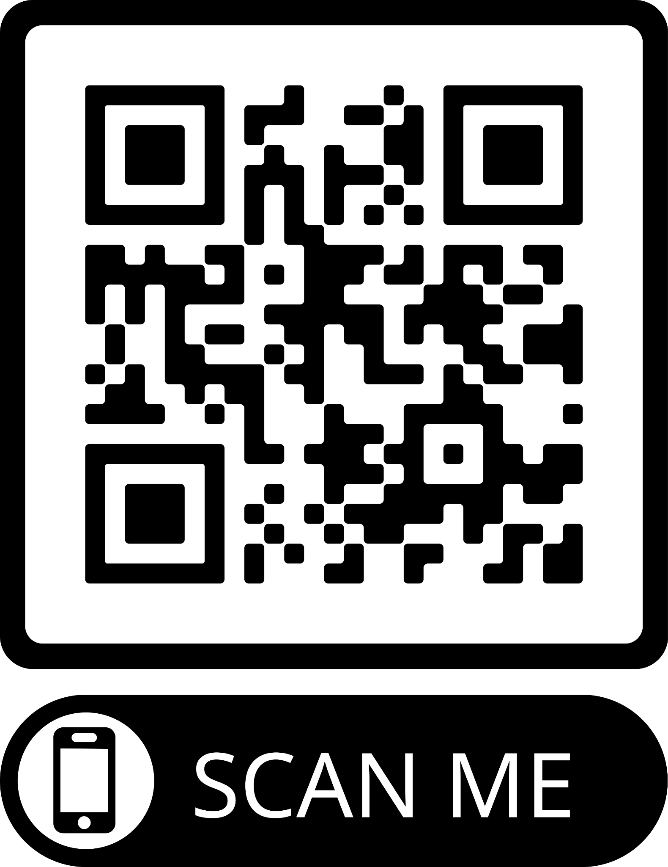
#6 Fostering Connections - The Christmas Shoppe
Saturday Dec 07, 2024 08:00 AM- 12:00pm.
To volunteer to set up you must fill out this form.
Grace United Methodist Church
2113 Old Monrovia Rd NW
Huntsville AL 35806

Slide 15

Workshop:
Time Management for Success
December 2024

Slide 16

Why is time management important?
As members of NHS, we balance the demands of academics, community service, extracurricular commitments, and more.
It is crucial to learn effective strategies to manage your time wisely so that you have time for all these responsibilities as well as relaxation.
Doing so will set you up for success in high school and in college/the workforce after you graduate.

Slide 17

4 Techniques to Help You Manage Your Time

Slide 18
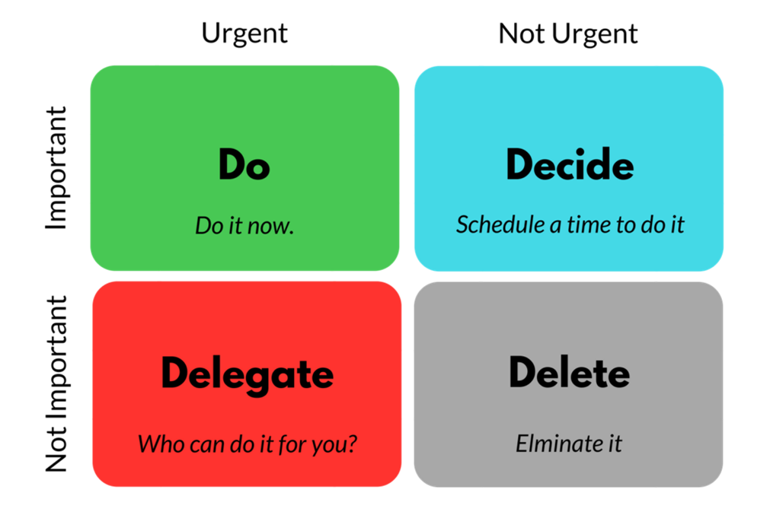
#1 - The Eisenhower Matrix
Developed by President Eisenhower
Helps you decide on and prioritize tasks by using four quadrants.
Urgent & Important: Do it now.
Important, Not Urgent Schedule a time for the task.
Urgent & Not Important: Delegate or minimize time spent.
Not Important, Not Urgent Eliminate or Reduce.

Slide 19
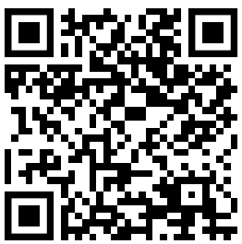
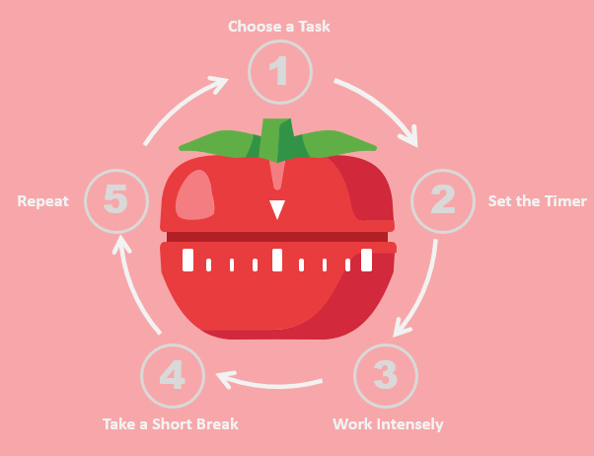
#2 - Pomodoro Technique
More info:
Overview: Work in focused intervals of 25 minutes, followed by a 5-minute break. After four cycles, take a longer break (15-30 minutes).
Helps maintain focus, prevents burnout, and boosts productivity.
Use a timer or a Pomodoro app to stay on track.

Slide 20
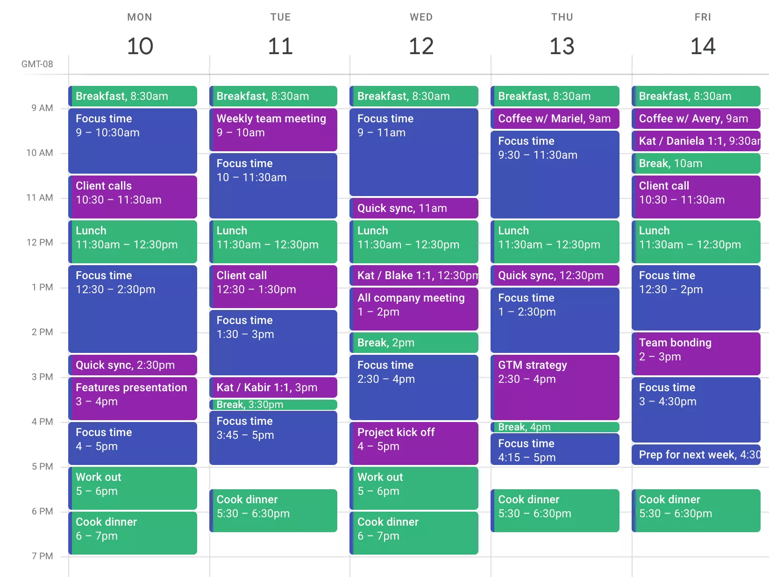
#3 - Time Blocking
Overview: Schedule specific blocks of time on your calendar for particular tasks or study sessions.
Reduces procrastination and helps you visualize your day.
Tip: Include buffer time between blocks for unexpected interruptions.
E.g. Google Calendar, Notes app, Reminders app

Slide 21
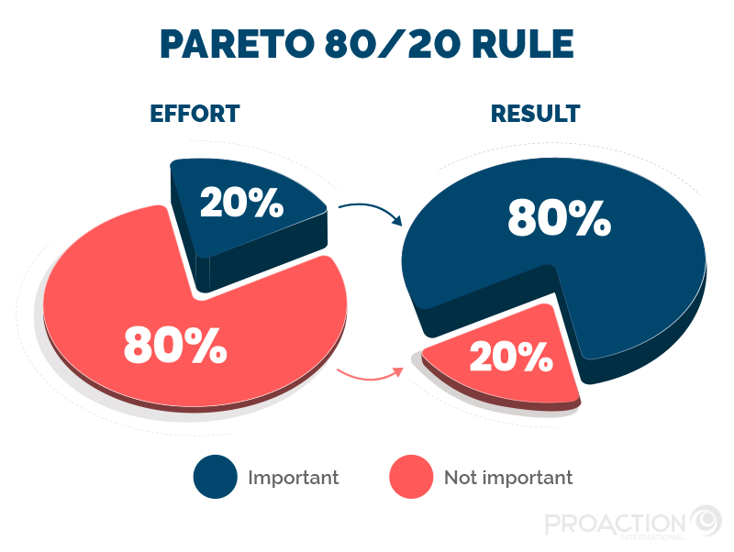
#4 - 80/20 Rule (Pareto Principle)
Overview: 80% of your results come from 20% of your efforts. Focus your time on the tasks that will yield the greatest results.
Helps you identify high-impact activities and avoid wasting time on less important tasks.
Study Example: Instead of trying to study every single detail, prioritize reviewing key concepts that are most likely to appear on an exam or are foundational for understanding.

Slide 22
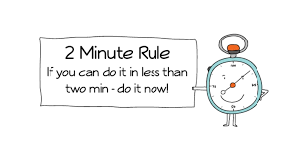
#4 - Two-Minute Rule
Overview: If a task takes less than 2 minutes, do it immediately (e.g., replying to a quick email or putting away your books).
Make a list of all your tasks and evaluate which ones would only take a couple of minutes
Prevents small tasks from piling up and becoming overwhelming.

Slide 23

Short Video - More Tips
LINK

Slide 24
Alternate Video (1.5 minutes shorter)
https://www.youtube.com/watch?v=RiI1NkaDXlQ

Slide 25
Thanks for listening!

Slide 26
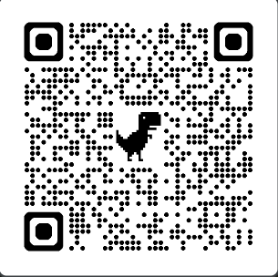
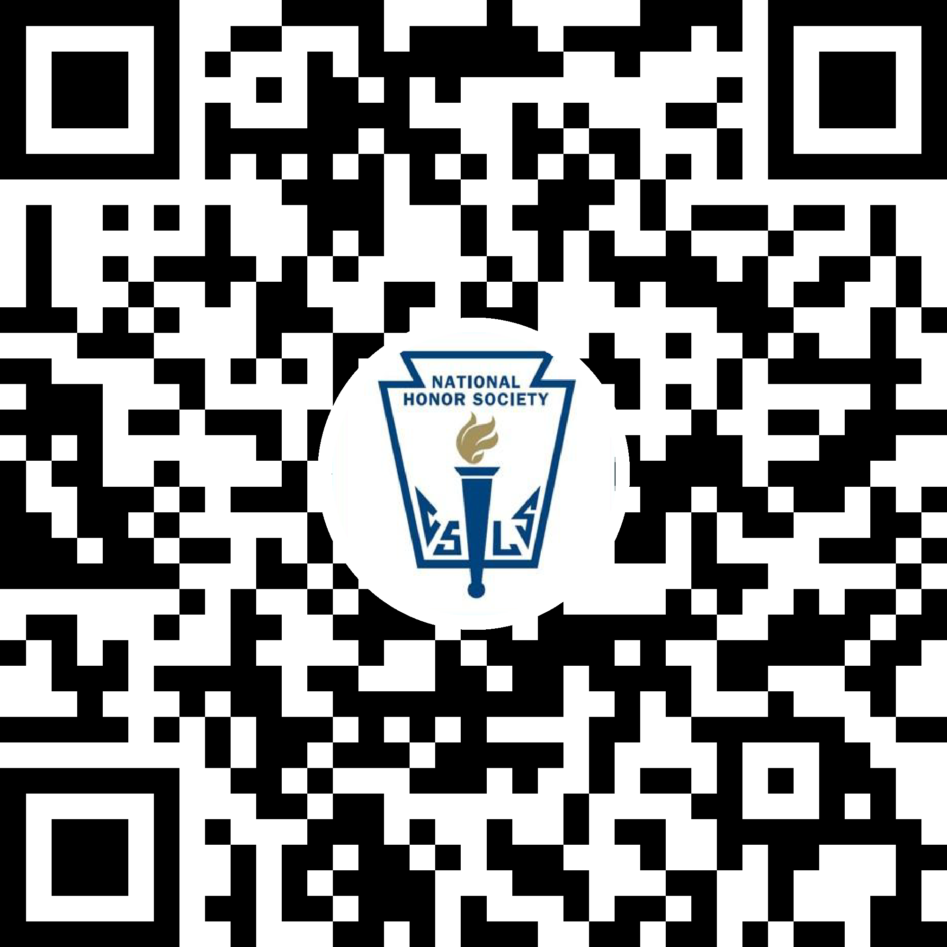
Join the Attendance & GroupMe
Attendance: GroupMe:

