Slide 1


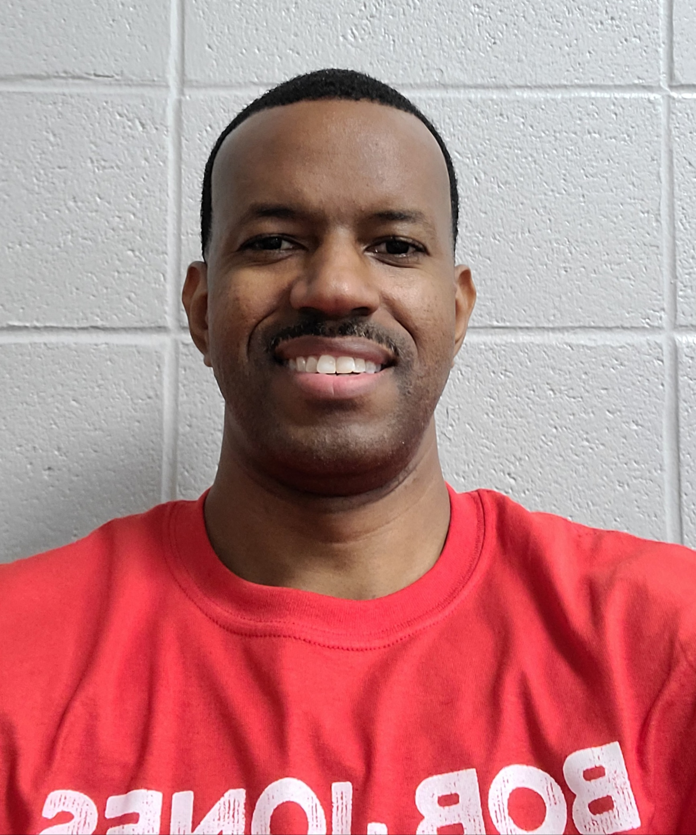
Health Education
Coach Moore
Email:
Dmoore@madisoncity.k12.al.us
Office Number:
256-772-2547

Slide 2
HEALTH PURPOSE & FOCUS
Health- the combination of physical, mental/emotional, and social well-being.
Purpose: Health education is designed to investigate theories and practices of wellness in order to be a productive and healthy adult so that you may achieve anything you wish without personal limitations.
Focus: Health literacy - refers to a person’s capacity to learn about and understand basic health information and services, and to use these resources to promote one’s health and wellness.

Slide 3
9 - WEEK PLAN
This course will involve a weekly participation regimen which will include both activity and content knowledge requirements. They will consists of individual and group activities, articles, & videos related to health education.
WEEKLY TOPICS
Week 1 - Introduction to Health
Week 2 - Leading a Healthy Lifestyle
Week 3 - Skills for Healthy Living
Week 4 - Physical Fitness
Week 5 - Nutrition
Week 6 - Substance Abuse & Diseases
Week 7 - Stress
Week 8 - Mental / Emotional Health
Week 9 - Eating Disorders
Dates subject to change

Slide 4
DAILY THEMES
MONDAY | (INTRODUCTION MONDAYS) - Introduction of Weekly Topic - Lecture, PPT, Assignments, Etc.
TUESDAY | (MENTAL HEALTH TUESDAYS) – Meditation and Reflection, Quiet Time, Study Hall, Etc.
WEDNESDAY | (WORKBOOK WEDNESDAYS) – In-class assignments and projects
THURSDAY | (ACTIVITY THURSDAYS) – Indoor and Outdoor Individual and Group Activities; Fitness; Games; Sports, etc. (Participation Grade)
FRIDAY | (FINISH-UP FRIDAYS) – Weekly Reviews, Movies, Personal Catch-up Time, Study Hall, etc.

Slide 5
OUTSIDE SPEAKERS
HIV Education - Madison City Schools District Nurse
Presentation
Question/Answer session
Suicide Prevention - Crisis Services Center
Scenario/Module Training
Resources

Slide 6
DAILY ROUTINES
People Time (No Phones or Technology): The first 5-10 minutes of each class to build relational capacity.
Participation: Daily participation in assignments and activities is required and will heavily affect your grade!!!
Restroom Policy: Use the restroom before class. You get about 5 minutes to use the restroom. No restroom requests during the last 10 minutes of class.

Slide 7
SUBMITTING ASSIGNMENTS
Schoology - Almost all assignments will be made available on Schoology. Timely submission of assignments is paramount for full credit.
In-class assignments are due before the bell rings at the end of the block unless otherwise specified by the instructor.
Out-of-class assignments are due by the beginning of class on the due date unless otherwise specified by the instructor.
Group activities and assignments -All group members are expected to participate meaningfully and equally within their group.

Slide 8
MAKE-UP WORK
Upon returning to school from an excused absence, MCS make-up work policy allows for three (3) days to make up any missed assignments (including tests). Grades of zero will be assigned for assignments missed because of unexcused absences.
Make-up tests will only be given to a student who has an excused absence. It’s the student’s responsibility to make arrangements with and to notify the teacher regarding make up work and tests.

Slide 9
MCS TECHNOLOGY RULES
Concerning the use of cell phones and other electronic devices:
Devices should be on silent and kept in your purse, backpack, or pocket during class unless otherwise instructed. You may not place it on your desk. Parents, guardians, and other family members should call the front office in case of emergency.
If you violate this rule, you can expect the following consequences:
  First offense – The phone or device will be placed in a phone chart at the front of the room. You may pick it up at the end of class.
  Second offense – The phone or device will again be placed in a phone chart at the front of the room until the end of class and a parent/guardian will be notified.
  Third offense – This is defiance and an administrator will be notified.

Slide 10
GRADING POLICY
Grades will be earned through an accumulation of points throughout the 9-week period. Percentages will be consistent with Madison City School’s policy.

Slide 11
DAILY GRADE CALCULATIONS
The grading policy is based heavily on participation, effort, and completion of assignments.
All assignments are worth 100 points and are averaged for a daily grade
Example #1
Assignment #1…….. 80/100
Assignment #2…….. 90/100
Assignment #3…….. 70/100
Total………………… 240/300
Daily Grade………… 80%
Example #2
Assignment #1…….. 100/100
Assignment #2…….. 0/100
Total………………… 100/200
Daily Grade………… 50%

Slide 12
OFFICE HOURS
Daily office hours:
  Fall: Tuesdays and Thursdays – 4th Block.
  Spring: Tuesdays and Thursdays – 1st Block.
I will be able to answer any questions via Schoology messenger or email.
Please either message me or email me ahead of time any questions or concerns you may have.

