Slide 1
Bob Jones High School Chorus
Introduction to Chorus

Slide 2
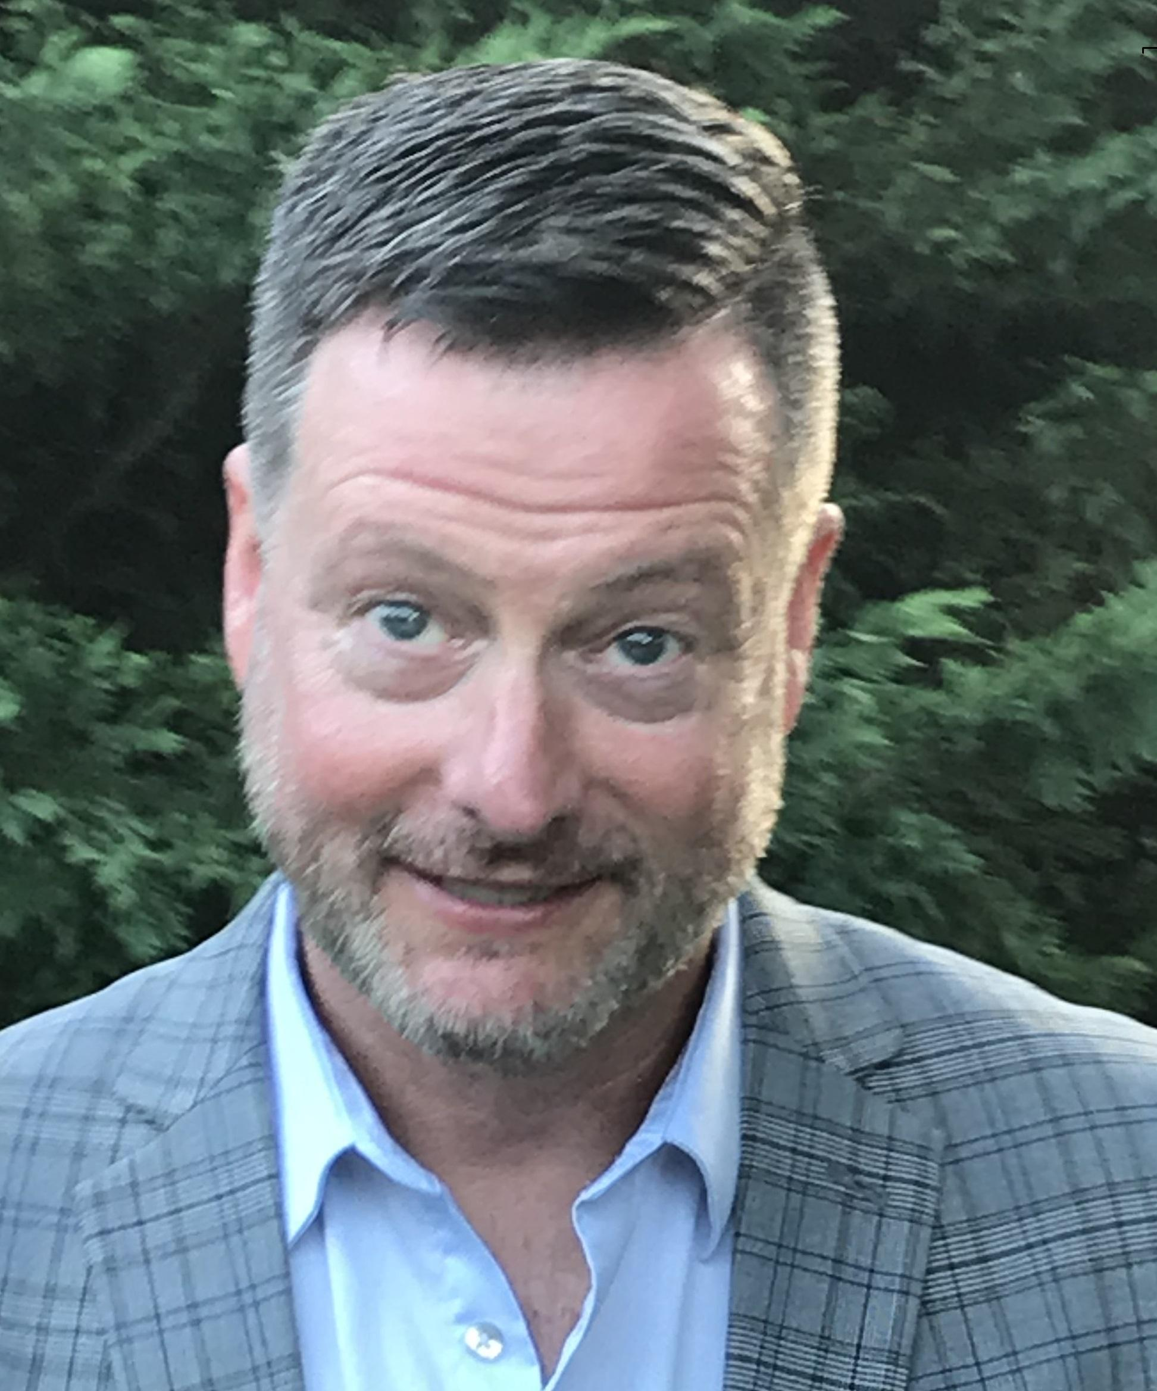
Meet Mr. Fields, Chorus Teacher
Mr. Fields has taught Chorus and Class piano classes at BJHS since 1999. He has taught music at multiple levels, from elementary aged students, through the collegiate level, as well as church choirs and community choruses.
Under his direction, the choruses have won competitions in Atlanta, Branson, Nashville, Orlando, Washington, DC, and Williamsburg.
Mr. Fields earned Bachelor of Music and Master of Education degrees from The University of Alabama
Mr. Fields is on the board of the Alabama chapter of American Choral Directors’ Association and is the President of Alabama Vocal Association

Slide 3
What to expect in chorus this semester
Sing every day, but very little (possibly no) singing in groups
Focus on every individual’s development of stronger vocal technique
Become a stronger music reader
Gain an overview of Music History -- relate music to history and culture
Study the fundamentals of Music Theory -- how is music composed so it can be preserved for future
The class will be taught similarly to class voice lessons -- individuals can progress at their own pace

Slide 4
What else to expect
More frequent graded assignments -- short assignments to check your understanding
Use this time to hone YOUR skills so that when we return to singing together, the entire group is stronger
Different types of performances -- our performances may look more like a “talent showcase” or some other type of performance we can share with the community. There will probably be no in-person concerts

Slide 5
What about the chorus syllabus?
We will meet all the goals of the Syllabus, except group singing.
No uniform purchase is necessary until we can return to face to face concerts -- even then, it may be time to rethink the formal uniform. A committee of students and parents will be looking into this.
No music binders until further notice. The plan for now is to distribute music electronically, through email or Schoology.
Please make sure to enter your virtual class on time. The classes will be recorded and available afterward, but you will miss out on being able to interact, especially on Wednesdays and Fridays

Slide 6
Weekly Schedule
Online student support is available throughout class every day
Monday: Vocal Techniques
Tuesday: Music History
Wednesday: Synchronous Instruction (WebEx) the first 30-40 minutes of class time
Thursday: Music Theory
Friday: Synchronous Instruction (WebEx) the first 30-40 minutes of class time

