Slide 1
Bob Jones High School Class Piano
Introduction to Class

Slide 2
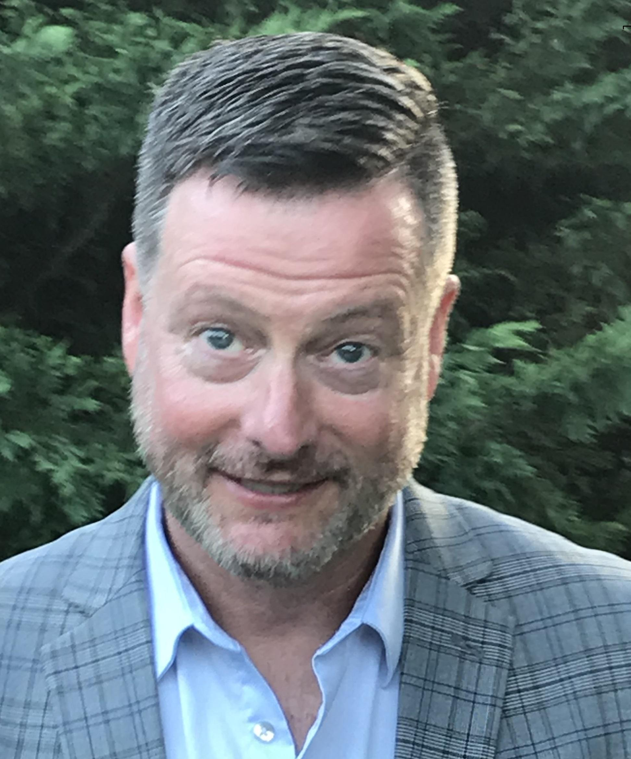
Meet Mr. Fields, Chorus and Class Piano Teacher
Mr. Fields has taught Chorus and Class piano classes at BJHS since 1999. He has taught music at multiple levels, from elementary aged students, through the collegiate level, as well as church choirs and community choruses.
Under his direction, the choruses have won competitions in Atlanta, Branson, Nashville, Orlando, Washington, DC, and Williamsburg.
Mr. Fields earned Bachelor of Music and Master of Education degrees from The University of Alabama
Mr. Fields is on the board of the Alabama chapter of American Choral Directors’ Association and is the President of Alabama Vocal Association

Slide 3
Course Description
Piano classes are open to all students at Bob Jones High School regardless of prior musical experience. Students with previous piano study will be assessed during the first week to determine the level at which they will begin work in the class.

Slide 4
Course Goals
Perform a varied repertoire of experience-appropriate music. Read and notate music. Improvise melodies, variations, and accompaniments. Compose and arrange music within specified guidelines. Listen to, analyze, and describe music. Evaluate written music and musical performances. Relate music to history and culture. Compare relationships between music, the other arts, and disciplines outside the arts.

Slide 5
Course Expectations
All policies set forth in the Student Handbook and Code of Conduct will be followed in this course.
Arrive on time, with all materials, ready to participate fully in class.
Keep up with all assigned music and materials.
Maintain a digital portfolio of performance examples and personal compositions.

Slide 6
Expectations (continued)
Participate in all class activities – whether performing, listening, or composing.
Demonstrate appropriate audience deportment when listening to performances of others.
Demonstrate appropriate stage deportment when performing for an audience.
Beverages, and other liquids can destroy a piano or keyboard. Please keep these items away from your instrument.

Slide 7
Expectations (continued)
Electronic devices may be used only with permission of the teacher.
Passes from class should be used for emergency situations only – each pass disrupts the entire musical rehearsal because the rehearsal stops any time the teacher pauses to sign a pass.
Off-task or disruptive behaviors are unacceptable, and will result in disciplinary action.
Fingernails should be kept trimmed. Proper hand position is a criterion for grading; long fingernails that prevent proper hand position will result in lowered grades.

Slide 8
Grades
Daily Grades 30% of nine-week grade (this includes daily participation in all class activities)
Test Grades 70% of nine-week grade (this includes periodic progress assessments, written tests, and performances)
Final Exam 20% of final course grade

