Slide 1

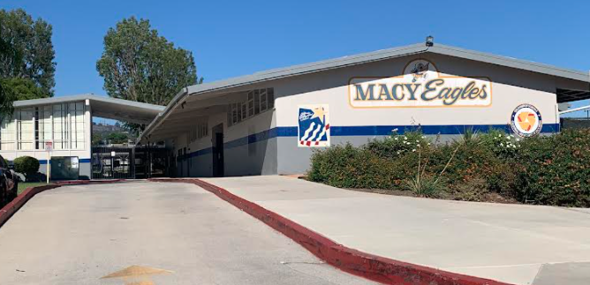

2018 general obligation bond authorization
Measure LL
LOWELL JOINT SCHOOL DISTRICT
A Tradition of Excellence Since 1906
“Home of Scholars and Champions”
Citizens’ Bond Oversight Committee
Annual Report 2022-23
June 17, 2024

Slide 2
LOWELL JOINT SCHOOL DISTRICT
A Tradition of Excellence Since 1906
“Home of Scholars and Champions”
Measure LL Program Overview
The voters of the Lowell Joint School District authorized Measure LL General Obligation Bonds in the amount of $48,000,000 on November 6, 2018. Funds received from the bonds are to be used to:
Repair leaky roofs, old rusty plumbing and failing electrical systems
Replace wood and support beams that have extensive termite damage and dry rot
Renovate classroom facilities so they meet current building and safety standards
Remove hazardous materials like asbestos and lead paint from school sites
Upgrade classrooms, school facilities and technology to support high-quality instruction in math, science, technology and the arts
Improve student safety and campus security systems including security fencing, security cameras, emergency communications systems, smoke detectors
and fire alarms
Improve heating, ventilation, air conditioning, insulation and doors
to increase energy efficiency
Improve access to school facilities for students with disabilities

Slide 3
LOWELL JOINT SCHOOL DISTRICT
A Tradition of Excellence Since 1906
“Home of Scholars and Champions”
Measure LL
Citizen’s Bond Oversight Committee Purpose
The purposes of the Committee are set forth in Proposition 39, and the Committee Bylaws were developed and approved subject to the applicable provisions of Proposition 39. The Committee is subject to the Ralph M. Brown Public Meetings Act (“Brown Act”) of the State of California and meetings are conducted in accordance with the provisions thereof. The District provides necessary administrative support to the Committee consistent with the Committee’s purposes, as set forth in Proposition 39.

Slide 4
LOWELL JOINT SCHOOL DISTRICT
A Tradition of Excellence Since 1906
“Home of Scholars and Champions”
Measure LL
Citizen’s Bond Oversight Committee Membership
The current Committee consists of seven members and includes representatives from the organizations required under Proposition 39:
Parent or guardian of a child enrolled in the District (one representatives)
Parent Teacher Association or a school site council (one representatives)
Business Community Representative within the District (one representative)
Active in a senior citizen’s organization (one representative)
Active in a bona-fide taxpayers association (one representative)
Members of the community at-large (two representatives)

Slide 5
LOWELL JOINT SCHOOL DISTRICT
A Tradition of Excellence Since 1906
“Home of Scholars and Champions”
Measure LL
Citizen’s Bond Oversight Committee Members
Member | Representative Group | Current Term
Jan Averil | Tax Payer Organization | Dec., 2021 – Dec., 2024
Paul Caffrey | Active PTA/Site Community Member | Dec., 2021 – Dec., 2024
Stuart Gothold | Active Senior Citizens Group | Dec., 2021 – Dec., 2024
Taffi Graham | At-Large Community | Dec., 2021 – Dec., 2024
Richard Jones | At-Large Community | Dec., 2021 – Dec., 2024
Casey Powers | Business Representative | Dec., 2022 – Dec., 2024
Veronica Quezada | Parent/Guardian Enrolled Student | Dec., 2023 – Dec., 2024

Slide 6
LOWELL JOINT SCHOOL DISTRICT
A Tradition of Excellence Since 1906
“Home of Scholars and Champions”
Measure LL
Citizen’s Bond Oversight Committee
Community Activities
In order to perform the duties as set forth within the Bylaws, the Committee engaged in the following authorized activities (where applicable):
District staff presented financial reports and regular updates on past, current, and future projects
Posted copies of the 2020-21 annual Lowell Joint School District Building Fund (Measure LL) Financial and Performance Audits (“Audits”) required by Prop 39 (Article XIIIA of the California Constitution)
Inspected District facilities and grounds for which bond proceeds have been or will be expended
Reviewed efforts by the District to maximize bond proceeds by
implementing various cost saving measures

Slide 7
LOWELL JOINT SCHOOL DISTRICT
A Tradition of Excellence Since 1906
“Home of Scholars and Champions”
Measure LL
Citizen’s Bond Oversight Committee
District Support
The District provided the Committee with the following technical and administrative assistance:
Prepared and posted public notices, as required by the Brown Act.
Provided meeting rooms with audio/visual equipment
Prepared and distributed copies of meeting materials, such as agendas and reports
Retained all Committee records and provided public access to the District website
Attended Committee proceedings and reported on the status of projects and expenditures of Bond proceeds. The following District staff provided administrative support:
  MJ Evanoff, Executive Assistant to the Superintendent
  Denise Soto, Administrative Assistant, Business Services
  Cathy Weissman, Bond Contracts & Accounting Compliance Manager

Slide 8
LOWELL JOINT SCHOOL DISTRICT
A Tradition of Excellence Since 1906
“Home of Scholars and Champions”
Measure LL
Citizen’s Bond Oversight Committee Meetings
During the 2022-23 year, the Committee met four (4) times.
Meetings were held at the District Office
2022/2023 Meetings
September 9, 2022
December 13, 2022
March 14, 2023
June 13, 2023
2023/2024 Meetings
September 12, 2023
December 12, 2023
March 12, 2024
June 11, 2024

Slide 9
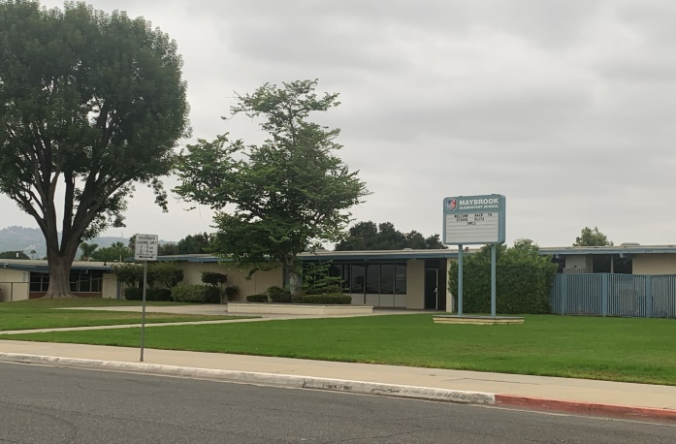
LOWELL JOINT SCHOOL DISTRICT
A Tradition of Excellence Since 1906
“Home of Scholars and Champions”
Measure LL Project Update
Maybrook Elementary Interim Housing Phase I – Complete
Addition of Portable Classrooms and Restrooms
Lighting Upgrades
Site Work

Slide 10
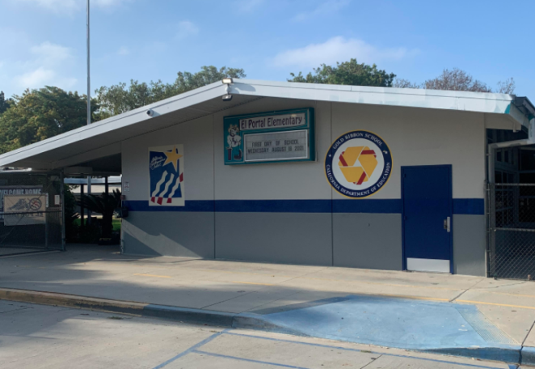
LOWELL JOINT SCHOOL DISTRICT
A Tradition of Excellence Since 1906
“Home of Scholars and Champions”
Measure LL Project Update
El Portal Elementary - Complete
Re-Roofing of Permanent Buildings
New Fire Alarm System

Slide 11
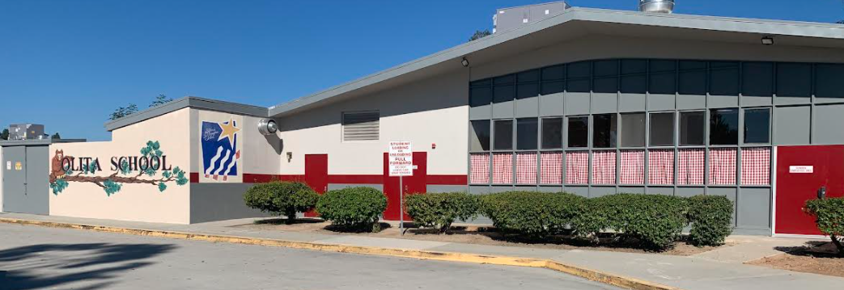
LOWELL JOINT SCHOOL DISTRICT
A Tradition of Excellence Since 1906
“Home of Scholars and Champions”
Measure LL Project Update
Olita Elementary - Complete
Re-Roofing of Permanent Buildings
HVAC Replacement
Electrical Upgrades

Slide 12
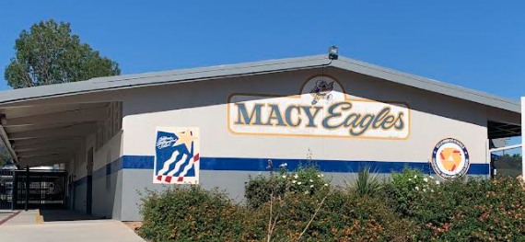
LOWELL JOINT SCHOOL DISTRICT
A Tradition of Excellence Since 1906
“Home of Scholars and Champions”
Measure LL Project Update
Macy Elementary – Complete
Re-Roofing of Permanent Buildings
HVAC Replacement
Electrical Upgrades
Fire Alarm
Sewer Repairs
Limited Storm-Water Repair

Slide 13
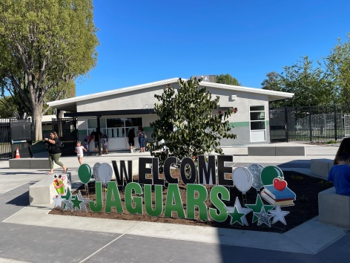
LOWELL JOINT SCHOOL DISTRICT
A Tradition of Excellence Since 1906
“Home of Scholars and Champions”
Measure LL Project Updates
Jordan Elementary – Complete
Portable Replacement
Re-Roofing of Permanent Buildings
HVAC Replacement
Electrical Upgrades
New Fire Alarm
New Sewer Line

Slide 14
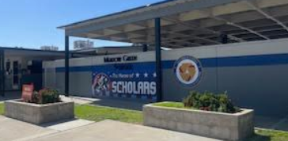
LOWELL JOINT SCHOOL DISTRICT
A Tradition of Excellence Since 1906
“Home of Scholars and Champions”
Measure LL Project Updates
Meadow Green Elementary – Complete
Re-Roofing of Permanent Buildings
HVAC Replacement
Electrical Upgrades
Fire Alarm
Sewer Repairs
Storm Drain

Slide 15
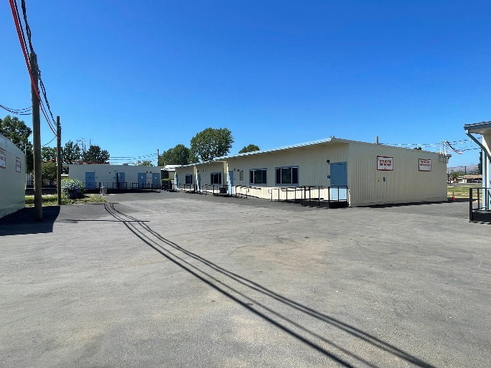
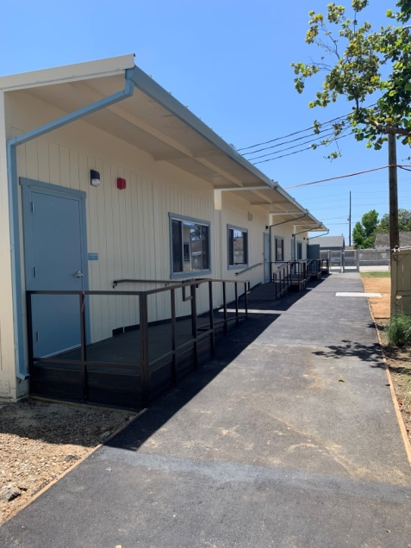
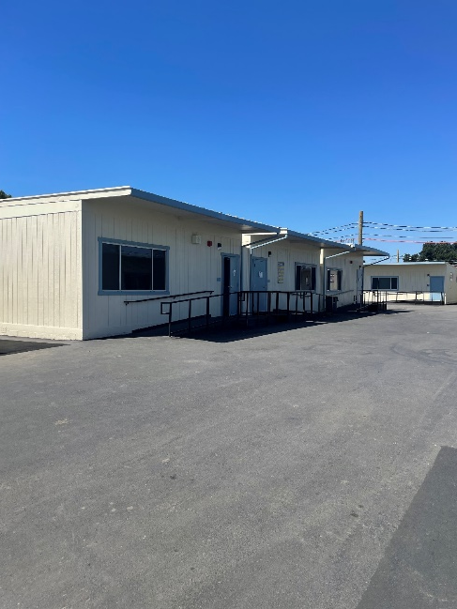

LOWELL JOINT SCHOOL DISTRICT
A Tradition of Excellence Since 1906
“Home of Scholars and Champions”
Measure LL Project Update
Maybrook Elementary Phase II - Complete
Addition of Portable Classrooms and Restrooms

Slide 16
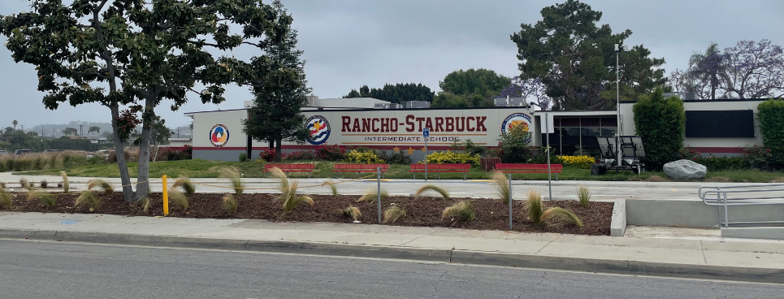
LOWELL JOINT SCHOOL DISTRICT
A Tradition of Excellence Since 1906
“Home of Scholars and Champions”
Measure LL Project Updates
Rancho Starbuck Intermediate – In Progress
Re-Roofing of Permanent Buildings
HVAC Replacement
Electrical Upgrades
New Fire Alarm
New Sewer Line

Slide 17
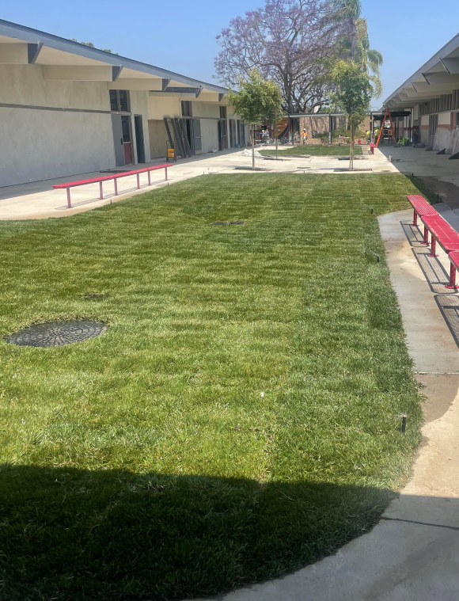
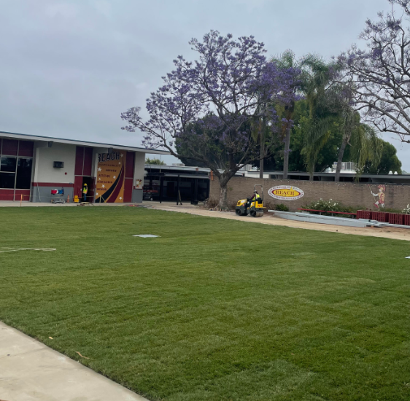
LOWELL JOINT SCHOOL DISTRICT
A Tradition of Excellence Since 1906
“Home of Scholars and Champions”
Measure LL Project Update
Rancho Starbuck Intermediate Project
Grounds Progress

Slide 18
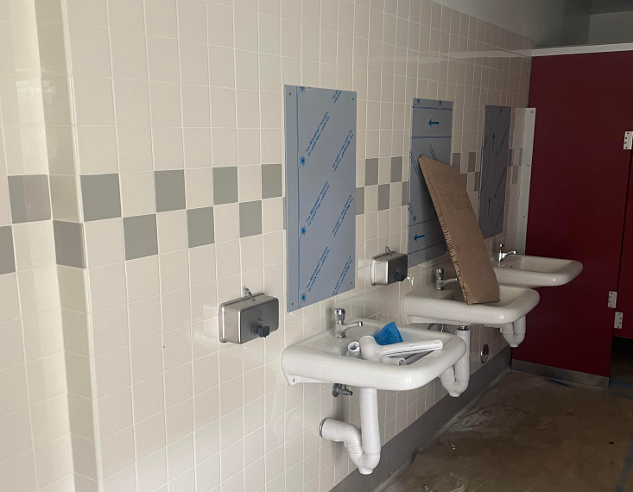
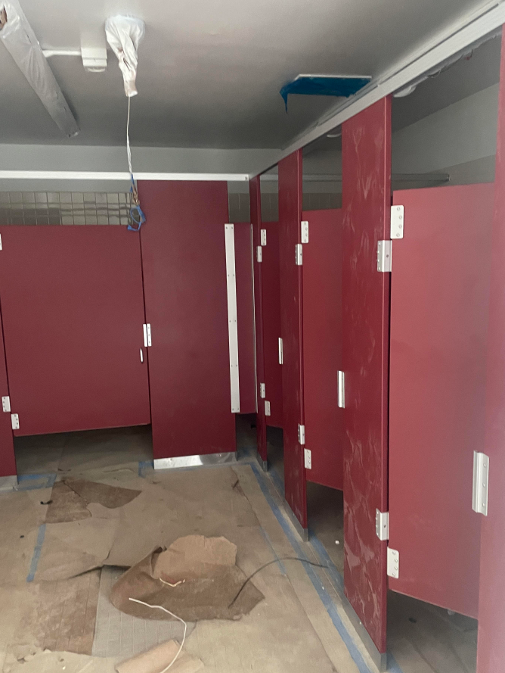
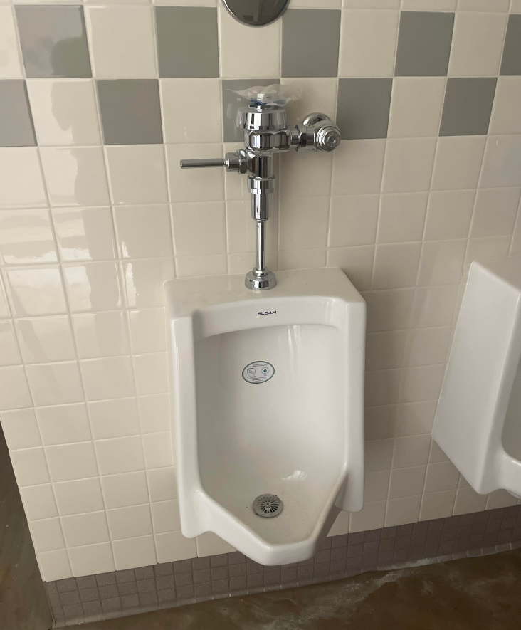
LOWELL JOINT SCHOOL DISTRICT
A Tradition of Excellence Since 1906
“Home of Scholars and Champions”
Measure LL Project Update
Rancho Starbuck Intermediate Project
Accessible Restroom Progress

Slide 19

LOWELL JOINT SCHOOL DISTRICT
A Tradition of Excellence Since 1906
“Home of Scholars and Champions”
Measure LL – Financial Update

Slide 20
LOWELL JOINT SCHOOL DISTRICT
A Tradition of Excellence Since 1906
“Home of Scholars and Champions”
Measure LL Project Budgets & Expenditures
District Project Name | Project Budget per GBA Report 8/4/2020 | Project Expenditures to Date through 5/30/2024 | Difference | Comments
Maybrook Interim Housing Phase I | $3,750,000 | $3,352,536 | <$397,464> | Phase I Certified by DSA
Maybrook Interim Housing Phase II | $3,317,000 | $2,464,211 | <852,789> | Phase II Complete. Awaiting DSA Submission
El Portal Re-Roofing | $2,617,713 | $2,324,921 | <$292,792> | 100% Complete. In to DSA for Certification
Jordan Modernization | $14,552,815 | $12,120,993 | <$2,431,822> | 100% Complete. In to DSA for Certification $2M of Modular Cost Funded by Bond, $1.4M by Developer Fees
Macy Re-Roofing, F/A, and HVAC | $5,595,920 | $5,208,514 | <$387,406> | Certified by DSA
Meadow Green Re-Roofing and HVAC | $7,388,138 | $6,987,797 | <$400,341> | 100% Complete. In to DSA for Certification
Olita Re-Roofing and HVAC | $5,657,936 | $5,078,375 | <$579,561> | Certified by DSA
Rancho Starbuck Re-Roofing and HVAC | $12,200,000 | $9,045,004 | <$3,154,996> | In Progress
Districtwide Ad’s, Bidding, Pre-Qualification, Other |  | $908,004
Combined District-Wide | $55,091,756 | $47,490,355 | <$7,589,167>

Slide 21
LOWELL JOINT SCHOOL DISTRICT
A Tradition of Excellence Since 1906
“Home of Scholars and Champions”
Measure LL Projected State Matching Funds
Measure LL Project Authorization |  | $48,000,000
Olita State Matching Funds Received (Fall 2021) |  | $3,404,000
Macy State Matching Funds Received (Spring 2024) |  | $4,769,028
Total Project Funds Available |  | $56,173,028
The District is in the process of applying for approximately $15.8 million in State Matching Grant Funds pending passage of a new state bond measure. Estimated wait is 4-8 years.
School Site | Pending/Projected State Matching Grants
Maybrook Elementary | Funding Unlikely
El Portal Elementary | $1,286,053
Rancho Starbuck Intermediate | $6,981,766
Jordan Elementary | $3,109,592
Meadow Green Elementary | $4,454,043
Total | $15,831,454

Slide 22
LOWELL JOINT SCHOOL DISTRICT
A Tradition of Excellence Since 1906
“Home of Scholars and Champions”
Measure LL
Citizen’s Bond Oversight Committee
Audit Findings
The 2022-23 annual Lowell Joint School District Building Fund (Measure LL) Financial and Performance Audits had no findings.

Slide 23
LOWELL JOINT SCHOOL DISTRICT
A Tradition of Excellence Since 1906
“Home of Scholars and Champions”
Measure LL
Citizen’s Bond Oversight Committee
Conclusion
Based upon the listed activities, the Committee advises the public that the District is in compliance with Article XIIIA, Section 1(b)(3) of the California Constitution: Bond proceeds have been expended on projects set forth in the ballot measure. No bond proceeds have been used for teacher or administrative salaries or other school operating expenditures; and audits have been performed as prescribed bylaw.

Slide 24
LOWELL JOINT SCHOOL DISTRICT
A Tradition of Excellence Since 1906
“Home of Scholars and Champions”
Measure LL
Citizen’s Bond Oversight Committee
Additional Information
Meeting minutes, audits, and various other documents are available on the District website:
https://www.ljsd.org/Departments/Citizens-Bond-Oversight-Committee/CBOC-Board-Agendas-and-Minutes/index.html.

Slide 25

LOWELL JOINT SCHOOL DISTRICT
A Tradition of Excellence Since 1906
Questions

