Slide 1


Lowell Joint School District
Tradition of Excellence Since 1906
“Home of Scholars and Champions”
2024-25
Proposed Annual
Budget Report
Presented to the Board of Trustees
June 3, 2024

Slide 2
2024-25
Annual Budget Cycle
June - Board Adopts Budget
December – Board Approves First Interim Report
January – Governor Proposes 24-25 State Budget
March – Board Approves Second Interim Report
May – Governor Issues May Revise
August – Board Approves 45 Day Adjustments
July - State Adopts State Budget
September – Board Approves Unaudited Actual Report
We Are Here
District Calendar
State Calendar

Slide 3
2024-25 Budget Assumptions
General Fund Revenue
Local Control Funding Formula (LCFF)
  COLA 1.07%
  Base Grant $29.8 Million
  Supplemental Grant $3.5 million
  Concentration Grant: $383K
  ADA: 2,953.04 (3 year average) (Actual 23-24 ADA=2,875.74)
  Official enrollment of 3,028 (Through April, 2024)
  Seat attendance has declined from traditional 97-98% to 95.0%, which negatively affects ongoing funding by approximately $700,000 per year

Slide 4
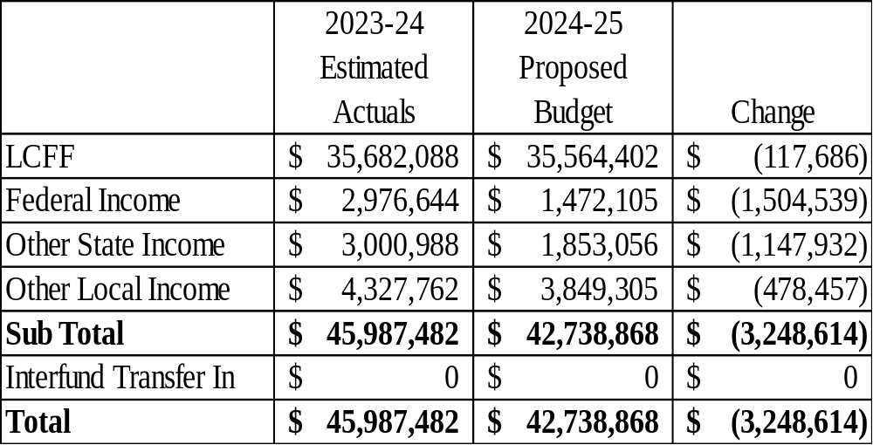
2024-25 Budget Revenue

Slide 5
2024-25 Budget Revenue
General Fund Revenue
Major Changes from 2023-24 Estimated Actuals
Federal Revenue <$1.5M>
    One-Time Federal ESSER Funds Expiring
State Revenue <$1.1M>
    Block Grant Recovery Payment
    Arts/Music Instructional Materials Grant
    Reduction
Local Revenue <$474K>
    Reduction in Interest Earned

Slide 6
2024-25 Budget Assumptions
General Fund Expenditures
Local Control Accountability Plan (LCAP)
Salaries
  Budget per Board Approved Salary Schedules
  Minimum Wage Increase to $16.00 on January 1, 2024
  Step, Column and Longevity: Actuals for 2022-23
  Health and Welfare
    Maximum medical benefits package remains at Kaiser Family Rate
      Approximately $26,000 per covered family for 2023-24

Slide 7
2024-25 Budget Assumptions
General Fund Expenditures
Pension Costs
  STRS pension rate of 19.10% (Unchanged from 2022-23)
    Increases $75,000 due to Step and Column movement and 11% Salary Increase
  PERS pension rate increase 0.37% (26.68 from 27.05%)
    Approximate $26,000 increase
Supplies
  Consumer Price Index (CPI) for 2024-25 is 3.10%
    School site budgets increase based on CPI
    Department Budgets Increase by CPI

Slide 8
2024-25 Budget Assumptions
General Fund Expenditures
Utilities
  Increasing rates
Insurance
  Increases (property value increase, pool rate increase, excess insurance carrier increase (fires, cybersecurity, abuse claims)

Slide 9
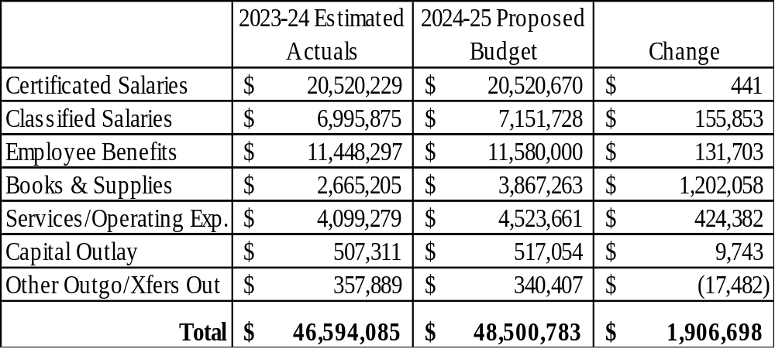
2024-25 Budget Expenditures

Slide 10
2024-25 Budget Assumptions
General Fund Expenditures
Major Changes from 2023-24 Estimated Actuals
Classified Salaries +$156K
  Step & Column
Statutory and Health Benefits +$131K
  6% Increase to Health and Welfare Benefits
Books & Supplies +$1.2M
  Expenditures of One-Time Funding
Services/Operating +424K
  Learning Recovery Block Grant and CalSHAPE Expenditures

Slide 11
2024-25 Budget Assumptions
General Fund Reserve
  Ending balance projected at $ 13.6 Million
  The Designation For Economic Uncertainties Reserve is 5% per board policy (state minimum is 3%)
  Education Code 42127(a)(2)(B&C) requires explanation of amounts above 3%. This additional 2% above the state required minimum is approximately $970,000
  If the district were to reserve one month’s payroll, the total would be 8% (approximately $3,200,000)
  U.S. General Services Administration recommends 17% reserves

Slide 12
2024-25 Budget Assumptions
General Fund Reserve
  A resolution is required to commit, and un-commit, funds above 10% reserves for future identified needs to maintain compliance with this new requirement
  Annual Retiree Health and Welfare Liability Deposit into Irrevocable Trust of $200,000
  Significant reduction in reserves has a negative impact on credit rating for future general obligation bond issuances.

Slide 13
Cost of Declining Enrollment/ADA
Example:
  2022-23
    Enrollment of 3,050
    ADA of 98% = $27.8M
    ADA of 93% = $26.4M
  2023-24 – COLA 8.22%
    Enrollment of 3,000
    ADA of 98% = $29.6M
    ADA of 93% = $28.1M
    The increase of $1.7M is 6.4%, not 8.22%
      This is before factoring for PERS and H&W increases

Slide 14
Multi-year Projections
Revenue Assumptions
(Future Years)
Local Control Funding Formula Sources:
  COLA
    1.07% in 2024-25
    2.93% in 2025-26
    3.08% in 2026-27
    3.30% in 2027-28
  ADA
    Reduce ADA by 7 in 2024-25 due to seat attendance instability (95% vs Historic 97%)
    No ADA change in 2025-26 or 2026-27 (wait to see what occurs in 2024-25 enrollment)

Slide 15
Multi-year Projections
Revenue Assumptions
(Future Years)
One-Time Funding is Gone
COLA’s Have Been Reduced
Consumer Price Index is Rising
Inflation Makes Goods More Expensive
How Will the Governor Address the $8.8B Gap in Prop 98 Funding for Schools?

Slide 16
Multi-year Projections
Expenditure Assumptions
(Future Years)
2025-26 Other District Expenses
  $100,000 Special education contribution increase
  2025-26 Consumer Price Index (CPI) 2.86% cost increase for supplies, services, utilities, contracted services, insurance services, non-public schools
  2026-27 Consumer Price Index (CPI) 2.87%

Slide 17
Multi-year Projections
Expenditure Assumptions
(Future Years)
2025-26 Salaries and Employee Benefits
    1.5% Certificated step and column costs
    1.8% Classified step and longevity costs
    0.4% Non-unit step and longevity costs
    6.0% Increase in employee health and welfare benefits
    LJEA step/column costs assume 2 teacher retiree savings
    STRS pension projected at 19.1% (no change from 22/23)
    PERS pension increase of 0.55% (27.60% from 27.05%)
    Vehicle replacement
    Equipment Replacement
    Irrevocable Trust Payment

Slide 18
Multi-year Projections
Expense Assumptions
(Subsequent Years)
2026-27 Salaries and Employee Benefits
    1.5% Certificated step and column costs
    1.9% Classified step and longevity costs
    0.4% Non-unit step and longevity costs
    6.0% Increase in employee health and welfare benefits
    LJEA step/column costs assume 2 teacher retiree savings
    STRS pension projected at 19.1% (no change from 23/24)
    PERS pension increase of 0.40% (28.00 from 27.60%)
    Vehicle replacement
    Irrevocable Trust Payment

Slide 19
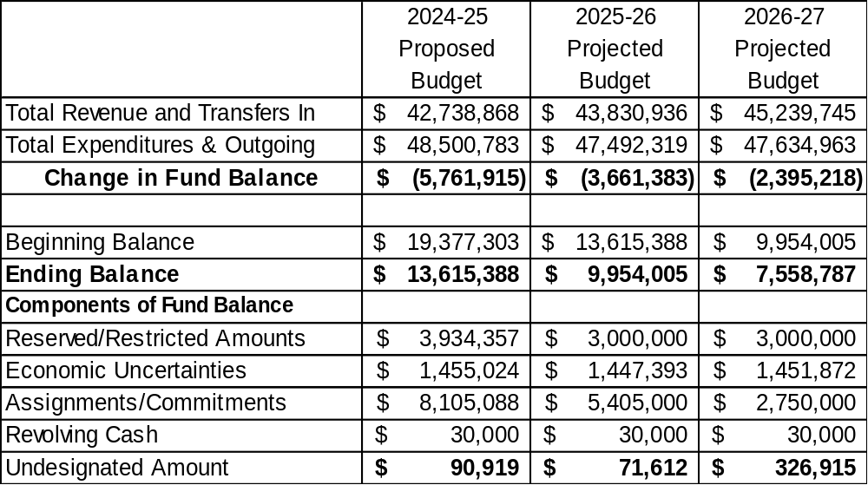
Multi-year
General Fund Summary

Slide 20
Surplus/Deficit Spending
One-Time Pandemic Funding is done
Funding ongoing programs with one-time funds is not sustainable
Appropriation of categorical and school site carryover also increases expenditures in the current year
Attendance is slowly returning to pre-pandemic levels
Deficit spending for 2024-25, 2025-26, and 2026-27 will reduce Ending Fund Balance by $11.8M

Slide 21
Future Considerations….
Updates to the District budget will be provided at the August 5, 2024 Board meeting after the State budget is adopted.
Governor’s Budget
  Proposes reducing funding from the 2022-23 school year and lowering the Prop 98 guarantee
    This will reduce funding for schools ongoing

Slide 22
Facilities
Voter approved $48 million general obligation bond – MEASURE LL projects are almost complete. Thank you for the community support!
Second and FINAL debt issuance in November 2020 saved local taxpayers over $5.1 million ☺

Slide 23
Facilities (continued)
State match money status
  All seven school sites have the first step completed: eligibility calculations for match amount
  Olita was submitted a few years ago and matching funds of $3.4 million were received in December, 2021 ☺
  Macy was submitted for match money and matching funds of $4.7 were received in April, 2024
  Total of approximately $15M in remaining State match eligibility

Slide 24
Facilities (continued)
  Special Reserve Fund 40.0 receives ongoing lease income and contains sale of Carden property funds
    This income supports deferred maintenance and repairs expenses
    Ongoing annual lease income will be approximately $800,000 (Starbuck property- leased to Whittier Christian HS)

Slide 25
2024-25 Facilities Funds
Four Funds
  Deferred Maintenance – planned maintenance projects
  Capital Facilities - developer fees for student growth
  Special Reserve for Capital Outlay – capital facilities projects
  Building Fund – General Obligation Bond projects
    Measure LL projects are accounted for here!
    $48 million was authorized by voters in November 2018
    $14 million was issued in July, 2019
    $34 million issued in October, 2020
    Maybrook, Olita, El Portal, Jordan, Macy, and Meadow Green completed so far. Rancho Starbuck completion - Summer, 2024.

Slide 26
Nutrition Services Fund
This federal program now requires a maximum of 6 months operating expenses in reserves:
  We continue to plan deficit spending for supplies and equipment to reduce reserves to meet this maximum
Custodial salaries charged to this fund began in 2019/20 for the portion of daily time cleaning during and after lunch service. This added approximately $120,000 in expense to this fund, so additional reserves should be reduced or eliminated going forward.
Increased Cafeteria Worker hours from 2.0 to 3.75
Nutrition Services continues to operate profitably with no contributions necessary from the General Fund

Slide 27
Child Development Fund
New fund dedicated to revenue and expenditures for the early learning programs
There has been high demand for these programs
Forecast potentially adding classes in 2024-25

Slide 28
2024-25 Multi-Year Projection
Budget Report
Approval of the District’s 2024-25 Proposed Adopted Budget is Recommended

Slide 29
2024-25 Multi-Year Projection
Budget Report
A sincere “Thank You” to the
Business Services Team!
Chelle Price – Director of Fiscal Services
Accounting Technicians
Beatriz Rodriguez
Jeanette Trevino
Randi Vasquez
Michelle Wolfarth

Slide 30
QUESTIONS?

