Slide 1
MODULE 4
(Correlated with LCVS Educator Site Content)

Slide 2
Market Phases – ‘The Business Cycle’
  1. expansion
  2. peak
  3. contraction
  4. trough
Peak
Expansion
Contraction
Trough

Slide 3
I. The Labor Market
Summary: the supply of labor and demand for labor are the primary factors that influence wages in any field; next are the skills, abilities, experience, and education of the worker
Questions for Thought:
- Should we just let the market determine everyone’s pay and benefits? Why/not?
  - Why are these both important to understand when seeking a job or hiring employees?

Slide 4


A. The ‘Labor Force’
1. Two categories
a. Employed
b. Unemployed
2. What about everybody else?
3. Full Employment
- underemployed
B. Types of Unemployment
1. Frictional
2. Seasonal
3. Structural
4. Cyclical

Slide 5
C. Factors Affecting Employment/Wages
1. Supply/Demand
2. Human Capital
3. Others
- wage discrimination
- gov’t regulations
- unions
- labor mobility
4. Free Market or not? = upward mobility

Slide 6
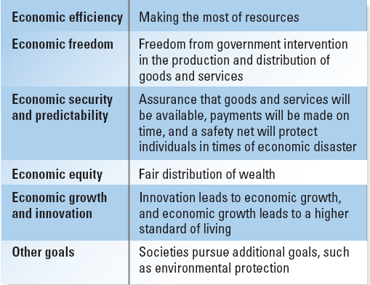
Gov’t Concern – Balancing Economic Goals & Societal Values

Slide 7
II. Economic Growth & Progress
A. Measuring the Economy
1. ‘Real’ vs. ‘Nominal’ values
2. GDP and GNP
B. Cycles of growth (or decline)
1. Recession
2. Depression
3. Inflation
4. Stagflation
C. Federal Spending

