Slide 1
MODULE 3
(Correlated to LCVS Educator Site Content)

Slide 2
I. Markets
Summary: people engage in exchange with others to acquire their needs and wants; when done voluntarily for each party’s gain there is incentive to participate
Questions for Thought:
- Why is ‘voluntary’ exchange important?
- What would happen if people were forced to exchange only certain items at controlled prices through third parties?
- What happens if you make a bad choice?
- Do we need ‘rules of fair play’? Why/not?

Slide 3
A. Traits of successful Free Enterprise
1. Economic Freedom
a. Personal choice, protected under law
2. Private Property
a. Individual ownership
b. Integrity, independence, and impartiality of legal system

Slide 4
3. Competition
a. Free entry/exit
b. Fair/consistent rules, properly enforced
4. Contracts
5. Self-interest
6. Voluntary Exchange
7. Profit Motive

Slide 5
II. Competition
Summary: as people compete for profit to satisfy their self-interest, individuals will make the most efficient choices which will lead to greater wealth and opportunities for all
Questions for Thought:
- Isn’t competition negative? Why won’t less competition help everyone get more?
- What about those who are unable to compete with everyone else?

Slide 6
A. Perfect Competition (price alone)
1. Identical Products
2. Many buyers/sellers
3. Informed buyers
4. Free entry/exit

Slide 7
B. Imperfect/Monopolistic Competition
      (not only price)
1. Product Differentiation
2. Many firms
3. Few artificial barriers
4. Slight price control
C. Non-price Competition
1. physical characteristics
2. location
3. customer service
4. advertising, image, or status

Slide 8
III. Life Outside ‘The Market’
Summary: societies that do not practice free market principles have lower standards of living and limited economic power; gov’t that restrict trade in certain things create an unintended niche market (black markets)
Questions for Thought:
- China is communist. What has helped them succeed recently in the world?
- Why is there less variety and frequent shortages in centrally planned economies?

Slide 9
A. Prices, but with major Gov’t intervention
1. Distribution by other means
- black markets
- rationing (worse than w/o prices)
B. Distribution Without Prices
- barter
- rationing
- force

Slide 10

C. Centrally Planned Economies
1. gov’t control of resources & production
2. Socialism and Communism
a. Socialism
b. Communism
D. Problems w/ Central Planning
1. good short term/bad long term
2. diminish incentive/production
3. lower variety/quality

Slide 11
IV. The Mixed Economy
Summary: the truly free market cannot exist in a world of political boundaries, so some governmental involvement is unavoidable and sometimes necessary
Questions for thought:
- To what extent can any gov’t make better choices for me than me?
- Beyond guaranteeing the basic rights of life, liberty, and property, does the gov’t have any other obligations? Should it? Explain.

Slide 12
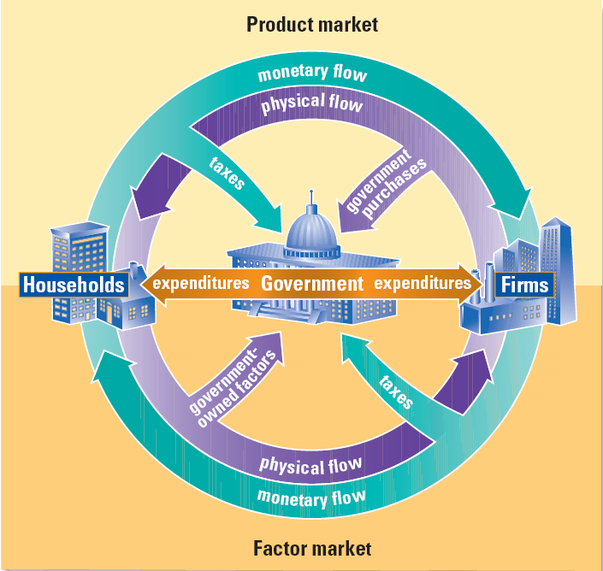
A. Circular Flow Model of Mixed Economies

Slide 13
V. Gov’t Intervention/Interference
Summary: gov’t has a part to play, but when it oversteps its responsibilities, negative economic, political, and social consequences can follow
Questions for Thought:
- Are gov’t restrictions on certain economic activities helpful or harmful? How?
- To what extent should the gov’t protect us from ourselves? How much responsibility do we bear for our own choices? Are there times when no one is at “fault” and things just happen?

Slide 14
A. Supply & Demand v. Gov’t Regulation
1. Intervention in Market – Disequilibrium (shortage/surplus)
a. Price ceilings (e.g. - rent controls)
b. Price floors (e.g. - minimum wage)
2. Intervention in Labor and Safety
a. Child labor laws
b. Helmet laws, food service, etc.
3. Intervention in providing goods/services
a. Public/private goods
b. Healthcare

