Slide 1
MODULE 2
(Correlated to LCVS Educator Site Content)

Slide 2
I. Education, Skills, & Labor
A. Relation between Ed. & Labor
1. Positive Correlation in Employment
2. Positive Correlation in Wages
*Top earnings are ‘Professional’ Classifications

Slide 3
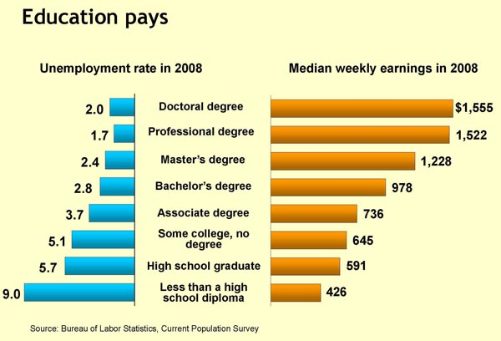

Slide 4
Labor and Skill sets, see pg. 217
1. Categories
a. Unskilled
b. Semi-skilled
c. Skilled
d. Professional

Slide 5
II. Banking
A. What is a bank?
1. Basic Accounts/Services
a. Savings accounts
- regular
- special
- CDs
b. Checking accounts
- regular (checks, ATM/Debit)
- special
- Money Market Mutual Funds

Slide 6
c. Loans/Credit
- Auto/Home/Business
- Credit Cards (student/minor, regular, business)

Slide 7
B. Types of Financial Institutions
  1. Commercial banks
  2. Savings banks
  3. Credit unions
  4. Savings and Loan Associations
  5. Finance companies

Slide 8
C. Other Financial Intermediaries
1. Mutual Funds
2. Insurance Companies
3. Pensions
D. Benefits of Using Them
1. Easy Diversification
2. Information
3. Greater Liquidity

Slide 9
III. Stocks and Bonds Markets
A. Stock
1. Common
2. Preferred
3. Dividends

Slide 10
B. Stock Transactions
1. Stock Brokers
2. Buying/Selling
a. Capital gain
b. Capital loss
C. Stock Exchanges
1. Location (e.g. – NYSE)
2. OTC (e.g. – NASDAQ)

Slide 11
D. Stock Indexes/Averages
1. Dow Jones Industrial Average
2. Standard & Poor’s

Slide 12
E. Bonds
1. Four Components of a Bond
a. Par value
b. Maturity
c. Interest
d. Yield

Slide 13
2. Four Types
a. Corporate
b. Municipal
c. Treasury
d. Savings

