Slide 1
MODULE 1
(Correlated to LCVS Educator Site Content)

Slide 2
What is Economics?
SUMMARY:
Economics is the field of social sciences that addresses human choices and behavior as it relates to acquiring needs and wants. Predictions are made based on patterns shown in group behaviors/choices over time.
QUESTIONS for THOUGHT:
How does scarcity relate to opportunity cost?
How are needs & wants related? How do they differ?
What is the difference between efficiency and expediency and how does that relate to unintended consequences?

Slide 3



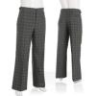

I. Basic Concepts
A. Needs
1. Concrete
2. Abstract
B. Wants
C. Scarcity

Slide 4




II. Factors of Production
A. Land
B. Labor
C. Capital
1. Physical
2. Human
D. Entrepreneurs

Slide 5




III. Production & Productivity
A. Productivity
B. Good
1. Durable
2. Non-durable
C. Service
vs.

Slide 6
IV. CHOICE AND COST
A. Cost
B. Trade-offs
C. Opportunity Cost
1. TINSTAAFL
D. Secondary Effects

Slide 7
V. Markets
Summary: people engage in exchange with others to acquire their needs and wants; when done voluntarily for each party’s gain there is incentive to participate
Questions for Thought:
- Why is ‘voluntary’ exchange important?
- What would happen if people were forced to exchange only certain items at controlled prices through third parties?
- What happens if you make a bad choice?
- Do we need ‘rules of fair play’? Why/not?

Slide 8


A. Why They Exist
1. Profit Motive - Efficiency
2. Specialization
a. Buying and selling

Slide 9
B. Free Market, see pg. 30
1. Households and firms (businesses)
2. Factor Market
3. Product Market

Slide 10
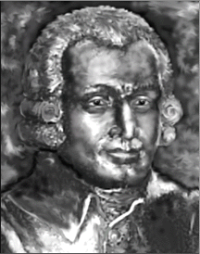
C. Motivation & Self-Regulation
1. Self-interest
2. Competition
a. incentive
3. ‘Invisible hand’ (…”the Wealth of Nations” – Adam Smith, 1776)

Slide 11
VI. Capitalism
Summary: individuals own property and make their own choices about how to use it for their own benefit; ultimately this encourages wise use of productive resources and greater efficiency
Questions for Thought:
- If it belongs to you, to what extent do you have the right to do what you want with it?
- If your ability to profit from your own decisions is removed how will that affect your actions and decisions?
- If your ability to suffer from poor decisions is removed, how will that affect your actions and decisions?

Slide 12
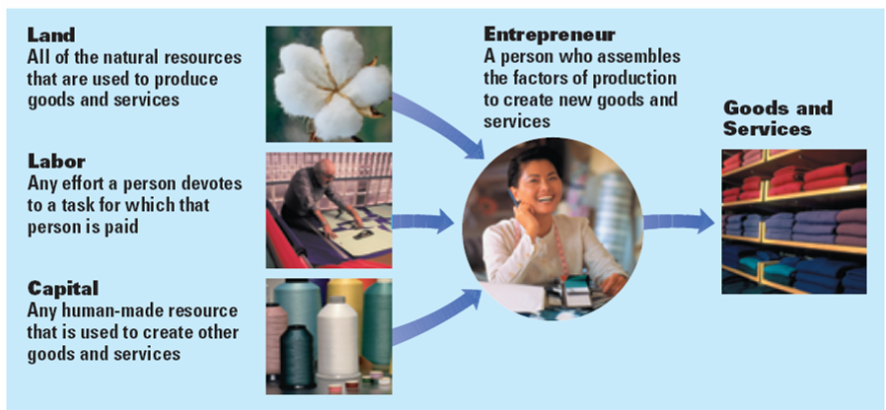

Slide 13
VII. Prices and Markets
Summary: prices help to distribute goods and services in a market setting; this is the most efficient and fair method and crosses all language and cultural divides
Questions for Thought:
- How are prices fair, especially when some people can’t afford certain items?
- Why are prices an effective and efficient communication between buyer and seller?
- Who controls prices? Why is that the main point of their effectiveness?

Slide 14
A. Prices
1. Communication tool
2. Distribute goods/services
3. Advantages
a. Flexible
b. Free

Slide 15
B. Economic Model of Price Adjustment
Supply
Price
Demand
Quantity

Slide 16
C. Demand
1. Law of Demand
a. Substitution effect
b. Income effect
2. Demand Curve
a. Law of demand
b. Ceteris paribus
3. Change in Quantity Demanded

Slide 17
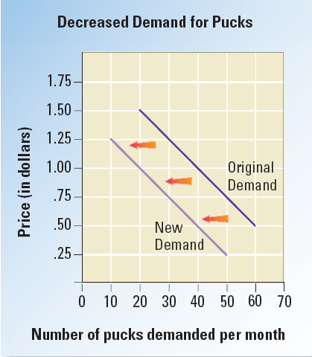
4. Change in Demand
  a. Income
  - normal v. inferior goods
  b. Consumer Expectations
  c. Population
  d. Consumer tastes & advertising
  e. Price of Related Goods
  - complements
  - substitutes

Slide 18
5. Elasticity of Demand
a. Elastic
b. Inelastic
c. Unitary elastic
d. Factors affecting Elasticity
- price range
- availability of substitutes
- ‘relative’ importance
- necessity or luxury?
- time until purchase

Slide 19
e. Elasticity and Revenue, pg. 95-96
- P x Q = TR
- Elasticity affects seller’s price
Elastic = lower price
Inelastic = higher price
Unitary = based on cost
- Marginal revenue

Slide 20
D. Supply
1. Law of Supply
a. Production rate & market entries
2. Supply Curve

Slide 21
3. Elasticity of Supply
a. Elastic
b. Inelastic
c. Unitary Elastic
4. Relationship b/w Supply & Time
a. Inputs
b. Short run
c. Variable Inputs
d. Long run

Slide 22
5. Changes in Supply
1. Reactions to price
2. Reactions to cost
S1
S2
Original
New

Slide 23
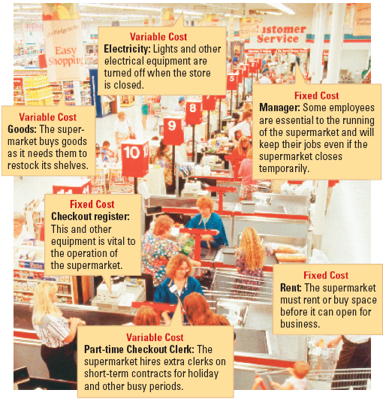
E. Cost of Production
1. Inputs (factors of production) = costs
a. Variable cost (labor/materials)
b. Fixed cost
c. Total cost
d. Marginal cost

Slide 24
V. The Market in Motion
B. Economic Model of Price Adjustment
Summary: consumers and producers engage in self-serving behavior, each seeking their own gain; as conditions change, behavior changes to achieve maximum gain or minimum loss
Questions for Thought:
- Why do we say the market is ‘self- stabilizing’? Does it need controls?
- Who is should be held responsible when it gets out of control? What should be done?

Slide 25
A. Combining Supply and Demand
1. Equilibrium – the balanced market
B. Economic Model of Price Adjustment
Supply
Price
Demand
Quantity

Slide 26
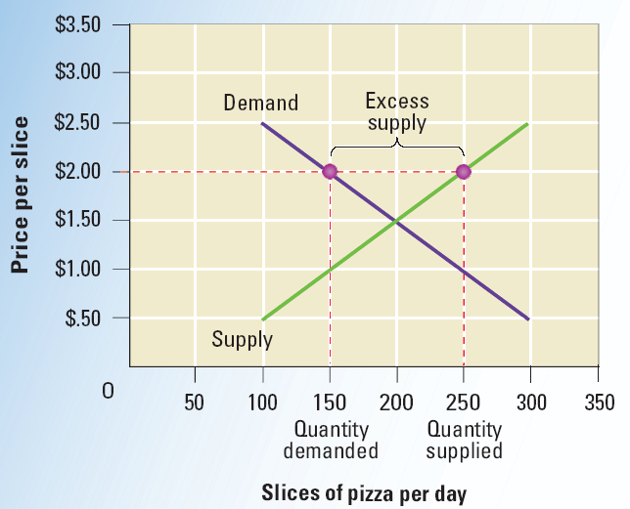
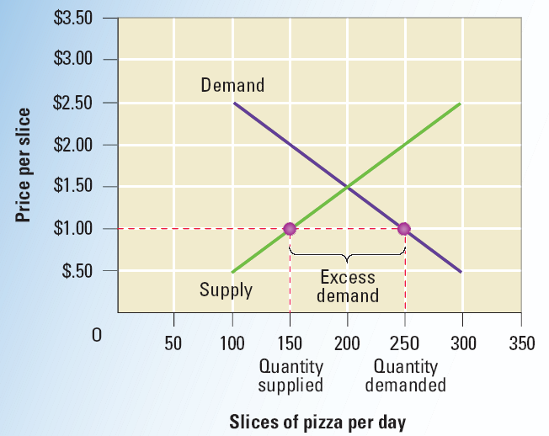
B. Disequilibrium
1. Shortage
2. Surplus

Slide 27
C. Changes to Market Equilibrium
1. Changes in price
2. Changes in supply
3. Changes in demand

