Slide 1
Plants
Assembled and Presented by Dean Struempf

Slide 2
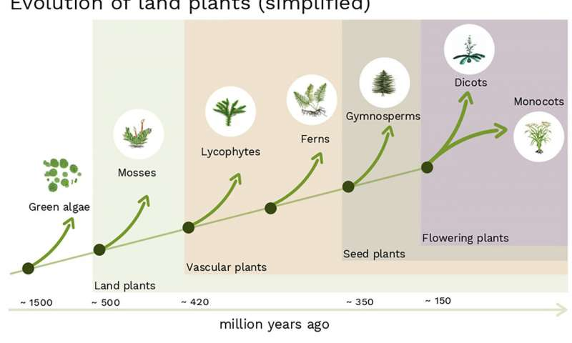
From Aquatic Ecosystems to Terrestrial Ecosystems
About 500 million years ago, the history of life on Earth laid the foundations for our current environments.

Slide 3
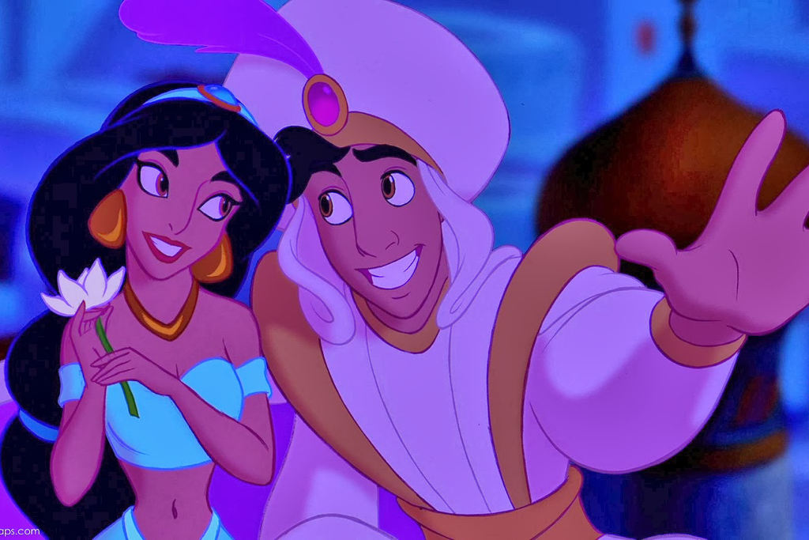
A Whole New World!

Slide 4
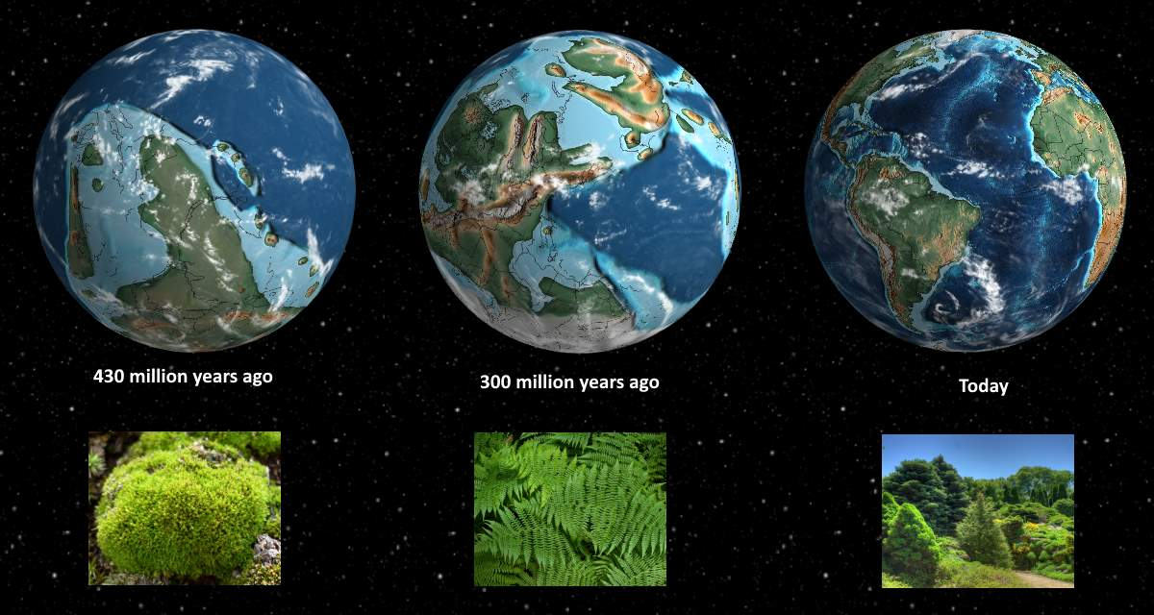
From Aquatic Ecosystems to Terrestrial Ecosystems

Slide 5
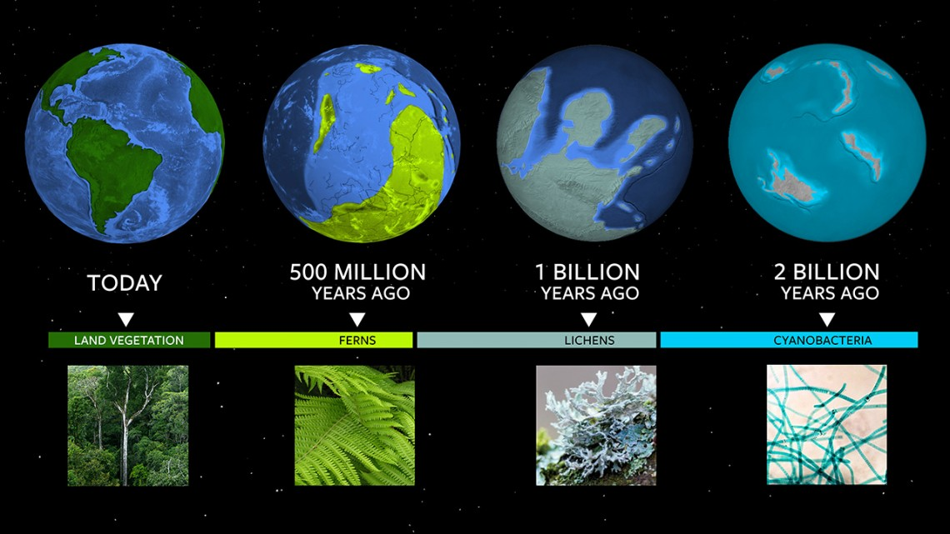
From Aquatic Ecosystems to Terrestrial Ecosystems
Notes:
Astronomers that search for exoplanets are also observing the apparent colors of these planets for evidence for alien life. The color of a planet may indicate life, such as the green we see on Earth from space.

Slide 6
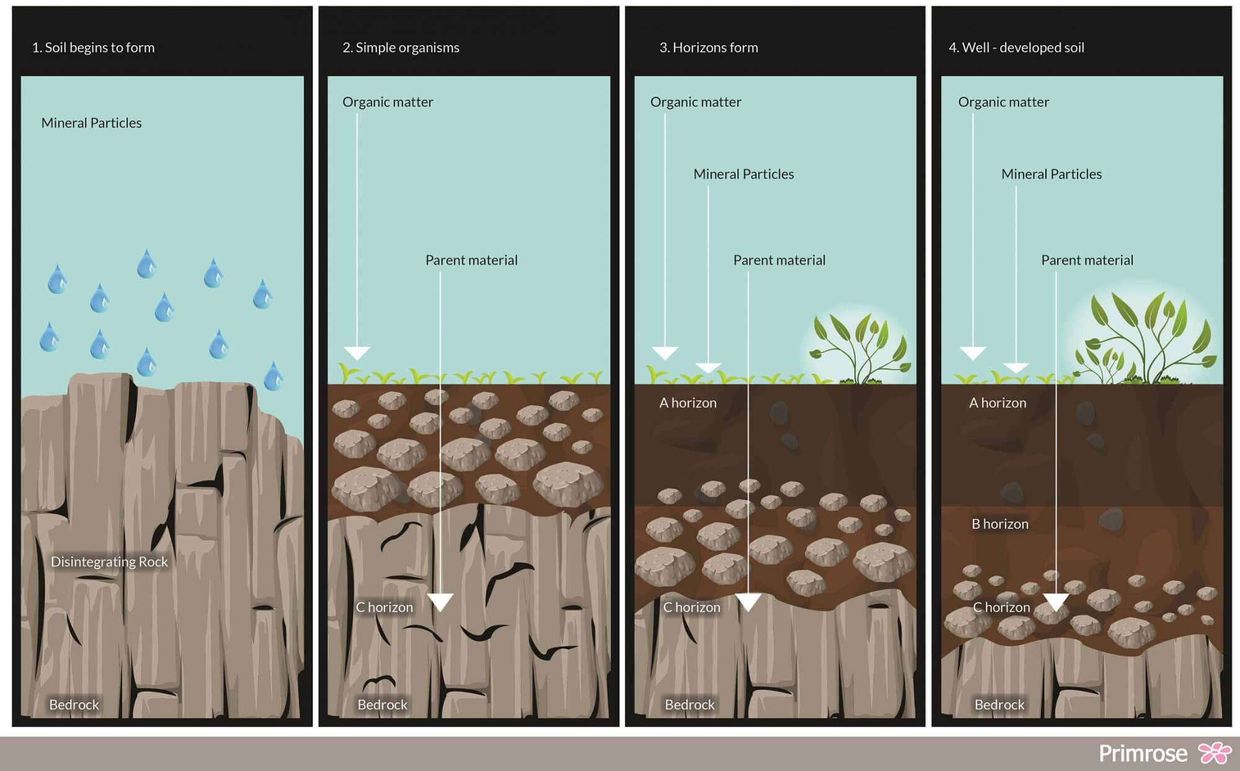
From Aquatic Ecosystems to Terrestrial Ecosystems
The evolution of land plants laid the foundations of soil formation, and a new environment for the evolution of land dwelling animals to exploit.

Slide 7
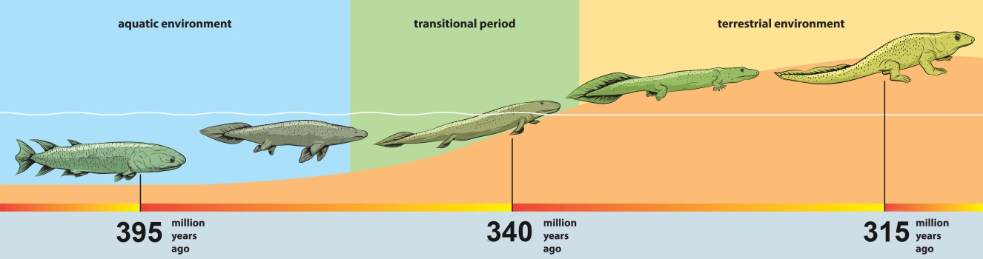
From Aquatic Ecosystems to Terrestrial Ecosystems
The evolution of land plants laid the foundations of soil formation, and a new environment for the evolution of land dwelling animals to exploit.

Slide 8
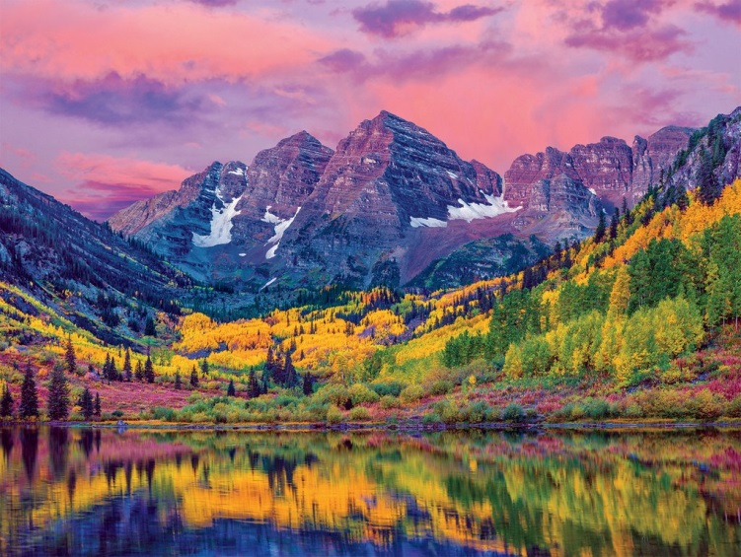
Notes:
Maroon Bells in Aspen, Colorado

Slide 9
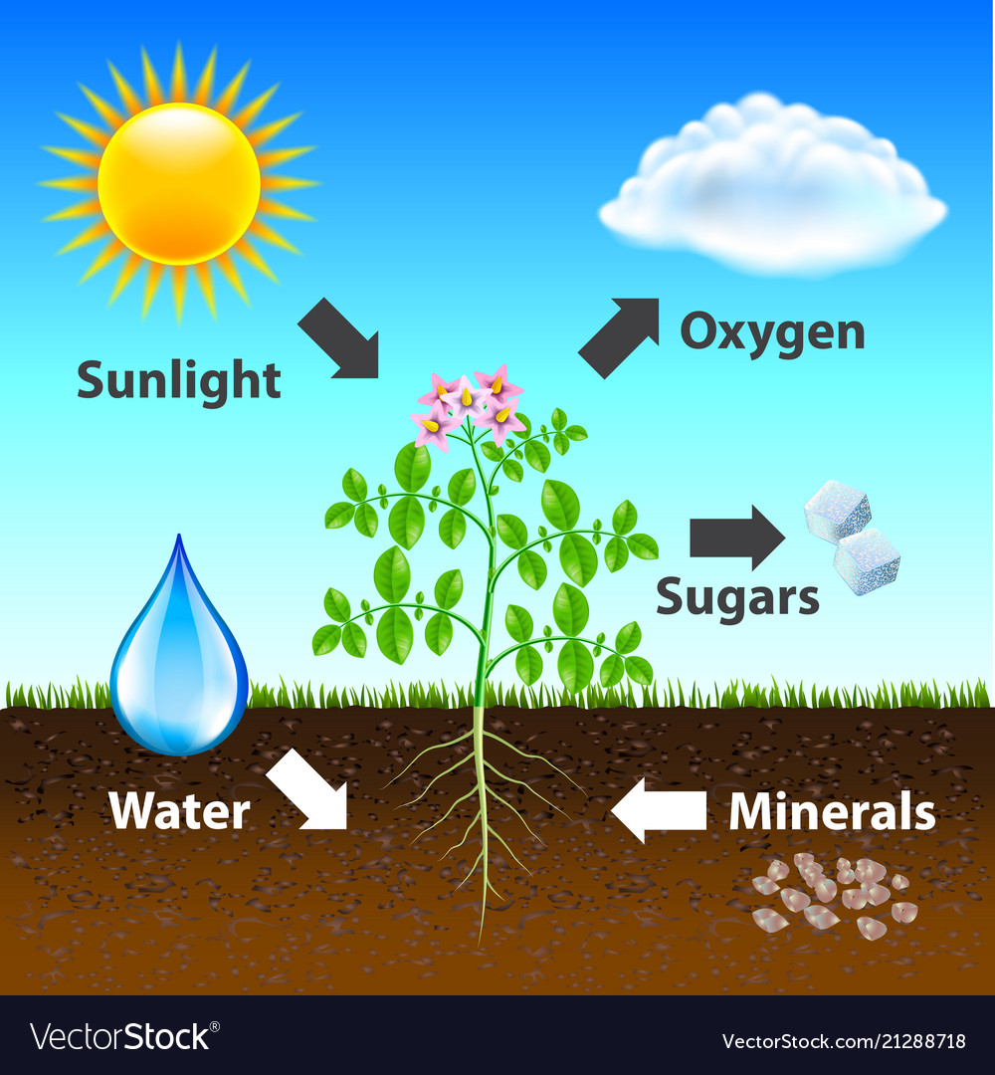
Basic Needs of Plants
Plants need:
  Sunlight
  Gas exchange
  Water
  Minerals
Notes:
What is missing from this picture? Carbon Dioxide
What process produces sugars/carbohydrates in plants? Photosynthesis
What organisms benefit from plants? Consumers

Slide 10
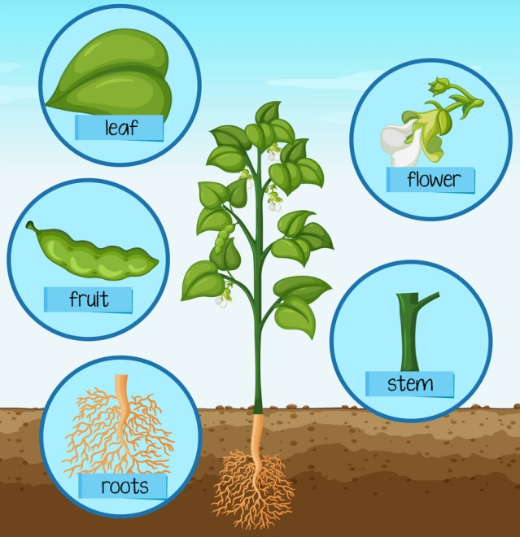
Parts of a Plant
Roots
  Support/Anchor
  Store food
  Absorb water and dissolved nutrients.

Slide 11
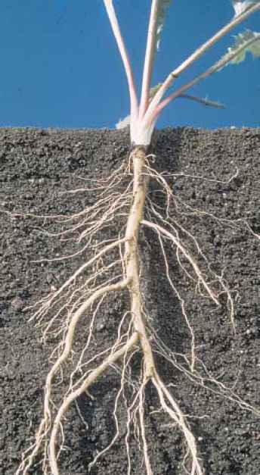
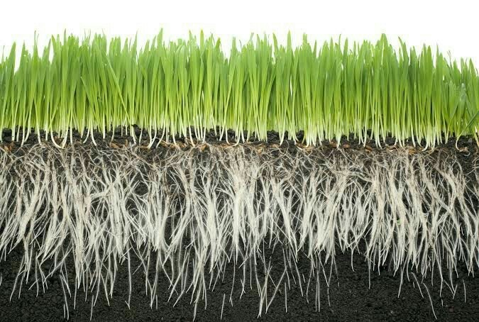
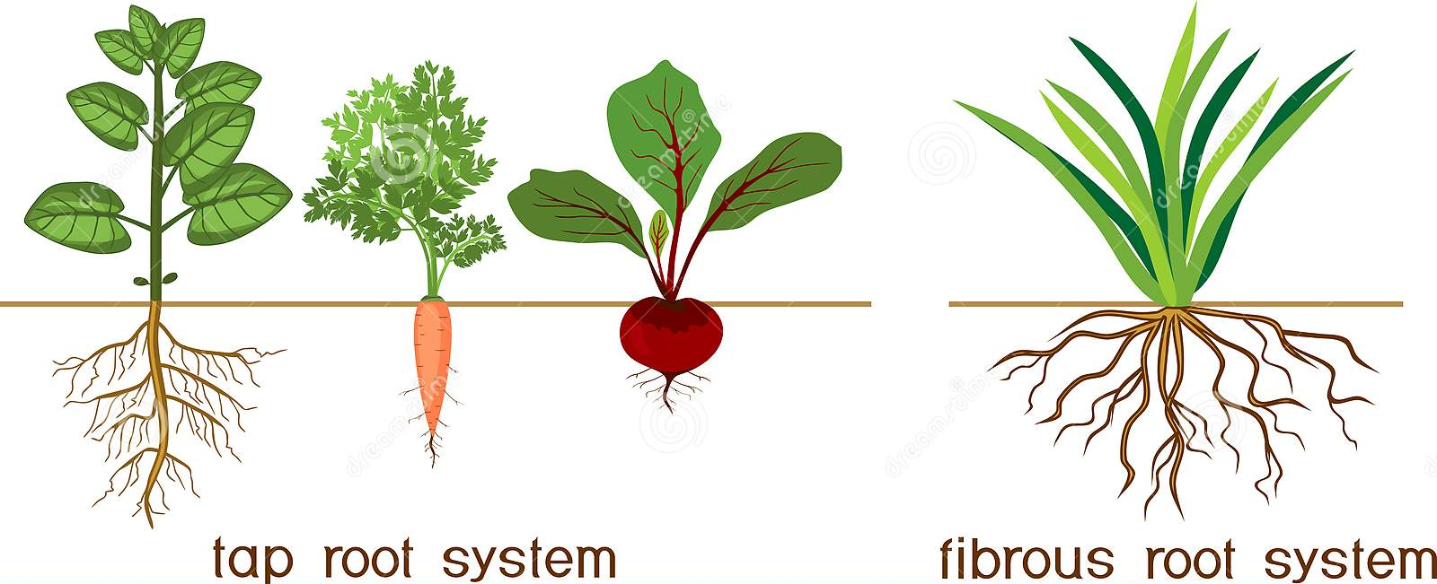
Parts of a Plant
Roots
  Support/Anchor
  Store food
  Absorb water and dissolved nutrients.

Slide 12
Parts of a Plant
Stem
  Produce and support leaves, branches and flowers.
  Hold leaves up to the sun.
  Transport materials throughout the plant.

Slide 13
Parts of a Plant
Leaf
  Gas exchange
  Specialized (broad and flat) for Photosynthesis

Slide 14
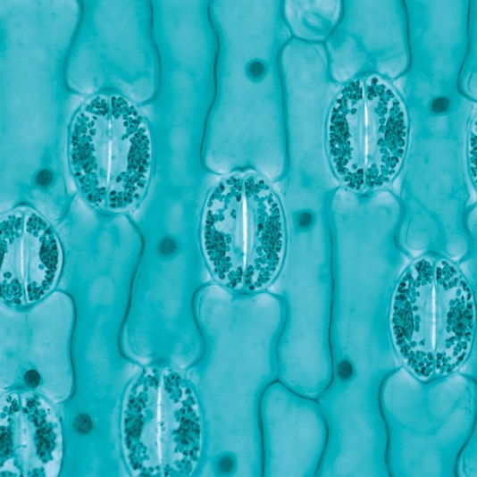
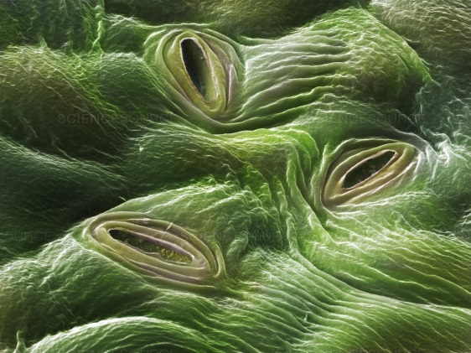
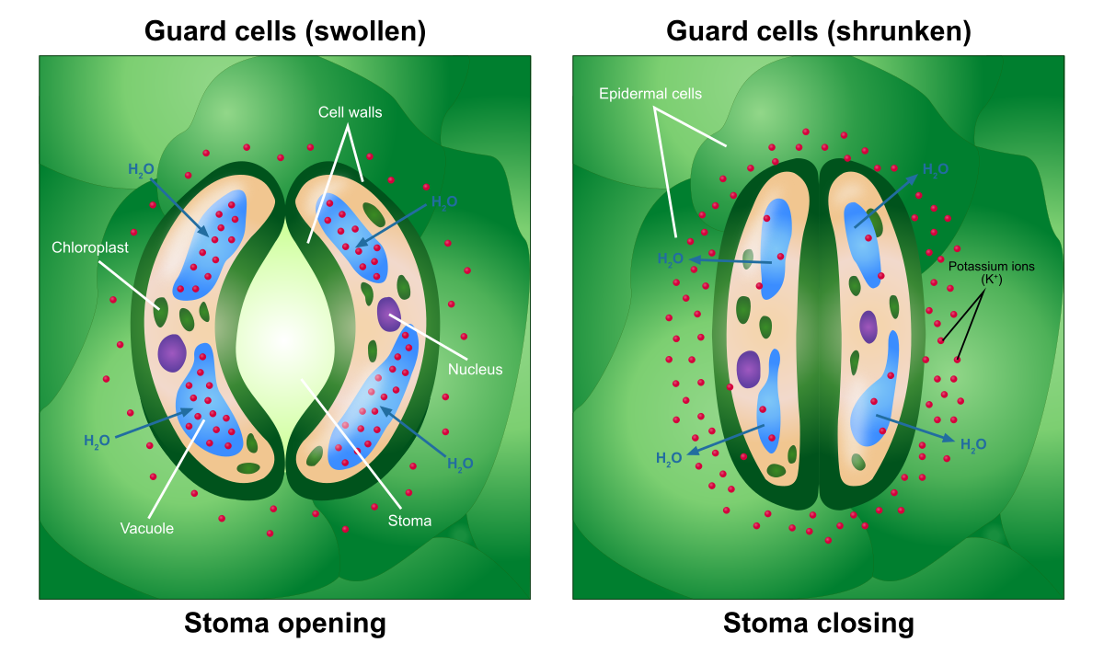
Parts of a Plant
Leaf
  Gas exchange
  Specialized (broad and flat) for Photosynthesis

Slide 15
Parts of a Plant
Fruit
  Protective layer of nutrient-packed tissue for seeds.
  Some adapted for seed dispersal via animal ingestion and subsequent growth in fecal distribution.

Slide 16
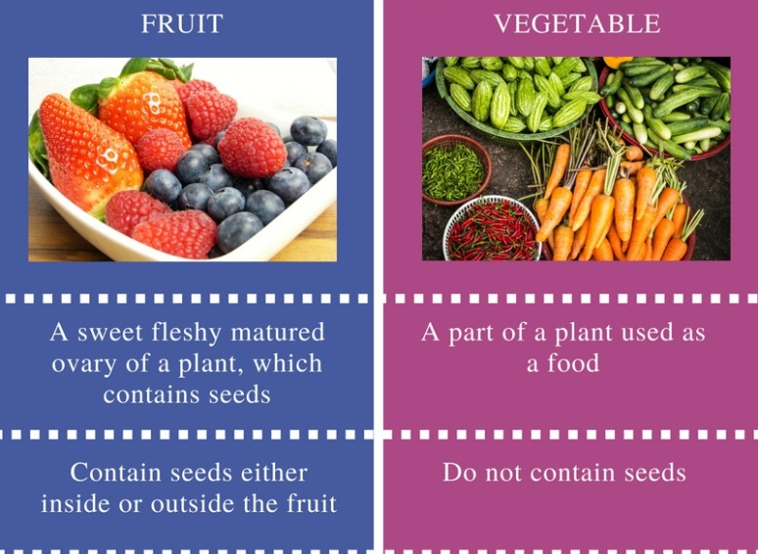
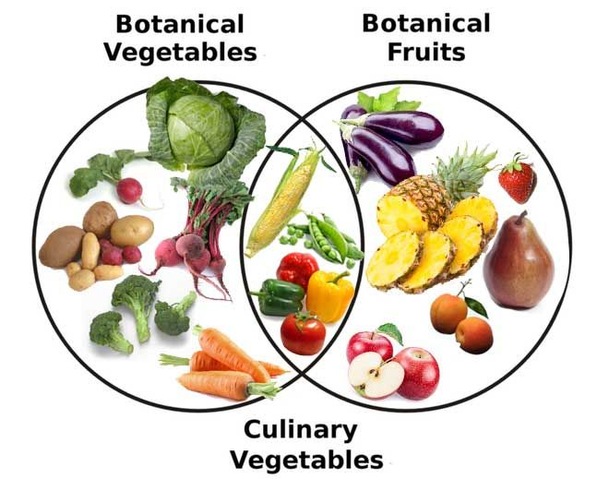
Fruits vs Vegetables

Slide 17
Parts of a Plant
Flower
  Reproductive organs
  Many have adapted to attract animals, such as insects or hummingbirds to aid in pollination (the sex)

Slide 18
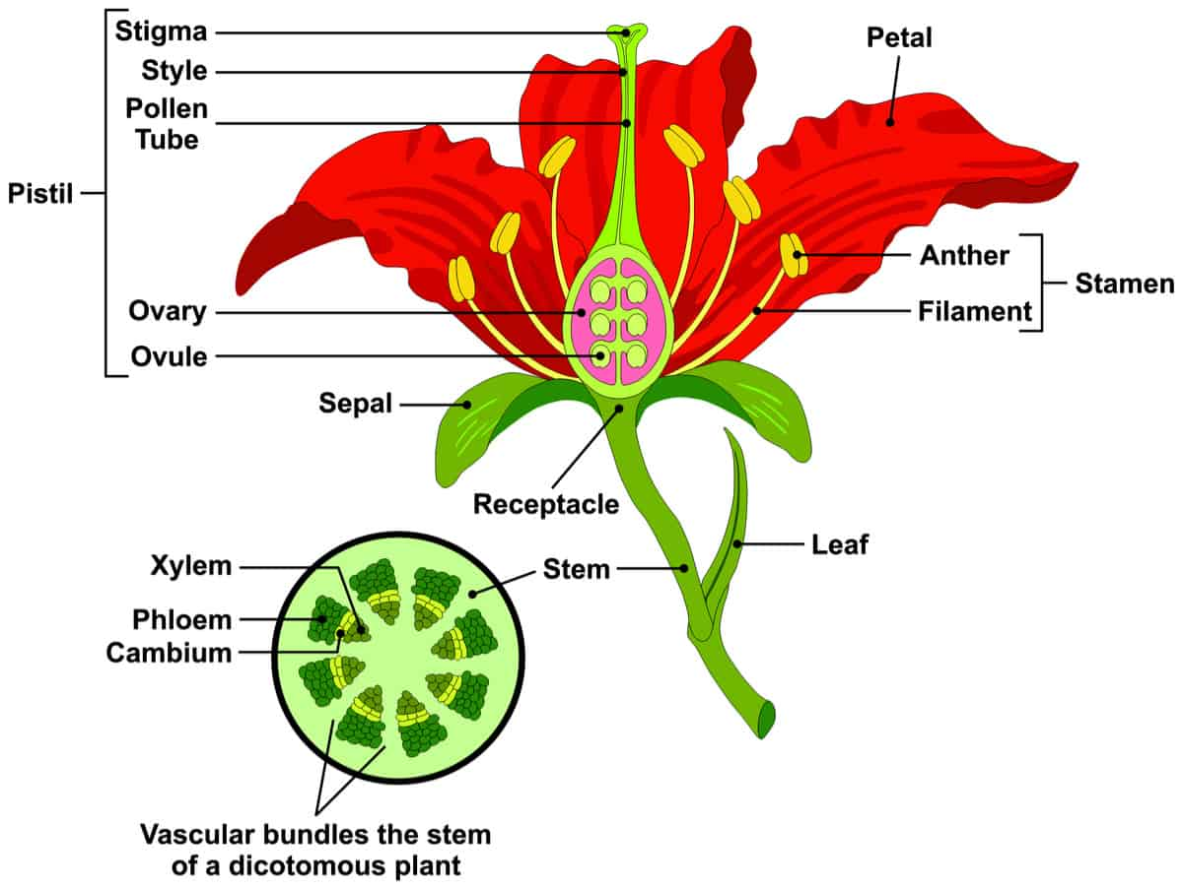
Parts of a Plant
Flower
  Reproductive organs
  Many have adapted to attract animals, such as insects or hummingbirds to aid in pollination (the sex)

Slide 19
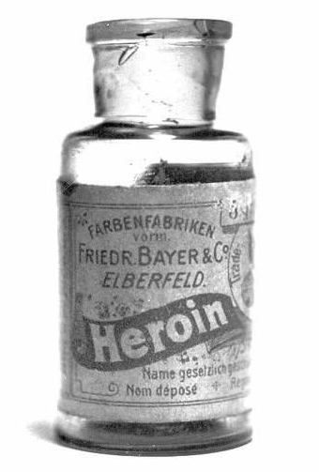
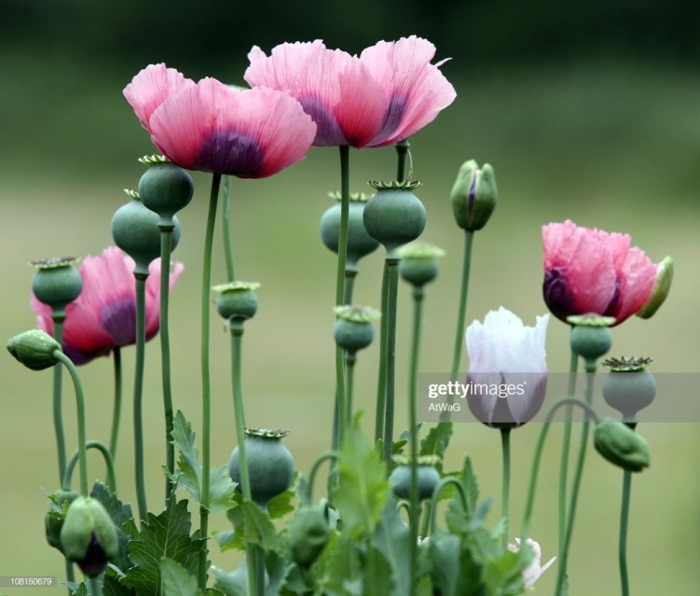
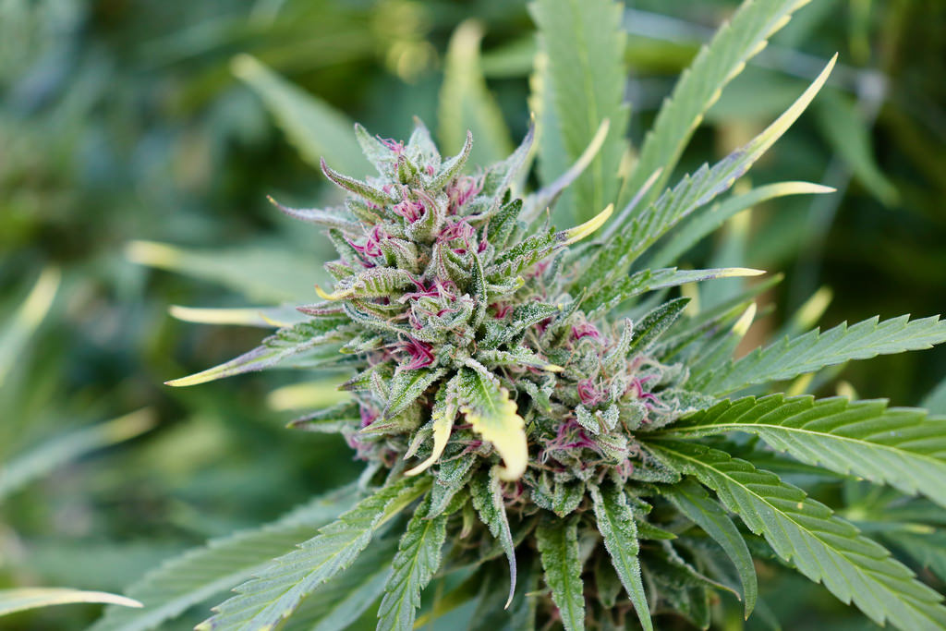
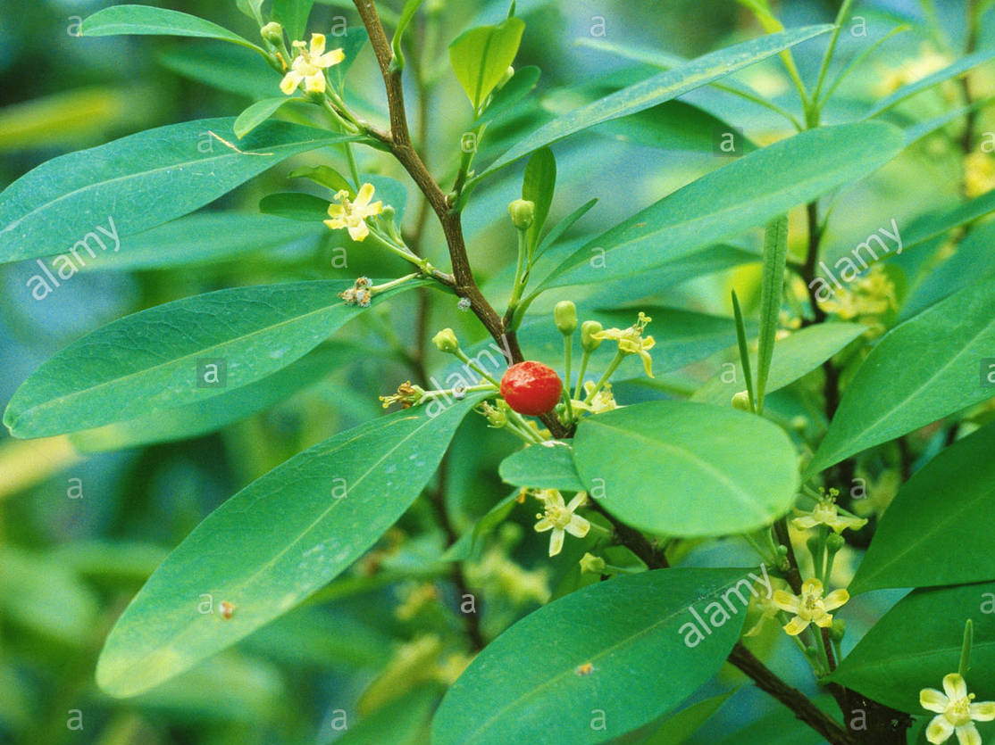
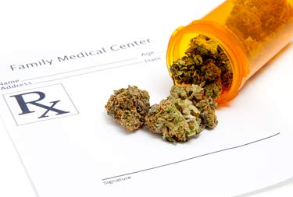
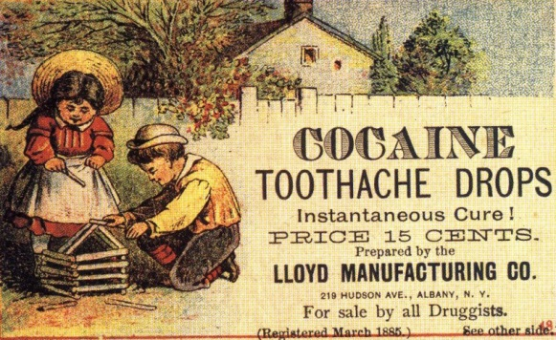
Parts of a Plant
Flower
  Reproductive organs
  Many have adapted to attract animals, such as insects or hummingbirds to aid in pollination (the sex)

Slide 20
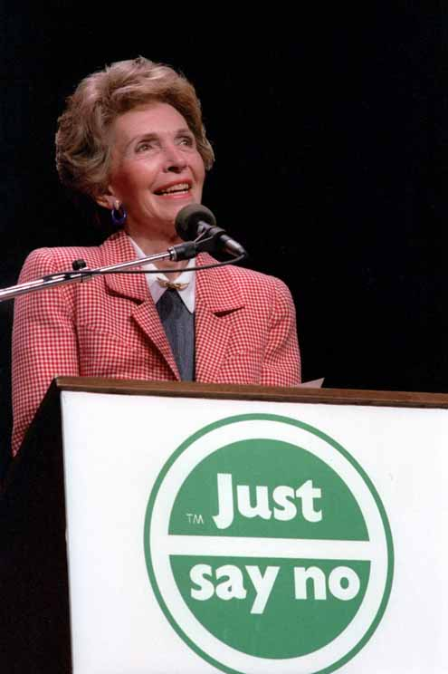

Slide 21
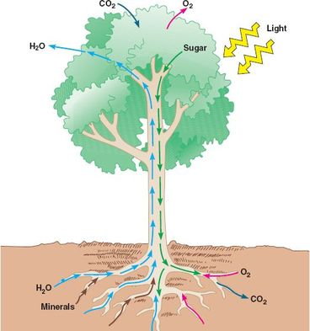
Plants are able to transport materials needed to survive primarily by:
  Transpiration
  Vascular Tissues

Slide 22
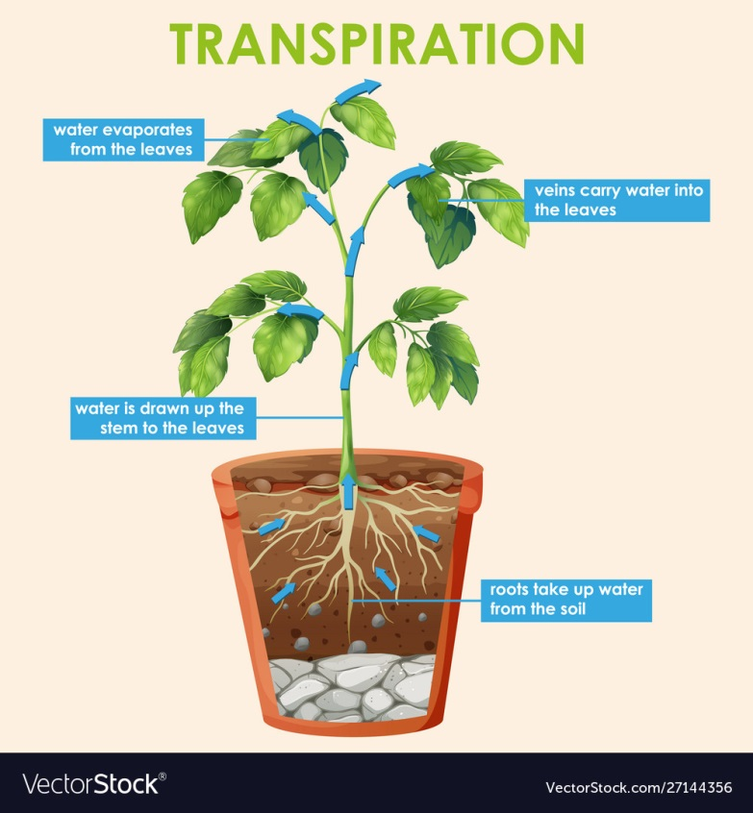
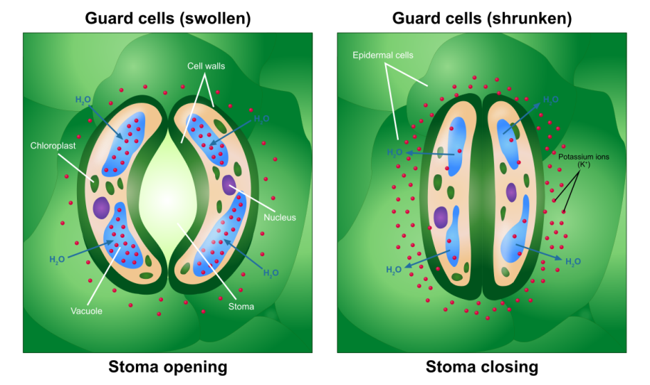
[Evaporative] Transpiration
Transpiration- process by which a plant regulates water loss through openings called stomata.
  Recall, stomata contain guard cells that regulate gas exchange.

Slide 23
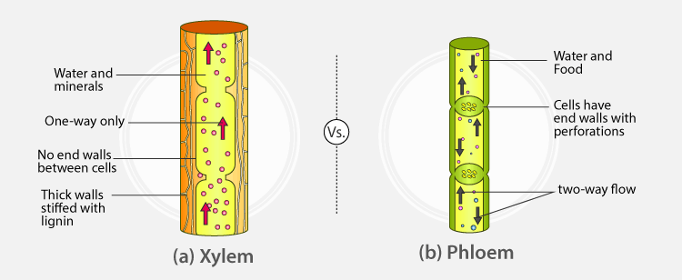
Vascular Tissue:
Xylem & Phloem
Xylem- Transports water and minerals.
Phloem- Transports water and food.

Slide 24
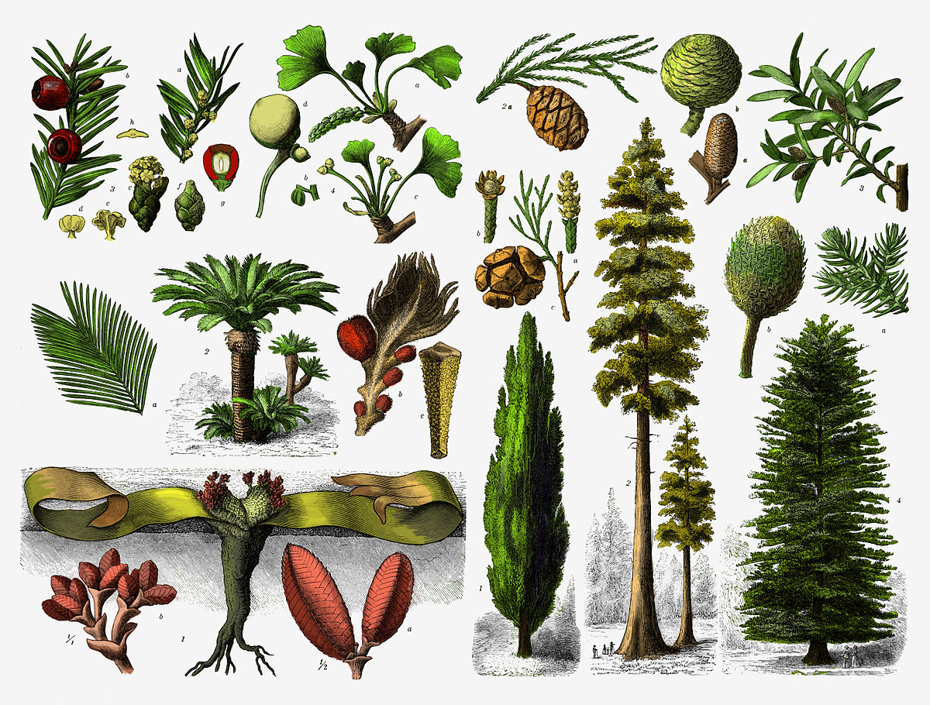
Gymnosperms vs. Angiosperms

Slide 25
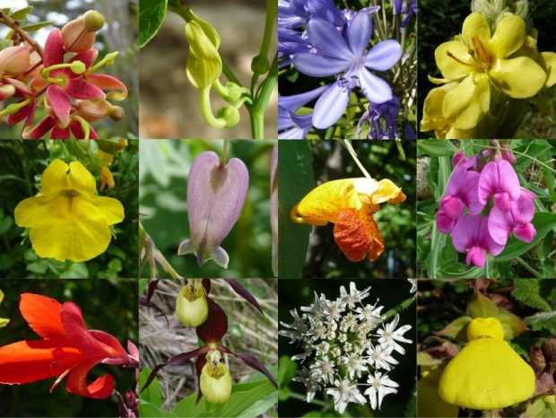
Gymnosperms vs. Angiosperms

Slide 26
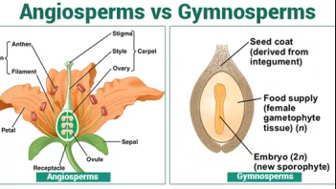
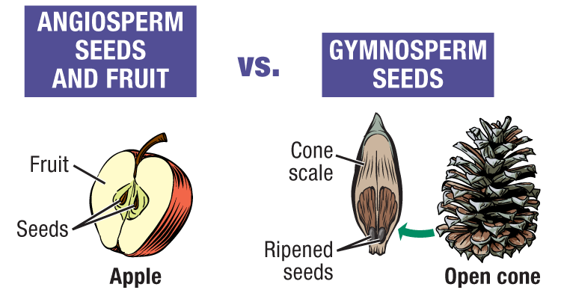
Gymnosperms vs. Angiosperms
Gymnosperms
  “naked seeds”
  Wind pollination
Angiosperms
  Covered seeds
  Wind pollination
  Animal pollination

