Slide 1
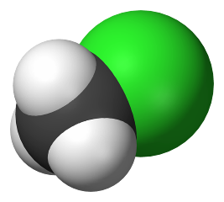
atomization: the process of breaking a molecule into
its individual atoms
H
..
..
.
.
.
..
(g)
..
H–C–Cl
..
.
C (g) + 3 H (g) + Cl (g)
.
.
..
H
methylchloride
(chloromethane)
-- ΔH for a given bond (e.g., the
C–H bond) varies little between
compounds.
CH₃Cl was once used
as a refrigerant, but it is
toxic and so is now used
primarily in the production
of silicone polymers. It is
also used as an
organic solvent.
e.g., C–H bonds in CH₄ vs. those
in CH₃CH₂CH₃ have about
the same ΔH

Slide 2
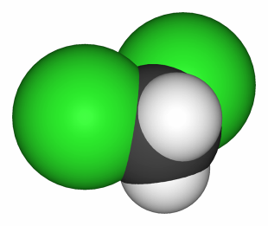
-- Typical values of bond enthalpies for specific
bonds have been tabulated.
-- To find bond enthalpy for atomization, add
up bond enthalpies for each bond broken.
Calculate the bond enthalpy for the
atomization of dichloromethane.
Cl
(i.e., break 2 C–H
bonds and
2 C–Cl bonds)
H–C–Cl
H
ΔH_{atm} = 2 (413 ^{kJ}/_{mol})
+ 2 (328 ^{kJ}/_{mol})
= 1482 kJ/mol

Slide 3

You can approximate reaction enthalpy using
Hess’s law and tabulated bond enthalpies.
ΔH_{rxn} Σ(ΔH_{broken bonds}) – Σ(ΔH_{formed bonds})
Approximate the reaction enthalpy for the combustion
of propane.
C₃H₈ + 5 O₂ 4 H₂O + 3 CO₂
H
H
H
..
..
H
..
..
..
..
..
H–C–C–C–H
O=O
H–O
..
O=C=O
..
H
H
H
..
Broken:
2 C–C: 2 (348)
–2023 kJ
8 C–H: 8 (413)
6475 kJ
5 O=O: 5 (495)
Formed:
(Actual = –2220 kJ)
8 O–H: 8 (463)
8498 kJ
6 C=O: 6 (799)

Slide 4
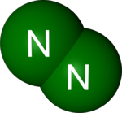
bond length: the center-to-center distance
between two bonded atoms
-- fairly constant for a given bond (e.g.,
the C–H bond), no matter the compound
e.g., C–H bonds in CH₄ are about the same length
as those in CH₃CH₂CH₃
-- Average bond lengths have been
tabulated for many bonds.
-- As the number of bonds between two atoms
increases, bond length… and bond enthalpy…
e.g., C–C C=C C–C
1.54 A
1.34 A
1.20 A
348 ^{kJ}/_{mol}
614 ^{kJ}/_{mol}
839 ^{kJ}/_{mol}

