Slide 1

George Ranch
High School
Class of 2018
&
Class of 2019

Slide 2

PRINCIPAL – Fred Black
ASSOCIATE PRINCIPAL- Greg Tielke
Grade
AP
Counselor
  9
  10
  11
  12
  Nikki Nelson
  Kevin Croft
  Kimberly Johnson
  Deborah Bible
  Latrice Patton
  Christy Tucker
  Carin Reeves
  Trudy Love
Testing Coordinator
Kyra Thomas
College & Career Facilitator
Rebecca Mobley
Registrar
Jean Abboud

Slide 3
House Bill 5 GRADUATION PLANS BEGINNING 2014-2015
House Bill 5 mandated new graduation plan for all incoming 9th grade students in 2014-2015 and in the future.
Foundation High School Program (FHSP)
Foundation High School Program + Endorsement (FHSP+)
Foundation High School Program: + Endorsements +Distinguished Level of Achievement (FHSP+DLA)

Slide 4
Foundation High School Program (FHSP)
4 credits English (English I, II, III and 1 additional credit)
3 credits mathematics (Algebra I, Geometry and 1 additional credit)
3 credits science (Biology and two additional credits)
3 credits social studies (US History, Gov’t (1/2), Eco (1/2), W. Geography or W. History)
2 credits LOTE
1 credit physical education
1 credit fine arts
5 elective credits
22 Credits to Graduate

Slide 5
Foundation High School Program + Endorsement (FHSP+)
Foundation High School Program (22 credits)
Endorsement
  Additional math credit (1)
  Additional science credit (1)
  Two additional electives (1)
Math credits must include Algebra II
26 credits to graduate

Slide 6
Distinguished Level of Achievement (DLA)
Foundation High School Program (22 credits)
Endorsement
  Additional math credit (1)
  Additional science credit (1)
  Two additional electives (2)
Math credits must include Algebra II
Required for top10% automatic college admission
(UT exception – 7% in 2014)
26 Credits to Graduate

Slide 7

STEM Endorsement
Clusters in the STEM Endorsement:
  Science, Technology, Engineering, and Mathematics
  Science Sequence requires Biology, Chemistry, & Physics (Refer to Graduation Plans Handout)
  2 Credits in Foreign Language

Slide 8
Business & Industry
Endorsement
Clusters in the Business & Industry Endorsements:
  Agriculture, Food, & Natural Resources
  Architecture & Construction
  Business Management & Administration
  Finance
  Hospitality
  Information Technology
  Marketing
  Transportation, Distribution & Logistics

Slide 9
Public Service Endorsement
Clusters in Public Service Endorsement:
  Education & Child Services
  Health Science
  Hospitality & Tourism
  Human Services
  Law, Public Safety, Corrections & Security
  4 Courses in Junior Reserve Officer Training (ROTC)

Slide 10
Arts and Humanities Endorsements
Clusters in Arts & Humanities Endorsement:
  English
  Fine Arts
  Foreign Language(LOTE)
  Social Studies

Slide 11
Multidisciplinary Studies Endorsement
Multi-disciplinary Studies Endorsement:
  A variety of advanced courses from multiple content areas including AP and dual credit
  Can include courses from the curriculum of each endorsement area

Slide 12
Endorsement Requirements for Incoming 9th Grade (Fall 2014)
Students entering 9th grade in 2014 must indicate their endorsement in writing.
Students may choose to change their endorsement area by completing the "Endorsement Change Request" form with student and parent signature. This form can be requested from the counselor.

Slide 13
9th Grade STAAR/EOC Exams
9th Graders will take the following STAAR End of Course Exams during Spring 2016:
  Algebra I (If Enrolled)
  Biology
  ELA I
10th graders will take the following STAAR End of Course Exams during the Spring 2016:
- ELA 2
- US History (If Enrolled)

Slide 14
Performance Acknowledgements
Awarded on diploma and transcript
May be earned by
  Dual credit
  Bilingualism and Biliteracy
  Outstanding performance on AP exams
  Outstanding performance on PSAT, ACT-PLAN, SAT or ACT
  Earning a nationally or internationally recognized business or industry certification or license

Slide 15
Benefits of House Bill 5 Graduation Plans
Students develop and update their 4 year plans and selection of endorsement
Students are encouraged to take courses that are most interesting to each individual student
Students are encouraged to take courses that support their post-secondary/career readiness
Create a seamless transition between high school and post-secondary/career opportunities

Slide 16
HB 5 / Graduation Plans
It is essential that each student explore the colleges they are interested in applying.
Understanding their high school course requirements for admission will help you with your course selection while in high school.

Slide 17

Class rank
Class rank
Class Rank is based on the cumulative grade point average for grades 9-12.
A student’s GPA is derived by dividing the total number of grade points by the number of semester courses attempted.
Rank comes from the registrar’s office.
Class rank will be updated after each subsequent semester.
Log in to Naviance for GPA/Class Rank

Slide 18
Weighted gpa
Level | Weight
AP | 1.3
PAP/DUAL | 1.2
ADV. ACADEMIC | 1.1

Slide 19
credits
Credits
0-5
5.5-11.5
Classification
Freshman
Grade
9
10
11
12
12-18.5
19-above
Sophomore
Junior
Senior

Slide 20
Course Selection for 2016-2017 will Take Place in the
SPRING SEMESTER

Slide 21

Please Access the GRHS WEBSITE to stay up to date on all GRHS Activities and Programs
http://www.lcisd.org/campuses/georgeranchhs

Slide 22

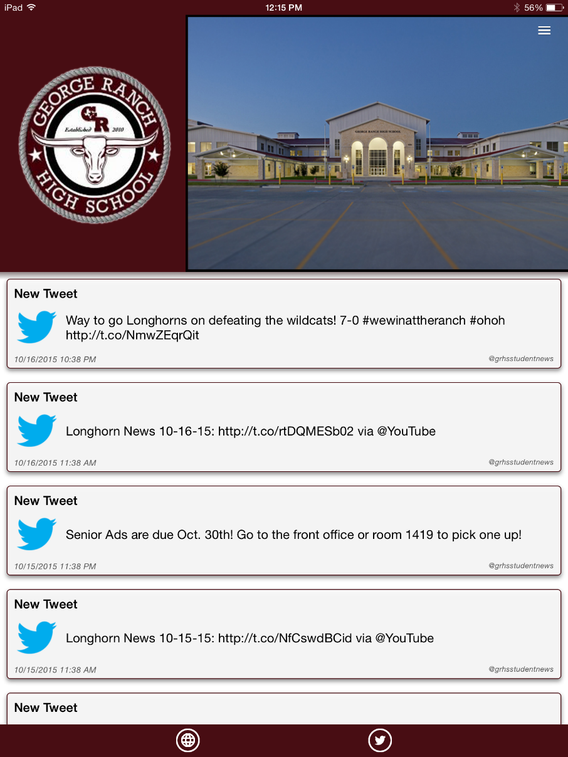
SCHOOL INFO APP

