Slide 1
Course Selection Night
Welcome to the 2024 Course Selection Night

Slide 2
Tonight’s Agenda
General Session:
  Course Selection Information
  Endorsements and Programs of Study Overview
  Advanced Academics Overview
  Career and College Planning Resources [SchooLinks] Intro
  Dismissal to Workshop Sessions
Wanting more information? Please attend this evening’s workshop sessions:
  Programs of Study and CTE: Room
  Dual Credit: Room
  Advanced Academics (PAP, Pre-AP, AP, OnRamps): Room
  College and Career Planning (College Board, Khan Academy, SchooLinks): Room
  Explore courses, contents, clubs, etc.: Hallways
  Counselor Corner (endorsements, graduation plans, course selection): Room
Notes:
Add rooms and any additional sessions/topics as desired [by campus]

Slide 3
[Add Admin Crew]
Notes:
Add Admin info and pics

Slide 4
[Add Counselor and CCF Crew]
Notes:
Add Counselor and CCF Names, Alphas, pics., additional roles, etc.

Slide 5
Course Selection
Information:
For Additional Information Please See Counselor Corner, directly after the General Session

Slide 6

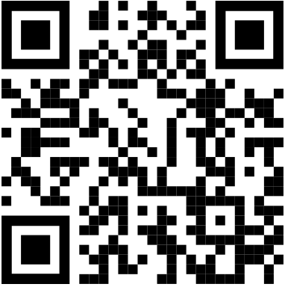
Course Selection Overview
High School Timeline:
Course Selection in Skyward through “Career Plans” begins Tuesday, January 17th and closes at 5:00 p.m. Friday, February 3rd.
Course Verification through Student one-on-ones begins Monday, February 6th and ends Friday, March 31st.
Course Selection Catalog
Notes:
Update dates and campus specific info

Slide 7
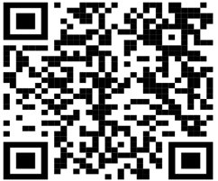
Career Plan/Skyward
Informational Video:
The district Career Plan templates are intended to serve as a guide to families when planning for graduation. All courses except the required Endorsement course can be changed to accommodate academic level and interest.
Written instructions can be found on each campus website under Counselor Corner. Look for
Career Plan Course Selection Instructions.
The QR Code will take families to an informational step-by-step video on how to complete the process. This too will be available on each campus website under Counselors Corner.
All choices will be verified and double checked by your child's counselor during the
course verification process to make sure they have the correct classes for that year.
We are here to help! This is a very exciting time and LCISD has some amazing options
for your student.

Slide 8
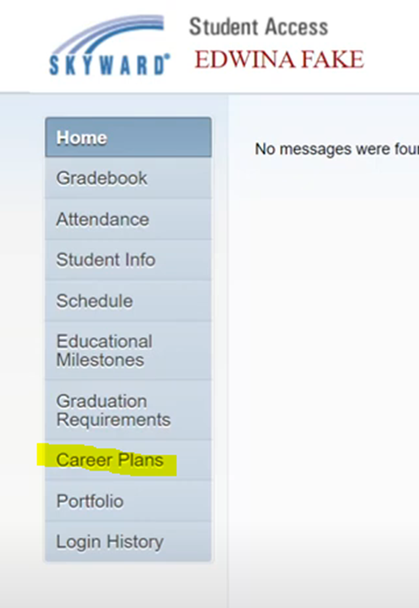


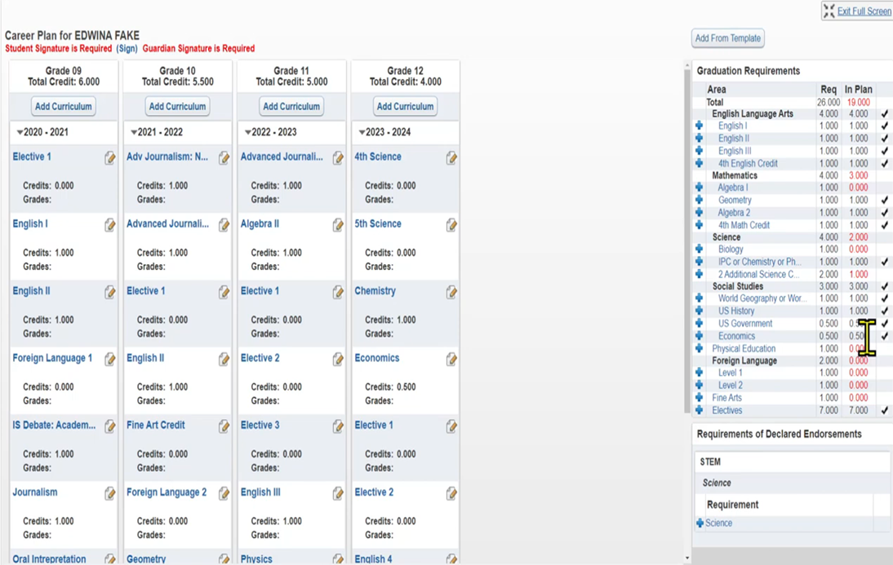

Slide 9
Endorsements and Programs of Study
Overview:
For Additional Information Please Attend Workshop Session, directly after the General Session

Slide 10
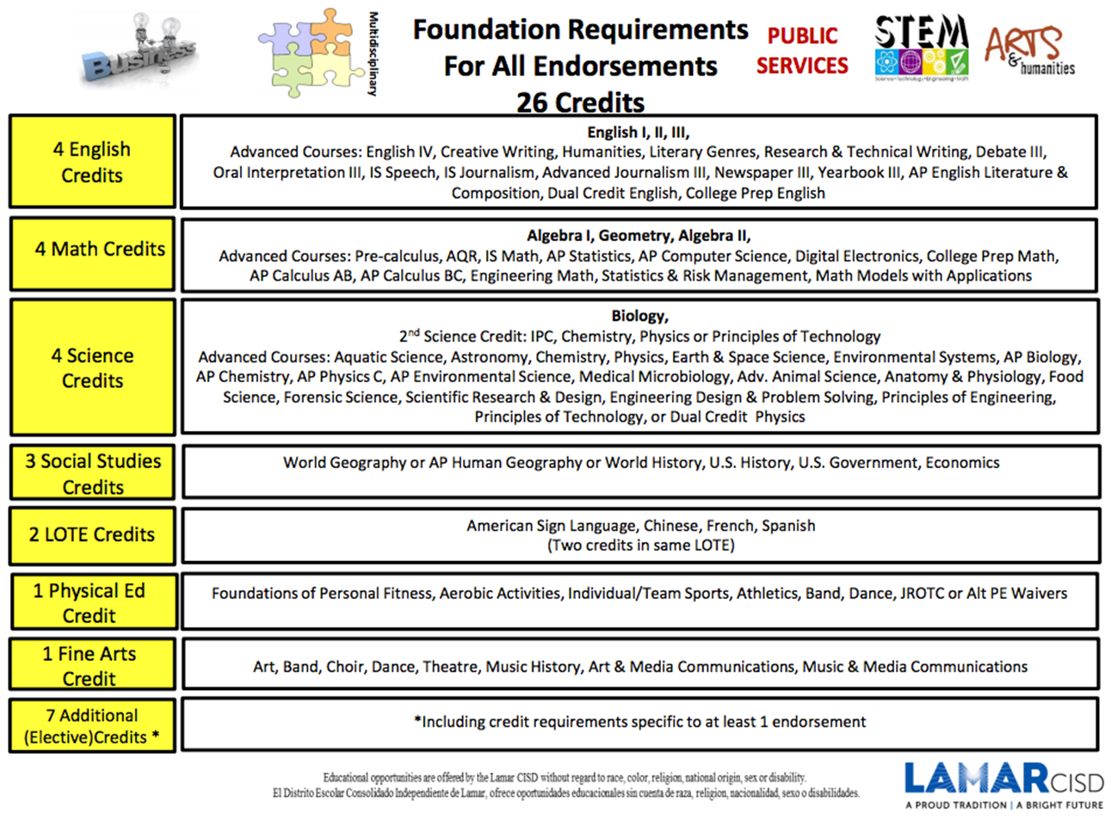

Slide 11
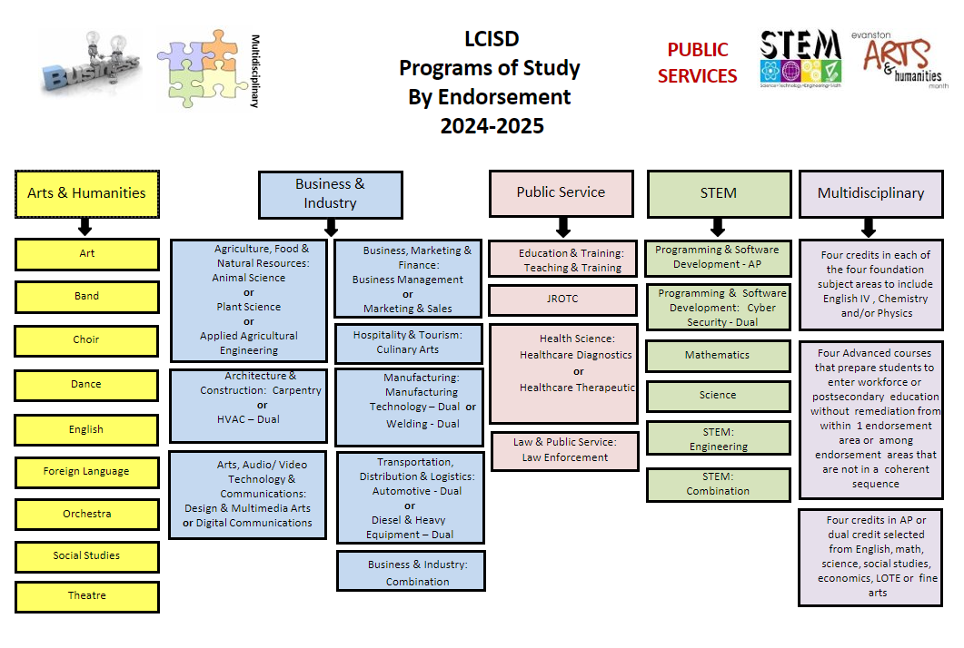

Slide 12

Programs of Study by Endorsement
Arts & Humanities
English
&
Social Studies
Fine Arts
LOTE
Notes:
•Languages Other Than English (LOTE):
4 levels of the same language in a LOTE OR
2 levels of the same language in a LOTE and 2 levels of a different language in a LOTE (ex. ASL 1, ASL 2, French 1, French 2)
•Fine Arts:
4 credits from 1 or 2 categories in Fine Arts (Art, Band, Choir, Dance, or Theatre)
•English:
3 English elective credits in addition to the 4 required credits (ex. Creative Writing, Literary Genres, Humanities)
•Social Studies:
2 Social Studies elective credits in addition to the 3 required credits

Slide 13



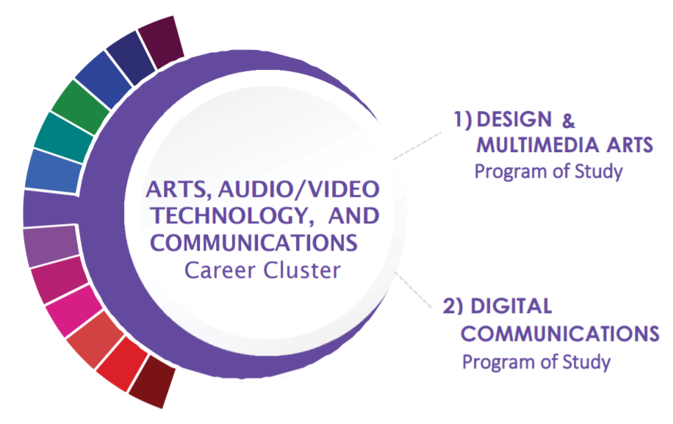
Programs of Study by Endorsement
Business & Industry
Notes:
•Career and Technical Education (CTE):
There are many different pathway choices
4 elective credits from the pathway of your choice such as Animal Science, Welding, Business Marketing, Culinary Arts, etc.
•English:
3 English elective credits in Broadcast Journalism, Newspaper, Yearbook, or Debate

Slide 14



Programs of Study by Endorsement
Business & Industry
Notes:
Kayse

Slide 15


Programs of Study by Endorsement
Public Service
Notes:
•Career and Technical Education (CTE):
• Pathway options include:
•Education and Training
•Health Science
•Law Enforcement (not currently offered on campus)
•JROTC (bus to Lamar)

Slide 16
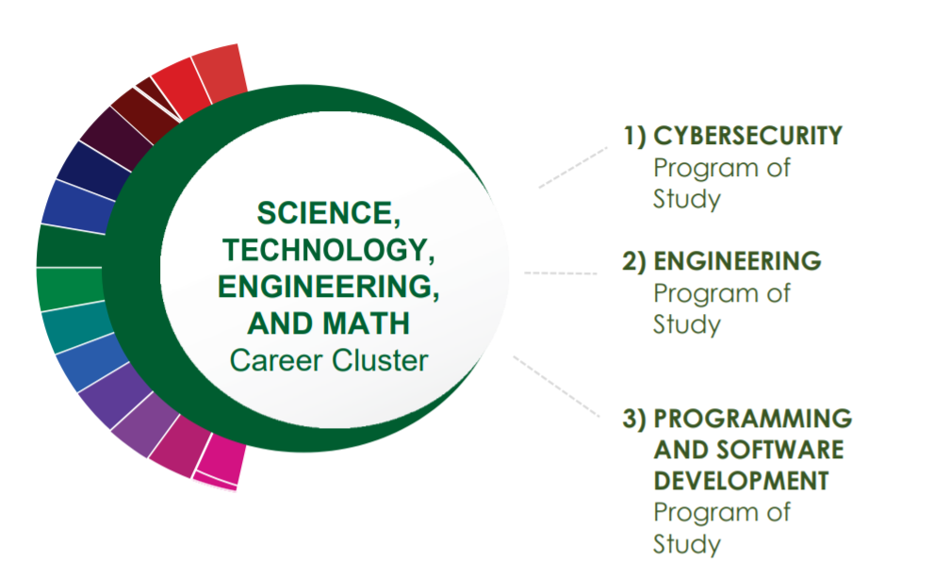
Programs of Study by Endorsement
STEM
Notes:
IMPORTANT: Algebra 2, Chemistry and Physics are required
•Engineering (Project Lead the Way):
4 course sequence
•Programming & Software Development
Computer Science
•Math:
A total of 5 credits in math
Must include Algebra I, Geometry, Algebra II, and 2 additional math courses for which Algebra II is a prerequisite
•Science:
A total of 5 credits in science
Must include Biology, Chemistry, Physics, and 2 additional science course

Slide 17
Programs of Study by Endorsement
Multidisciplinary
Advanced Courses:
4 advanced courses (3rd or 4th course in a pathway) from within one or more endorsement areas
Four by Four:
Four courses in each of the four foundation subjects
English (must include English IV)
Math
Science (must include Chemistry or Physics)
Social Studies
AP or Dual Credit:
4 total credits of AP or Dual Credit courses from English, Math, Science, Social Studies, Economics, LOTE, or Fine Arts

Slide 18
Endorsements MIPs (Most Important Points and Recommendations)
Recommendations, FAQs)
Notes:
Kayse and Roberts

Slide 19
Need More Info?
Counselor Corner Room:
Counselor Corner and Resources
Notes:
Add Website, resources, room for following workshop

Slide 20
Advanced Academics
Overview:
For Additional Information Please Attend Workshop Session(s), directly after the General Session

Slide 21

Advanced Academics
Advanced Placement (AP)
1.3 Multiplier
College Credit based on exam score
HS gradebook only
Grades 9-12
Dual Credit and Dual Enrollment
1.3 Multiplier
College credit based upon college grade
HS and College Gradebooks
Grades 11-12
Pre-AP and PAP
1.2 Multiplier
No college credit
College Board Pre-AP Algebra I
PAP are Pre-Advanced Academics courses (non-College Board)
Grades 6-12
*for campus specific course questions please visit the Counselor Corner during workshops

Slide 22
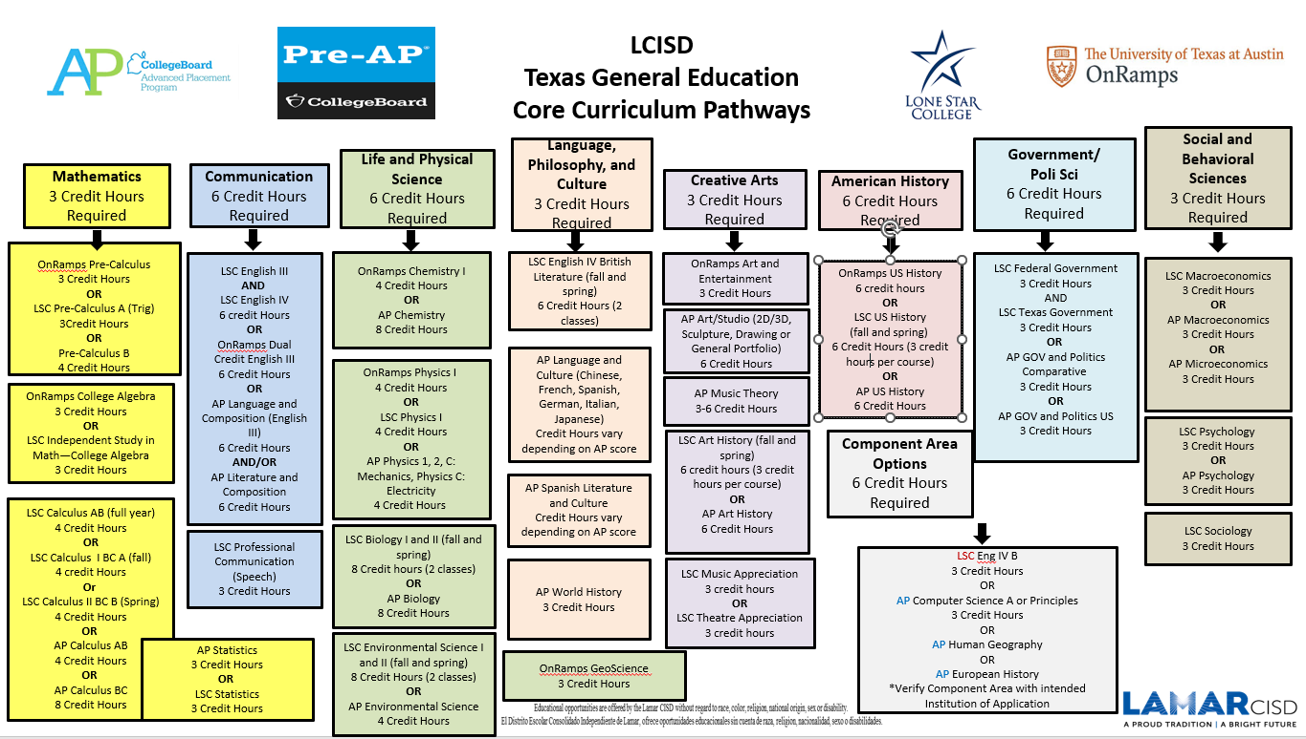
Notes:
Pathways to be discussed in workshop and just note that this can be found in the course guide (Advanced Academics Section)

Slide 23
Join us in workshops for additional information.
Dual Credit
AP, Pre-AP, PAP
Workshop Room:
Workshop Room:
Notes:
Add Workshop Room Numbers

Slide 24
SchooLinks
College and Career Planning Resources:
For Additional Information Please See Counselor Corner, directly after the General Session

Slide 25

Need Additional College and Career Readiness Information?
Workshop with College and Career Facilitator: Room
Assistance with SchooLinks, College Applications, Khan Academy and College Board, and much more.

Slide 26
SchooLinks
•LCISD’s College and Career Exploration Tool for grades 6-12
•It is a modern College & Career Readiness platform with over 80 experiences such as career interest inventory assessments, college and career search, internship matching, portfolio, scholarships and more
•This can be accessed through the student’s Class Link account.
College and Career Readiness Platform

Slide 27
Workshops:
CTE Workshop:
Room:
Learn more about the numerous courses within Lamar CISD's Programs of Study.
Dual Credit:
Room:
Learn about enrollment, courses offered, and the benefits of Dual Credit Programming
Advanced Academics:
Room:
Learn about courses, exams, and the benefits of Advanced Placement courses.
Counselor Corner:
Room:
Get your endorsement and course selection, as well as graduation planning
questions answered.

Slide 28
Workshops:
[add]:

Slide 29
Also, visit with teacher, clubs, and much more...
[add pictures from last year or list]
Notes:
Add Counselor and CCF Names, Alphas, pics., additional roles, etc.

Slide 30
Course Selection Night
Thank you!

