Slide 2
College and Career Information
Mary Saville
College and Career Facilitator | AP Testing Coordinator

Slide 3
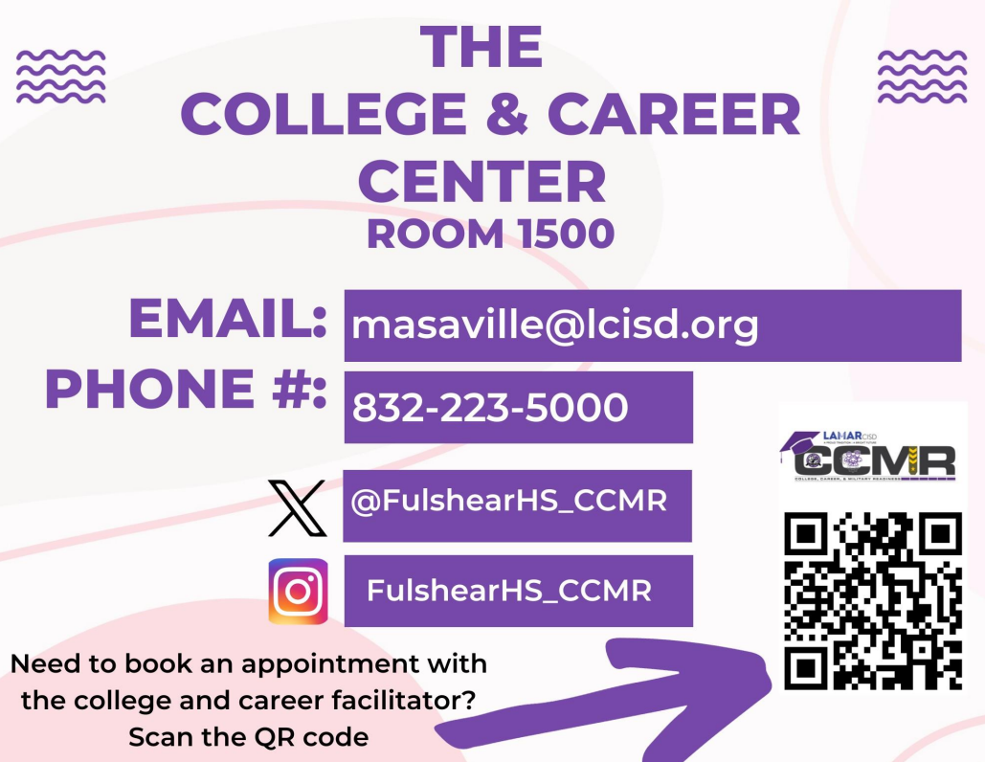


Slide 4

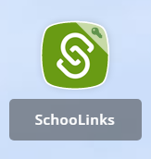
SchooLinks
What is SchooLinks?
How do I access SchooLinks?
SchooLinks is a college and career readiness platform with curriculum that engages students throughout the process of self discovery, career education, and college planning and application.
Go to our district website: www.lcisd.org
In the upper left-hand corner, click on ClassLink.
Once you have logged into ClassLink, you will find the SchooLinks icon and click it to log in.

Slide 5
SchooLinks
What do I use SchooLinks for?
Assessments to determine learning style(s), help students “find their path,” social/emotional learning, etc.
Career research/Career center
College search tool
Scholarship matching
College financing tool
Requesting college application materials
  Letters of recommendations
  Transcript requests
Tracking Service Cord hours
All grade levels should be logging into SchoolLinks on a regular basis!
Parents can request an access code to be able to create their own SchoolLinks account to view their student’s progress in SchoolLinks.

Slide 6
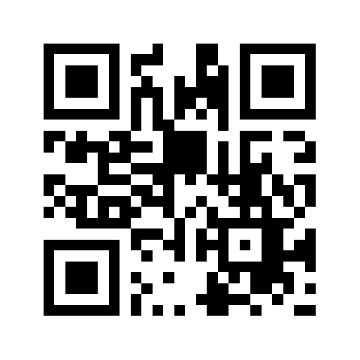
College Board
PSAT/SAT
Advanced Placement Courses
PSAT: Pre-liminary SAT
PSAT/NMSQT: Pre-liminary SAT/National Merit Scholarship Qualifier Test
SAT: The SAT is a globally recognized college admission test that lets you show colleges what you know and how well you can apply that knowledge. A student who takes the SAT can expect a test of reading, writing and math comprehension.
The AP Program offers college-level courses and exams that you can take in high school.
Your AP score could earn you college credits before you even set foot on campus. In fact, most AP students who enroll in four-year colleges start school with some credit.
Source: https://satsuite.collegeboard.org/sat?navId=www-sat and https://apstudents.collegeboard.org/what-is-ap

Slide 7
Khan Academy
Official SAT Practice that will create a tailored practice plan for you/your student based on a diagnostic or your SAT or PSAT/NMSQT® scores and will allow you/your student to get constant feedback and progress.
Khan Academy research suggests three best practices associated with substantial improvements in SAT scores: leveling up skills, taking a full-length practice test, and following personalized practice recommendations. Students who used Official SAT Practice for six or more hours and followed at least one best practice scored 39 points higher than students who did not use Official SAT Practice.
Visit SATpractice.org
Source: https://www.khanacademy.org/SAT

Slide 8
Service Cord
What is Service Cord?
Students who earn a specific number of district approved volunteer hours from freshman to senior year earn a white service cord to wear at graduation
Class of 2024- 100 hours (COVID waiver)
Class of 2025- 160 hours
Class of 2026- 160 hours
Class of 2027 – 160 hours
Where to find volunteer opportunities?
SchooLinks
SchooLinks messages, and CCMR social media pages for service cord approved volunteer opportunities
Source: https://www.lcisd.org/docs/default-source/students-parents-documents/choices/service-cord.pdf?sfvrsn=32bc1fe0_6

Slide 9
Service Cord
Students must follow service cord guidelines and deadlines. Hours must be entered into SchooLinks and approved by the volunteer supervisor prior to deadline.
Hours entered after the deadline will automatically be denied.
Service Cord Guidelines are available
  LCISD website
  Fulshear CCMR website
Source: https://www.lcisd.org/docs/default-source/students-parents-documents/choices/service-cord.pdf?sfvrsn=32bc1fe0_6

Slide 10
Service Cord Deadlines
September 15 | Hours served after May 1st- September 14th are considered "summer hours" and must be entered, AND VERIFIED by supervisor, by September 15 of the following school year, for approval.
December 15 | All hours completed between September 15th – December 14th must be entered, AND VERIFIED by supervisor, by December 15th, for approval.
April 15- Seniors Only | Senior year service hours completed from December 15th through April 14th must be submitted, AND VERIFIED by supervisor, by April 15th, for approval. Any hours submitted or verified after April 15th will not be considered.
May 1 | All hours completed from December 15th through April 30th must be Submitted, AND VERIFIED, by no later than May 1st.
Hours should not be retroactively entered (e.g., seniors entering hours from freshman year—this is due to the bookkeeping and verification requirements of the supervisor or supervising agency) and will not be approved.
Source: https://www.lcisd.org/docs/default-source/students-parents-documents/choices/service-cord.pdf?sfvrsn=32bc1fe0_6

