Slide 1
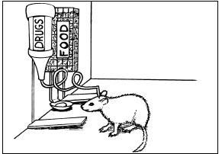
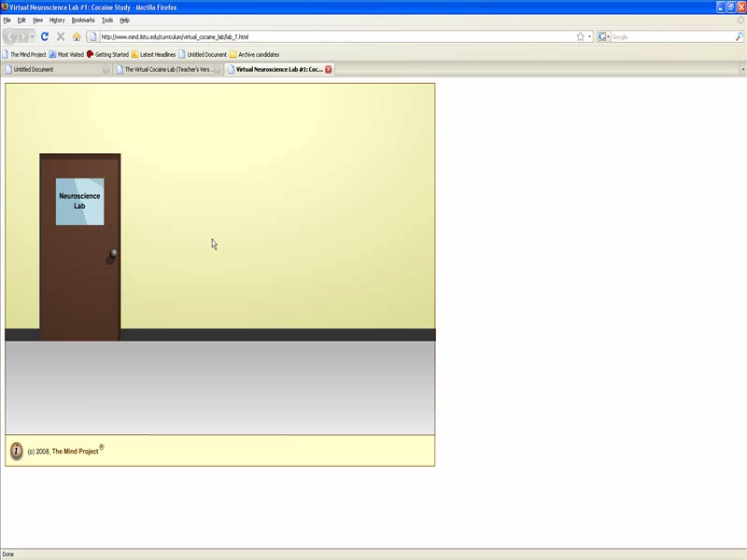
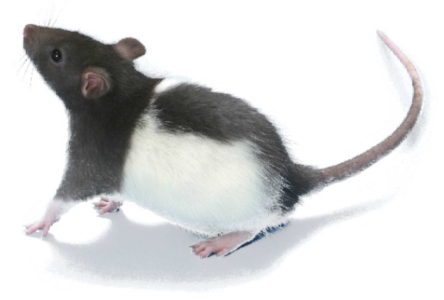
Neurological Disorders
Lesson 5.4
How is dopamine involved in addictive behaviors?

Slide 2
Do Now
Review last night’s homework with a partner.
  What hypothesis is this experiment testing?
  If the hypothesis is true, what should you observe?

Slide 3
Virtual Cocaine Lab
Notes:
If you are having difficulties playing this video through the PowerPoint slide, you can access it online at: http://sites.tufts.edu/greatdiseases/modules/neurological-disease/multimedia-backup/

Slide 4
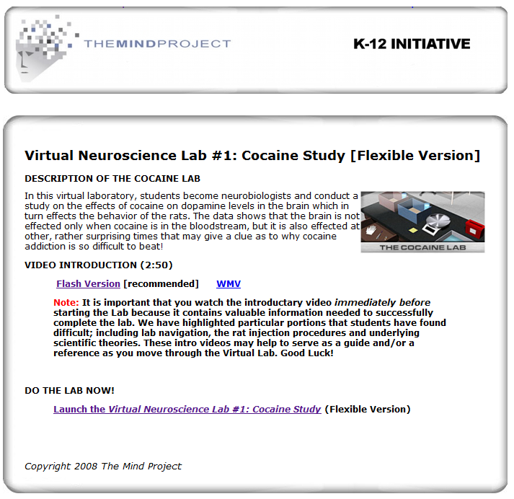

Slide 5
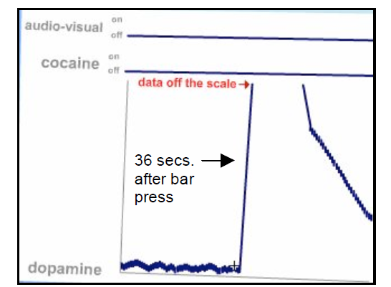
Let’s Look at the Data
This graph represents the time AFTER receiving cocaine. What phase of behavior is that?
The Consummatory Phase
What does this graph show?
Notes:
Dopamine levels rise very rapidly and substantially after a bar press and cocaine reward was administered.
Dopamine levels returned to normal after a rapid then gradual decrease over approximately 10 seconds.

Slide 6
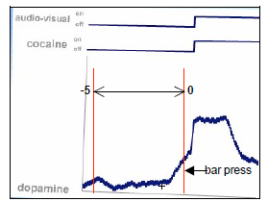
Let’s Look at the Data
This graph represents the time BEFORE receiving cocaine. What phase of behavior is that?
The Appetitive Phase
What does this graph show?
Notes:
Dopamine levels rise very rapidly and substantially after a bar press and cocaine reward was administered.
Dopamine levels returned to normal after a rapid then gradual decrease over approximately 10 seconds.

