Slide 1
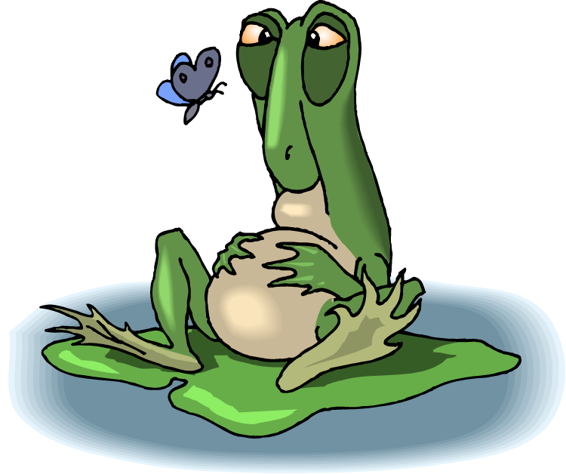
Homeostasis gone awry – How does the satiety pathway relate to obesity?
Metabolic Diseases
Lesson 3.5

Slide 2
Do Now
How do we know when to eat and when to stop eating?
Can we re-balance homeostasis to lose weight?

Slide 3
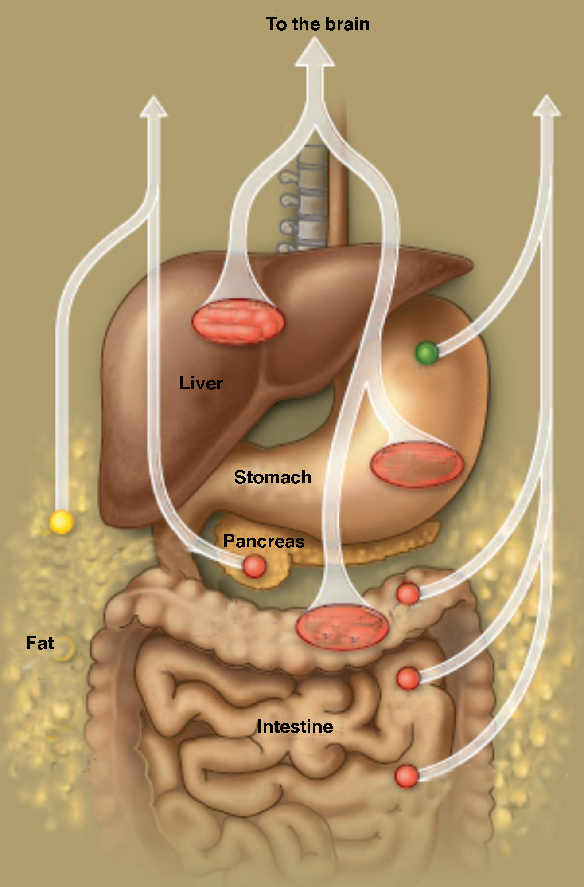
Hunger and Satiety signals to the brain
Hunger:
Ghrelin
Satiety:
Status of intestines and liver
Hormones
  Insulin
  Leptin
  Peptides (PYY, CCK)
nutrients
Grehlin
distention
Leptin
PYY
Insulin
distention
CCK
CCK
Notes:
There are many signals from the periphery that play a role in signaling energy needs. Ghrelin is a hormone secreted by the stomach in anticipation of food and is associated with hunger.
Insulin and glucose spike in the blood after eating a meal and signal fullness.
The adipose tissue itself secretes a hormone called leptin. The amount of leptin secreted increases with more fat stores and therefore reflects the amount of energy stores available.

Slide 4
Let’s discuss:
Long-term persistence of hormonal adaptations to weight loss
Question:
  What is the main question of the paper?
Method:
  How do they investigate this question?
Data:
  Each figure has its own Q,M,D,C
Conclusion:
  What conclusions can you make based on the data?

Slide 5
Let’s discuss:
Long-term persistence of hormonal adaptations to weight loss
Break into groups and prepare to present one of the first eight questions from the worksheet.
(10 minutes)
Question nine will be discussed as a class!

Slide 6
Question 1:
What is the main question that the authors are asking?

Slide 7
Question 2:
What methods did the authors choose to address the about question?
Who and what do they measure?

Slide 8
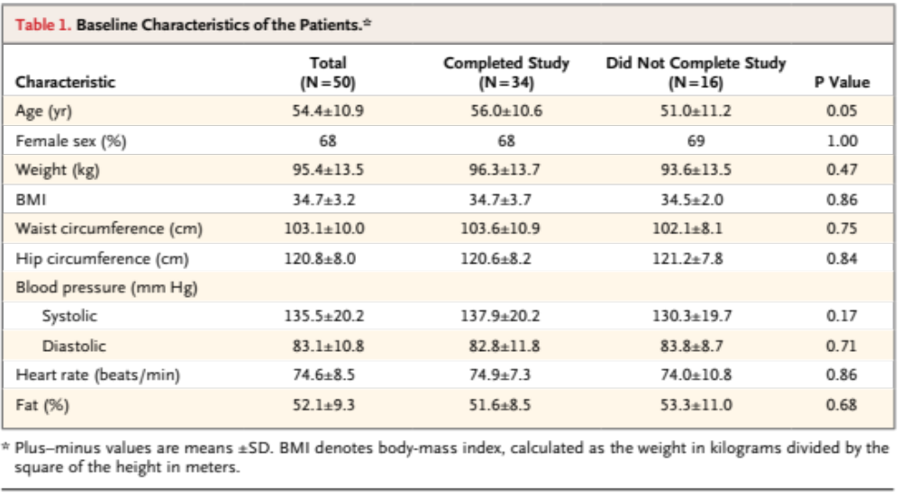
Question 3: Table 1

Slide 9
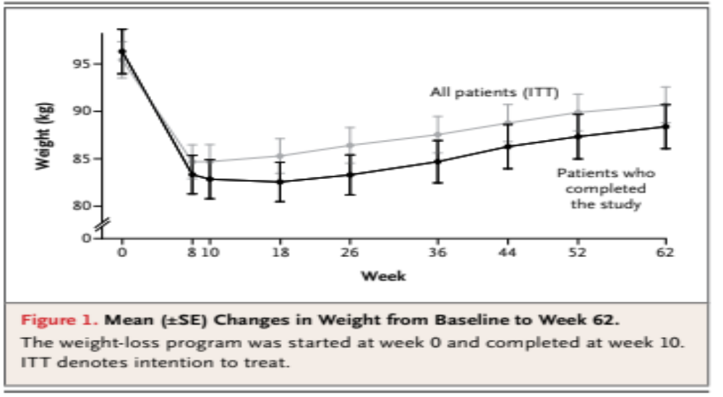
Question 4: Figure 1

Slide 10
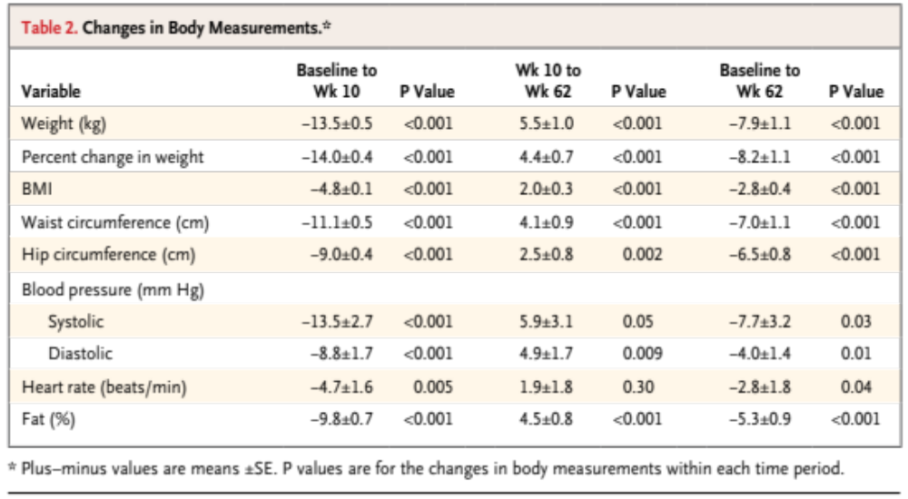
Question 5: Table 2

Slide 11
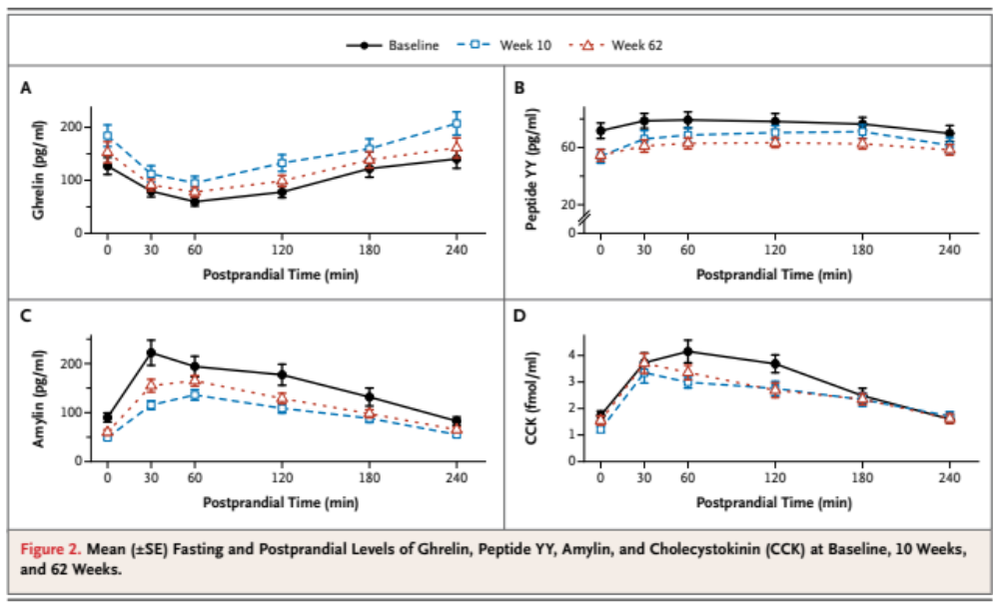
Question 6: Figure 2

Slide 12
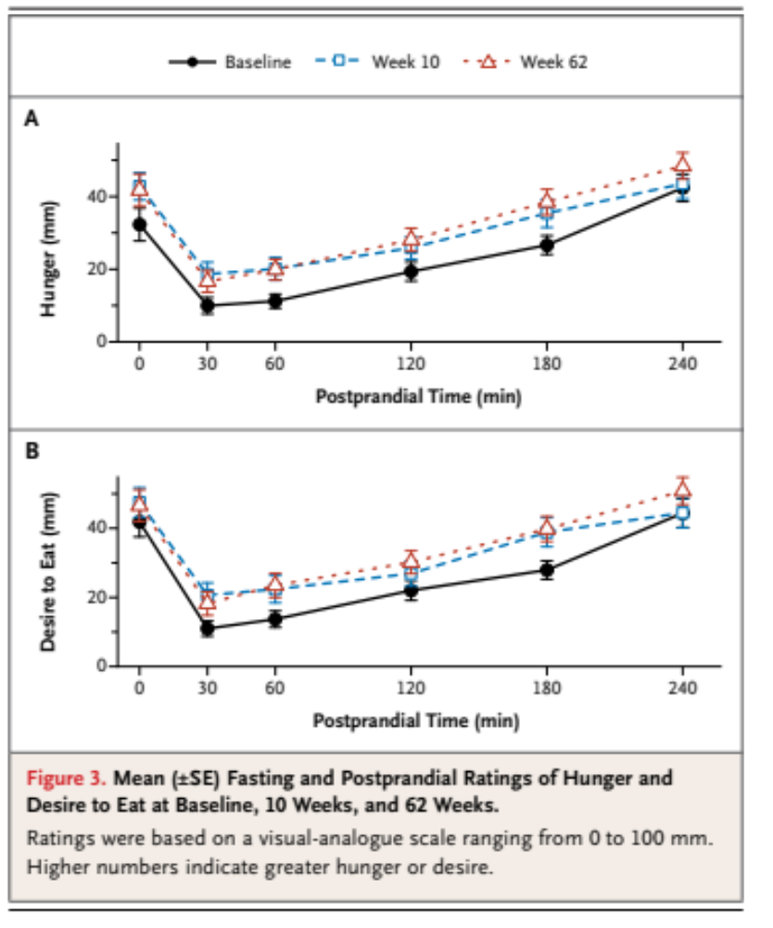
Question 7: Figure 3

Slide 13
Question 8:
What conclusions can we draw from this paper?
What are the implications for obese individuals trying to lose weight?

Slide 14
Question 9:
What did the paper leave unresolved?
Are there alternative explanations for the findings that might limit your conclusions?
What methods would you use to resolve this?

Slide 15
Wrap Up
These signals regulate our urges to eat, how might they contribute to developing obesity?

Slide 16
Homework
Complete the Lesson 3.5 Worksheet

