Slide 1
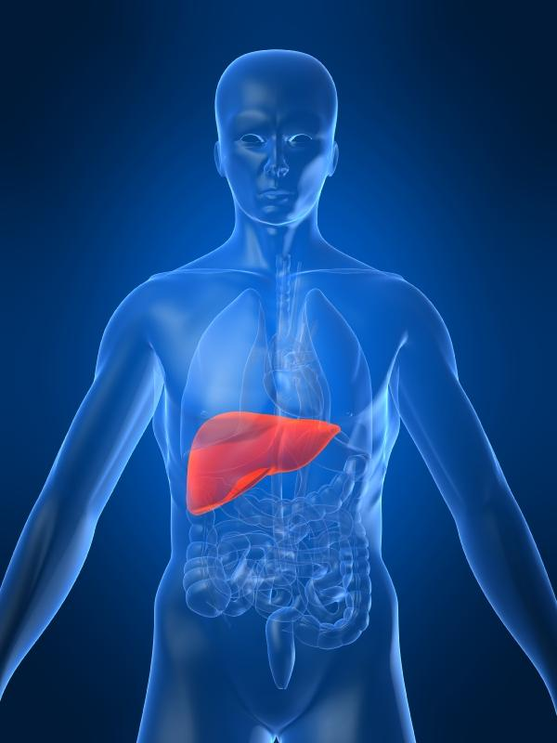
Metabolic Diseases
Lesson 2.3
Glucose homeostasis in the blood – Part 2

Slide 2
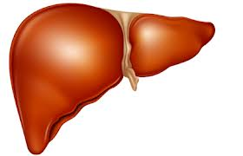
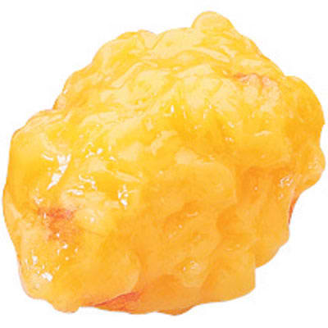
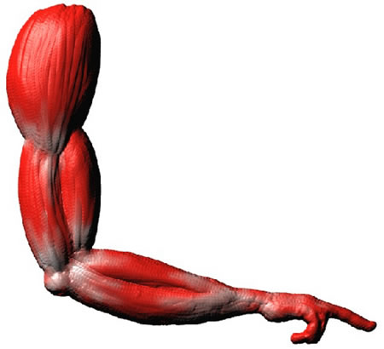
Do Now:homeostasis
Which of these pathways are activated when blood glucose is high? When it is low?
Glycogen
Protein
Triglycerides
Glucose
Amino Acids
Fatty Acids
Citric Acid Cycle
NADH & FADH₂ for the electron transport chain

Slide 3
Do Now:
Low Blood Glucose
Glycogen
Protein
Triglycerides
Glucose
Amino Acids
Fatty Acids
Citric Acid Cycle
NADH & FADH₂ for the electron transport chain

Slide 4
Do Now:
High Blood Glucose
Glycogen
Protein
Triglycerides
Glucose
Amino Acids
Fatty Acids
Citric Acid Cycle
NADH & FADH₂ for the electron transport chain

Slide 5

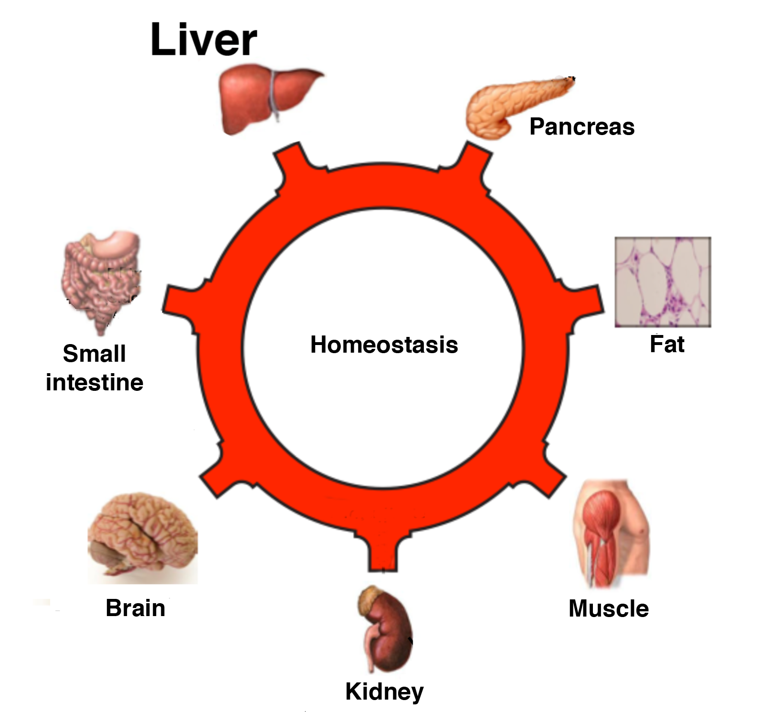
What organs are involved in energy metabolism?
Where do the metabolic pathways happen?

Slide 6
The liver is the MASTER REGULATOR:
It stores and un-stores energy, and makes new glucose
Glucose
Glucose
Adipose
stores fat
Glycogen
Protein

Slide 7
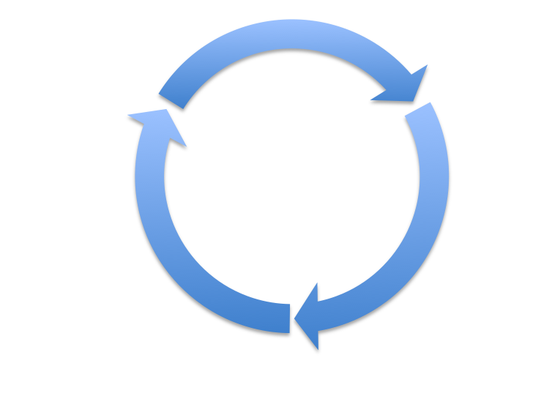
Storing extra glucose –
It starts in the liver
Glucose
Acetyl CoA
Glycogen
Acetyl CoA is the branch point between glycolysis and lipogenesis. It is a form in which energy is stored and is made from carbons and vitamin B.
Citric Acid
Cycle

Slide 8
Storing extra glucose –
The muscle stores glucose to use later
Glycogen
After exercise - A.A. are used for repair and building new muscle.
No exercise – A.A. are stored in “pools”. Once the pools are full, A.A. are either converted into fat or broken down and excreted.
Glucose
Glucose
Protein
Acetyl CoA
Glycogen
Citric Acid
Cycle
*We typically only have enough glycogen in the liver and muscles for about 18-24 hours.
Amino acids

Slide 9
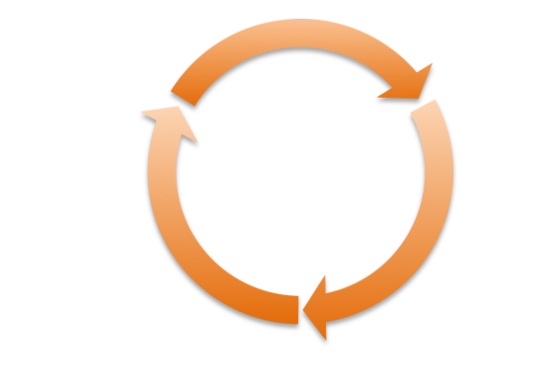
Storing extra glucose –
Extra glucose is stored as fat (lipogenesis)
We have unlimited fat storage!
Glucose
Adipose
stores fat
Triglyceride
Acetyl CoA
Lipogenesis
Makes
fat
Citric Acid
Cycle
If the body has enough ATP, excess Acetyl CoA can be used to make fat

Slide 10
Putting it all together
Storing Energy
Glycogen
Glucose
Adipose
stores fat
Glucose
Triglyceride
Protein
Acetyl CoA
Lipogenesis
Makes
fat
Glycogen
Citric Acid
Cycle
Amino acids

Slide 11
The liver is the MASTER REGULATOR:
it un-stores energy and makes new glucose
Amino
Acids
Glucose
Glycogen
Fatty Acids
Adipose
stores fat
The liver is the only organ that can release glucose into the blood!

Slide 12
Un-storing glucose:
1. Glycogen is used first! (~24 hours)
Glycogen
Glucose
Glucose
Acetyl CoA
Glycogen
Citric Acid
Cycle
Remember, glucose stored in the muscles can only be used in that muscle!

Slide 13
When glycogen is running low (fasting):
2. Amino acids are used for gluconeogenesis & energy
Glycogen
Glucose
Protein
Glucose
* This stage ends when the supply of free amino acids run out (several days) or else you start digesting your own organs!
Acetyl CoA
Glycogen
Citric Acid
Cycle
Gluconeogenesis
Amino acids

Slide 14
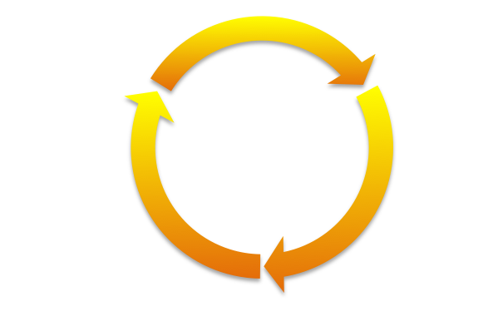
2. Lipolysis creates Acetyl CoA (happens at the same time as gluconeogenesis)
Glycogen
Adipose
stores fat
Glucose
Protein
Glucose
Triglyceride
Acetyl CoA
Glycogen
Citric Acid
Cycle
Lipolysis
breaks
down fat
Amino acids

Slide 15
3. After several days of fasting we rely solely on the adipose!
When all free amino acids are finally gone, fatty acids are converted into ketones (glucose-like) = ketogenesis
*brain and blood can use ketones just like glucose)
Adipose
stores fat
Triglyceride
Ketones
Citric Acid
Cycle
Lipolysis
breaks
down fat

Slide 16
Putting it all together
Un-Storing Energy
Stage 1 -
Glycogen
Adipose
stores fat
Glucose
Protein
Glucose
Triglyceride
Stage 1 -
Glycogen
Acetyl CoA
Citric Acid
Cycle
Stage 2
*Gluconeogenesis
*Lipolysis
breaks
down fat
Stage 2
Amino acids
* = must run together

Slide 17
Worksheet 2.4
Directions - Work in small groups to draw arrows into the figures on the first page. Describe the processes of storing energy and un-storing energy.
Notes:
If there is time have students work on the first page of the worksheet. If you run out of time assign this as homework.

Slide 18
Wrap Up:
Storing Energy
Glycogen
Glucose
Adipose
stores fat
Glucose
Triglyceride
Protein
Acetyl CoA
Lipogenesis
Makes
fat
Glycogen
Citric Acid
Cycle
Amino acids

Slide 19
Wrap Up:
Un-Storing Energy
Glycogen
Adipose
stores fat
Glucose
Protein
Glucose
Triglyceride
Acetyl CoA
Glycogen
Citric Acid
Cycle
Lipolysis
breaks
down fat
Amino acids

Slide 20
Homework
Complete/revise your work on the worksheet.

