Slide 1
Do Gut Bacteria Play a Role in Obesity?
Metabolic Disease
Case Study 2

Slide 2
Learning Objectives
  At the end of today’s lesson, you will be able to:
  Analyze and interpret data relating to the role of gut bacteria in obesity.
  Articulate advantages and disadvantages of using a mouse model to study human obesity.
  Construct an explanation for how gut bacterial composition could affect energy use, leading to change in weight.

Slide 3
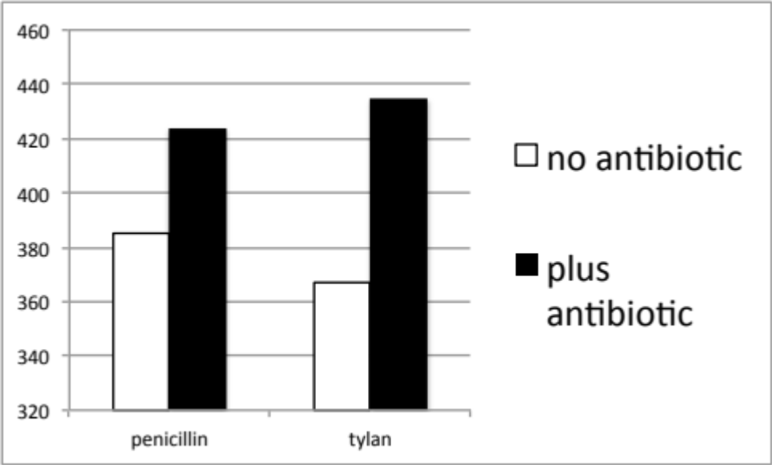
Do now:
What can you conclude from this graph?
Method: Antibiotic was included in the feed of chicks from birth to 3 weeks of age
Weight of Broiler Chicks at 3 weeks
Weight (g)
penicillin
tylan
Antibiotics
Source: Dafwang, Bird and Sunde (1984) Poultry Science 63:1027-1032.

Slide 4
How might antibiotic treatment lead to weight gain? Think of as many possibilities as you can!
Did the antibiotic change the chickens eating habits?
Did the antibiotic change the bacteria in or on the chickens?
Were the antibiotic’s effects on weight independent of their antibacterial effects?

Slide 5
We have trillions of bacteria living in our gut representing about 1,000 different species
The composition varies according to where you live, what you eat, your age and other factors!
Different ratios of bacterial types are seen in:
  People who have undergone treatment with antibiotics
  Breastfed vs. formula fed babies
  Older vs. younger people
  Vegans vs. carnivores
  Obese vs. lean individuals
Are the bacteria more than bystanders that reflect our living habits?

Slide 6
Activity: Analyze and Interpret Data
What conclusions do you draw from this graph?
100
Firmicutes (F)
80
Bacteroidetes (B)
60
Percent of total bacteria
40
20
0
12
26
52
Lean
Weeks on diet
Methods: A group of obese individuals participated in a diet for one year and the types of intestinal bacteria (Bacteroidetes and Firmicutes) were determined at various times. All individuals lost weight, regardless of diet type. Lean individuals were used as the control population.
Source: Ley et al. (2006) Nature 444, 1022-1023. doi:10.1038/4441022a

Slide 7
What conclusions do you draw from this graph?
Before dieting, obese individuals had fewer Bacteroidetes and more Firmicutes than lean individuals.
Individuals on a diet lose weight.
Obese individuals have a higher ratio of Firmicutes to Bacteroidetes than lean individuals.
Obese individuals have a higher ratio of Firmicutes to Bacteroidetes than lean individuals but that ratio changes to resemble the lean type after losing weight on a diet.

Slide 8
How can we explain the relationship?
Change in weight
Altered bacteria
Change in diet
OR
Altered bacteria
Change in weight
Experiments in mice eliminate many variables.
But are mice a good model for human obesity?

Slide 9
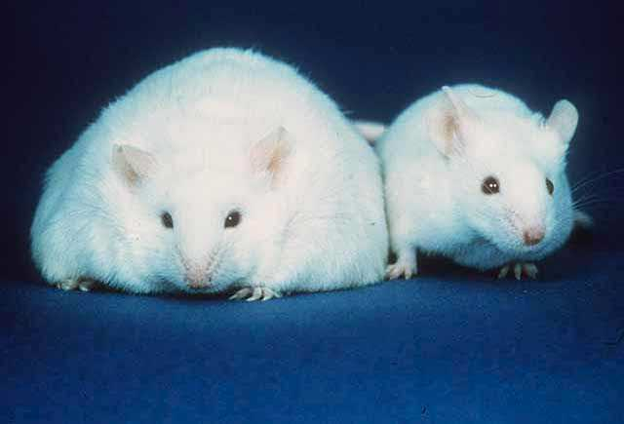
Mice can become obese
Notes:
Public domain picture from wikipedia
File:Fatmouse.jpg

Slide 10
Draw your predictions for the gut bacteria in Western-fed vs. the Chow-fed mice
Firmicutes
Bacteroidetes
Percent of total bacteria
Chow-fed
(lean)
Western-fed
(obese)

Slide 11
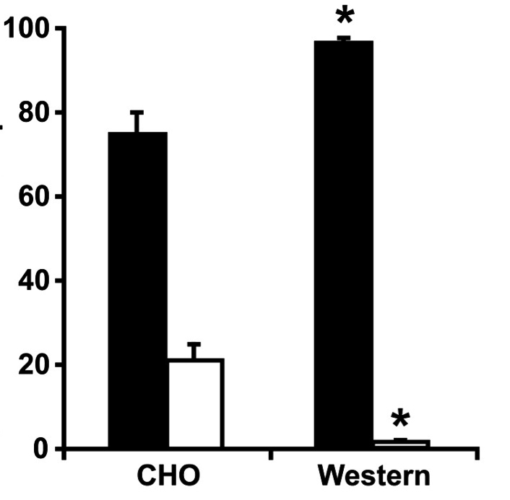
Is the data consistent with your prediction?
Firmicutes
Bacteroidetes
Percent of total bacteria
Just like humans, obese mice have a higher ratio of Firmicutes to Bacteroidetes than lean mice
Source: Turnbaugh et al. (2008) Cell Host and Microbe 3:213-223. doi: 10.1016/j.chom.2008.02.015.

Slide 12
Have we gotten any closer to addressing our question?
Change in weight
Altered bacteria
Change in diet
OR
Altered bacteria
Change in weight
What else could we do?

Slide 13
Predict the weight of mice in the two different fecal transplant experiments
Sterile chamber
Sterile chamber
?
chow
chow
chow
Transplant gut bacteria into lean mouse without any gut bacteria
Sterile chamber
Sterile chamber
?
“Western”
chow
chow
Source: Turnbaugh et al. (2009) Sci Transl Med 1:6ra14-6ra14. doi: 10.1126/scitranslmed.3000322

Slide 14
Are the results consistent with your prediction?
Sterile chamber
Sterile chamber
lean
chow
chow
chow
Transplant gut bacteria into lean mouse without any gut bacteria
Sterile chamber
Sterile chamber
obese
“Western”
chow
chow
Source: Turnbaugh et al. (2009) Sci Transl Med 1:6ra14-6ra14. doi: 10.1126/scitranslmed.3000322

Slide 15
Did this experiment distinguish causation from correlation?
Change in weight
Altered bacteria
OR
Altered bacteria
Change in weight
In this experiment, a change in bacteria led to a change in weight

Slide 16
Wrap Up
Draw out an experiment you would do to show that the weight gain in antibiotic-treated chickens is caused by a change in gut bacteria?

