Slide 1
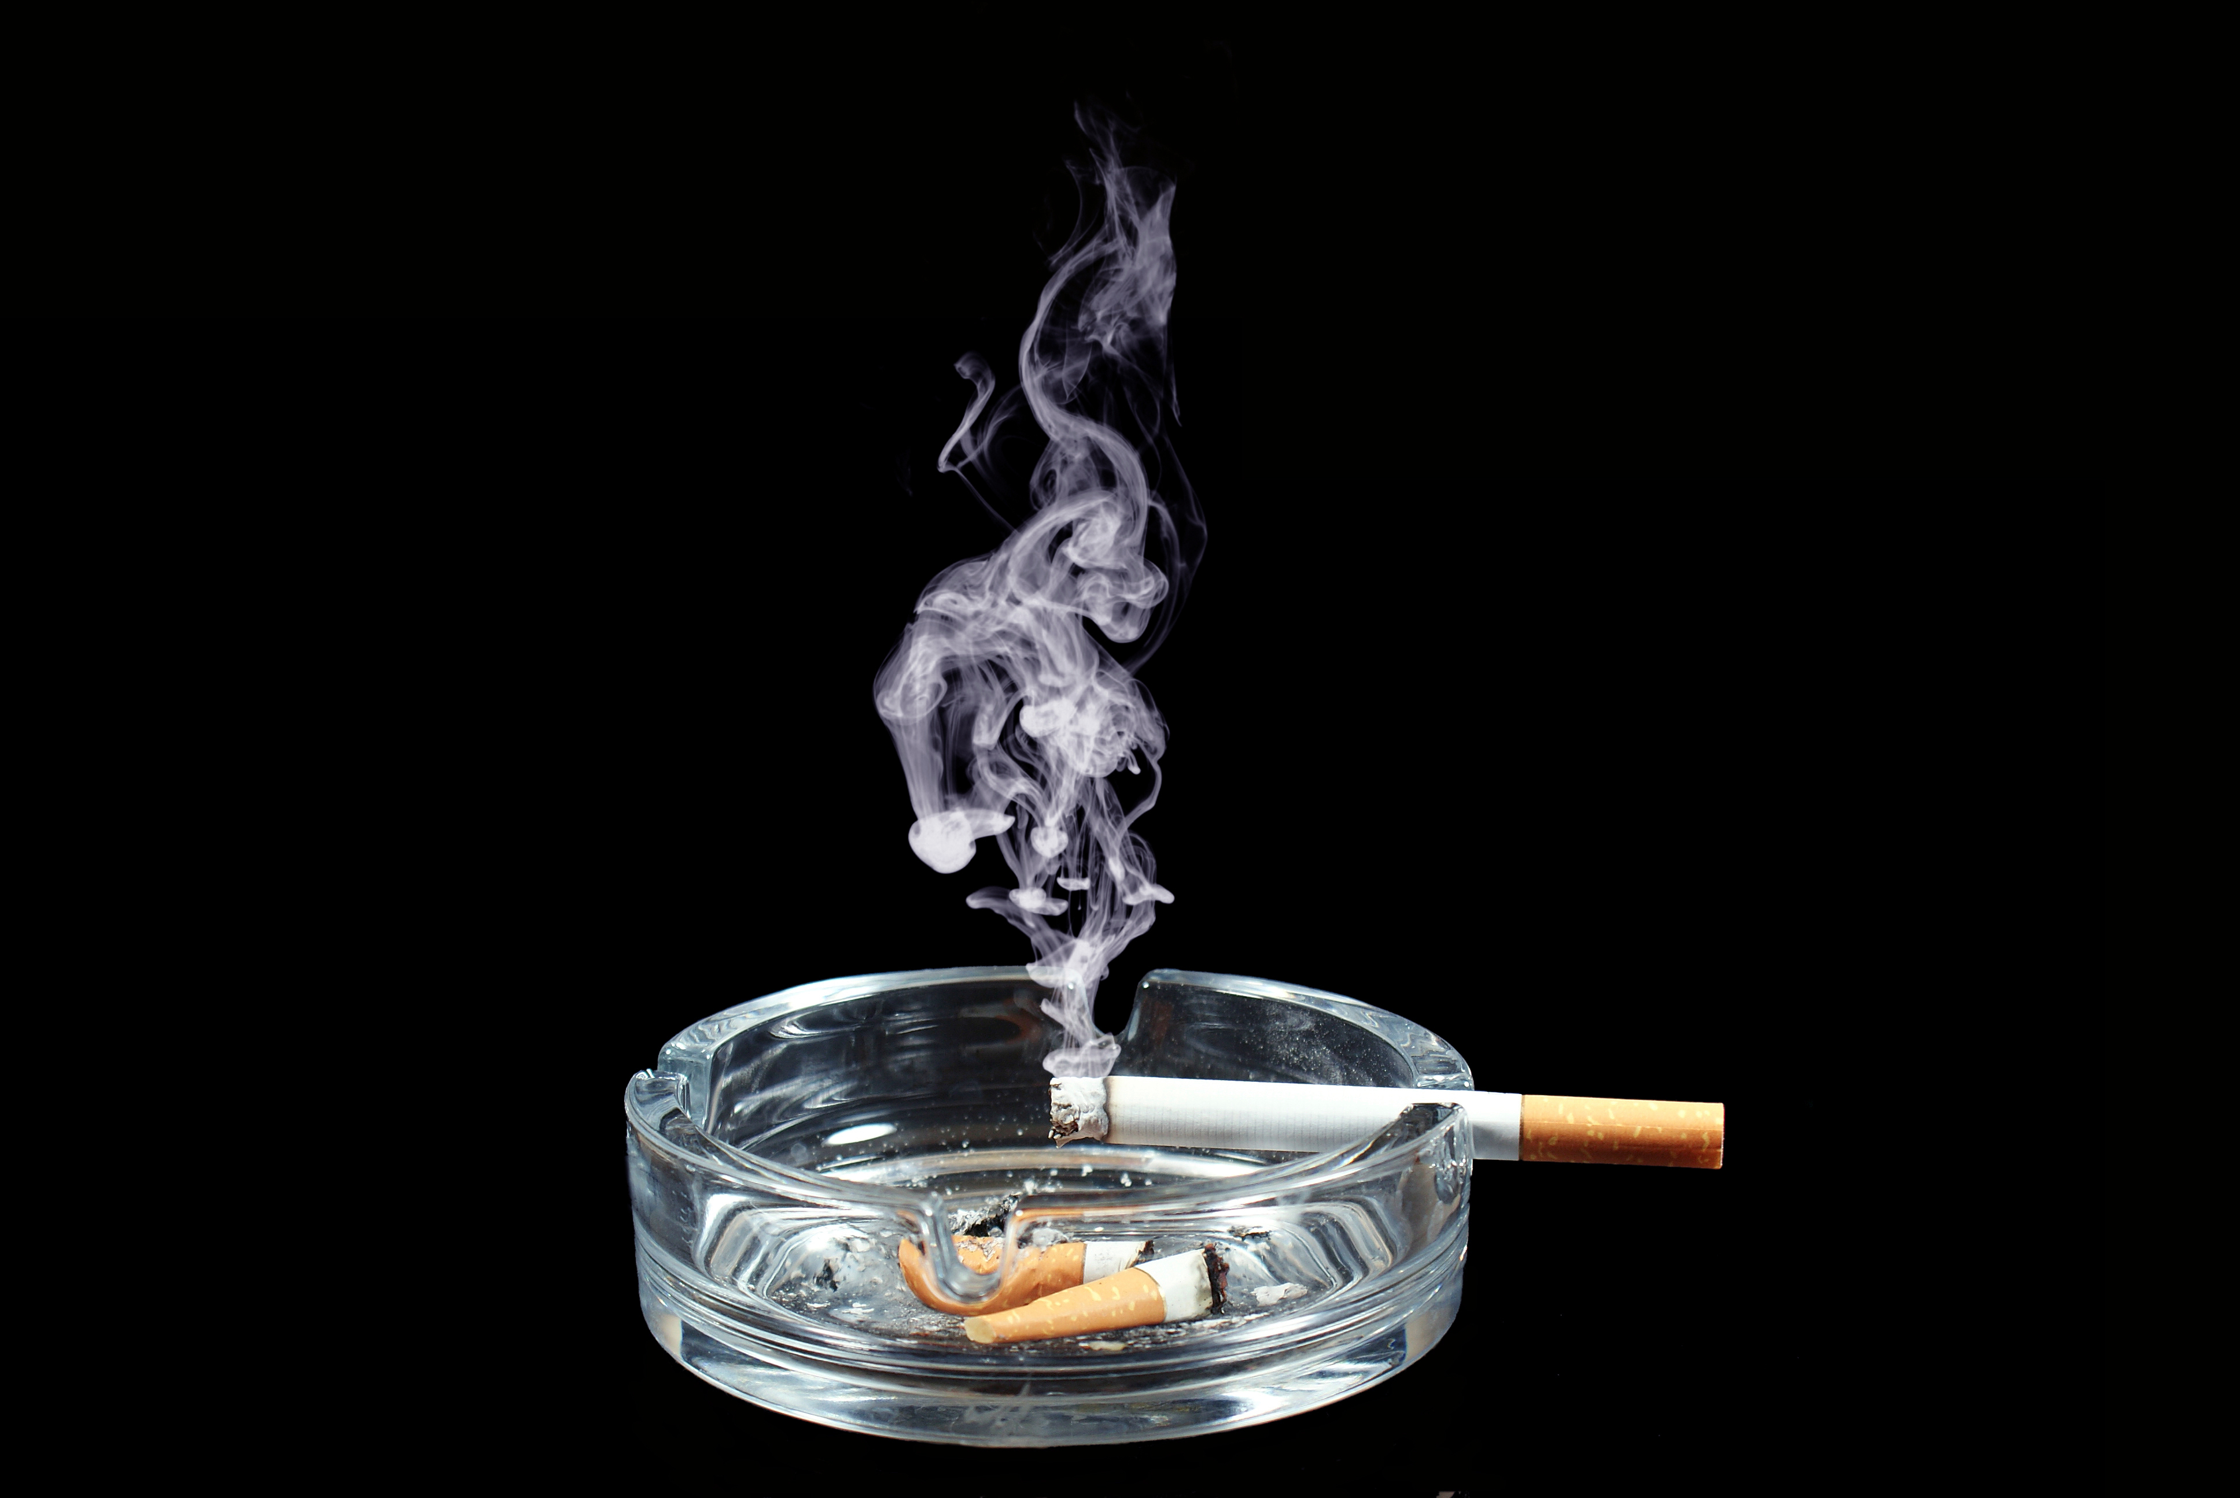
Cancer
Lesson 1.3
What do we now know about what causes cancer?

Slide 2
Do Now
What kinds of infectious agents, environmental agents and genes can cause cancer?
Infectious Agents – Rous sarcoma virus, HPV
Environmental Agents – chimney sweeps, cigarette smoke
Genes – Retinoblastoma gene, BRCA1 gene
What do all these cancers have in common?

Slide 3
What all cancers have in common
Cell growth is normally controlled by two types of genes proto-oncogenes and tumor suppressors.
  Proto-oncogenes tells cells to divide
  Tumor suppressor genes tells cells to stop dividing
When they mutate cell growth cannot be controlled.
  Mutating proto-oncogene = oncogene (cancer)
Uncontrolled cell growth causes tumors
Tumors can develop into cancer

Slide 4
How can environmental and infectious agents as well as genetics affect proto-oncogenes and tumor suppresors?
They cause these genes to mutate (a change in their DNA) → Uncontrolled cell growth → tumors → migrate away from site of proliferation = cancer
Mutated proto-oncogene = more active/more cell division
Mutated tumor suppressor = less active

Slide 5
Carcinogen
Any substance or agent that causes cancer
- this includes infectious agents and genetic mutations along with chemical and environmental agents.

Slide 6
How do carcinogens damage DNA?
Directly - They may cause changes to DNA (mutations):
They are called mutagens

Slide 7

How do carcinogens damage DNA?
Indirectly - they may cause cells to grow rapidly
– this induces mutations.
BPA mimics a hormone (estrogen) that normally causes cells divide.
When cells divide more than they normally would there are more chances for mutations to arise
BPA

Slide 8
How could you show that a chemical is a carcinogen?
A test that detects DNA mutations caused by the chemical would be useful
A test should also confirm that this chemical causes tumors in animals (if not in humans, which would be unethical, at least in another organism, like rats).

Slide 9
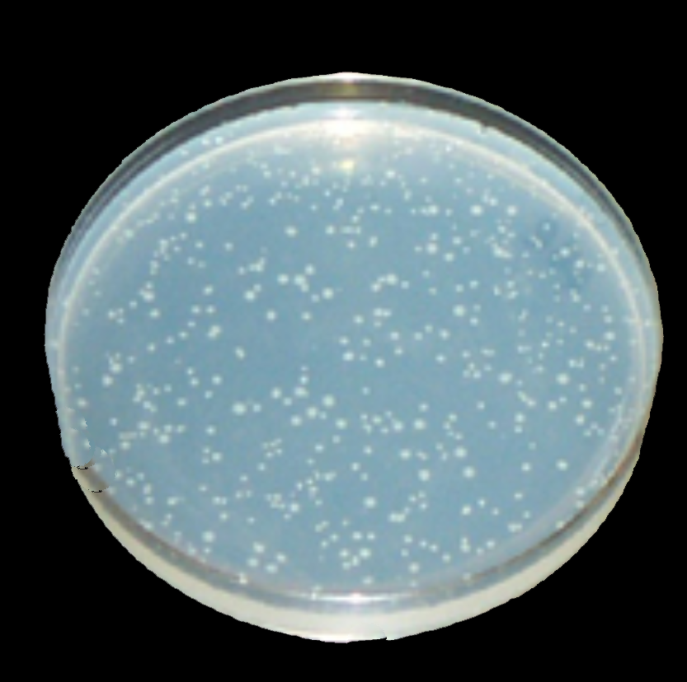
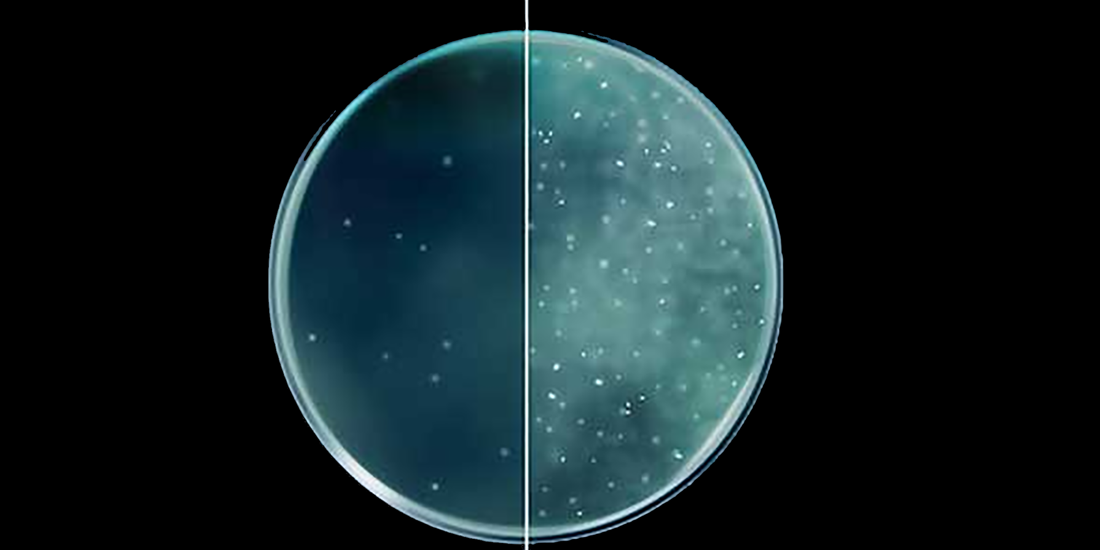
Identifying carcinogens with the Ames test
Mutant bacteria exposed to a chemical and it grows = carcinogen
Mutant bacteria exposed to a chemical and it does NOT grow = NOT a carcinogen
Bacteria grow well
On nutrient agar
Mutant bacteria
Can’t grow
Carcinogens reverse
the mutation – bacteria grow again

Slide 10
What kind of carcinogens can the Ames test detect and what kinds can’t it detect?
Can identify carcinogens that are mutagens (cause the DNA to change)
Cannot identify carcinogens like BPA that cause a cell to divide (plus bacteria do not respond to BPA since it mimics a human hormone)

Slide 11
How relevant is a carcinogen test that uses bacteria?
Humans and bacteria are likely to behave differently to different chemicals (think about disinfectants)
Humans metabolize chemicals in our liver, this will detoxify the chemical usually
Bacteria do not metabolize chemicals
Once a possible carcinogen has been identified on the bacterial test, it is further tested in rats

Slide 12
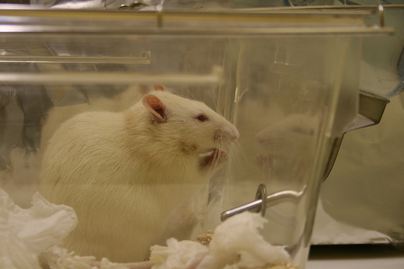
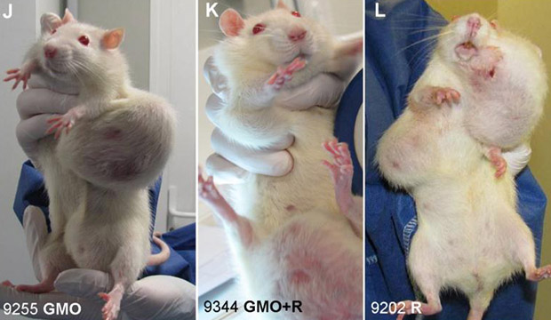
Rats are used to determine the dose of carcinogen needed
The rats are exposed until tumors appear
The carcinogen can be added to the rat’s food or drink
Or it can be painted on their backs (it is necessary to use the same size rats)
Notes:
This is needed because later we have worksheet activities where the experimental layout describes painting rat’s backs with a carcinogen etc. This will help them see why and how this is done.

Slide 13
Carcinogen dose and potency
The time from when the carcinogen is first given until a tumor appears is recorded as
mg carcinogen/kg rat/days dosed
The “TD50” is the dose necessary for 50% of the rats to develop cancer
If a carcinogen causes a tumor in rats, how do we know it will have the same effect in humans?
What is the equivalent dose that would be needed to form the tumor in humans.

Slide 14
What’s the point?
To see if a carcinogen causes tumors at all.
Then it will be determined whether the dosage needed to form a tumor relates in any way to the dosage a human would be exposed to
Example – the artificial sweetener (aspartame, sucralose, etc) can cause tumors in rats, but the equivalent dose needed to form tumors in humans would require the humans to eat kilograms of saccharine per day

Slide 15
Activity:
    What results does the Ames test report?
    Are any of the food additives carcinogens?
    Given this information, are you concerned about eating these foods?

Slide 16
Wrap Up: Ames test confirms a carcinogen… or does it?
Some substances appear positive according to the Ames test that may not cause cancer in humans (false positives).
Other substances appear negative on the Ames test that are known carcinogens (false negatives).

Slide 17
How would we show something is a carcinogen TODAY?
We can now grow normal cells in culture.
We can sequence DNA.
Near-future Ames test:
  Add carcinogens to normal cells.
  Test to see if normal cells begin to grow like cancer cells.
  Confirm that the carcinogen has caused growth-regulating genes to mutate.

Slide 18
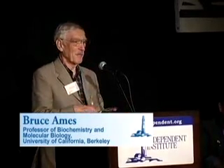
Homework
Watch Bruce Ames speak about the misconceptions created by the media from Ames test results

