Slide 1
Dyslexia Parent Orientation
Hughes Springs Elementary
903-639-3881
Brenda Fincher * Principal
Jonathan Whitaker * Vice Principal

Slide 2

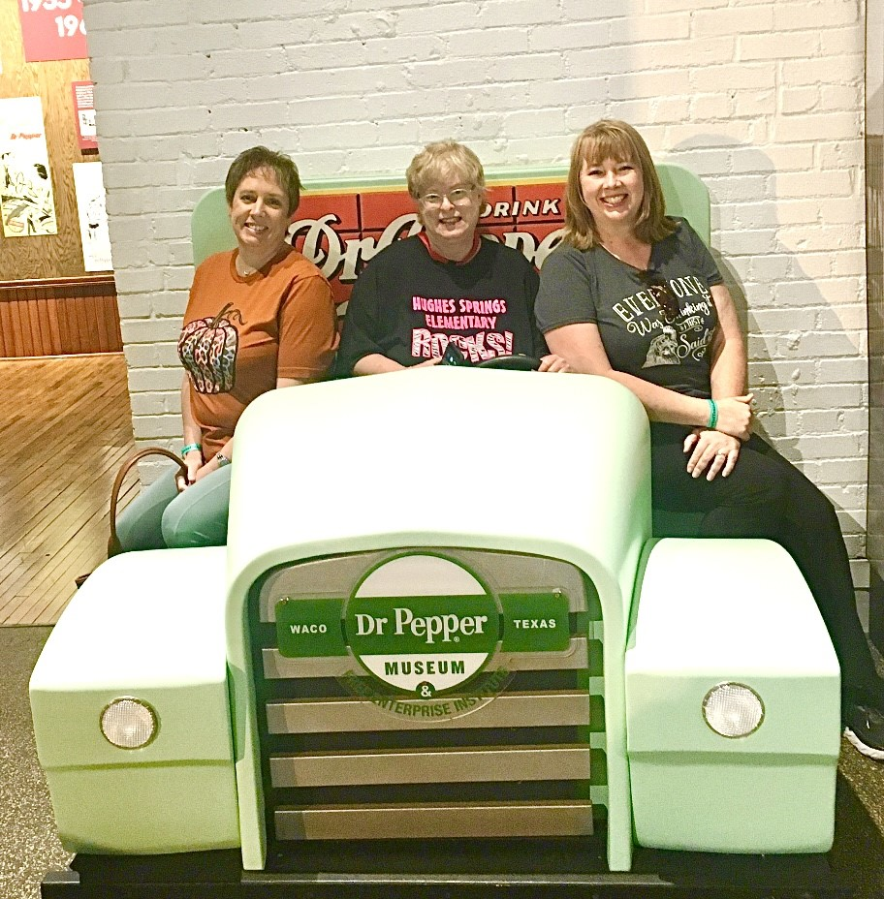
Hughes Springs ISD
Dyslexia Therapist
Jennifer Bean, CALT
Robin Powell, CALT
Stacy Newsom, CALT
All Dyslexia Therapist have been training in one or more of the following dyslexia programs:
Scottish Rite Take Flight
Reading by Design
MTA

Slide 3






What is Dyslexia?

Slide 4


Slide 5


Slide 6

Examples:
Say cat. Now say cat without the /k/ sound. What is your new word? at
Say time. Now say time without the /m/ sound. What is your new word? tie
Say winter. Now say winter without the /t/ sound. What is your new word? winner

Slide 7


Slide 8
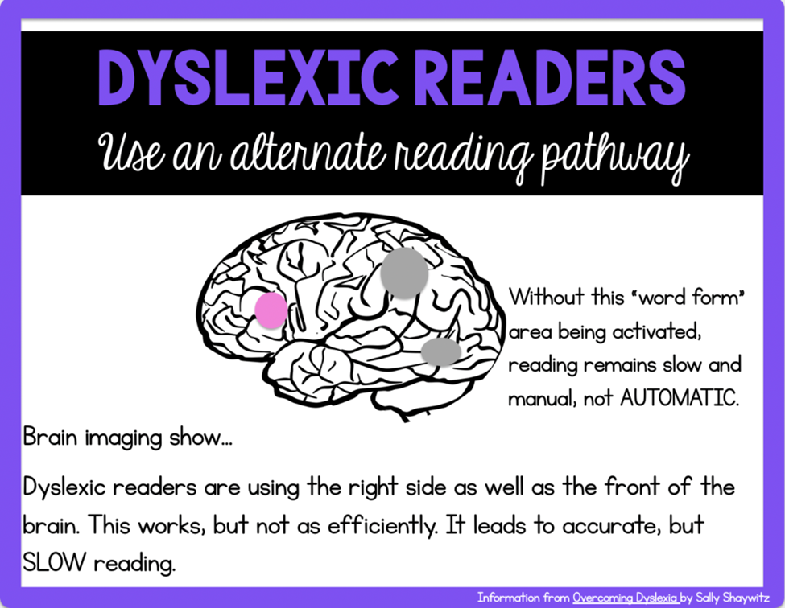

Slide 9
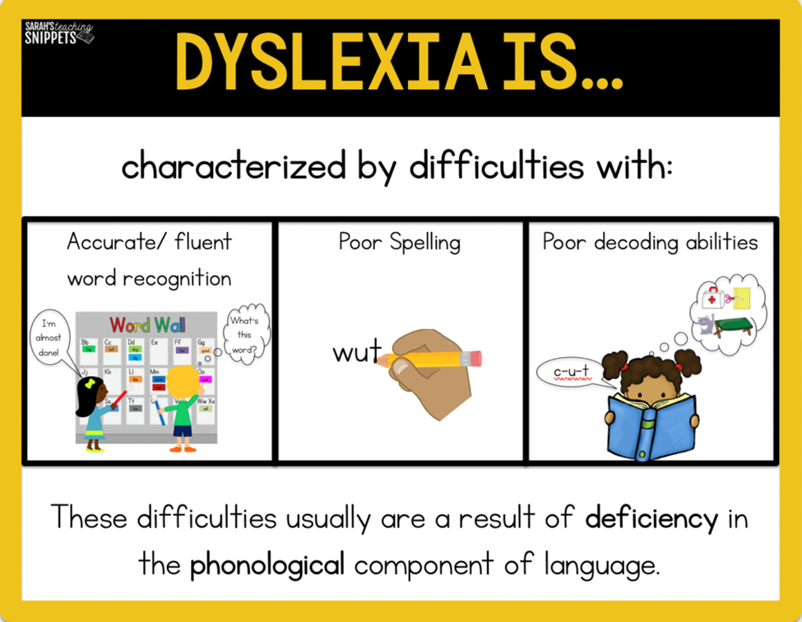

Slide 10


Slide 11
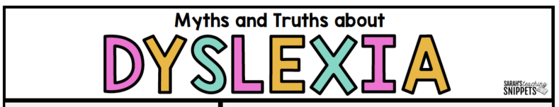

Slide 12
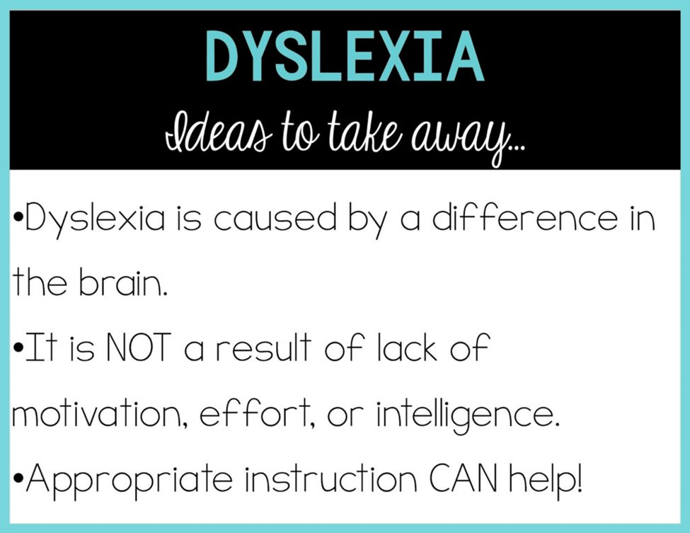

Slide 13
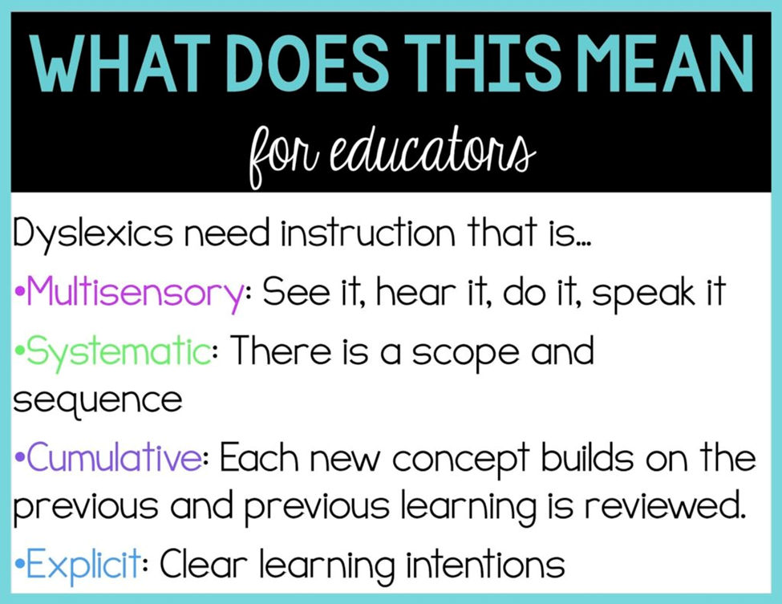

Slide 14

Inside you will find…
What is dyslexia?
How do we assess and identify for dyslexia?
What are effective strategies for students with dyslexia?
Who delivers instruction for students with dyslexia?
What accommodations are available for students with dyslexia?
What is the difference between IDEA, Section 504 and RtI?
Who do I contact for information or concerns?

Slide 15

https://dyslexiaida.org/free-conference-recordings/

Slide 16
Take Flight
Dyslexia Program
Developed by Texas Scottish Rite Hospital for Children

Slide 17
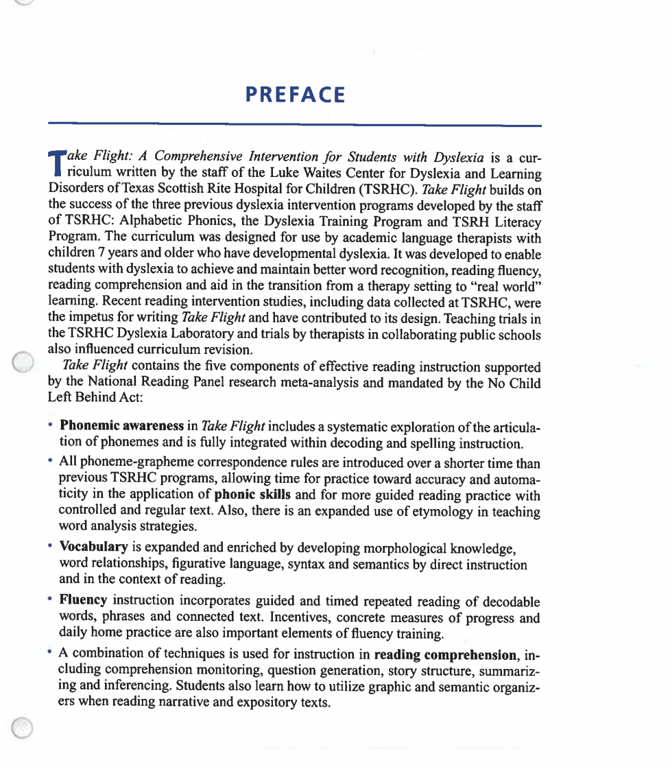

Slide 18
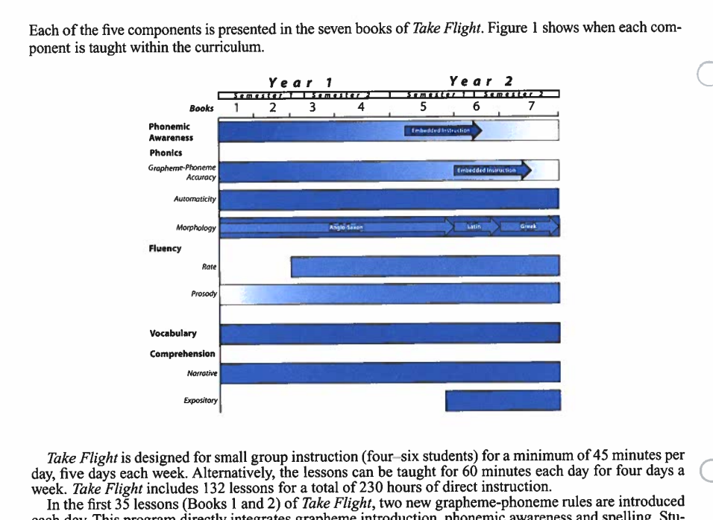

Slide 19
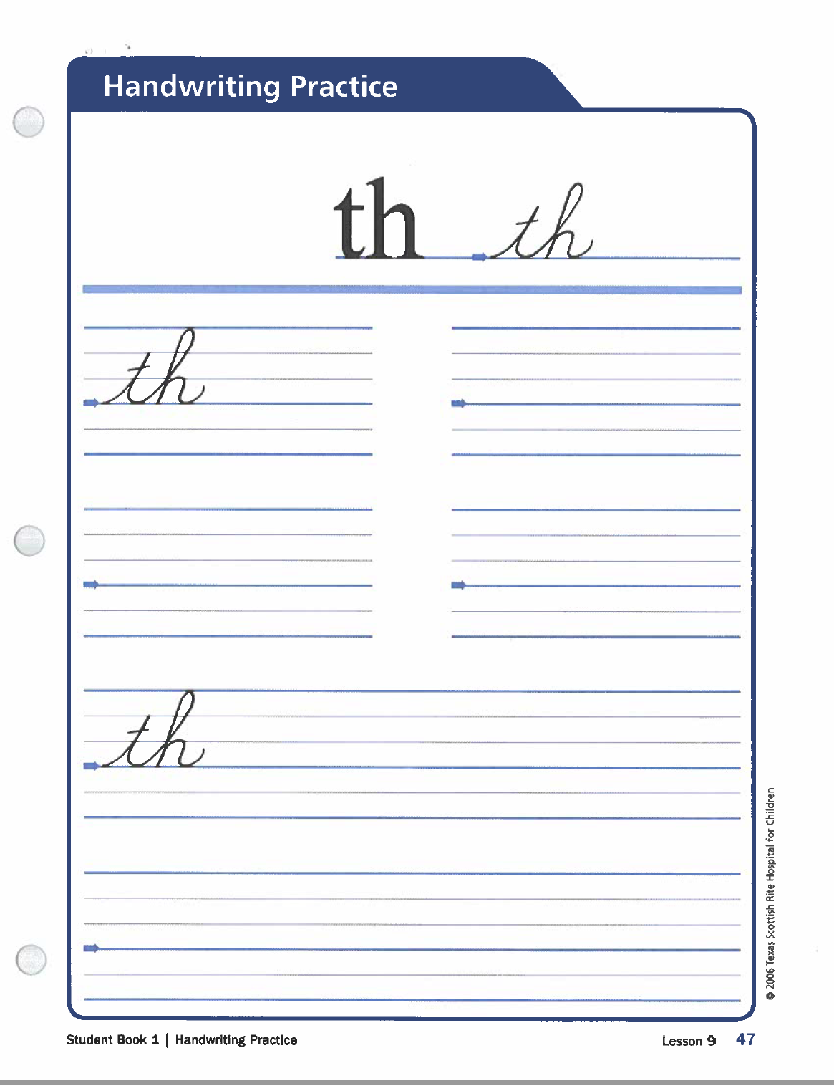


Slide 20
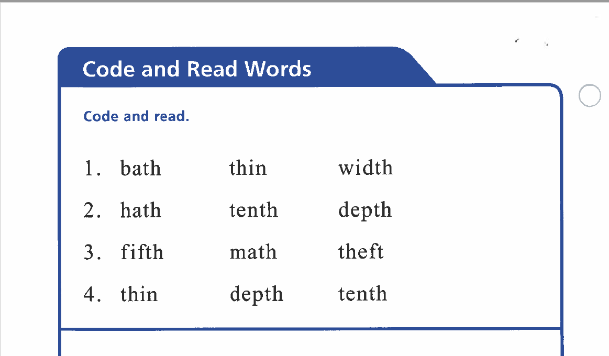

Slide 21
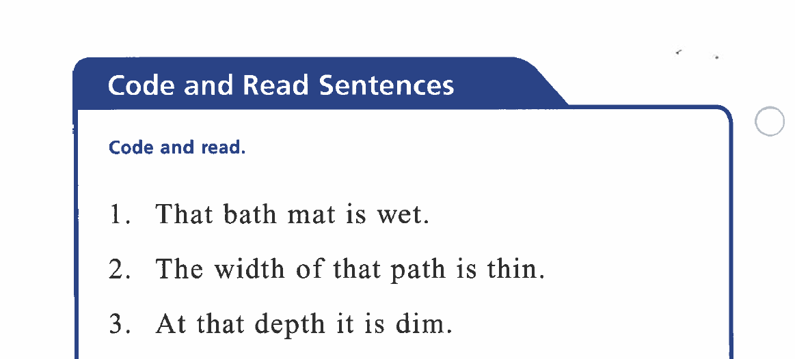

Slide 22
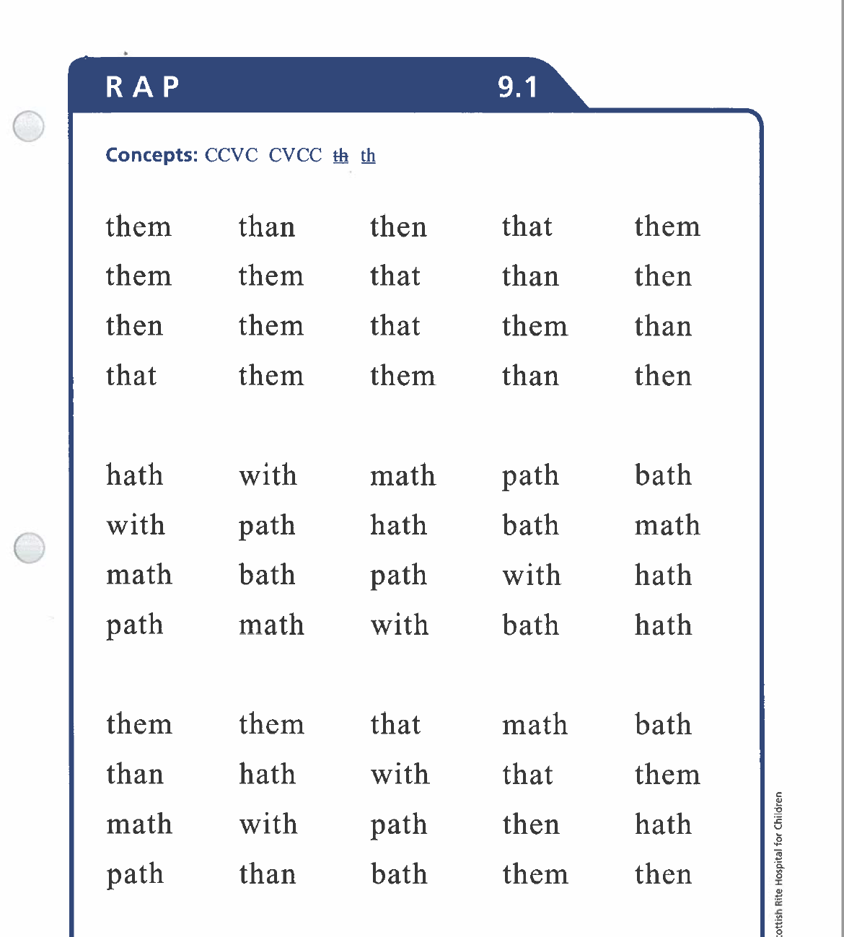


Slide 23
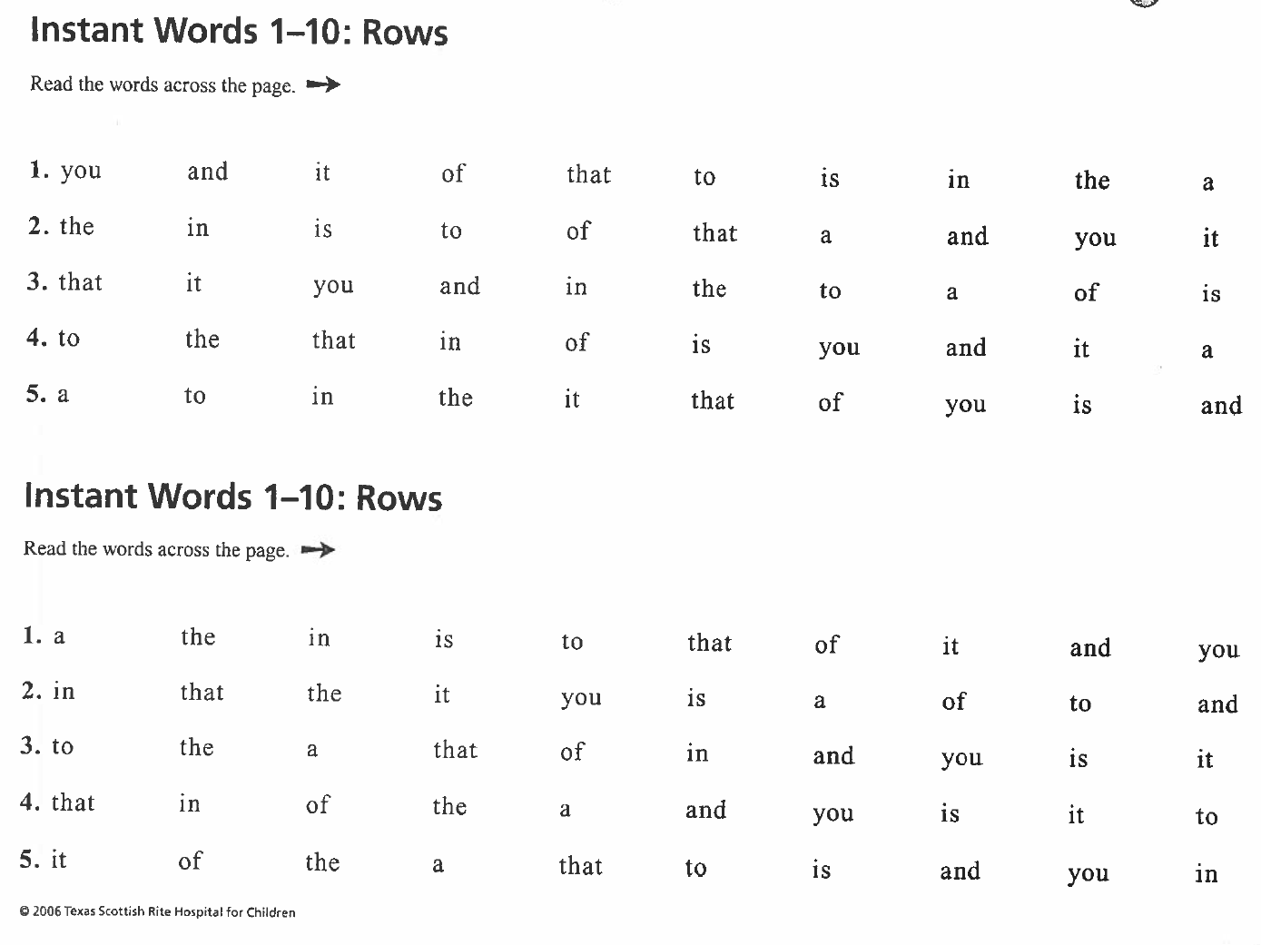


Slide 24
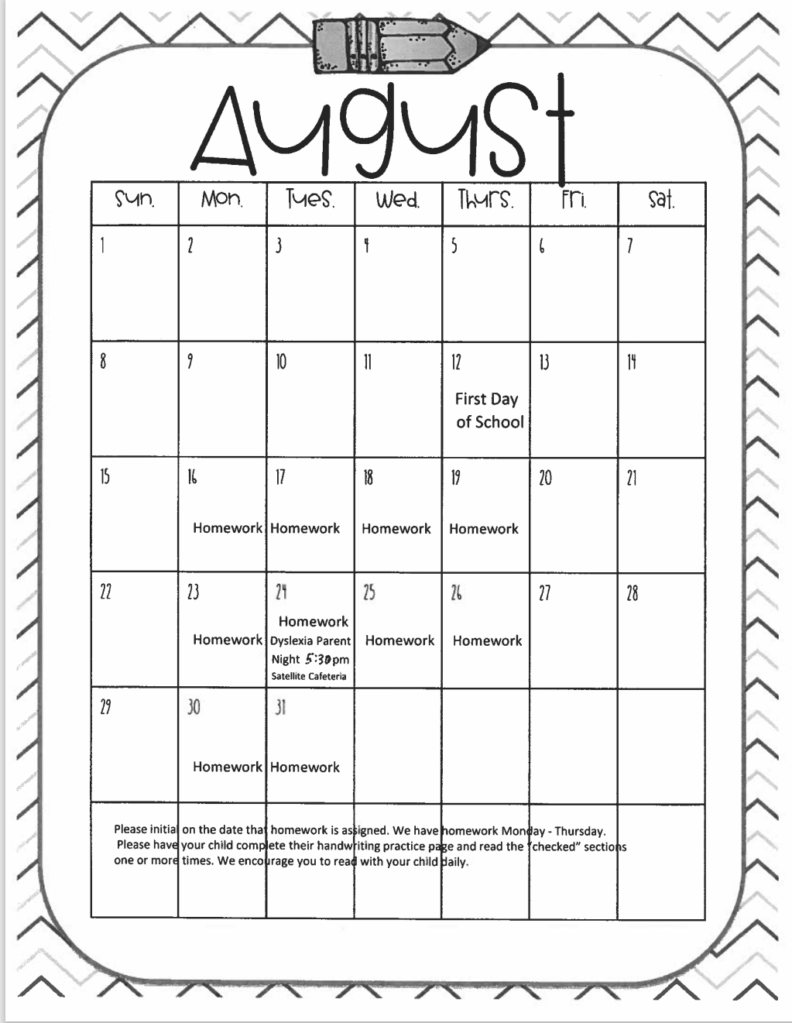

Slide 25

Learning Ally

Slide 26


Slide 27
Sophia’s Dyslexia
Fight Song

Slide 28
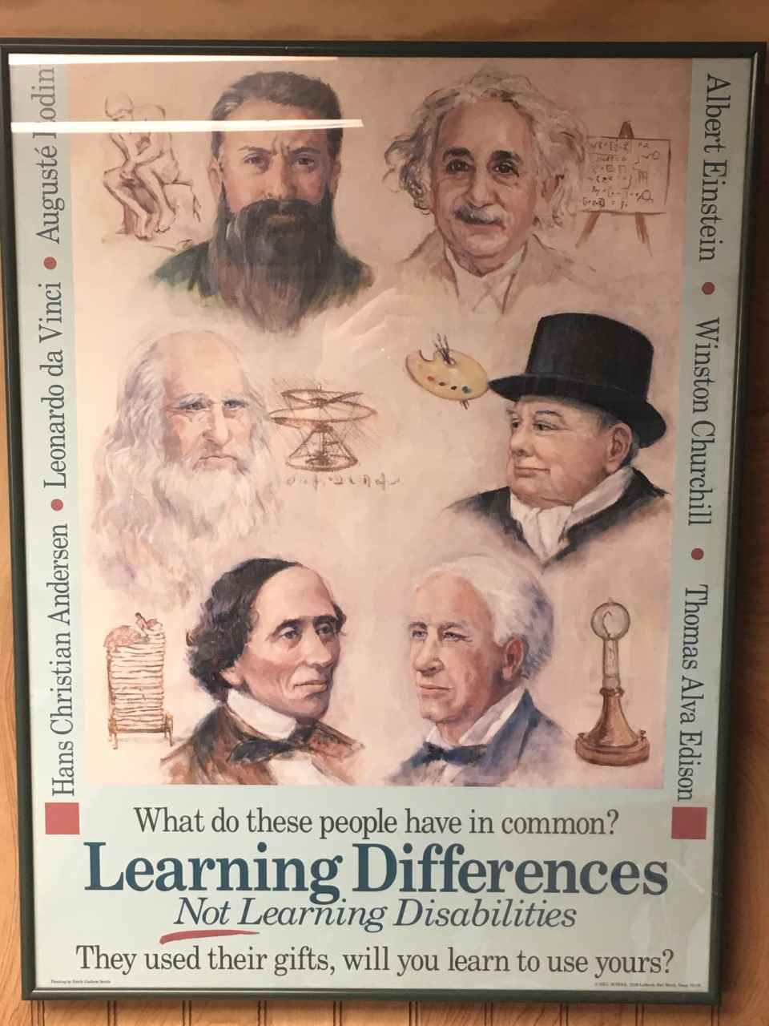
Thank you for attending Dyslexia Parent Night

