Slide 1

Understanding the Professional Leave Checklist
JUNE 2019
STRONGLY RECOMMENDED

Slide 2
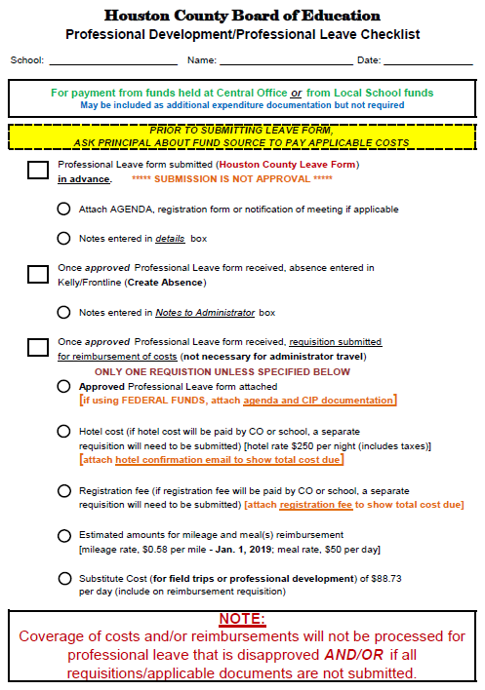
Locating the Form
HCBOE Website
www.hcboe.us
Departments > Accounting > Forms > Accounts Payable Forms
Departments > Accounting > Forms > Local School Forms
Staff Resources > Leave Request Resources

Slide 3

PURPOSE
BOARD POLICY
Professional Leave and Leave for Training
Professional leave may be granted to personnel for participation in educational activities related to instructional improvement in the Houston County School System.
Leave for training shall be granted to support personnel to participate in activities that will enrich the Houston County School System’s program and improve skills or understandings of the employee.

Slide 4
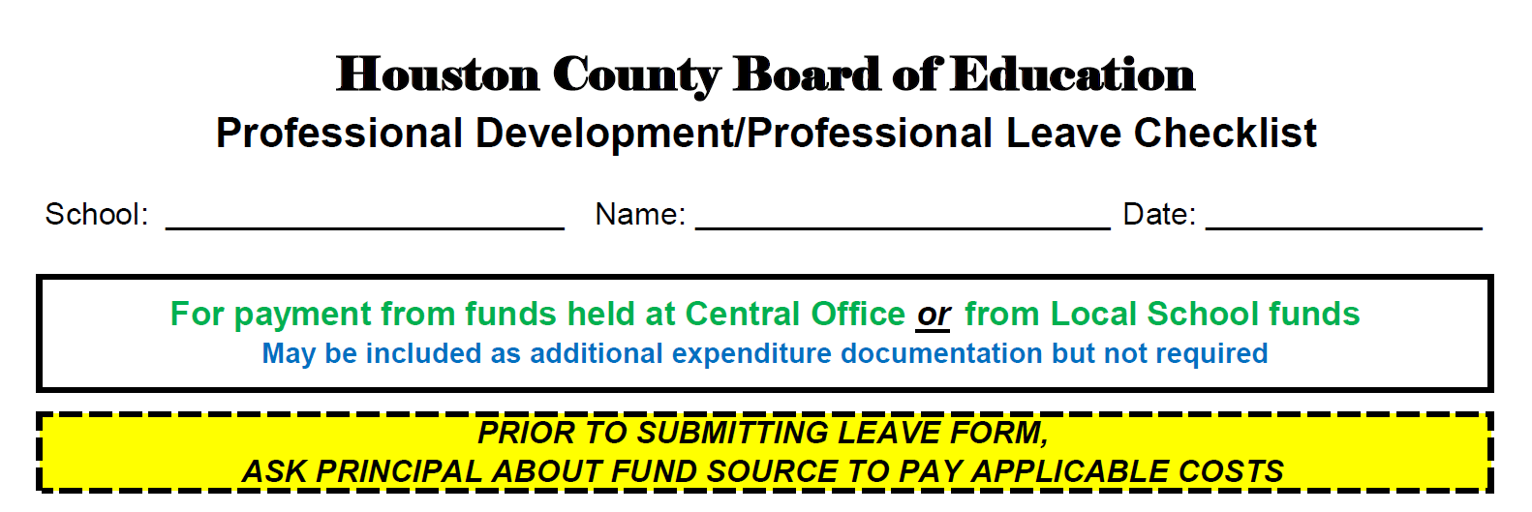
Checklist
Section 1
Enter
SCHOOL NAME
EMPLOYEE NAME
DATE

Slide 5
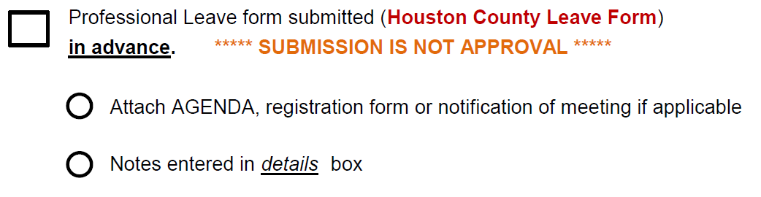
Checklist
Section 2
Request for Leave submitted in advance; submission IS NOT approval.
Attach documentation applicable to request for leave.
Enter details about request for leave.

Slide 6
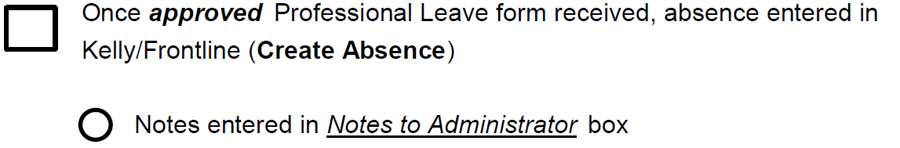
Checklist
Section 3
Enter absence in Frontline (Kelly Services) AFTER receipt of APPROVED leave form.
Enter notes in NOTES TO ADMINISTRATOR box.

Slide 7
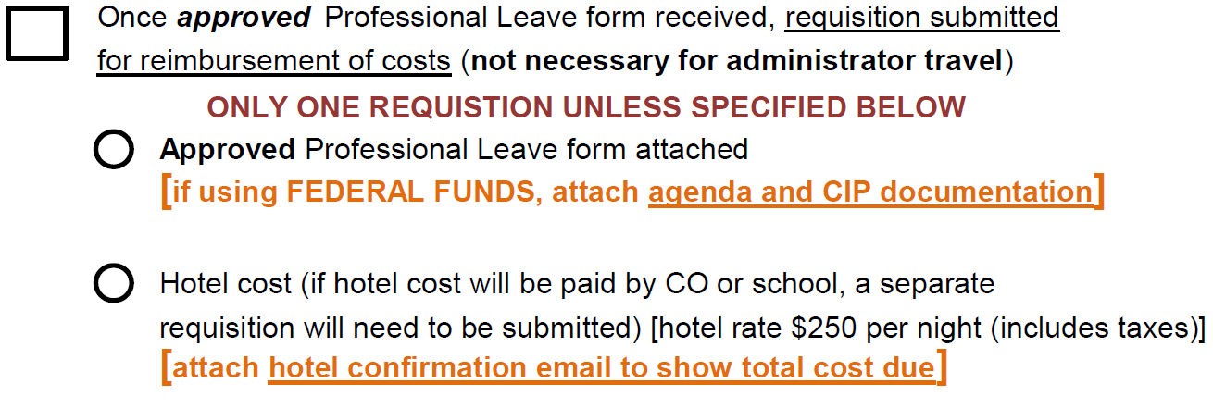
Checklist
Section 4
Submit requisition AFTER receipt of APPROVED leave form.
Attach leave form
Attach agenda and CIP docs for federal funds
Include hotel cost if applicable and attach hotel confirmation email

Slide 8
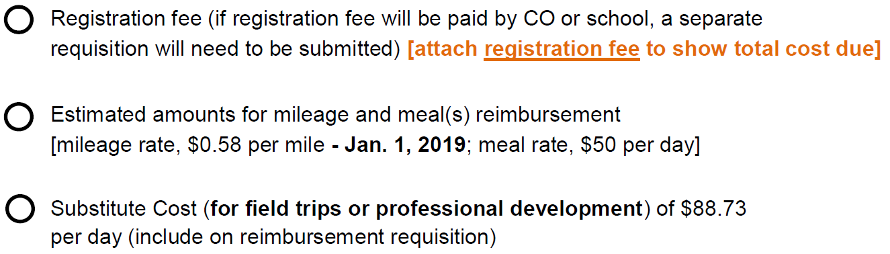
Checklist
Section 4 (cont.)
Include registration fee if applicable and include registration form
Include estimated costs for mileage and meals reimbursement
Include cost for substitute(s) if applicable

Slide 9

IMPORTANT
IMPORTANT
IMPORTANT
IMPORTANT
Contact your school secretary/bookkeeper for assistance if needed.

