Slide 1
Work-Based Learning Meeting
Welcome
Everyone

Slide 2
Basics
Your Teacher
I use Remind to communicate (you can email me if you don’t have a phone or data) dbell@hcboe.us
Juniors can Coop 2 blocks. Seniors may request more but you have to have approval.
Weekly Wage and Hour - Due every Monday by 3:00 PM.
Take out your syllabus

Slide 3
Coop Paperwork
You will find the following in your folder: (Colored paper) All of these will be turned in to me.
Purple training plan - Filled out by employer and returned to me
Orange School regulations - Read, Signed by you and a parent, and returned to me
Red Emergency form - FIlled out and returned to me
Blue Training Agreement - Signed by school, employer, parent, you, and returned to me
In addition the white papers are yours to keep. They provide valuable information.
Instructions for Remind and Google Classroom for your school.
Instructions are on Google classroom under Weekly Wage and Hour Instructions.

Slide 4
Remind
You are in a remind group with the school you attend.
Take out your phones, and we will sign up.
Use the white sheet that has your remind code.
I will send weekly reminders to you concerning your hours.

Slide 5
Google Classroom
Log on the computer in front of you:
User name: HCCA
Password: Flying62eagles#
Wait until everyone is logged on.

Slide 6
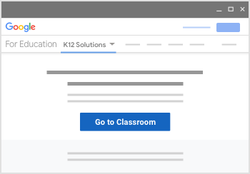
Google Classroom
Go to classroom.google.com and click Go to Classroom

Slide 7
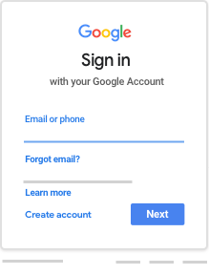
Google Classroom
Use your school issued email to log on.

Slide 8
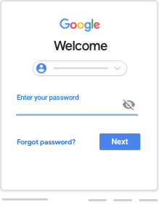
Google Classroom
Enter your password and click next.

Slide 9
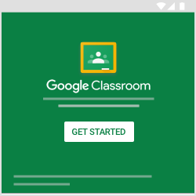
Google Classroom
If there is a welcome message, review it and click Accept.
If you're using an Google Workspace for Education account, click I’m A Student.

Slide 10
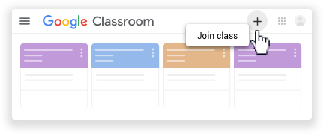
Google Classroom
Click the + sign and click join class.

Slide 11
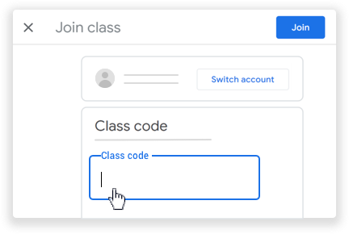
Google Classroom
Enter the class code supplied in your folder.
Enter the class code from your teacher and click Join.

Slide 12
Google Classroom
I am going to assign your interview for Coop.
Complete it and submit to me.
When everyone finishes, we will move on.
Now I have assigned your Weekly Wage and Hour Report. I am going to show you how to use it.
If you will stay under Classwork on Google Classroom, it will be easier for you to keep up with each new assignment.

Slide 13
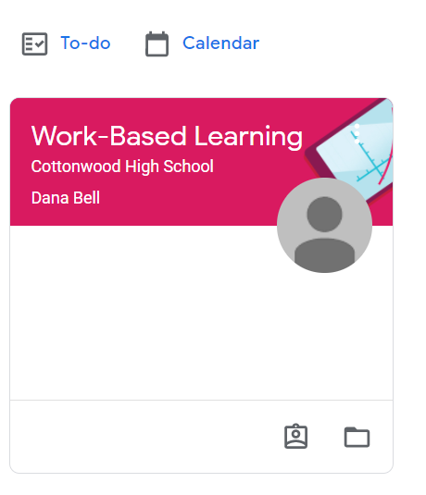
This is what you will see

Slide 14
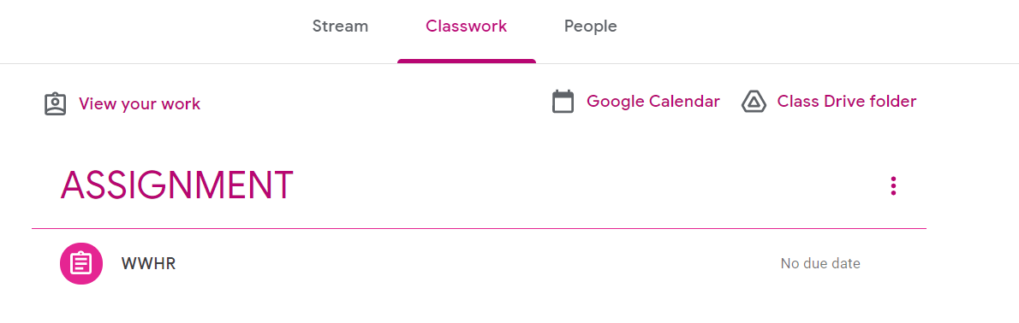
This is what you will see

Slide 15
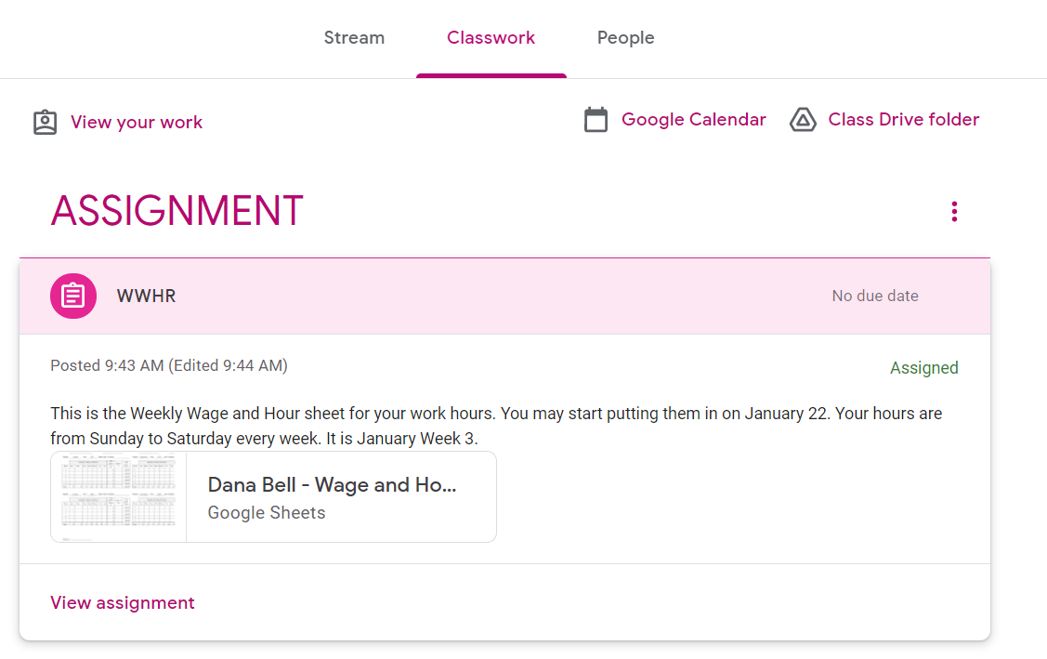
This is what you will see

Slide 16
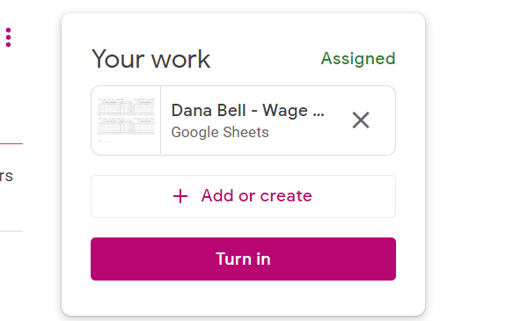

Slide 17
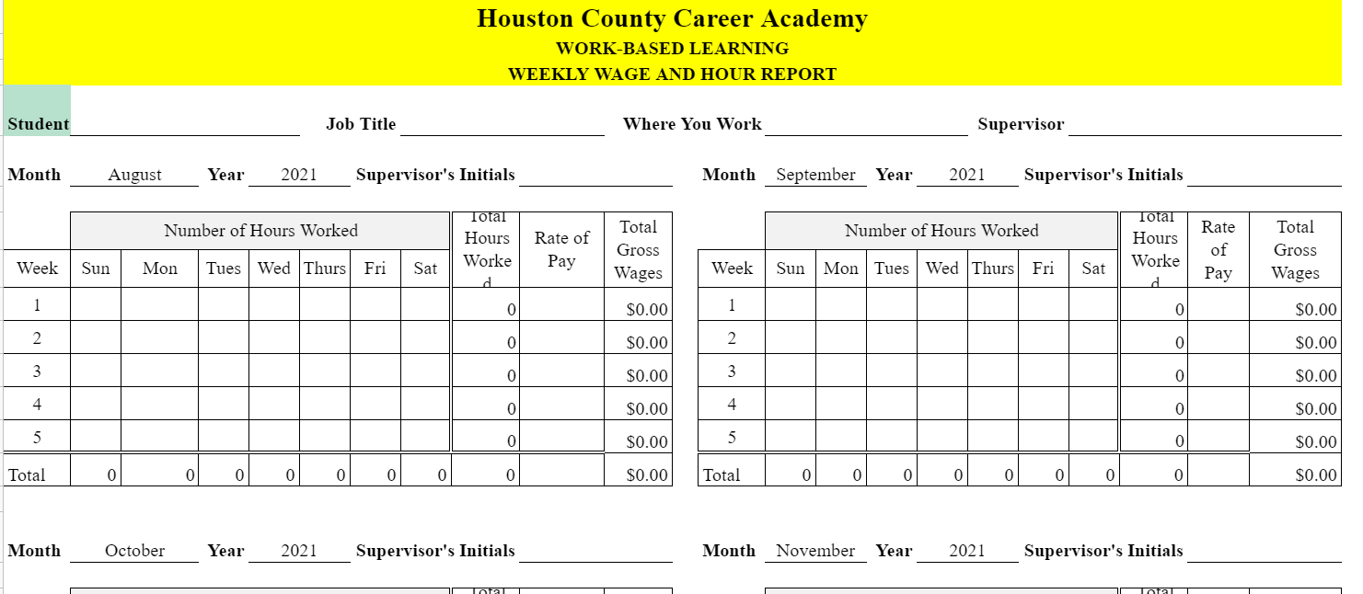

Slide 18

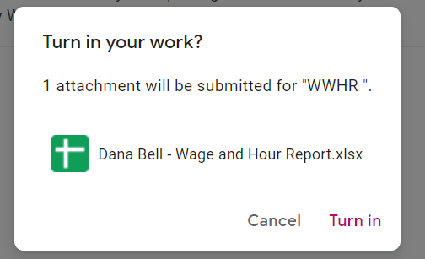
You have to click Turn in
Not once, but twice.

Slide 19
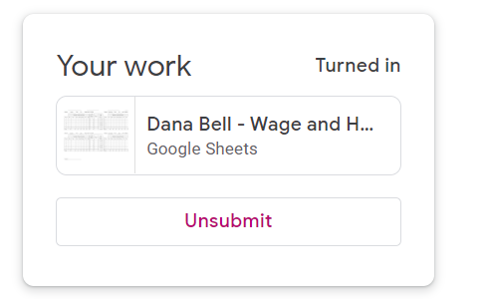
Then, it will say this.

Slide 20
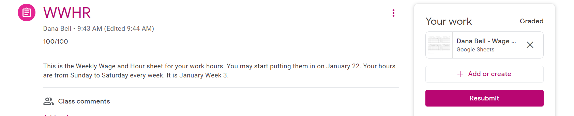
This is what you will see when it is graded.

Slide 21
Career and Job Opportunities
Houston County Career Academy

Slide 22
Work-Based Learning and Ready to Work
Here are some questions we would like for you to ask yourself:
What are some things I am interested in?
What do I want to do when I graduate?
College?
Career?
Technical School?

Slide 23
Smiths Inc.
The company specializes in heating, ventilation, and air-conditioning (HVAC) sector, working the commercial, industrial, & governmental markets. They are experienced in new construction, renovation and remodeling, maintenance and design-build construction.
ALL-HOURS SERVICE DEPARTMENT
SHEET-METAL FABRICATION
PIPING
CONSTRUCTION
HEATING, VENTILATION, AND AIR-CONDITIONING

Slide 24



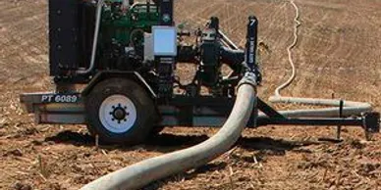


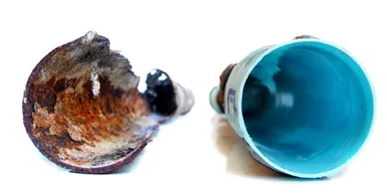
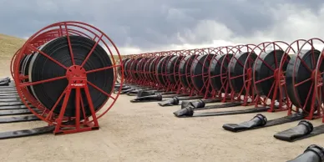
MaTex Hose is the TRU innovator in the industry. They design, develop and manufacture the highest quality lay flat hose.
Municipal
Industrial
Agricultural
Forestry
Military
CIPP
Fracking
Notes:
CIPP is a cured in place pipe. .
Fracking is the process of injecting liquid at high pressure into subterranean rocks, boreholes, etc. so as to force open existing fissures and extract oil or gas.

Slide 25
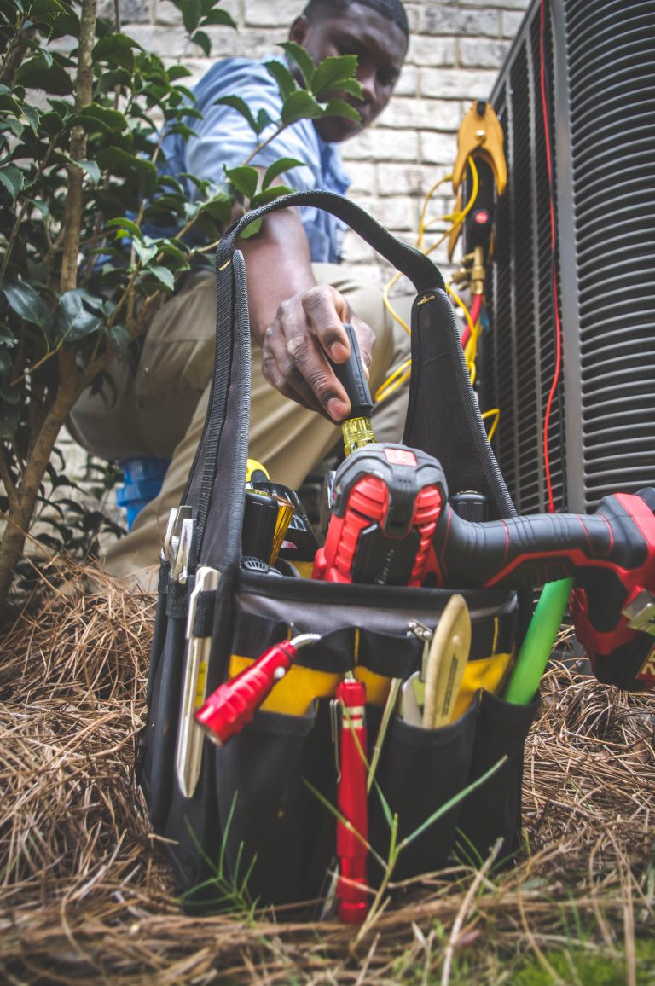
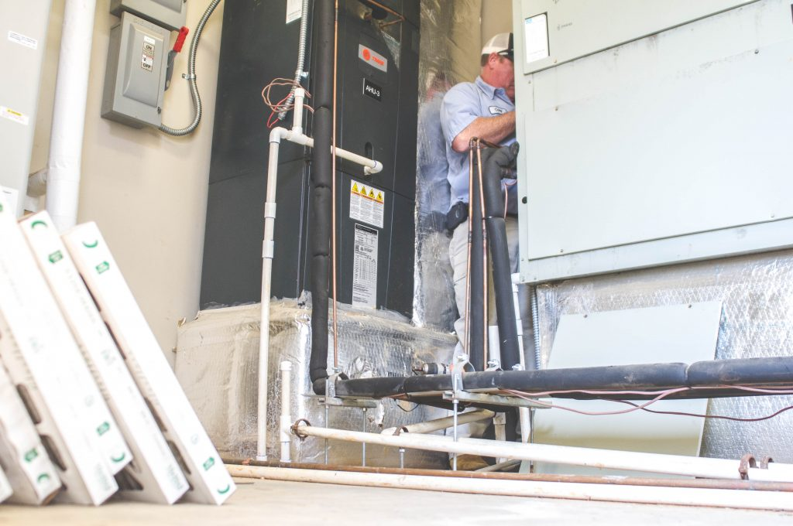
Woodalls Heating and Cooling
Bob Woodall is Dothan’s leader in all air-conditioning. They have serviced the Wiregrass for 50 years.

Slide 26
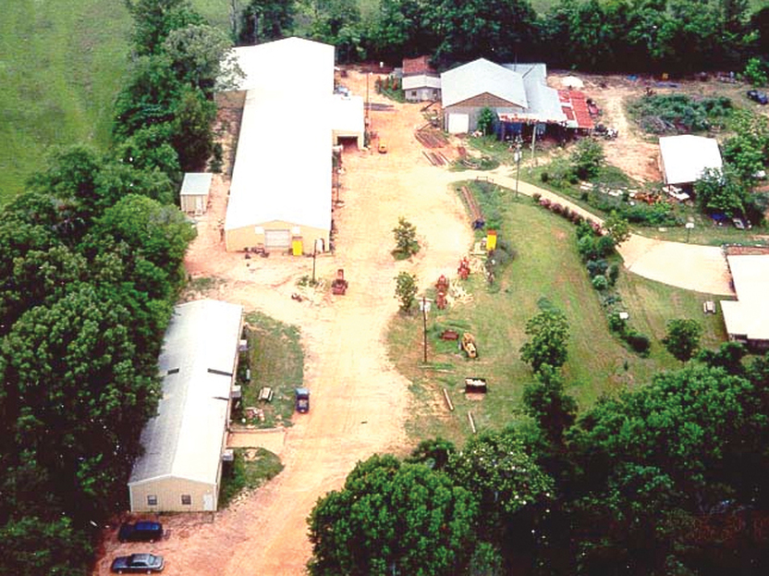
Cook’s Saw
Sawmill manufacturing
Maker of Equipment, Bandsaw blades, parts.
Have need of:
Welders, Mechanics, and Office Workers
This business is located in Wicksburg, AL.

Slide 27


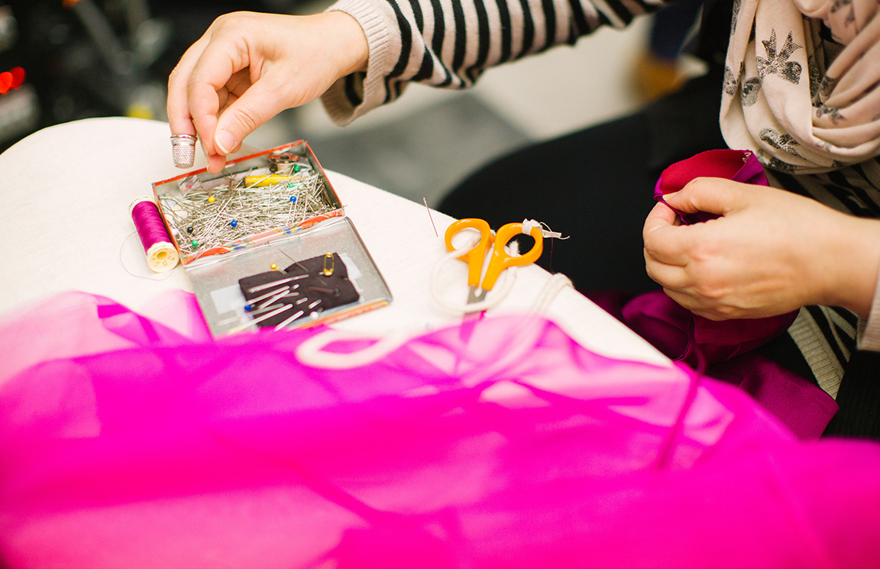
Southeastern Performance Apparel is proud to be the largest supplier of performance garments for groups in the United States, with additional customers across Europe and Asia. They hire designers, sewers, cutters, and various other positions.

Slide 28

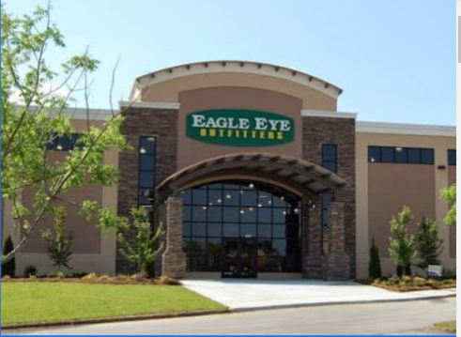
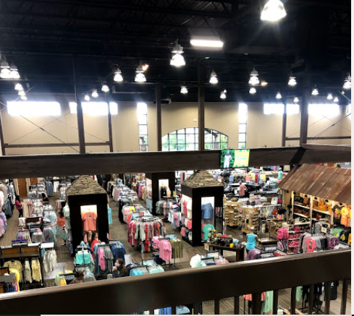
https://shopeagleeye.com/open-positions

Slide 29





Glasstream Powerboats
AVAILABLE JOB POSITIONS:
ACCOUNTING CONTROLLER
Dothan, AL
CNC OPERATOR / PROGRAMMER
Dothan, AL
AUTO-BODY / FIBERGLASS REPAIR
Dothan, AL
FINAL ASSEMBLY BOAT BUILDER
Dothan, AL
SUB ASSEMBLY BOAT BUILDER
Dothan, AL
OUTBOARD MARINE ENGINE RIGGER
Dothan, AL
LAMINATION TECHNICIAN
Dothan, AL
UPHOLSTERY TACKING TECHNICIAN
Dothan, AL
CUSTOM PAINT SPECIALIST / PRODUCTION ARTIST / AIRBRUSH
Dothan, AL

Slide 30
Places hiring immediately
ALL fast food restaurants
Eagle Eye
Hobby Lobby
Walmart
Shoe Station
Ross
Longhorn
Olive Garden
Rural King
Blue Plate
Dothan Animal Hospital
RES
RMS
RHS
WES

Slide 31
What are Employability Skills
Mindsets:
Lifelong Learning - Willingness to work and learn and apply new knowledge
Self-Confidence - Belief in own ability to succeed
Learning Strategies:
Effective communication - Clearly express ideas
Initiative - Self motivated
Problem solving - Creative thinking skills to solve problems
Attention to detail - Thorough when completing a task
Decision making - Identify individual interests and skill for a potential career

Slide 32
Employability Skills
Work Ethic
Self-Discipline - Demonstrate self-control and follow rules with little direction
Independence - Carry out expectations with minimal supervision
Time management - Plan and organize to make best use of time
Integrity - Be honest and trustworthy
Professionalism - Demonstrate skills and behaviors appropriate for work
Adaptability - Be willing to adjust to changes
Teamwork
Be able to work with others

Slide 33
Work-Based Learning
It is my desire to help you learn some Employability, as well as, Technical Skills to succeed in the workplace. I am here to help you be successful. Please contact me for guidance, help, or advice in your job. Together, we can make this school year a positive and valuable experience.
Mrs. Bell

