Slide 1








Welcome to
Houston County Career Academy!
Dual Enrollment
Informational Meeting
Let’s stay connected:
HCCAeagles.us
Houston County Career Academy
@HCCAdothan
HCCA_dothan

Slide 2


REQUIREMENTS FOR PARTICIPATING
IN DUAL ENROLLMENT CLASSES:
Requirements for Participating
in Dual Enrollment Classes:
Dual enrollment is only open for upcoming 10th-12th grade students
Career tech courses – minimum 2.5 GPA
Academic courses – minimum 3.0 GPA
ENG 101 - Must score an 18 or higher on the English portion of the ACT
MTH 112 - Must score a 22 or higher on the Math portion of the ACT
MTH 113 – Must score a 23 or higher on the Math portion of the ACT
MTH 125 – Must score a 25 or higher on the Math portion of the ACT
Any student who fails or withdraws from a DE course is required to sit out the following semester. (Fall or Spring. Summer is not included.)

Slide 3
DUAL ENROLLMENT CAREER TECH
PROGRAMS OFFERED:
Dual Enrollment:
AccuPlacer Testing
Accuplacer testing can be conducted
by Houston County Career Academy
employees.

Slide 4
DUAL ENROLLMENT CAREER TECH
PROGRAMS OFFERED:
Dual Enrollment Career Tech
Programs Offered:
Aviation
Emergency Medical Services
Medical Assisting
Welding
Fire Science

Slide 5


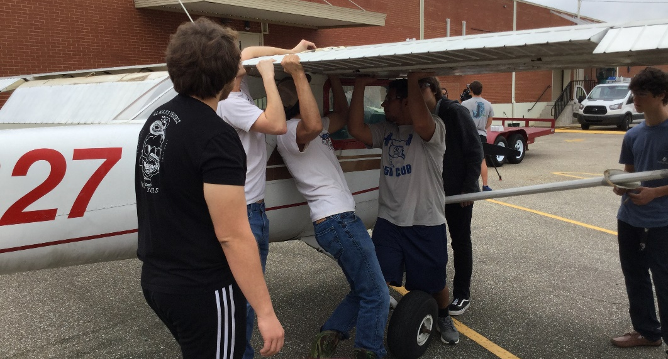
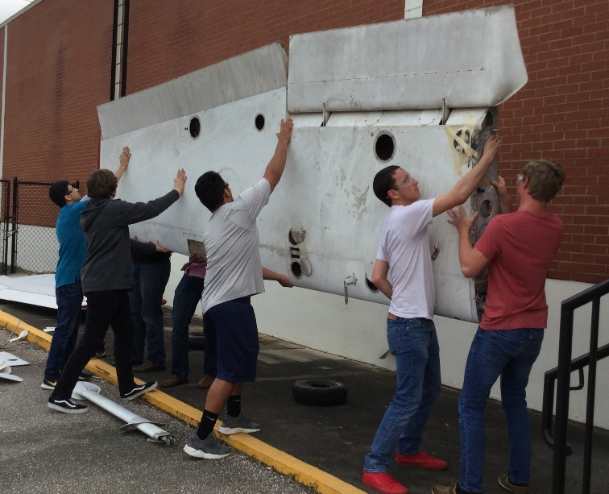



AVIATION
The best way to jumpstart your career in one of Alabama’s hottest career fields, and earn nearly $30 an hour, is in the hands-on classrooms of Alabama Aviation College. You’ll learn from experienced aviation professionals and choose from programs in aircraft maintenance and avionics technology, gaining skills that transfer directly to the automotive, machinery and machine industries. High school students earn both high school and college credit, and those who start as sophomores can be very close to completing the program by the time they leave high school. Workforce development grant money may even pay the cost of their tuition.
Classes Included:
Semester 1 - AMT 101 – Basic Electricity
AMT 102 – Materials and Processes
Semester 2 - AMT 100 – Technical Prep
AMT 111 – Aircraft Sheetmetals

Slide 6

EMS
The EMT level of training is completed in one semester and allows the entry-level EMT to manage both medical and trauma patients. The AEMT level of training is also completed in one semester and allows those at an EMT level to advance in skill preparation and job opportunities. Specific tasks that those certified at this level are allowed to perform vary greatly from state to state, but students learn advanced skills such the use of advanced airway devices, intravenous fluids, and some medications.
The Paramedic level of certification requires three additional semesters of program training and is combined with degree and/or certificate-required academic courses. Paramedics provide more extensive pre-hospital care than do EMTs or AEMTs. In addition to carrying out the procedures of the other levels, paramedics administer medications orally and intravenously, interpret electrocardiograms (EKGs), perform endotracheal intubations, and use monitors and other complex equipment. However, like the AEMT, procedures paramedics are permitted to do vary by state. EMTs, AEMTs and Paramedics work in a variety of settings including industry, fire-rescue, ambulance, aircraft and emergency centers.
Classes Included:
Semester 1 - EMS 118 – Emergency Medical Technician
EMS 119 – Emergency Medical Technician Clinical

Slide 7
MEDICAL ASSISTING
The Medical Assisting Program has been made available to our students as a Dual Enrollment class from Wallace Community College. The program seeks to ensure students have opportunities to acquire the knowledge and skills necessary for the practice of medical assisting and also prepare them to successfully write the American Association of Medical Assistant Certifying Board examination and become a Certified Medical Assistant (CMA).
Classes Included:
Semester 1 - MAT 101 – Medical Terminology
MAT 102 – Theory I
Semester 2 - MAT 103 – Theory II
MAT 122 – Interpersonal Skills

Slide 8
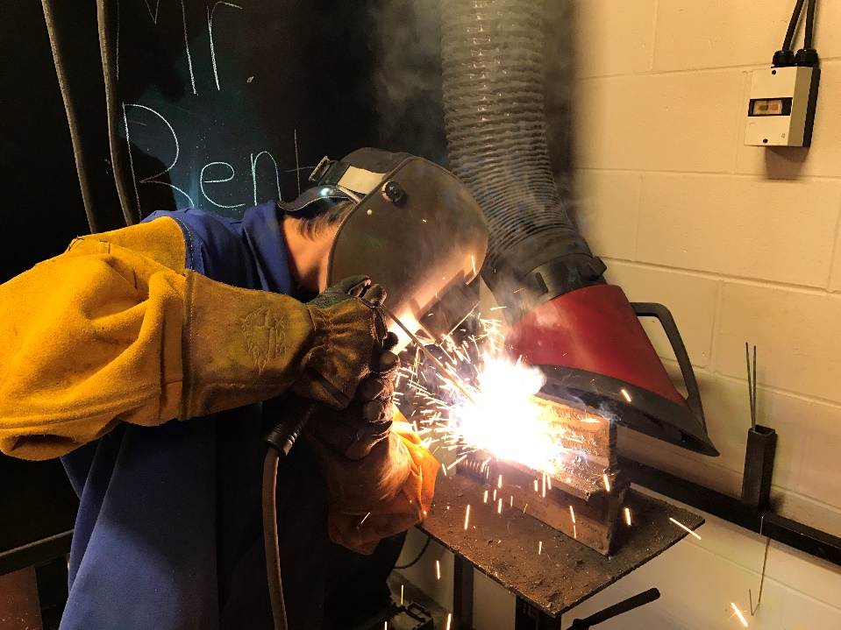
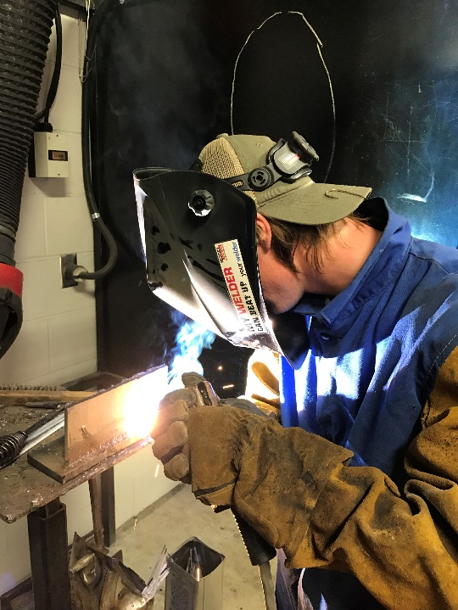

WELDING
Offered through a partnership with Wallace Community College, the dual enrollment welding program prepares students with the principles of welding, as well as the nature of metals and types of gases used in welding. The welding curriculum also includes skills in welding and fusing of various metal types using an array of techniques and methods.
Employment opportunities available for students who pursue a welding career include but are not limited to the following:
Welder, Cutter, Machine Operator, Technician, Supervisor, Inspector, Instructor, and more
Classes Included:
Semester 1 - WDT 108 – SMAW Fillet/OFC
WDT 109 – SMAW Fillet/PAC/CAC
WDT 123 – SMAW Fillet/PAC/CAC Lab
Semester 2 - WDT 122 – SMAW Fillet/OFC Club
WDT 110 – Industrial Blueprint Reading
WDT 120 – SMAW Groove

Slide 9
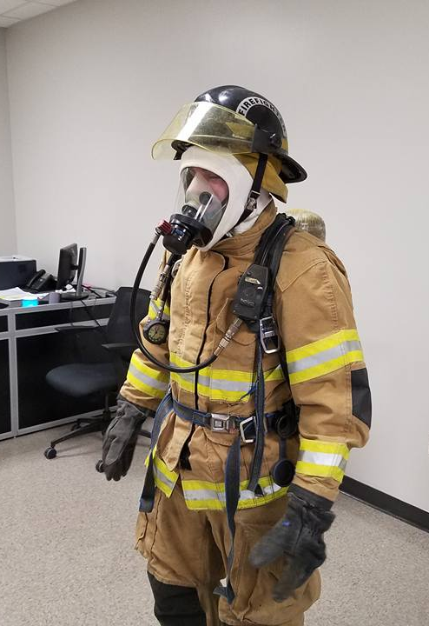
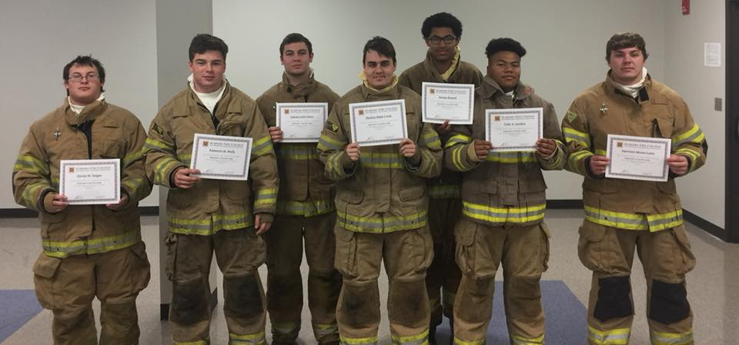
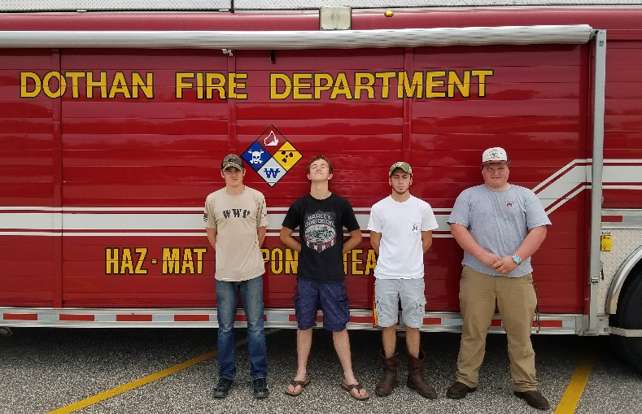


FIRE SCIENCE
The Fire Science class was implemented in the fall of 2016 and allows senior level students the opportunity to gain fire and safety knowledge as well as potentially earn certification as a volunteer fire fighter. Students must be 18 years old or turn 18 by the end of the school year in order to enroll in this class. After completion of the course, students have the option to complete the bridge program which will certify them in five weeks to be a level one fire-fighter.
This program will cover the 160 hours required to complete the firefighter training program

Slide 10
Dual Enrollment
Academic Programs Offered
SUMMER 2020
Speech 107
Music/Art
FALL 2020
History 202
Math 112
Psychology 200
English 101
SPRING 2021
History 201
Math 113
Biology 103
Music/Art
Speech 107
English 102

Slide 11
Fall Dual Enrollment
Offered At Home Schools:
School | Semester | Class
AHS | Fall | ENG 101
CHS | Fall | ENG 101
CHS | Fall | HIS 202
HCHS | Fall | ENG 101
RHS | Fall | ENG 101
RHS | Fall | ENG 101
RHS | Fall | ART 200
WHS | Fall | ENG 101
WHS | Fall | PSY 200

Slide 12
Spring Dual Enrollment
Offered At Home Schools:
School | Semester | Class
AHS | Spring | ENG 102
CHS | Spring | ENG 102
CHS | Spring | HIS 201
HCHS | Spring | ENG 102
RHS | Spring | ENG 102
RHS | Spring | ENG 102
RHS | Spring | PSY 200
WHS | Spring | ENG 102
WHS | Spring | ART 200

Slide 13
Fall Dual Enrollment
Offered At HCCA Campus:
Dual Enrollment Offerings for 2020-2021
Fall Offerings
School | Semester | Class | Day | Time | Instructor | Grade Level | ACT Req.
HCCA | Fall | HIS 202 | T, TH | 7:30-8:45 | Carter | 10-12 | n/a
HCCA | Fall | HIS 202 | M, W | 7:30-8:45 | Carter | 10-12
HCCA | Fall | MTH 112 | M,W | 9:15-10:30 | WCC | 11-12 | 22 on math portion
HCCA | Fall | PSY 200 | M, W | 2:15-3:30 | WCC | 10-12 | n/a
HCCA | Fall | MAT 101 | M, W | 12:30-2:15 | WCC | 11-12 | n/a
HCCA | Fall | MAT 102 | T, TH | 12:30-2:15 | WCC | 11-12 | n/a
HCCA | Fall | EMS 118 | M-F | PM | WCC - Woods | 12 (must be 18 before the end of the year) | n/a
HCCA | Fall | AMT 101 | M-F | PM | ESCC | 12 (returning students) | n/a
HCCA | Fall | AMT 102 | M-F | AM | ESCC | 10-12 | n/a
HCCA | Fall | WDT 107 | M-TH | AM | WCC - Dean | 11 | n/a
HCCA | Fall | WDT 110 | M-TH | AM | WCC - Dean | 11 | n/a
HCCA | Fall | WDT 122 | M-TH | PM | WCC - Dean | 12 (returning students) | n/a

Slide 14
Spring Dual Enrollment
Offered At HCCA Campus:
Spring Offerings
School | Semester | Class | Day | Time | Instructor | Grade Level | ACT Req.
HCCA | Spring | HIS 201 | T, TH | 7:30-8:45 | Carter | 10-12 | n/a
HCCA | Spring | HIS 201 | M, W | 7:30-8:45 | Carter | 10-12
HCCA | Spring | MTH 113 | M, W | 9:15-10:30 | WCC | 11-12 | 23 on math portion
HCCA | Spring | MTH 125 | M, W | 2:15-3:30 | WCC | 11-12 | 25 on math portion
HCCA | Spring | BIO 103 | T/TH | 9:20-11:35 | Brantley | 10-12 | n/a
HCCA | Spring | MUSIC/ART | M, W | 2:15-3:30 | WCC | 10-12 | n/a
HCCA | Spring | SPEECH | T, TH | 2:15-3:30 | WCC | 10-12 | n/a
HCCA | Spring | MAT 103 | M, W | 12:45-2:15 | WCC | 11-12 | n/a
HCCA | Spring | MAT 122 | T, TH | 12:45-2:15 | WCC | 11-12 | n/a
HCCA | Spring | EMS 119 | M-F | PM | WCC - Woods | 12 (must be 18 before the end of the year) | n/a
HCCA | Spring | WDT 122 | M-TH | AM | WCC - | 11 | n/a
HCCA | Spring | WDT 122 | M-TH | AM | WCC | 12 | n/a
HCCA | Spring | WDT 123 | M-TH | PM | WCC | 12 (returning students) | n/a
HCCA | Spring | AMT 100 | M-FR | AM | ESCC | 10-12 | n/a
HCCA | Spring | AMT 111 | M-FR | PM | ESCC | 12 (returning students) | n/a
HCCA | Spring | Fire Science 530011 | M-FR | PM | Hayes | 11 or 12 grade | n/a
HCCA | Spring | Fire Science 50012 | M-FR | PM | Hayes | 11 or 12 grade | n/a

Slide 15
Dual Enrollment Agreement
Students participating in Dual Enrollment
classes, as well as their parents or guardians,
will be asked to sign an enrollment/attendance agreement prior to registration.

Slide 16
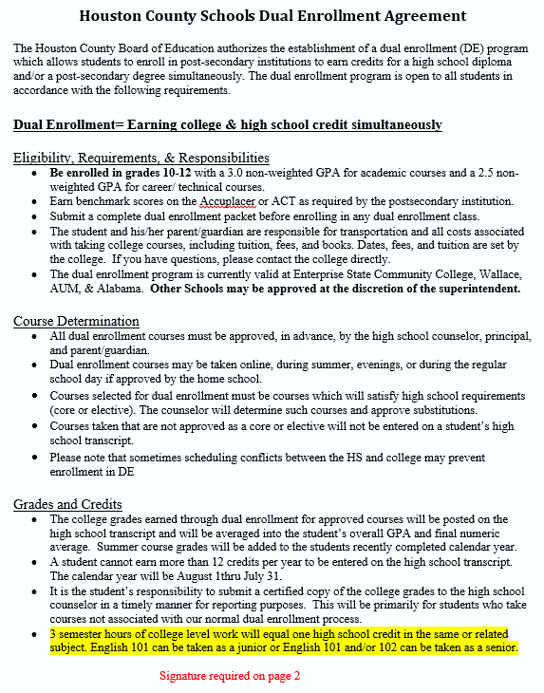



Slide 17
Registration Deadlines:
Houston County Deadline for
submitting completed DE packets:
March 6th – for summer classes
April 20th – for fall and spring classes

Slide 18

Wallace Community College

Slide 19


Scholarship Opportunities
Wiregrass Foundation Scholarship
This scholarship, provided through the Wiregrass Foundation, is open to SENIORS in the Dothan City Schools System (Dothan High School—formally Dothan and Northview High) and Houston County Schools System (Ashford High, Cottonwood High, Houston County High, Rehobeth High, and Wicksburg High).
Seniors must have a 3.0 or higher GPA and receive free or reduced lunch in order to be eligible. The scholarship will pay for one 3 credit hour academic course in the fall semester and one 3 credit hour academic course in the spring semester. Books are not included as a part of the scholarship. Eligible students should contact their high school counselor.

Slide 20






Scholarships—Cont’d
Workforce Development Grant Scholarship
This scholarship is provided through the Governor’s Office of Workforce Development to give area students a head start in several high demand careers. The scholarship pays tuition for career-technical courses. The funding budget for this scholarship varies from year to year, but it is an excellent avenue to obtain career-ready skills while still in high school.
These courses would include:
Air Conditioning and Refrigeration,
Automotive Technology
Child Development
Computer Science
Electrical Technology,
Graphic arts & animation (dRAFTINg)
Industrial Maintenance,
Emergency Medical Service Basic (EMS)—2.5 GPA required
(seniors preferred due to testing requirements—18 years old)
Medical Assisting—2.5 GPA required
Office Administration
Welding
BIO201/202 (pre Healthcare majors—pre-rad, pre-PTA,
Pre-respiratory, pre-nursing) *bio103 is a pre-req not covered by the grant
New

Slide 21

privacy rights as a college student--FERPA
Under the Federal Family Educational Rights and Privacy Act (FERPA), faculty and staff at WCC cannot discuss grades, attendance, or other private educational records with anyone except the student without written permission of the student.
Even though Dual Enrollment students are in high school—they are still covered by FERPA legislation!!

Slide 22
Continuous Eligibility Policy
Students who meet the criteria for initial admission for a Dual Enrollment for Dual Credit program as specified will maintain continuous eligibility so long as they earn a grade of C or better in all attempted college courses.
Students who fail to meet this minimum grade requirement or who withdraw from a course will be SUSPENDED from the program for a minimum of one term. The one-term suspension may not be served during the summer. The student may not re-enroll until the suspension has been served. For re-entry, the student must reapply to the program and must meet the minimum grade point average requirements.

Slide 23
Questions?
dualenrollment@wallace.edu
(334)556-2423 Or (334) 556-2624

Slide 24

DUAL ENROLLMENT OPPORTUNITIES

Slide 25

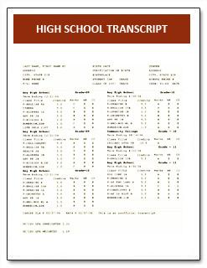
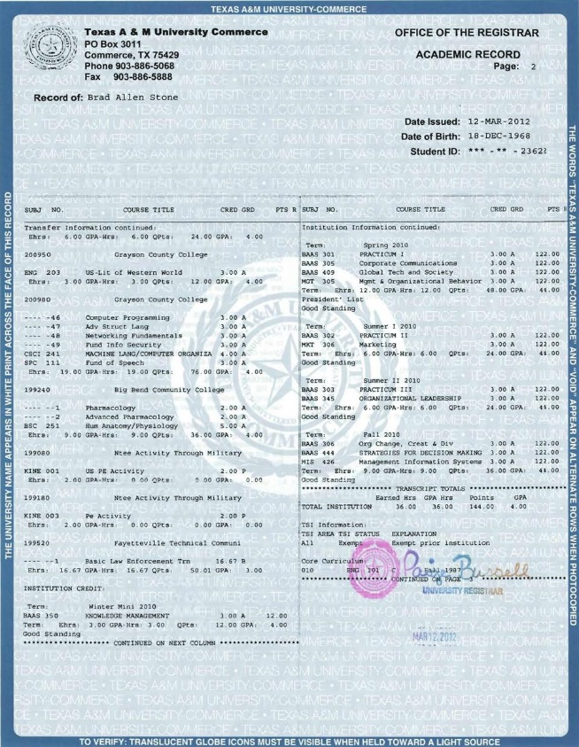
DUAL ENROLLMENT FOR DUAL CREDIT
Dual Enrollment for Dual Credit allows eligible high school students to earn both college credit and high school credit for courses taken through Enterprise State Community College while still enrolled in high school.

Slide 26
DUAL ENROLLMENT ALLOWS YOU TO:
Earn college credits before leaving high school
Shorten the time it takes to earn a college degree
Experience the academic rigor of a college course while still in the supportive environment of high school
Develop good time management and study skills
Enhance your college admission application package or resume
Transition more easily from high school to college
Prepare for a career
Save money – Tuition and fees are less expensive at a community college and scholarships may be available

Slide 27

DUAL ENROLLMENT SCHOLARSHIPS
Funded through Workforce Development grants
Available for courses in career/technical education (CTE) programs (High-Wage/High-Demand occupations)
Will only cover the cost of English, Math, and Science courses that are required for completion of a qualifying CTE credential/degree.

Slide 28
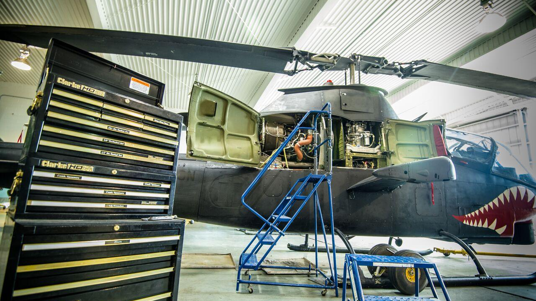
AMT Program

Slide 29
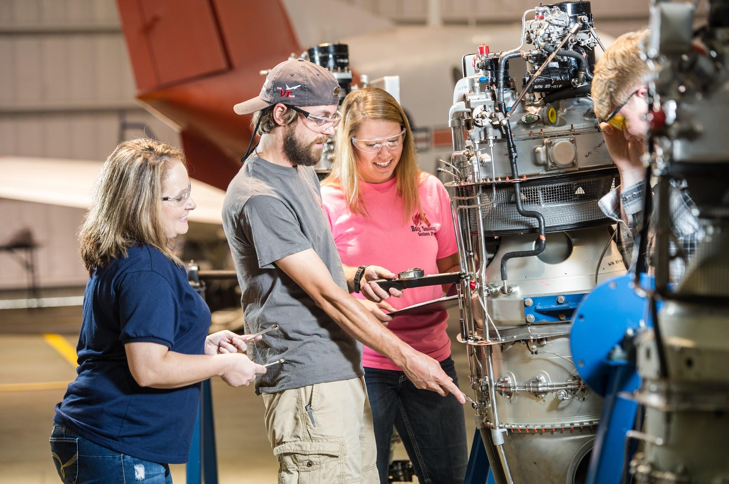
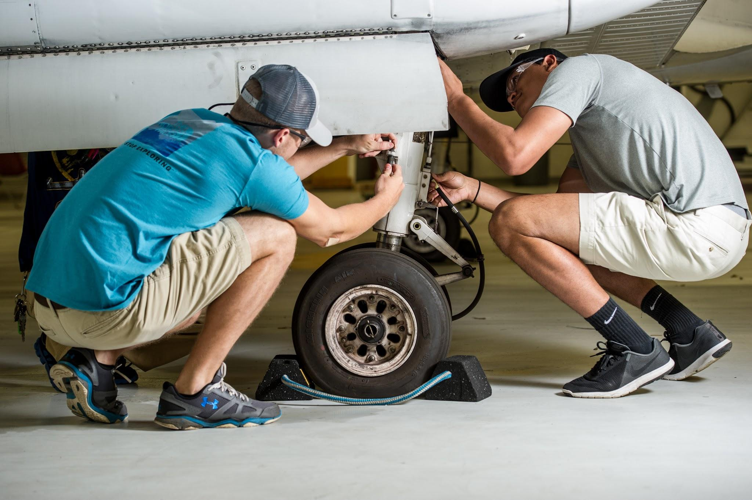
Aviation Maintenance Technology
Become an Aircraft Mechanic in 2 years!
AIRFRAME & POWERPLANT
Skill Sets Learned:
Airplanes and Helicopters
Body, Paint, Rigging, Engine Overhaul, Tire pressure, Electricity, Materials and Processes, etc … HANDS ON EXPERIENCE
2 year program teaching students the skills, knowledge and ability they need to land a high paying job
Airframe and Powerplant technicians are in high demand!
Military
Commercial Airlines
Industrial
Disney World
Hospitals
Manufacturing companies
Provides knowledge & skills needed to take FAA exams
Notes:
Body, Paint, Rigging, Engine Overhaul, Tire pressure, Electricity, Materials and Processes, etc … HANDS ON EXPERIENCE

Slide 30
AIRFRAME
COURSES
OFFERED
AT
HCCA
Become an Aircraft Mechanic in 2 years!
Fall 2020
AMT 102 – Material and Processes – 1st year students - Monday – Friday, 8:15 am – 9:55 am
AMT 101 – Basic Electricity – 2nd year students - Monday – Friday, 12:45 pm – 2:15 pm
SUMMER SEMESTER??
YES, Dual enrollment students may attend summer semester. You’ll take the AMT courses at AAC, Ozark campus. You will be responsible for your own transportation.
YES, the Workforce Grant will cover summer semester courses.
Spring 2021
AMT 100 – Technical Prep – 1st year students - Monday – Friday, 8:15 am – 9:55 am
AMT 111 – Aircraft Sheetmetal – 2nd year students - Monday – Friday, 12:45 pm – 2:15 pm
Notes:
Body, Paint, Rigging, Engine Overhaul, Tire pressure, Electricity, Materials and Processes, etc … HANDS ON EXPERIENCE

Slide 31
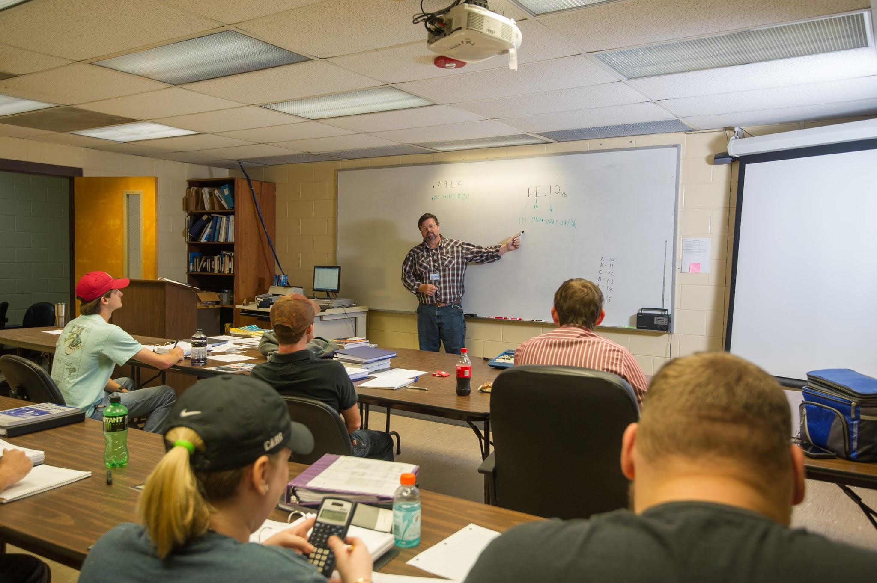
Dual Enrollment
AMT, AVT, MECH-
Also includes academic courses through ESCC.
What are the requirements to participate?
In grade 10th, 11th, or 12th
Have a cumulative unweighted GPA of 2.5 on a 4.0 scale. We have a waive for 2.0 GPA.
Continuous Eligibility for Dual Enrollment for Dual Credit – Students who meet the criteria for initial admissions for a Dual Enrollment for Dual Credit program as specified will maintain continuous eligibility so long as they earn a grade of C or better in all attempted college courses. Students who fail to meet this minimum grade requirement or who withdraw from a course will be SUSPENDED from the program for a minimum of one term. The one-term suspension may not be served during the summer. The student may not re-enroll until the suspension has been served. For re-entry, the student must reapply to the program and must meet the minimum grade point average requirements.
Have written approval from the high school
Be academically, physically, and socially ready for college classes.
Possible placement test required – for academic courses (English & math)

Slide 32
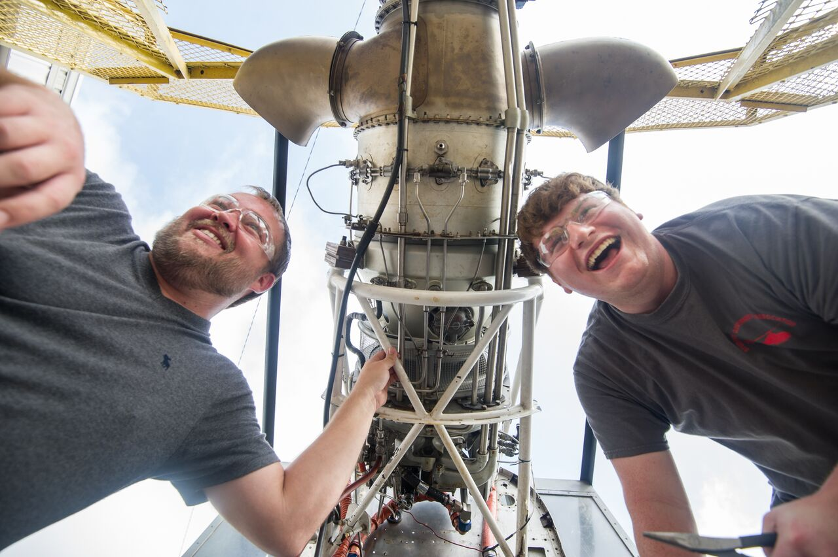
AAC HISTORY!
The Alabama Aviation College originated in 1960 in Ozark, Alabama.
1962 the programs were certified through the FAA.
The only Aviation Maintenance Program in the state of Alabama
One of the only Part 1- 147 schools that still allows students the opportunity to do a complete overhaul and block test (run up)

Slide 33
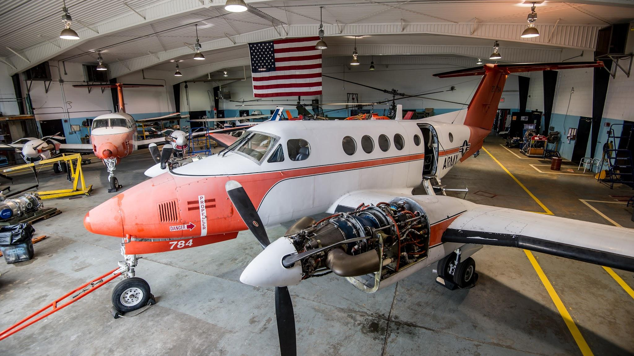
BENEFITS of Aviation

Slide 34



What does Aviation Training mean for a student's Future?
Next 3-5 year - 54,000 jobs open.
Next 2 decades- 70,000 new aircraft created

Slide 35
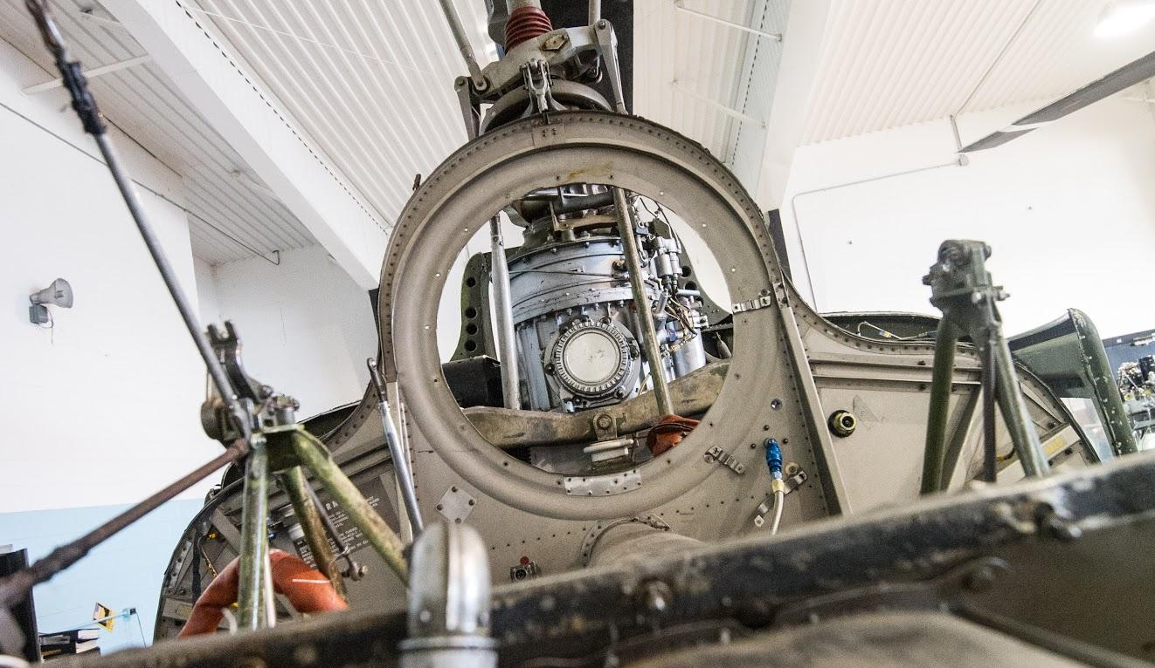
ADMISSIONS

Slide 36
How Do I Enroll…
Complete the Dual Enrollment Application packet and provide the following:
Residency Form
Photo ID
Identity Verification Form (W9)
1
Submit Supplemental Items
2
High School Transcript
ACT Test Score or
Take the ACCUPLACER (if required)
Register For Classes
3
Request dual enrollment courses during your high school registration. Talk with your parents and high school counselor.

Slide 37
Why choose AAC?
OPPORTUNITY
The opportunity to grow as a mechanic is limitless, with various labs and hangers on campus students are given every opportunity to get their hands dirty.
PROGRAMS
AMT
AVT
Mechatronics
STUDENT LIFE
There are organizations on campus to help students find their neitch while in school.
CAREER
AAC puts on 2 career fairs each year. This give students the opportunity to see what is out there and to apply for jobs. The job market is starting to boom right now and with the new administration in office, we are already seeing positive changes to this industry on the local scale.

Slide 38



@ALABAMAAVIATIONCENTER
#AACOZARK
Ways to follow us!
Ann Kelley- Spence
Dual Enrollment Director
dualenrollment@escc.edu
334-347-2623 EXT:2208
Escc.edu

Slide 39
Welcome to
Houston County Career Academy!
Dual Enrollment
Informational Meeting
Let’s stay connected:
HCCAeagles.us
Houston County Career Academy
@HCCAdothan
HCCA_dothan

