Slide 1
Even & Odd Numbers
Quick Check 4-9

Slide 2
Which number is odd?
12
22
23
34
0 of 32

Slide 3
Which number is even?
71
52
43
19
0 of 32

Slide 4
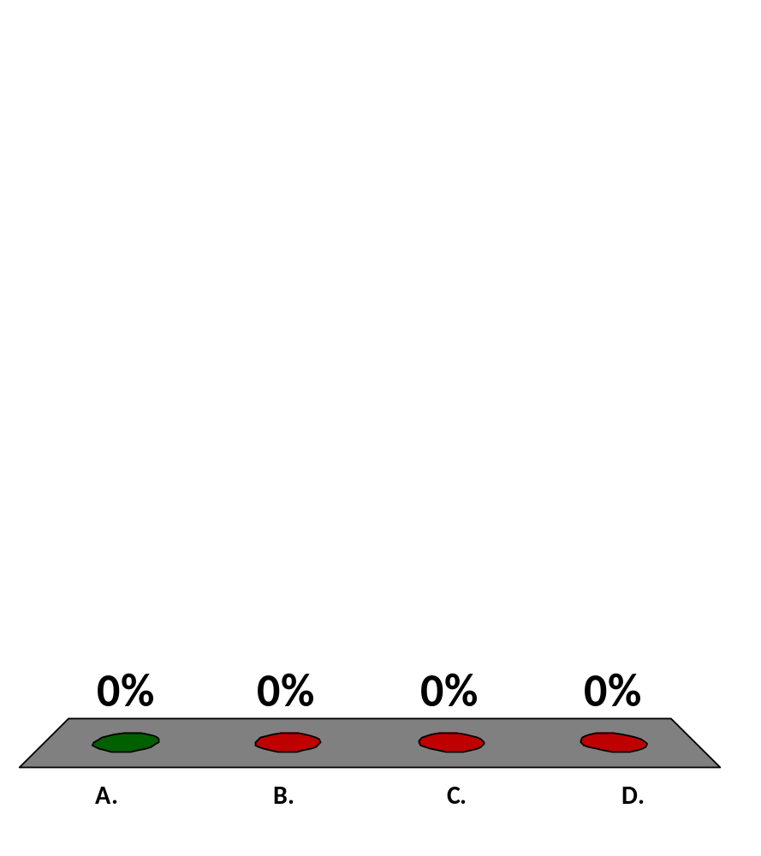
Which number is odd?
39
44
56
98
0 of 5

Slide 5
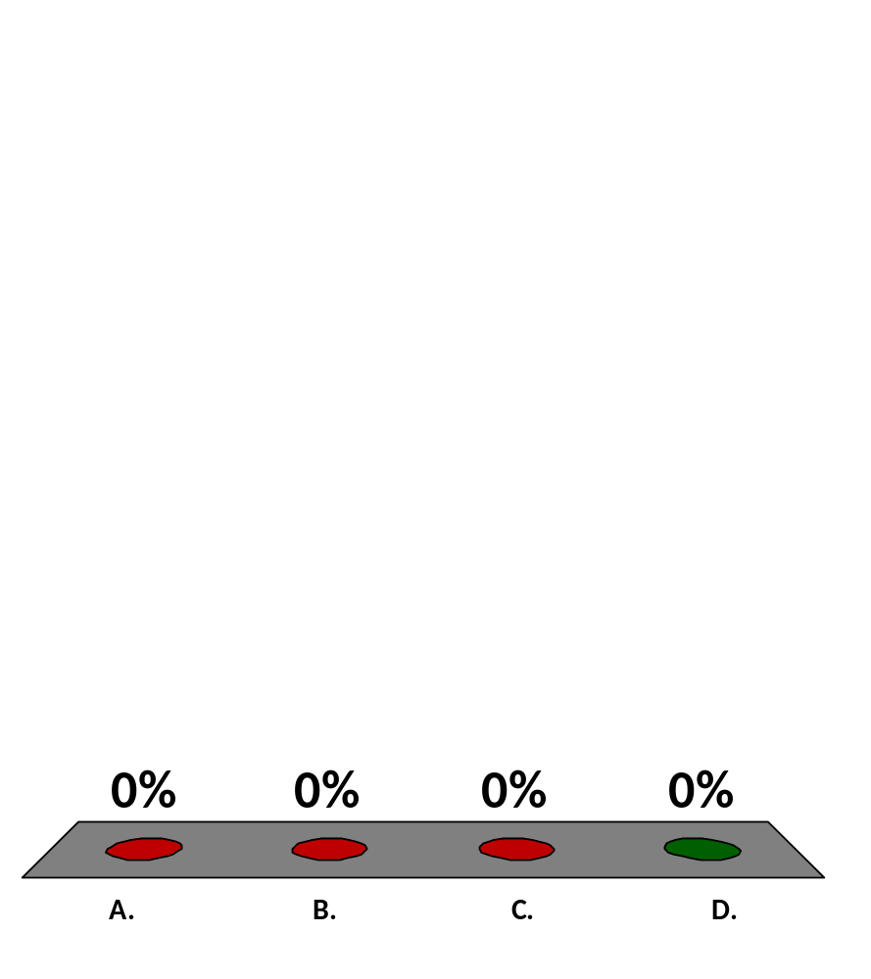
Which number is even?
95
63
29
18

Slide 6
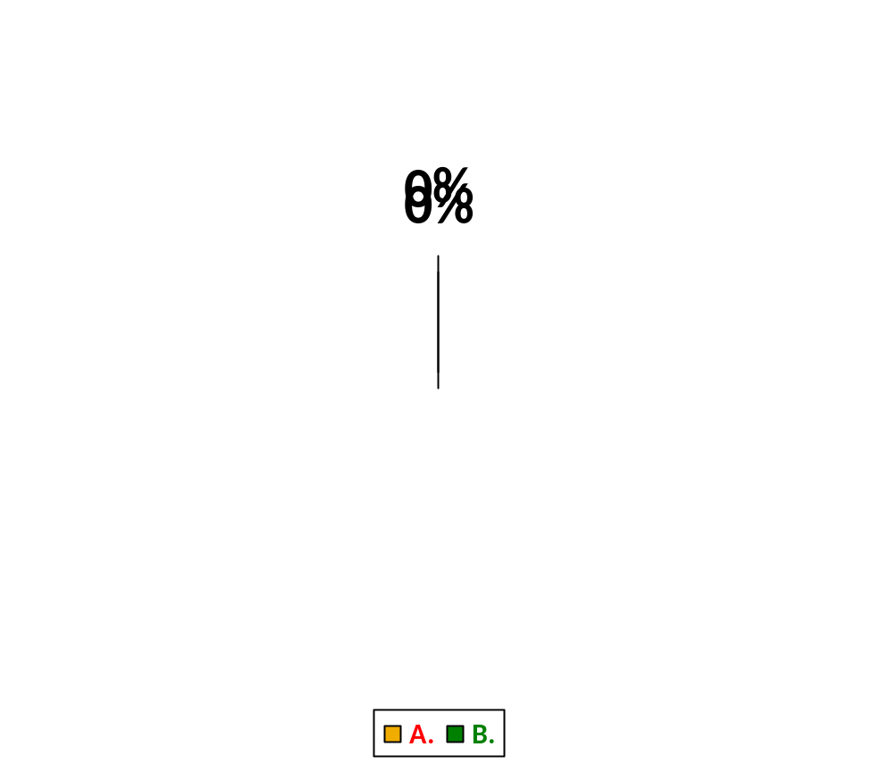
If you add 2 even numbers, will the sum be odd or even?
Odd
Even
0 of 5

Slide 7
If you add 2 odd numbers, will the sum be odd or even?
Odd
Even
0 of 5

