Slide 1
Characterization Uncovered

Slide 2
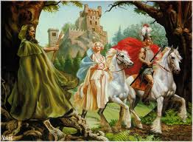
What is characterization?
Characterization:
  How an author develops a character and makes him or her seem believable.

Slide 3

Three methods authors use to describe characterization are:
Thoughts/Actions
Appearance/Personality
Other’s Thoughts

Slide 4
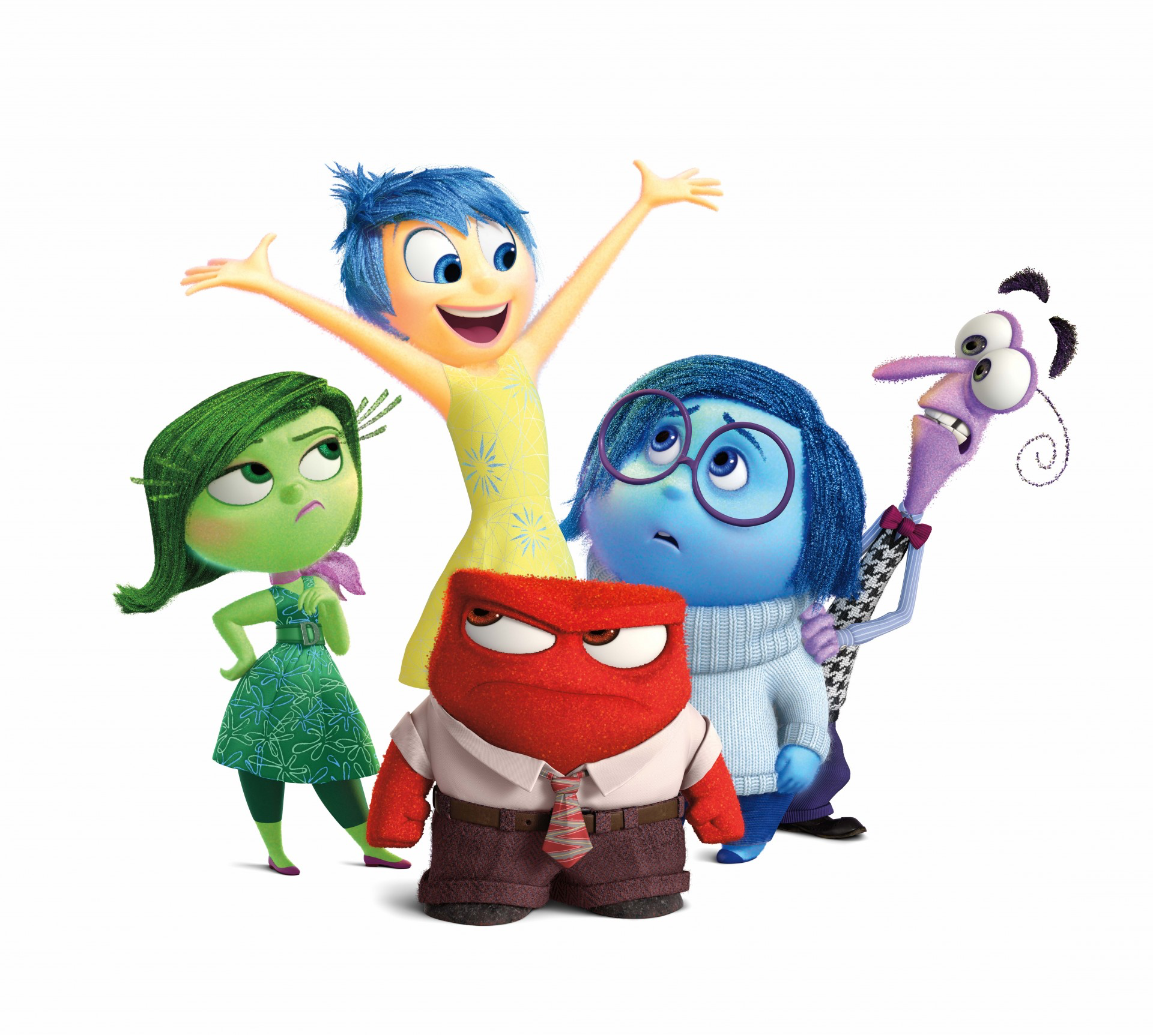
Thoughts/Actions
  Sharing the character’s thoughts, actions, and dialogue

Slide 5
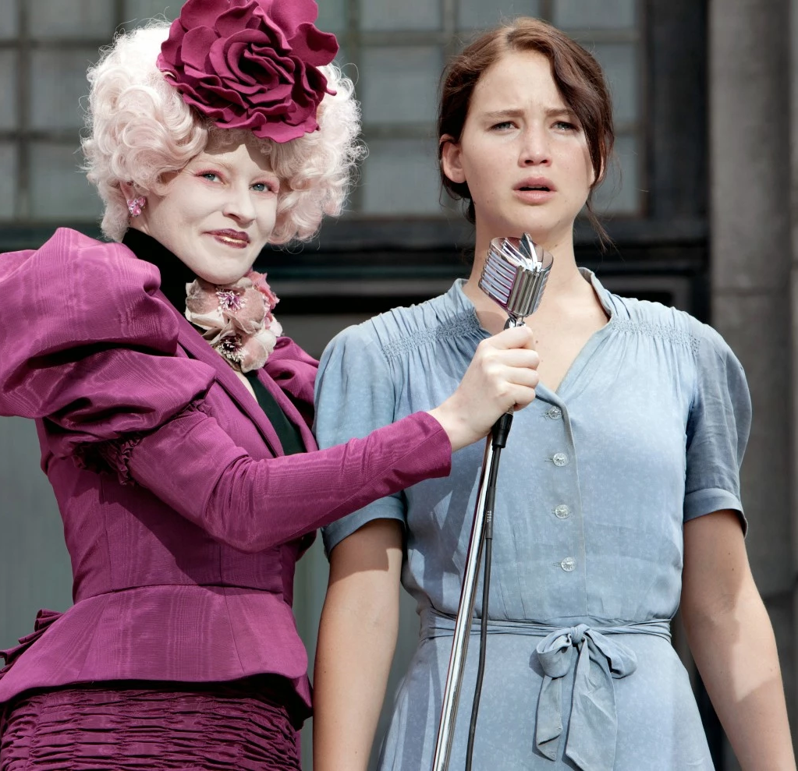
Appearance/Personality
  Describing his/her appearance and personality

Slide 6
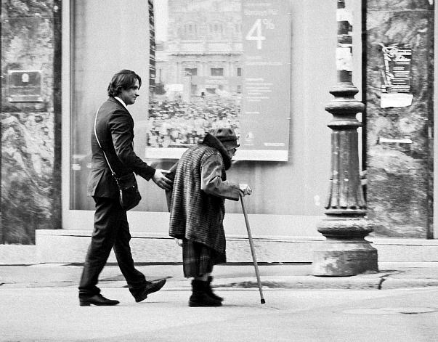

Other’s Thoughts
  Revealing what others in the story think of the character

Slide 7
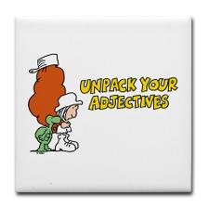
Traits and Characterization
We often use traits to discuss characterization.
A character trait is a distinguishing quality or characteristic, typically belonging to a person.
NOTE: Character traits are usually adjectives.

Slide 8
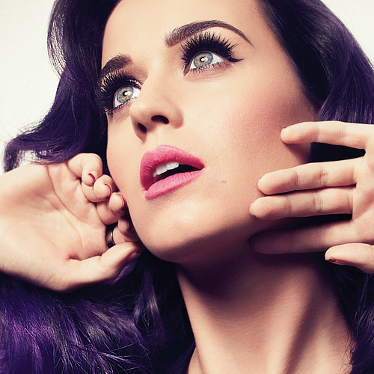
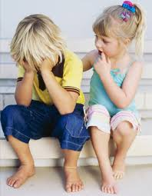
Physical Traits and Psychological Traits
Physical (outside description)
For example:
beautiful, skinny, tall
Psychological (inside/personality description)
For example:
caring, compassionate, friendly

Slide 9
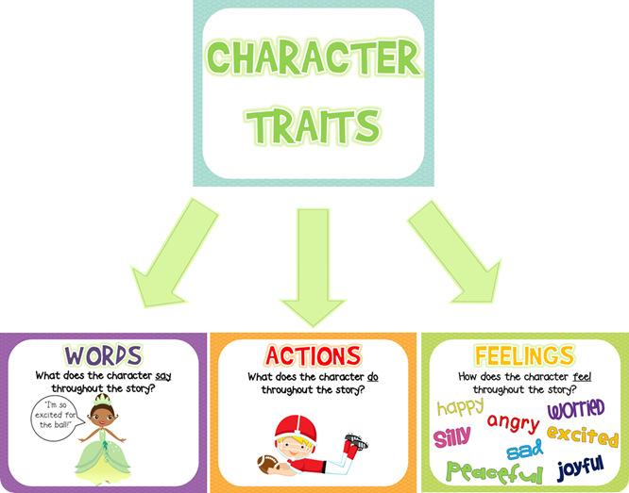

Slide 10
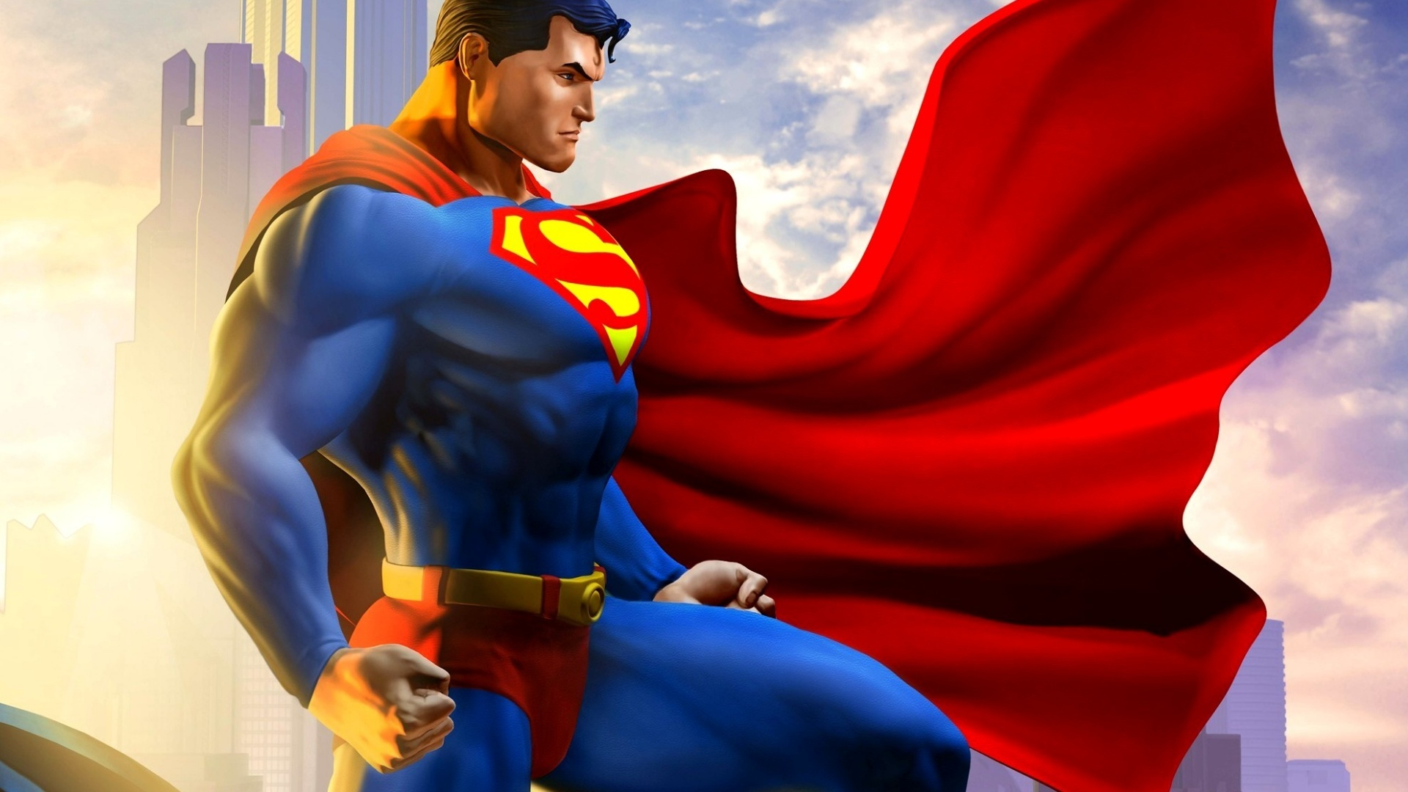
Let’s Practice!
Your mission is to write about Superman’s characterization!
Physical traits:
Psychological traits:

