Slide 1
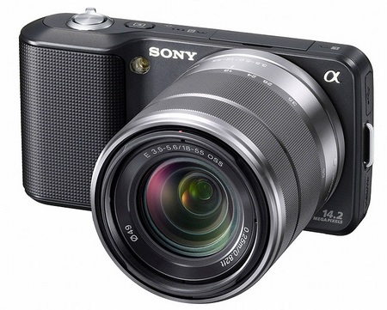
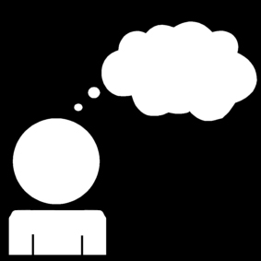
POINT OF VIEW

Slide 2
What is point of view?
Point of view is the narrator’s perspective OR a character’s attitude or perspective about the events and other characters in a story.

Slide 3
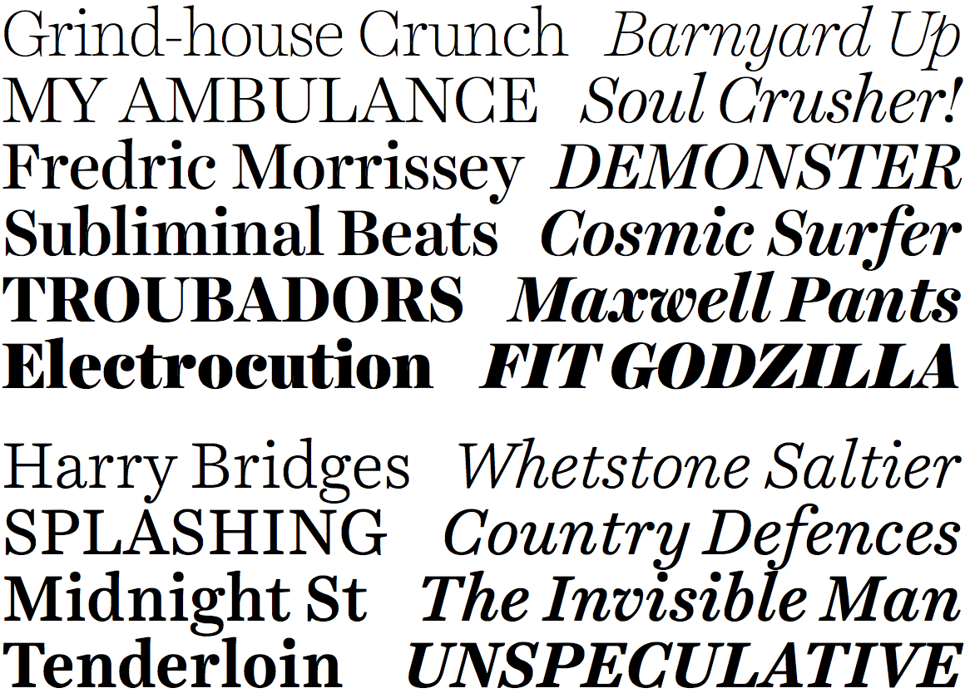
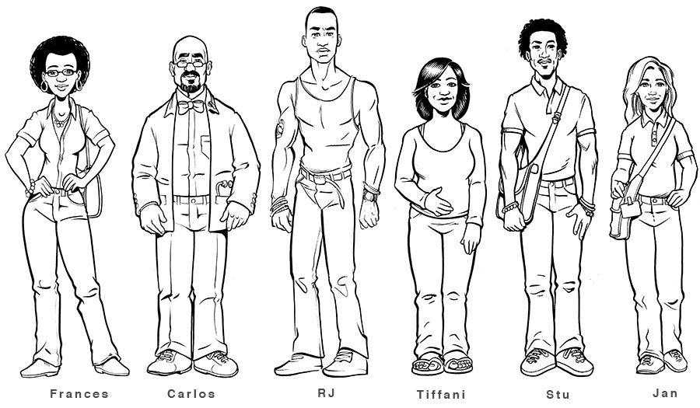
There are two types of Point of View.
Point of View
Narration
Character

Slide 4

Narration
When we think of narration, we think of who is telling the story – the narrator.
The narrator might be someone who participates in the story, or the narrator can be an outside observer of the story.
    In “The Monsters Are Due on Maple Street” the narrator is an outside observer.

Slide 5

One way to think about narration is by deciding which “person” is being used.
Three Types of Narration
First Person
Second Person
Third Person
  Limited
  Omniscient

Slide 6
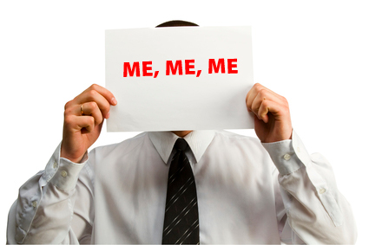
FIRST PERSON
In first person point of view, the narrator is a participant. It is usually the main character telling his or her own story.
The reader knows only what the narrator thinks, but no other characters.
Sample Signal pronouns: I, me, my, we, us, ours

Slide 7

SECOND PERSON
In second person point of view, the narrator tells the reader what the reader thinks, says, or does. The author makes the reader a participant in the action.
This is an awkward point of view and is used most often in advertising.
Sample Signal pronouns:
you, your, yours

Slide 8
THIRD PERSON
In third person the narrator is an outside observer, and the reader usually doesn’t know his or her name. The narrator doesn’t affect the story.
Limited - the narrator is an outside observer who can only see inside one character’s head.
Sample Signal pronouns: he, she, it

Slide 9
THIRD PERSON
Omniscient - the narrator is a godlike observer through whom the reader can see and know all things.
Unlike third person limited, the narrator can know many characters’ thoughts or what is happening in multiple locations at once.
Sample Signal pronouns: he, she, it

Slide 10
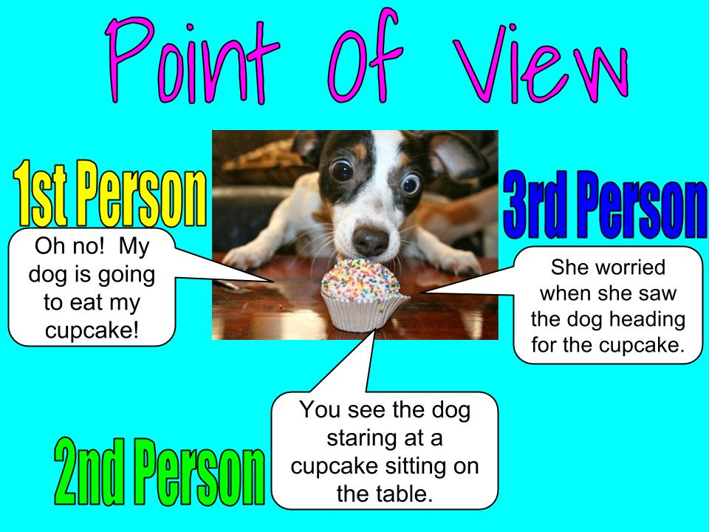

Slide 11
Character
When we think about a character’s point of view, we think about his/her perspective on a situation.
Perspective is the way someone views the world.
In order to know someone’s perspective, we think about his/her beliefs, attitude, values and life experiences.

Slide 12
Examples
If a person…
believes technology is not good for people, he will likely have a negative perspective on buying his daughter an iPhone.
values honesty, she will probably have a negative perspective on a person who starts rumors.
loves sushi, she will likely have a positive perspective on going to a Japanese restaurant for dinner.

Slide 13
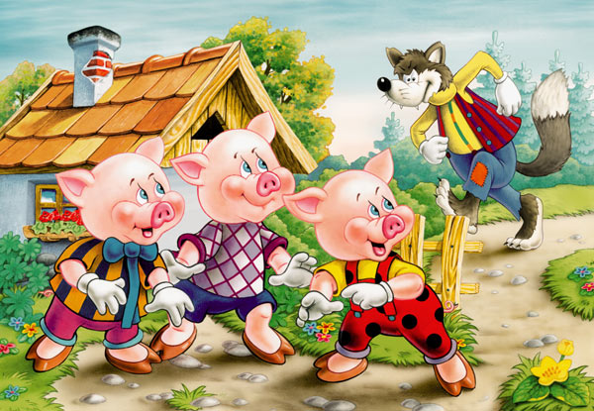
“The Three Little Pigs”
Think about this classic story.
What is the pigs’ point of view on the wolf? What beliefs / value / attitudes / life experiences might lead to this perspective?
What is the wolf’s point of view on the pigs? What beliefs / values / attitudes / life experiences might lead to this perspective?
What is the narration point of view of this story?

