Slide 1
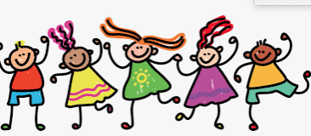
Facilitating Friendships
Dr. Tara Leufroy (School Psychologist) and Jenny Doan (School Psychologist Intern)

Slide 2
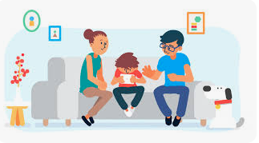
Talk About It
Parent-teacher conferences
Address it with your child head-on
Share a story about a time you had to make new friends as a kid or adult
Daily chats/Discussing Disagreements
Revisit It
Notes:
Teachers have valuable information about their student’s social skills. If your child has has an IEP reach out to IEP team; school psychologist. If your child receives behavioral support from an additional adult at school, such as an embedded aid or a 1-1, then I would ask the behavioral aide how your child is interacting with others and if they are developing friendships.
Depending on their level of understanding, open up the conversation and let your child know that you are aware of the situation and ask their take on it. Ask if they ever get lonely at school, do they want friends, who are they playing with at recess.
Share a time when it didn’t go as planned, be sure to discuss what you did to make it better
Conversations with your child about their friends and how they handle conflict. I’m currently helping a small group of 3rd graders work thru their difficult history so they can move on and rekindle their friendships. Teaching them how to handle conflict and disagreements by modeling can help your child do it independently.
Continually check in with your child on how they are feeling; get updates from your child and the school team

Slide 3
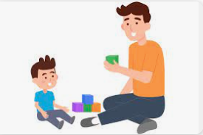
Building Blocks to Friendships
Help your child understand what a friend is
Keep things simple
Ask questions like, “Do you like being around people who call you names?” and “Do you like being around people who say nice things to you?”
Understanding abstract concepts can be challenging for young kids, especially those with Autism.
Be literal when you can.
Use clear, plain language like, “ “friends are nice to you and say things that make you feel better when you have a bad day.”
Notes:
It’s important to go over qualities of a good friend to your child. Keep things simple and ask, “Do you like being around people who call you names?” Do you like being around people who say nice things to you?
Understanding abstract concepts can be difficult for young children especially those with Autism. So be literal and use clear concrete language. Some things you can remind your child are: sharing is caring, it's important to listen to others so they know their thoughts and ideas are being heard, be happy for friends when something good happens to them, to let an adult know when there is a disagreement that they cannot solve, its okay to cry when friends hurt your feelings, facial expressions help others to have a good day, always tell the truth

Slide 4
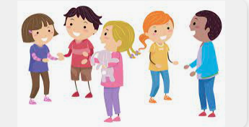
Social Rules
How to help your child follow social rules
Start by breaking down social rules in ways your child can understand and practice
  Role playing
  Use your child’s favorite TV show to focus on reading body language and other social cues
Praise your child for successful social interactions
Meet and greet politely
Take turns talking
Paying attention to others
Think about others before acting
Cooperate with others
Notes:
Social Rules
Meet and greet politely
Saying greetings, introductions, and goodbye
Politely offering and receiving compliments
Being able to start and finish conversations
Take turns talking
Listening when others speak and looking them in the eye
Not interrupting
Responding appropriately and at the right time
Pay attending to others
Stopping what you are doing so you can listen
Reading people’s emotions through their body language and facial expressions
Changing your behavior to match what other people are doing, like quieting down with the rest of the room
Think about others before acting
No touching without asking
No cutting in line
Waiting your turn
“W” for wait pressed lightly on arm or should if needed to decrease interrupting, will take time
Standing a comfortable distance away when talking
Parents you can teach your child about personal space
Let your child feel “too close” and help them understand how it is how others feel when we are in their personal bubble. Your child’s personal bubble may be larger than others
Show your child the right distance to maintain; use props; hula hoop and have them stand in the middle (2 feet)
Stage conversations and have family members take turns standing too close or just the right space when talking to each other
Talk about other social cues your child can look for to see if the other person is uncomfortable
Cooperate with others
Follow directions when you are asked to
Asking for help when you need it
Apologizing when necessary
Begging flexible and open to new ideas
How to help your child follow social rules
Start by breaking down social rules in ways your child can understand and practice
Role playing games are a good way to model behavior and help your child practice responding to different social situations
Use your child’s favorite TV show to focus on reading body language and other social cues
Praise your child for successful social interactions
Give positive and specific feedback can reinforce the behavior you want your child to repeat
With practice and support, your child will get better at following social rules

Slide 5
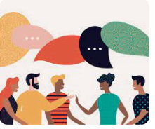
Role Play
Practice Initiating Conversations
Practice Empathy
Address Conflict Resolution
Practice Nonverbal Communication
Practice Taking Turns
Create Social Scripts
Social Stories
Notes:
For children with the language and communication skills to do so, we can role play conversations with them and encourage them to use appropriate greetings and ask open ended questions to keep the conversation going
Some of our children have difficulty understanding someone else’s point of view, so we can practice consoling a friend who is upset or cheering them up when they are feeling down.
Try role playing scenarios where your child practices resolving conflicts with peers. Now this a big one, especially if your child has difficulty with self-regulation. Practicing self-regulation techniques such as walking away, belly breathing, asking for an adult can help. Then we can encourage our children to use active listening skills.
Role play scenarios where your child practices nonverbal communication skills such as making eye contact, using appropriate body language and facial expression to convey emotions
Practice turn-taking in conversations and games with friends. This can help build skill of waiting patiently and listening to others.
Create social scripts to use in real-life situations. For example a script for introducing themselves to a new person, inviting a peer o play at recess, following another’s person's play scheme.
Social stories are great for “what if” situations dealing with friendships. You can google or make your own and help your child prepare for scenarios such as: a friend decides they don’t want to friends, a friend is being rude to others, when a friend hurts your feelings, a friend doesn’t want to do the same thing as you

Slide 6
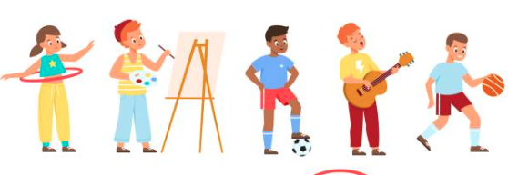
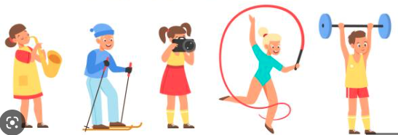
Find Opportunities for Socialization
Speak with your child’s school about after-school activities
Check with local organizations for special programs
Ask your school about support groups
Ask your child’s specialist for help
Get involved in your child’s hobbies and interests
Ask your child’s teacher to help you find peers with similar interests
Notes:
Common interests are important factors in developing and maintaining friendships.
It’s hard to be friends with someone you have nothing in common with. If your child loves art, enroll her in an art class. If your child loves science, find a young scientists group.
Make sure these groups have similar-aged peers so she is surrounded by age-appropriate behavior.
Asking the teacher or other staff member to spend some time watching your child at recess to see if they gravitate towards anyone or if they prefer or play with someone. Then encourage the children to set up a playdate. REach out to the parent to set up a playdate.
Why after-school activities are important?
It can be hard to make friends while you're in class, or navigate through lunch and recess especially if you lack social skills. After-school activities are an opportunity to connect to other kids in a diff way.
When choosing activities we must be realistic and start off with an activity that your child is already interested in so they are motivated to engage.
Choose a program with an intensity level that your child can handle. If a team sport demands high levels of physical, social, and motor skills then maybe your child with social anxiety may have more fun in individual track and field events.
Many neurodivergent children do better in highly structured programs like boy or girl scouts. These programs are highly organized, activities are hands-on, and the organization is dedicated to including children regardless of ability. Talking to the instructor about your child’s needs and how they can support can help you find a good match.
Some examples include sports, singing and instrumental programs, computer programming and robotics, dancing, and theater.
In middle and high school, there is a wide variety of clubs for students to join.

Slide 7
Questions????

