Slide 1

2nd Grade
Mrs. Aldaco

Slide 2

About the teacher
11th year at Mountain
24th year in education(17 full/7 sub teacher)
13th year teaching second grade
Taught all the lower grades, but truly enjoy teaching
the second grade curriculum and watching their growth
development at this age.

Slide 3

My Background…
Grew up in the San Gabriel Valley
Speak Spanish fluently
Went to Whittier College
BA in Business Admin. and Spanish Lit.
Cal Poly Pomona / Multiple Subject Credential
University of La Verne /Masters in Adv. Teaching Skills
Glendale Unified - Restorative Practice Teacher
Autry Museum Teacher
Mountain Avenue School Garden Advisor

Slide 4

Outside of school I love to…
Exercise / Self-care
Hike
Cooking and baking
Reading
Craft projects
Traveling to new places
Being my kids’ best cheerleader (soccer/band mom)
Advocate (special needs in my own family)
Spending quality time with family
Favorites:
Drinking a hot light cafe mocha and reading
Enjoying a good laugh with family/friends
Church activities

Slide 5

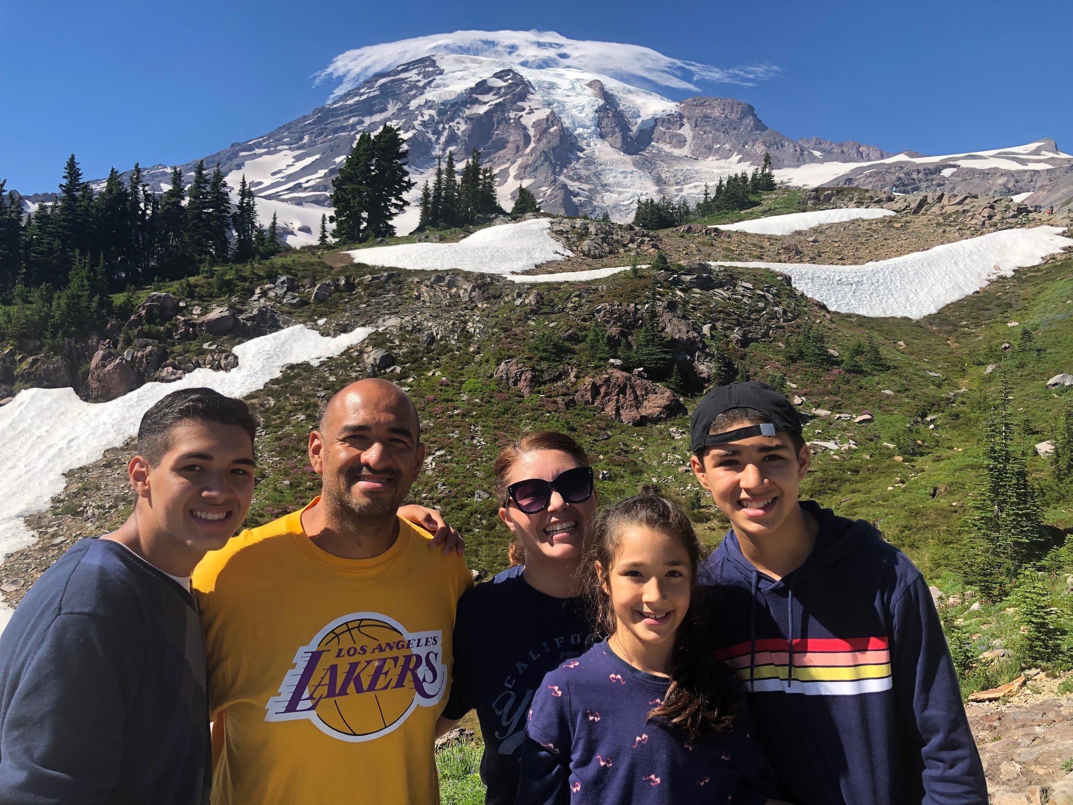
My Family
3 kids
This is July and Mt. Rainier was still covered in snow!
Here we are finishing the hike to the top of Mt.Rainier in Washington.
(A mom of two teens and a preteen).
Notes:
Live in Arcadia / 10th grader at Arcadia/ 8th grader/ 5th grader here /
Being a mom I have also have been a part of our special education services with my own kids - oldest had tics(in his younger years) / daughter has learning processing disability/ dyslexia

Slide 6

Educational Philosophy…
Every child is capable of learning and is a valuable member
of our classroom community.
Everyday I strive to Inspire my students to…
Reach their greatest potential
Grow in their personal confidence
Learn to have a growth mindset that mistakes are a part of learning and we are all a work in progress
Learn to work with our limitations and abilities to
always do the best we can

Slide 7

Classroom Community
My goal is to create a safe and positive classroom community where your child will
be academically challenged and encouraged to always do their best.
B - Be Kind
E – Encourage Others
A – Accept Responsibility
R – Respect Others
S – Stay Safe
Positive Classroom Incentives
Caught being good tickets - praises for good choices
Class marbles for positive choices
Class marble reward days
Yellow tickets (Bear store opens every Friday)
Self-Reflection Opportunities (when needed)

Slide 8

Everyone can be a positive class member!!
1. Opportunity for a self-reflection time with
teacher
2. Miss recess and for another self-reflection
opportunity (white slip may be given)
3. Call home or email parents to discuss a
plan to help child make positive choices
(blue slip may be given)

Slide 9

Be an Attendance HERO!
H - here
E - everyday
R - ready
O - on time

Slide 10
Attendance
All students should be at school by 8:15 am, so they may start the
day at 8:20 with our class.
All absences need to be directed to our school health clerk. You may call/send an email/or fill out absence form. Please cc me always on these emails.
Direct # : (818) 248 -7783
Online Form : CLICK HERE for form
All absences over five days will require an independent contract.
Please give me atleast a two weeks notice or more, so I may prepare
the missed work and get the proper signatures for your child to be excused.
Communicate - keep me informed. I always want to make sure your child does not miss core lessons and can get caught up quickly.

Slide 11
Schedule
Welcome/Student of the Day
ELA (Language Arts/Grammar/Phonics/Writing)
Brain Break
ELA (Language Arts/Grammar/Phonics/Writing)
Recess
MATH
Mindfulness/Character Education
Lunch
Quiet Reading Time/ELD
SCIENCE/SOCIAL STUDIES
Jobs/Highlights
Dismissed

Slide 12

Enrichment Opportunities
SMALL GROUPS - for ELA (twice a week or as needed)
PE - Using PushPlayPE
ART - All year/Spring class w/Mrs. Campbell
TECH CLASS (typing/google skills) - (Ms. Torosyan)
LIBRARY - Mrs. Gorin
GARDENING - Planting (carrots), weeding, watering all year
GARDENING CLASSES - Mrs. Sedhom/LA County Master Gardener/ (Fall/Spring)
CORE PLUS (Math focus) - Tuesdays/Thursdays (30 mins)
CHARACTER EDUCATION - Everyday
COMMUNITY CIRCLE TIME - Once a week
SCIENCE LABS - As we finish a science unit they provide hands-on practice

Slide 13

ELA - Benchmark
Ten units covering a variety of social studies, science, and literature topics
Phonics (letter and vowel patterns/syllables)
Grammar (parts of speech)
Annotation skills (close reading comprehension skills)
Fluent readers (learning how to articulate and read with expression)
Speaking and Listening skills - presentation of class work or writing pieces
A consumable book will come home after every Benchmark unit
We will be using our 2nd Grade Binder
2nd Grade Handwriting Skills
Phonics and Grammar workbook
Reading Comprehension workbook
Benchmark unit book
Small groups to address reading comprehension/grammar skills

Slide 14
Writing
Focus will be on developing writing skills, stamina, and confidence
Inventive or phonetic spelling will be encouraged
Spelling dictionaries will be used in class everyday
Writing complete sentences with correct punctuations and capitalizations
Staying on topic and forming a paragraph on a single topic
Rereading work to revise and edit
Using graphic organizers/circle maps/individual conferences to support them in
the writing stages
When helping your child to write, please encourage them to write what they hear, as correct spelling will happen over time.
Be their biggest writing supporter at home; praise them consistently for what they write not on how they’re writing.
Sharing our writing pieces will help them share their proud work to one another.
__________________________________________________________________________
Writing Genres
Narrative
Opinion
Explanatory/Informative
Friendly letters

Slide 15
AR ~ Accelerated Reading
(3 a semester)
What is AR? It is a reading comprehension quiz
program. Your child takes a 5
or 10 question quiz on the reading.
After I confirm your child’s AR reading level, they are to choose books to read at this level.
Books can be from home, school or classroom library. Mostly all books have a quiz.
Every school night your child will have for homework to read 20 minutes.
Your child is encouraged to read chapter books at least twice and fiction books - many times.
AR quizzes should be taken at school during our AR time.
You can check in with me at any time to confirm AR progress, but you will receive a report with every report card.
You may sign up for the “AR Parent Connect” opportunity that will automatically send you an email with your child’s score every time they take a quiz.
If your child is not looking like they will meet the semester goal, I will reach out to parents and see how I can assist more.
Regular reading develops vocabulary and reading fluency skills that assist in helping your child
grow into a more confident reader and write.
GOAL is for each student to take three or more book tests each trimester.
They are welcome to take more, but chapter books will take more time to read.
Notes:
If your child is not meeting the 3 or more goal, I will reach out and communicate to you to see how I can assist more.

Slide 16
Math - Envisions
Fluently add/subtract within 20
Fluently add/subtract using different strategies to 100 then to 1,000
Add/Subtract two and three digit numbers more fluently
Time (clock hands/time to the nearest five minutes, time before and after the hour)
Money skills(coin ~ dollar values/story problems using money)
Measuring Length (inches/cm/yards/using rulers to measure)
Geometric Shapes (vertices/faces/edges on 2D or 3D shapes)
Beginning multiplication strategies (arrays/repeated addition)
Each week one Envision’s homework/practice sheet and
IXL lessons will be assigned for homework to reinforce
topics taught in class.

Slide 17
Science - Carolina Science Program
Ecosystem Diversity
  Organisms and their habitats
  Plant growth/Pollination/Seed dispersal
  Relationships in our ecosystems
  Labs will focus on determining what do plants need to grow and creating a model on how plants are pollinated.
  Understand the role of pollinators (bees and others) their habitats and characteristics
Matter
  What is matter?
  How matter takes different shapes
  Labs: Making fruit punch playdough and molded crayon pieces from melting them
Earth’s Materials
  How water, rock, sand, and soil change the shape of land
  Erosion/Weathering
  Labs: Cornmeal models to understand how erosion occurs
and how to slow it down over time

Slide 18
Social Studies - TCI
1.Families Today and In the Past
2.Geography and Mapping Skills
3.Government Institutions and Practices
4.People Who Supply Goods and Services
5.People Who Made a Difference Dress Up)
________________________________________________________
Projects:
Grandparent interview
Family Tree (Why did our families come to America?)
California/North America Continent flour project
Biography Report - based on our biography reading
  Google slides biography presentation with the template provided
  Oral presentation (dress up as this person)

Slide 19
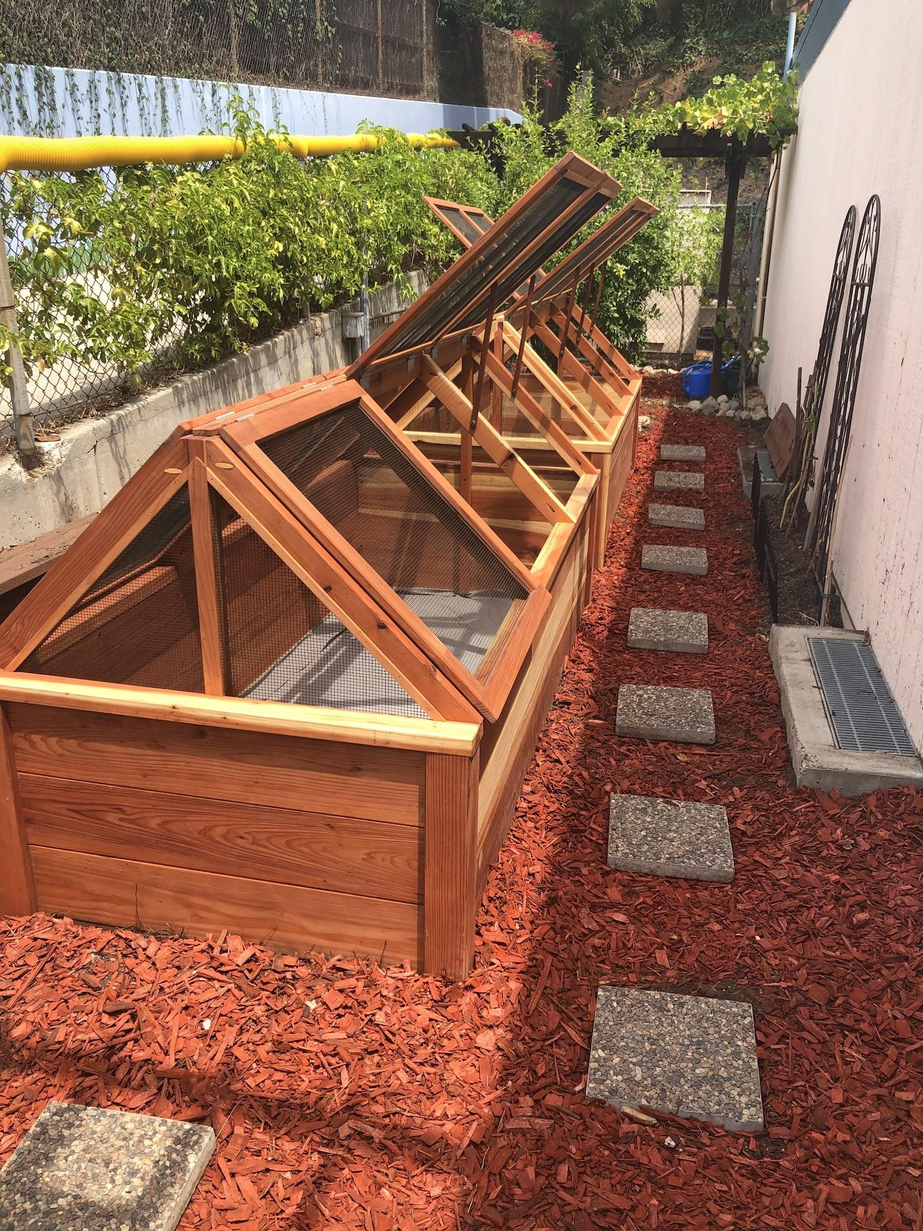
Gardening
Our school garden provides opportunities
for our class to work together, problem solve,
observe life cycles, and become responsible
caretakers of our harvest.
---------------------------------------------------
We’ll be planting carrots and snow peas
Students will share the responsibilities of watering, weeding, and caring on a weekly basis for our plants.

Slide 20
Homework
Weekly:
Mondays : iready lessons in reading and math (aim for two a week)/Typing Club
Tuesdays : IXL assigned lesson to practice and reinforce concepts
Wednesdays: Envisions math page from a current lesson of the week
Thursdays : Fluency folder (allow your child to read you the reading and sign)
Fridays : No homework
Additional Weekly reading homework (20 minutes)
Your child is encouraged to read a book at their reading level every school night.
They will help them to aim for three or more AR quizzes each trimester.
Encourage them to take an AR weekly or biweekly
(1st ) Aug-Nov / (2nd) Nov. - March / (3rd) March - June
Homework should take between 30 - 40 minutes
per night. If your child is taking longer, please
reach out and we can discuss.

Slide 21
Home Support
Provide a quiet and lighted space for your child
to do their work.
Allow them to have breaks, if needed.
Make sure to communicate with me if your child is consistently struggling or not able to finish homework.
Keep me informed on changes or things that may come
up that can affect your child’s ability to focus or stay
engaged at school.
Partners in your child’s education and
social-emotional development

Slide 22
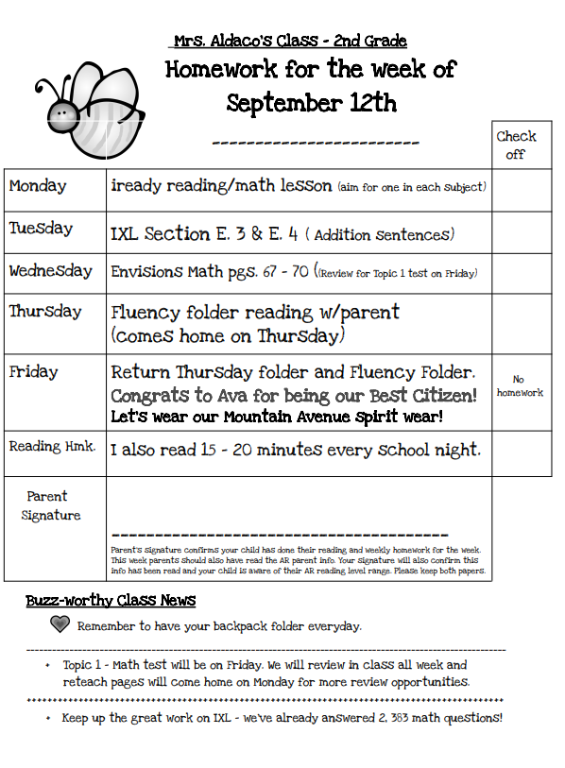
Sample Monday Homework

Slide 23
Conferences and Progress Reports
I’d like to meet with all parents/guardians in this first trimester to discuss your child’s progress and abilities.
I will send out a sign-up genius in September for this time. On our back table, is a sheet to let me know which method of meeting is preferred (in person/zoom/by phone - please let me know.
Brag Sheet - Please fill one out, if you haven’t already
Progress Reports will be sent in the middle of a trimester to communicate your
child’s progress in areas they may be needing more support and are not working
at grade level. They are also given to inform parents on social skills your child
can keep working on at home.
Always open to talking after school or a more suitable time, if needed.
.

Slide 24
Report Cards
Grades will reflect standards taught during that trimester.
Three report cards given - Nov./March/June
Your child’s effort, participation, classwork, and assessment scores will all be taken into account for their core subject trimester grades.

Slide 25
Field Trip
Spring Trip
STOUGH CANYON NATURE CENTER
BURBANK

Slide 26
Room Parents
Many positive opportunities
One or two parents (teamwork)
Be more informed of class/school events
Be the person who helps others stay connected
We’ll work closely to organize clay project days, labs, special
events and class parties
Field trip day chaperones
Will have an opportunity to see your child and classmates
grow and develop in various ways all year
How to sign up?
1. TB test clearance and Volunteer Agreement form turned
in at our office
2. Be available to attend PTA Room Parent meetings
First Room Parent Meeting - Thursday, September 5th @ 4 - 5 pm
3. It will be sent via email on our next school Thursday update.

Slide 27
Parent Volunteers
Many positive opportunities
Be available to be trained on our copy machines and workroom
do’s and don’ts
We’ll work together on exact dates and times for volunteering
or helping with projects
How to sign up?
1. TB test clearance and Volunteer Agreement form turned
in at our office
2. Be available to attend Workroom Parent meeting
First meeting - TBD
3. Sign up on my back table for clerical or projects/labs

Slide 28

Our district is using PARENTSQUARE - this is our parent communication program
Please sign the “Mountain Avenue Beginning of Year Agreements” and
“School Compact” emails this week.

Slide 29
Consider joining…
M.A.C.K. - Mountain Avenue Committed to Kids
Our school foundation
PTA - Parent/Teacher Association
_______________________________________
They provide the additional support and
assistance to keep many of our current
enrichment programs funded at our school.

Slide 30
Parent Communication
Monday Class email:
Informed on class learning and announcements for the week
School Website:
  www.gusd.net/mountainavenue
  A place to find more about our school-wide events
Class website:(Go to contact/teacher pages/Mrs. Aldaco
  https://www.gusd.net/domain/841
  BTSN info/AR info
Thursday Folders:
Please review all content and remove papers
Return empty folders every Friday.
Backpack Folders:
Will be used for homework sheets that will come home or other
important projects. These stay in your their backpack.
Best methods of quick communication : email or a phone call

Slide 31
SAVE THE DATE…
FLAG CEREMONY
September 22nd @ 8:25 AM
Hispanic American Month

Slide 32
IMPORTANT INFO
ALWAYS HAVE YOUR CHILD WEAR CLOSED-TOE SHOES
Best Citizens are chosen on Monday; parents are notified by email. They will also have the opportunity to care for our stuffed animal, “Betty Bee”all week.
In the second trimester we will have a special student each week
that will receive kind compliment notes from every student.
Birthdays are special in our class. Each student will have a confetti decorated desk/get a small gift/sticker for their b-day. Our class will also sing them a happy birthday. No treats are allowed, but you are welcome to donate a book in their honor.

Slide 33
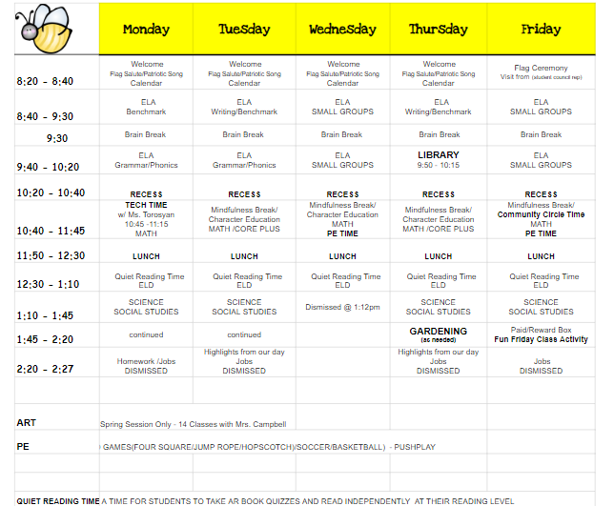
IMPORTANT INFO
.

Slide 34
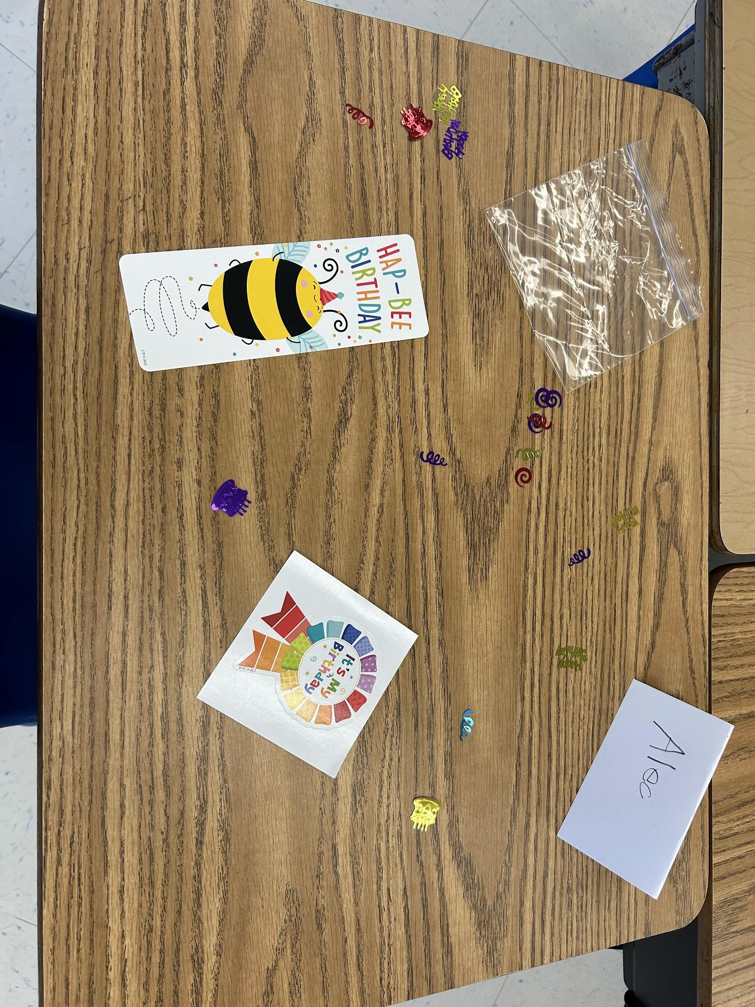
Confetti Birthday Fun!

Slide 35
Be on time for pick-up
Drive-thru lane can get tricky, especially on
rainy days.
Please remind your child to wait until you make a full stop to come to the car. An aide will help
them open the door, if needed.
If you are not here by the time the
aides have to leave, your child will be
brought to the office

Slide 36
SUPPLIES
All supplies are provided for your child.
If you would like to donate supplies, they are always welcome.
Large elmer’s glue sticks
Ticonderoga pencils
Kleenex tissue boxes
Gift cards (Amazon)

Slide 37
Thank you for coming!
Don’t forget to leave an encouraging
message on a flower post-it.
Look over back table info.
We are going to have a
wonderful year!

