Slide 1
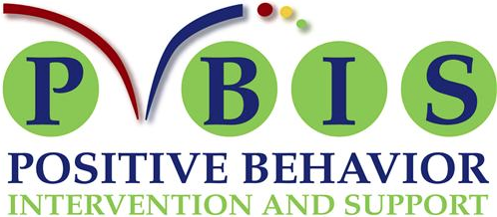
Glenoaks

Slide 2
PBIS by the numbers…
Last year, we joined the other Cohort 1 GUSD schools roll out PBIS.
As of 2016 21,559 schools across the country were using PBIS.
As of 2017-18 all Glendale schools are part of PBIS.
Studies show that PBIS, when used school wide, creates a reduction in office discipline referrals of up to 50%.

Slide 3
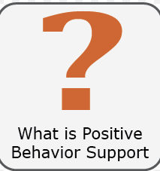
PBIS means that we are actively teaching and modeling positive behavior while also making sure to reward the positive behavior.

Slide 4
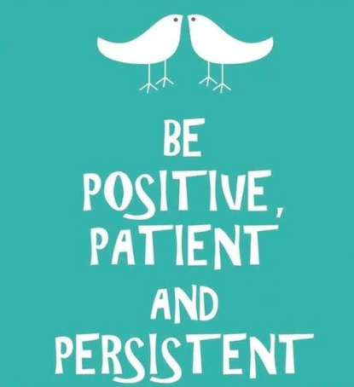
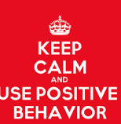

Five to one…5:1….
Find five positive behaviors to acknowledge for every one redirection
Notes:
There are still ways to communicate when expectations aren’t being met….

Slide 5

PBIS leads to…
Academic achievement
Following adult requests
Safe and positive social behaviors

Slide 6
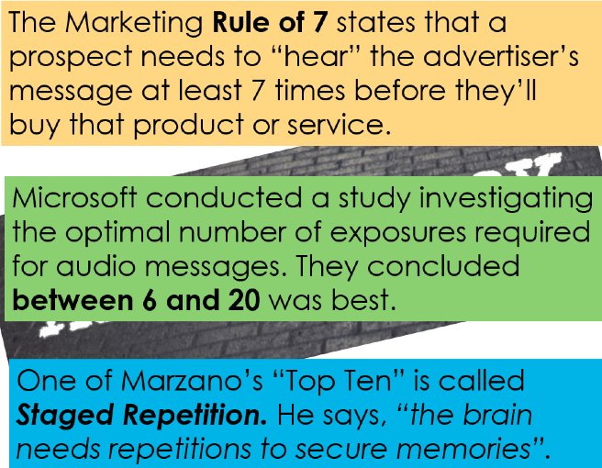
Repeat the Positive Supports and the Expectations

Slide 7


Just like we teach and reteach academic standards, we have to do the same with behavioral expectations!

Slide 8
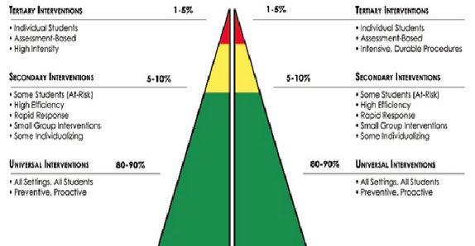
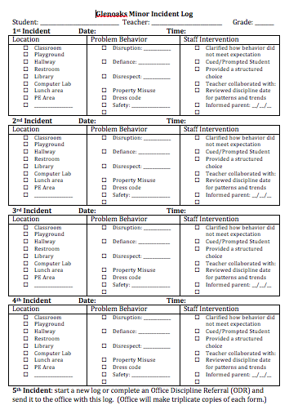
PBIS Reminds Us that We Teach and Support Academic and Behavioral Needs

Slide 9

PBIS Supports Teachers and Students with….
Video of expectations
School-wide Matrix and Poster
Campus visits with modeled explanations
Revisiting behaviors and expectations as needed
Notes:
Bulletin reminders of issues to revisit…..teacher discretion……we reteach academics, we reteach behaviors

Slide 10
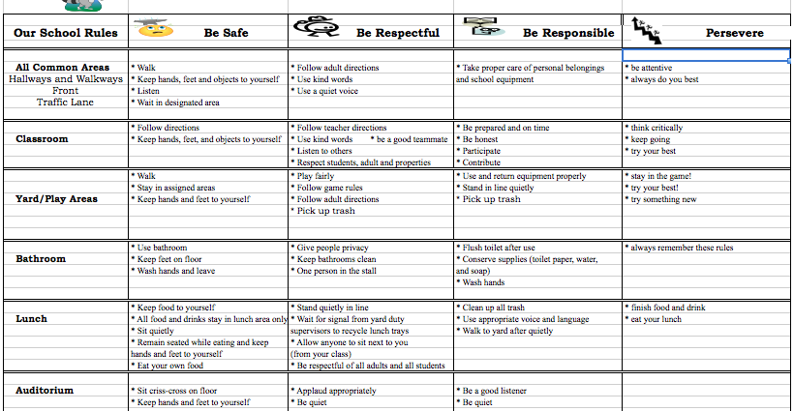
Glenoaks School Matrix

Slide 11
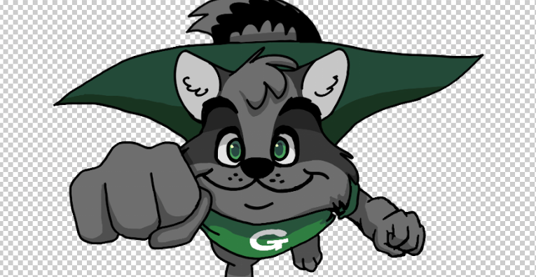
Super G Slips…
Reward positive behavior!!!

Slide 12

Super G Slips…
Play with the Principal
Golden Oak recognition
Classroom acknowledgments
Other school recognitions
Intrinsic motivations
At-home celebrations for earning Super G Slips!

Slide 13
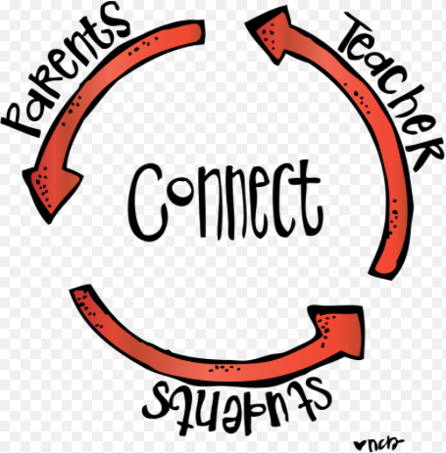
Together we can do this…
Make school expectations part of your home expectations.

