Slide 1


Glendale Unified School District
DISTRICT
ENGLISH
LEARNER
ADVISORY
COMMITTEE
Welcome!
We’re so glad you’re here.
October 14, 2019
Notes:
lena

Slide 2


English Learner District Leads:
Dr. Lena Richter
Director of Categorical Programs
Ms. Bonnie Cervantes
Coordinator of Categorical Programs
Notes:
L

Slide 3

DELAC:
A district-level advisory committee convened to give school district input on English Learner Programs
Notes:
L The strength of any organization comes from a variety of voices being heard.

Slide 4


Slide 5
DELAC Officer Responsibilities:
Chairperson
-Helps develop agenda
-Facilitate meeting
Secretary
-Takes minutes & emails them to District
Notes:
Lena

Slide 6


DELAC:
Responsibilities are to advise the district governing board on…
District English Learner Master Plan
District-wide needs assessment
A plan to ensure compliance with teacher or instructional aide requirements
Reclassification procedures
Required written notifications to parents
Local Control and Accountability Plan
Establishment of EL program, goals, and objectives
Notes:
L

Slide 7

English Learner Program Overview
Notes:
B

Slide 8

English Learner Roadmap Priorities
Adopted by CA State Board of Education July 12, 2017
Assets-oriented & Needs-responsive Schools
Intellectual Quality of Instruction & Meaningful Access
Systems Conditions that Support Effectiveness
Alignment & Articulation Within and Across Systems
Notes:
B –first two
L- second two
Assets-oriented. Halfway to bilingual (or tri, or quad!)

Slide 9
Obligations
PD
Identification
EL Services
ACCOUNTABILITY
Instructional
Program
FUNDING
Exiting
Services
RESOURCES

Slide 10

GUSD ENGLISH LEARNER PROGRAM
Purpose
Support students as they acquire both conversational and academic English language proficiency
Honor heritage language and culture
  Dual Immersion
  World Language Programs
Ensure student success in core academic classes
Ensure student competitiveness in college admissions and world employment markets
Notes:
B

Slide 11

GUSD ENGLISH LEARNER PROGRAM
Identification
Home Language Survey
  To be completed only once in a student’s career
Welcome Center
Initial ELPAC
  Novice-EL Program
  Intermediate-EL Program
  Initially Fluent-No EL Program
Identified EL until all Reclassification
Criteria are met
Notes:
L

Slide 12
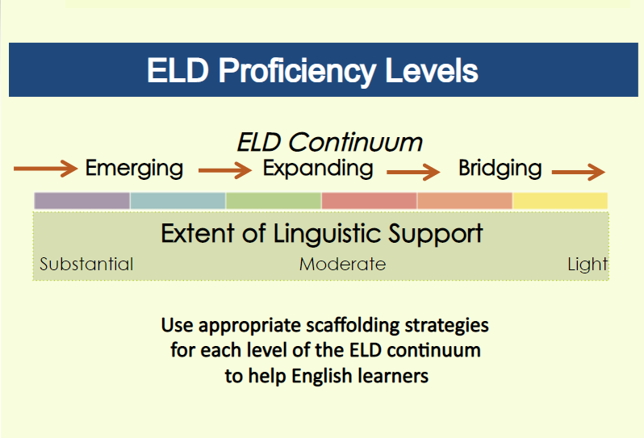

Slide 13

GUSD ENGLISH LEARNER PROGRAM
Instruction
Designated ELD Time
  Based on English Language Development Standards
  Emphasis on Academic Language
  Benchmark (K-5)
  Springboard (6-12)
Integrated ELD Time
  Throughout the day and across all disciplines
  Teachers use strategies to support language acquisition as well as content knowledge
Notes:
B

Slide 14
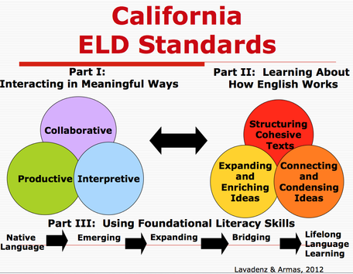

Slide 15

GUSD ENGLISH LEARNER PROGRAM
Assessment
Initial ELPAC
  Taken only once in student’s career
Summative ELPAC
  Taken annually by all students identified EL
  Based on English Language Development standards
  Monitors language acquisition progress of our ELs
  Computer-based this year!
CAASPP
  Taken annually by all CA students
  Monitors content knowledge and skills acquisition
  Computer-based
BCE
  Gr 11-12 Optional Bilingual Competency Exam
Notes:
L

Slide 16

GUSD ENGLISH LEARNER PROGRAM
Reclassification: All 4 criteria must be met
Summative ELPAC
  Overall score of 4 (new for 19-20)
Comparison of Basic Skills
  CAASPP
  i-Ready
  ELA End-of-Unit Tests
  SOLOM
Teacher Feedback
  Grades
  ELD Descriptors
Parental Input & Consent
  Consultation or Signature
Notes:
B

Slide 17
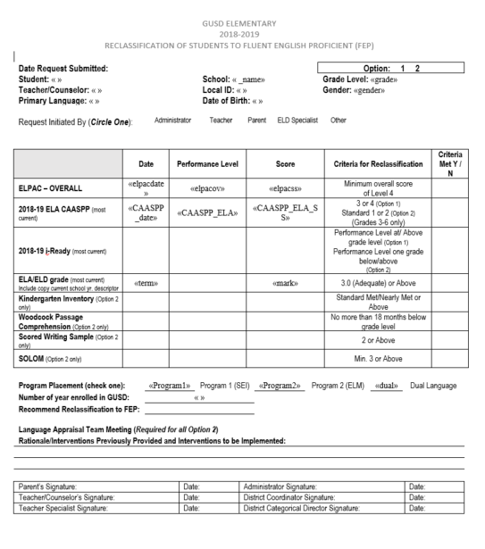

Slide 18
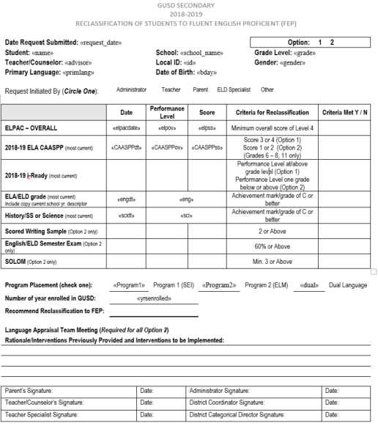

Slide 19

Reclassified Fluent English Proficient
Progress Monitoring
RFEP Monitor Progress for 4 years
Recent data analysis (i-Ready) shows reclassified students show higher growth performance in Reading and Math than their non-EL peers
Notes:
L

Slide 20

DELAC Elections

Slide 21


OTHER TOPICS FROM THE FLOOR
21

Slide 22
THANK YOU!
Lena Richter-Director lrichter@gusd.net
Bonnie Cervantes-Coordinator bcervantes @gusd.net
Notes:
lena

