Slide 1

Glendale Unified School District
DELAC Meeting
January 27, 2020
Lena Richter ● Bonnie Cervantes

Slide 2
Tonight’s Agenda
Welcome and Introductions
Call for Chairperson & Secretary
ELPAC Testing
  Data
  Administration
GUSD Master Plan for English Learners
  CA English Learner Roadmap
ELPI (English Learner Progress Indicator)
Other Topics from the Floor
Future Meetings

Slide 3
Your GUSD English Learner Team Leadership
Dr. Lena Richter, Director of Categorical Programs
  lrichter@gusd.net
Mrs. Bonnie Cervantes, Coordinator of Categorical Programs
  bcervantes@gusd.net
Your school’s Teacher Specialist

Slide 4
DELAC Officers
No prior experience necessary!
Chairperson
  Responsibilities: Conduct meetings, collaborate on meeting agendas. This will happen in partnership with Bonnie Cervantes
  Qualifications: Be a parent of an English Learner in GUSD
Secretary
  Responsibilities: Take notes during meetings. We will provide a laptop, and the notes can be taken in the language most comfortable to you
  Qualifications: Be a parent of an English Learner in GUSD

Slide 5
ELPAC Testing
Feb 3-May 29
Testing Administration
  Students Gr. 3-12 will test in groups for all parts of test except for Speaking
  Students Gr. TK-2 will test 1-on-1 with a trained GUSD Test Administrator for all portions (except for 2nd writing portion)
  Students Gr. TK-12 will take Speaking Portion with a trained GUSD Test Administrator

Slide 6
ELPAC Testing
Feb 3-May 29
Testing Preparation
  Go to www.elpac.org
  Click on Practice and Training Tests
  Click on Student Interface Practice and Training Tests
  Sign in as Guest
  Choose appropriate grade level
  Practice as many times as you like!

Slide 7
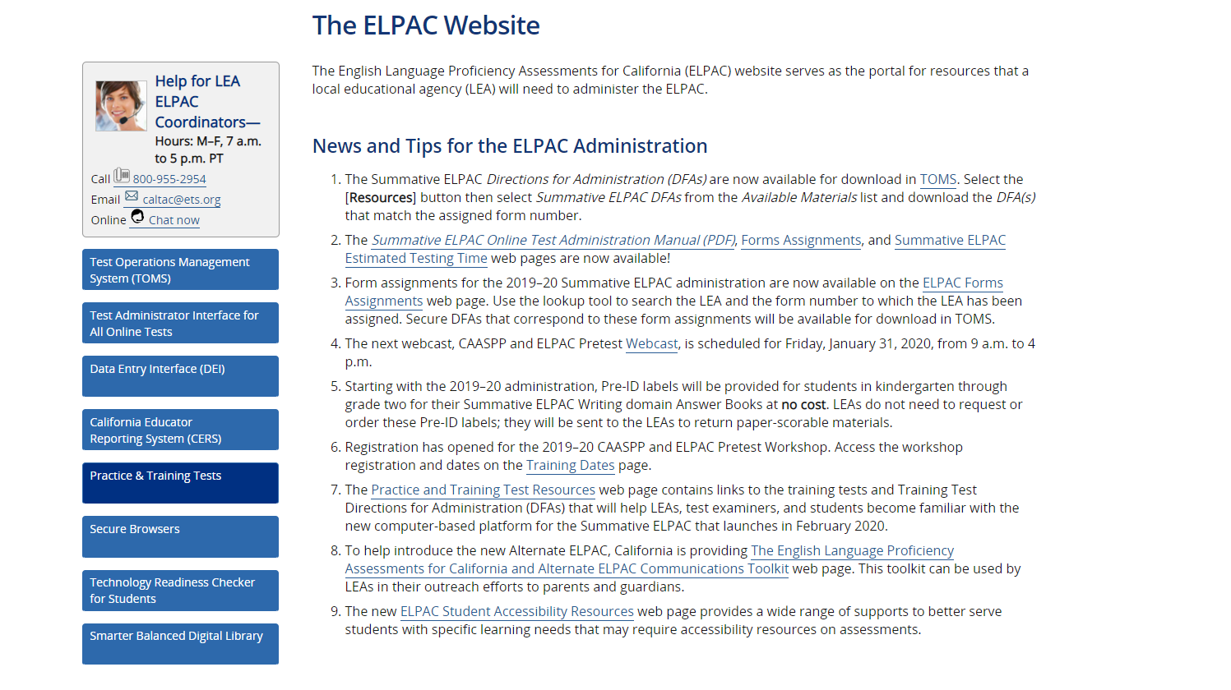

Slide 8
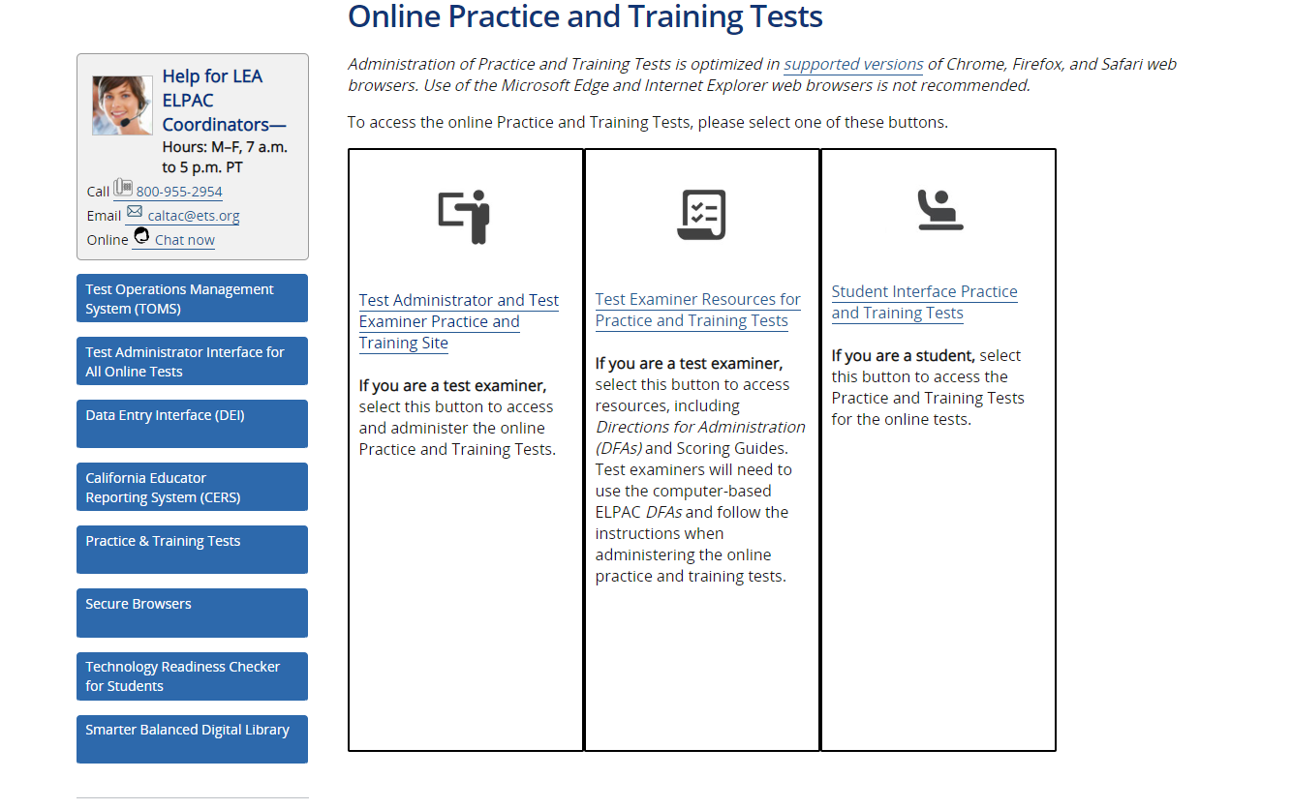

Slide 9
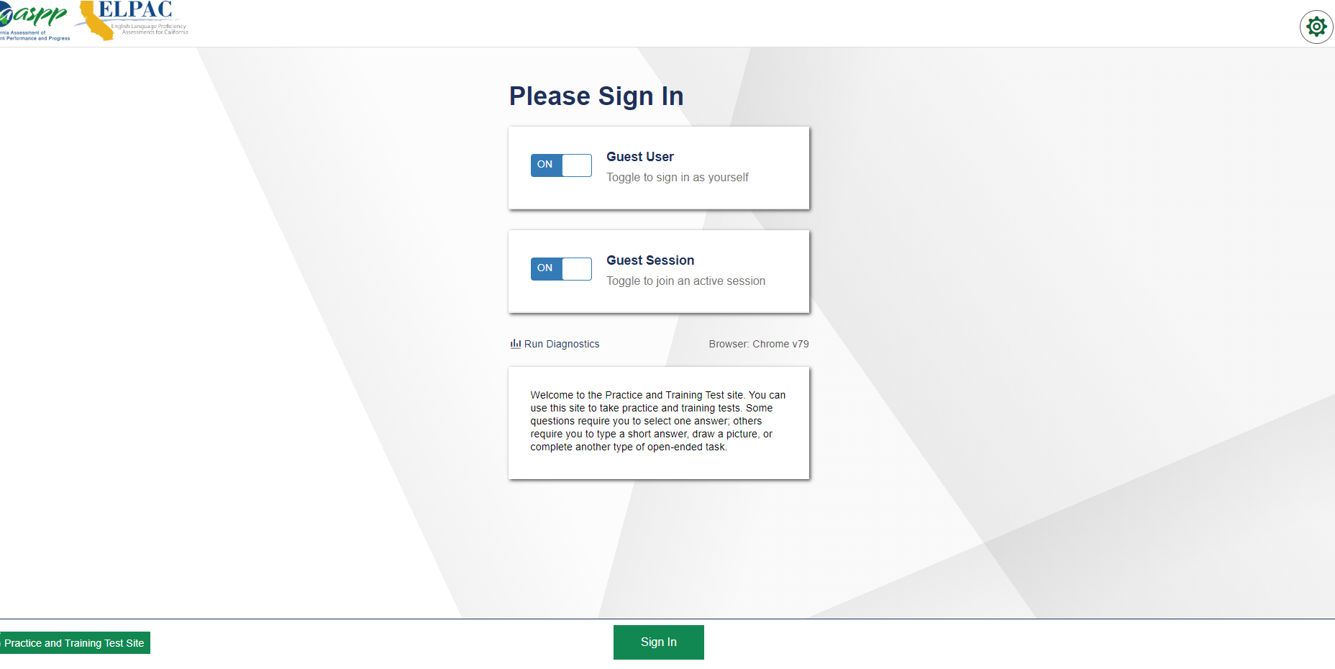


Slide 10
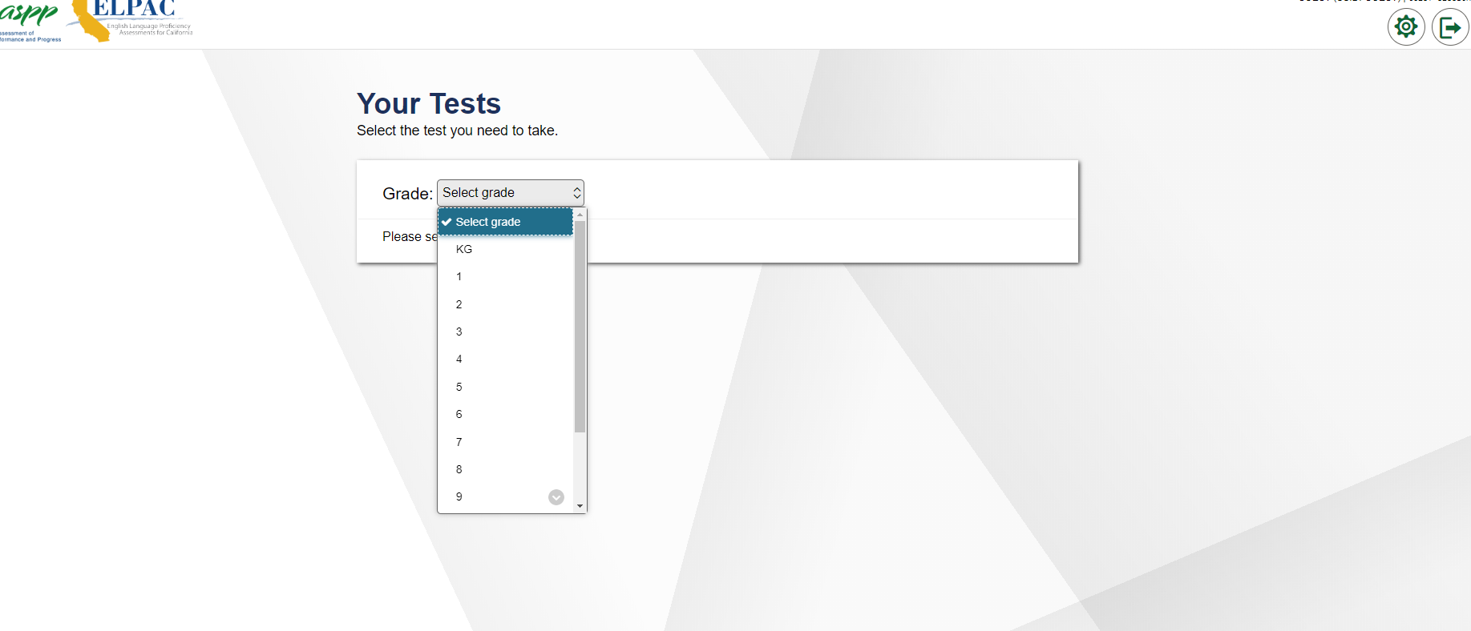

Slide 11
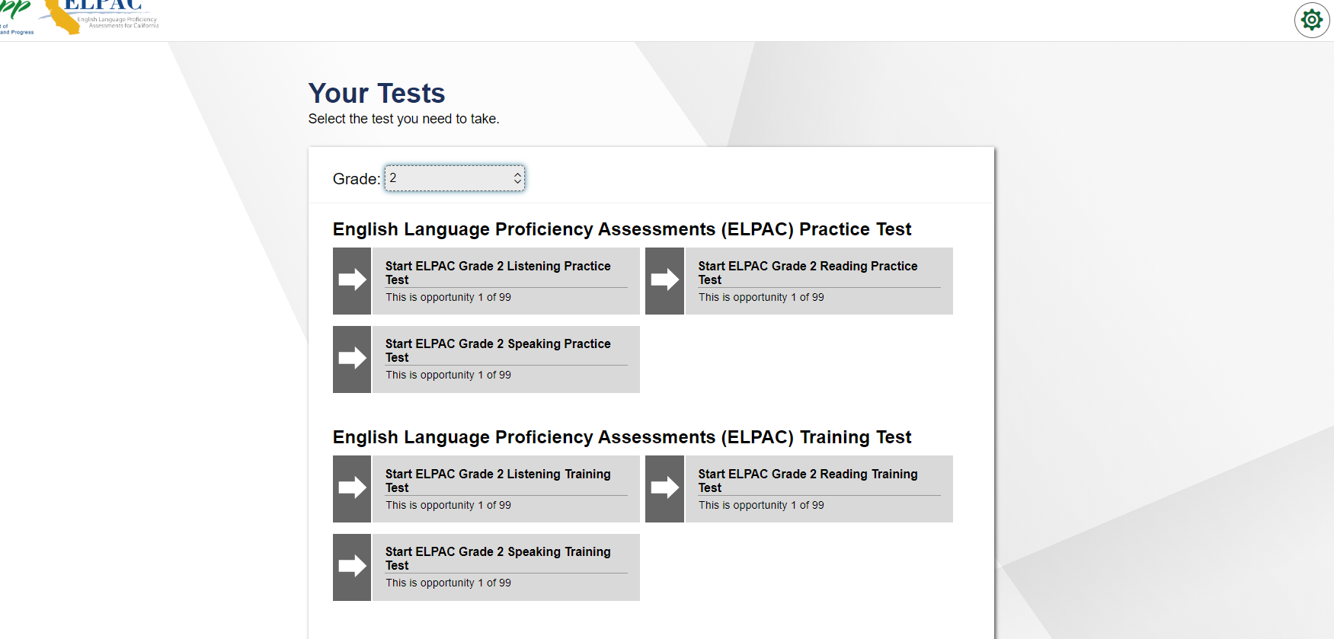
Be Sure to Choose ELPAC Tests!

Slide 12
ELPAC Data
Overall Performance Level 2018-19 | 4 | 3 | 2 | 1
Number of students | 1564 | 2179 | 1200 | 668
Percentage of students | 28% | 39% | 21% | 12%

Slide 13
GUSD
Master Plan for
English Learners
California English Learner Roadmap
  Approved July 12, 2017
  Shift in philosophy from English-only educational practices/policies
  Provides guidance, tools, and resources for districts to use
  Does NOT define one road (practice, program, or policy) for all Districts, Schools, or students

Slide 14
CA English Learner Roadmap
Four Interrelated Principles
  Research-based
  Intended to guide all levels of the system toward a coherent, aligned set of practices, services, relationships, and approaches
  Shared responsibility of all educators

Slide 15
English Learner Roadmap
Principle 1:
Assets-oriented and needs-responsive schools
Assets-oriented and Needs-responsive schools
  Pre-schools and schools are responsive to different English learner strengths, needs, and identities and support the socio-emotional health and development of English Learners. Programs value and build upon the cultural and linguistic assets students bring to their education in safe and affirming school climates. Educators value and build strong family, community, and school partnerships.

Slide 16
English Learner Roadmap
Principle 1:
Assets-oriented and needs-responsive schools
Assets-oriented and Needs-responsive schools
  Value home language and culture
  Provide safe school climate
  Support social and emotional health
  Build family and school partnerships

Slide 17
English Learner Roadmap
Principle 2:
Intellectual Quality of Instruction and Meaningful Access
Intellectual Quality of Instruction and Meaningful Access
  English learners engage in intellectually rich, developmentally appropriate learning experiences that foster high levels of English proficiency. These experiences integrate language development, literacy, and content learning as well as provide access for comprehension and participation through native language instruction and scaffolding. English learners have meaningful access to a full standards-based and relevant curriculum and the opportunity to develop proficiency in English and other languages.

Slide 18
English Learner Roadmap
Principle 2:
Intellectual Quality of Instruction and Meaningful Access
Intellectual Quality of Instruction and Meaningful Access
  High level of instruction and educational experiences
  Provide access to full standards-based curriculum
  Opportunity to develop third and fourth languages

Slide 19
English Learner Roadmap
Principle 3:
System Conditions that Support Effectiveness
System Conditions that Support Effectiveness
  Each level of the school system (state, county, school, pre-school) has leaders and educators who are knowledgeable of and responsive to the strengths and needs of English learners and their communities, and who utilize valid assessment and other data systems that inform instruction and continuous improvement. Each level of the school system provides resourced and tiered support to ensure strong programs and build the capacity of teachers and staff to leverage the strengths and meet the needs of English learners.

Slide 20
English Learner Roadmap
Principle 3:
System Conditions that Support Effectiveness
System Conditions that Support Effectiveness
  Data-driven classroom instruction and decision–making
  Targeted professional development to support English learners at all levels in all subjects
  Clear communication at state, district and site level

Slide 21
English Learner Roadmap
Principle 4:
Alignment and Articulation Within and Across Systems
Alignment and Articulation within and Across Systems
  English learners experience a coherent, articulated, and aligned set of practices and pathways across grade levels and educational segments, beginning with a strong foundation in early childhood and appropriate identification of strengths and needs, continuing through to reclassification, graduation, higher education , and career opportunities. These pathways foster the skills and knowledge students need for college and career-readiness and participation in a global, divers, and multilingual twenty-first century world.

Slide 22
English Learner Roadmap
Principle 4:
Alignment and Articulation Within and Across Systems
Alignment and Articulation within and Across Systems
  Communication district-to-district, school-to-school
  Develop multiple pathways for students
  Align practices and policies with state law district-wide

Slide 23
CA English Learner Roadmap
Table Talk
Table Discussion
  Your table has been assigned one of the principles. Read again the Vision, Mission, and your assigned principle.
  Discuss at your table:
  What seems new?
  What seems important?
  How might this be a shift from past practice?
  What might this look like at the classroom level? At the school level? At the district level?

Slide 24

Words from a Model CA EL Roadmap School District

Slide 25
GUSD
Master Plan for
English Learners
Glendale Multilingual Collective
  Formation Spring of 2020
  Purpose: To work with all stakeholder groups to develop a plan that ensures equity and access for all English Learners
  EL Students, parents, teachers, Dual-immersion, administrators, classified staff will be invited to participate and provide input
  EL Roadmap will be our steering document

Slide 26
State Seal of Biliteracy
& GUSD Bilingual Competency Award
State Seal of Biliteracy
  Receive Seal on Diploma and Transcript
  Recognized by Colleges and Universities
GUSD Bilingual Competency Award
  Receive Silver medal for 1 language other than English
  Receive Gold medal for 2 languages other than English

Slide 27
Bilingual Competency Exam
February 29, 2020
  Offered only to current 11th or 12th graders
  Free of Charge
  Satisfies one of the requirements for GUSD Bilingual Competency Award and/or for State Seal of Biliteracy
  Student with highest score from each school per language receives an acrylic award at their senior awards night

Slide 28
English
Learner
Progress
Indicator
Info goes here

