Slide 1
Glendale Unified
DELAC Meeting
December 9, 2019

Slide 2
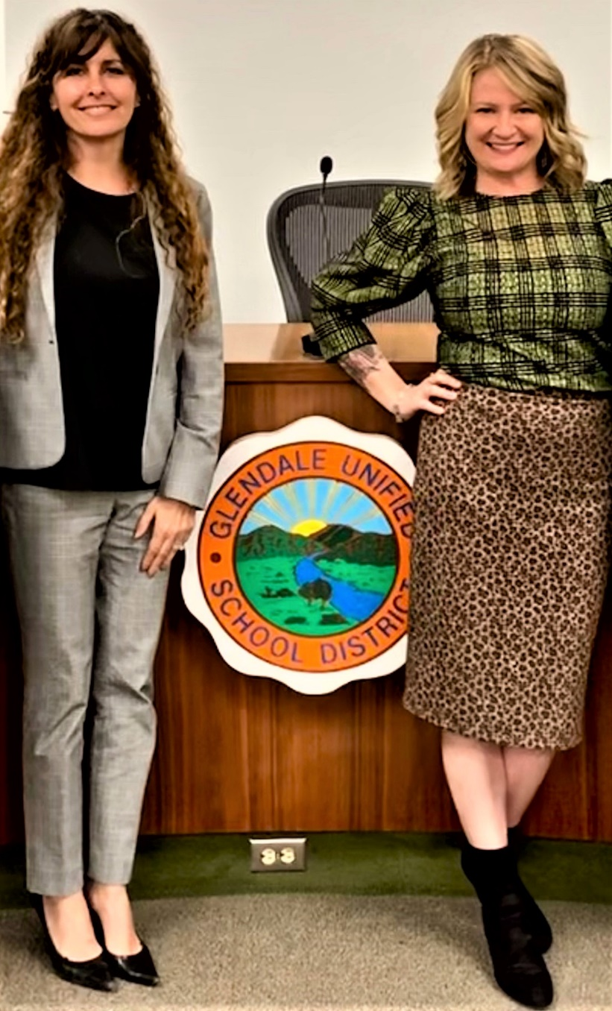
Welcome and Introductions
Dr. Lena richter
director
categorical programs
Bonnie Cervantes
Coordinator
categorical programs

Slide 3
Welcome and Introductions
Support staff
teachers
Teacher specialists
Site & District Administration
Notes:
I wanted to take a few moments and have these groups of people in attendance stand and be acknowledged for their work

Slide 4

Assets-oriented
&
Needs-responsive schools
Intellectual Rigor/
Meaningful Access
CA English Learner
Roadmap Principles
Systems
&
Supports
Alignment & Articulation
Notes:
Here I planned to discuss that we operate from the English Learner Roadmap which is outlind under these principles

Slide 5
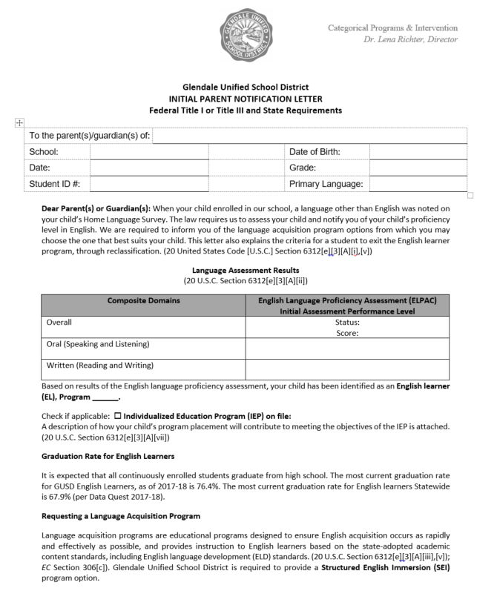
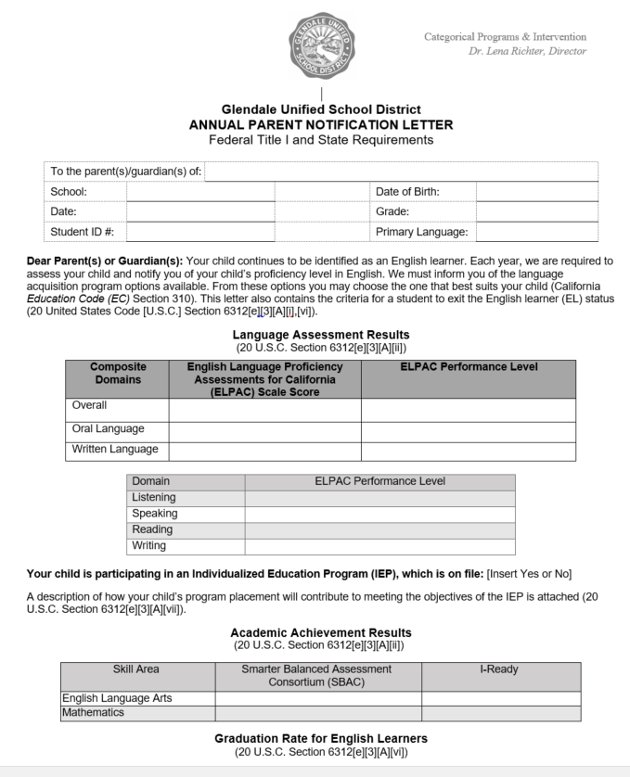
Initial and Annual Notifications
Notes:
These will be hard to see on the screen but I wanted to show example of what we’d be talking about so they can pull up the correct page in their packets

Slide 6
Initial and Annual Notifications
INITIAL Notification
-Sent to family only once
-Given to family after student takes Initial ELPAC
-Explains students’ placement and services they will receive
ANNUAL NOTIFICATION
-Sent to family every year
-Informs family of Summative ELPAC and CAASPP score reports
-Describes types of programs offered for English Learners
-Explains EL Reclassification Criteria
-Discloses parents’ rights and opportunities for input

Slide 7
Please take a few minutes to look over the letters.
What questions or comments do you have?

Slide 8
EL Classroom instruction
SANDRA ESPINOZA
DISTRICT ELD INSTRUCTION SPECIALIST

Slide 9
English learner parent support
DELAC Meeting
Sandra Espinoza
December 9, 2019

Slide 10

What is ELD?
What?
Daily English instruction provided to all English Learners
Why?
To help students learn English as quickly as possible to understand and use academic language
GOAL!
English learners are college and career ready!

Slide 11
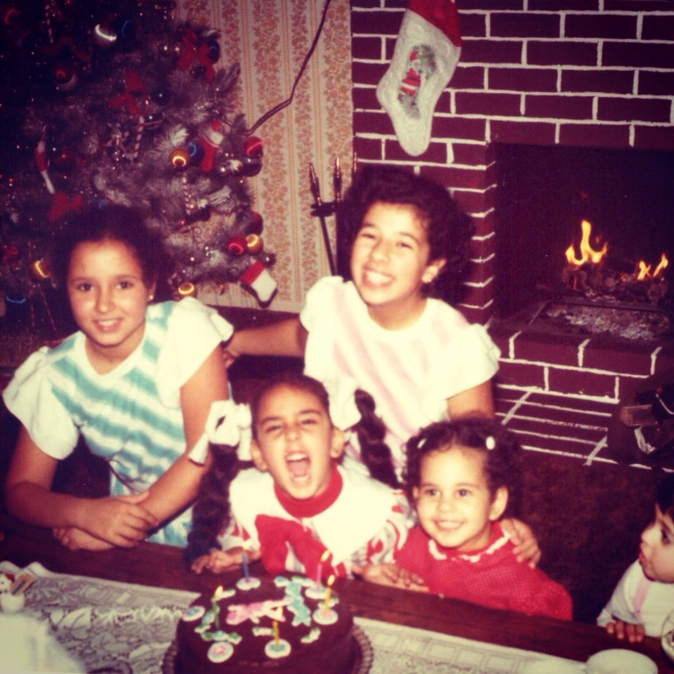
Why do students need ELD?
(English Language Development)
Research:
How long do you think it takes the average student to be proficient in speaking English?
How long do you think it takes the average student to develop academic language proficiency?
Notes:
What is the point of ELD? After all, I went through school without any of that, and I turned out just fine. So why we are shifting to developing the English language in our students throughout the day? I found out: 1. 3-5 years to become orally proficient, 2. 4-7 years for academic language proficiency
So I think it can be very deceiving when students develop oral fluency because we think that they know English, and it is also the reason some students get redesignated too early. They may be able to hold a conversation, but their academic vocabulary needs to be developed.
Within two years, everyone including me thought that I was fluent in English, no accent, and I could communicate with everyone just fine because everyday language that you use for communication can be learned quickly out of necessity. But I did not do well in English classes in school.
(Dictionary: hence - Find the words in the question and write down that sentence for the answer)

Slide 12
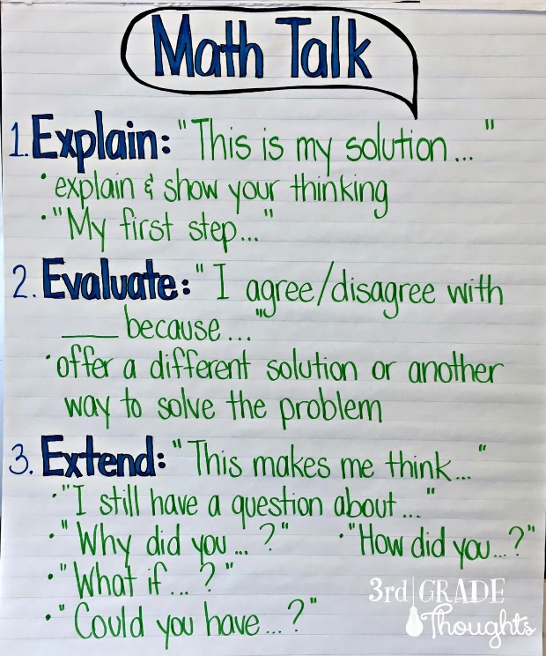
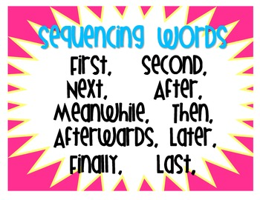

What must students be able to do with language?
Comprehend and evaluate ideas and complex text.
Construct explanations.
Justify answers.
Convey ideas and information to others
using academic language.

Slide 13
ELD Proficiency Levels
EMERGING
Learning to use English
Beginning to understand and use academic vocabulary
Applying their growing language skills in more sophisticated ways
Applying high-level language skills in a variety of contexts
Transition to grade level academic tasks
Program 1
(Possibly Program 2)
EXPANDING
Program 2
BRIDGING

Slide 14
Designated ELD
A specific time in the day during which English learners learn about how English works for successful participation in academic tasks.
Integrated ELD
Throughout the day and across subjects, English learners learn to use English as they develop academic English and academic content.

Slide 15
How do teachers use the ELD standards?
Part I: Interacting in Meaningful Ways
Reading
Part II: Learning about How English Works
Grammar
Part III: Foundational Skills
Critical Literacy Skills needed in English Language Arts
Writing
Listening
Speaking
Text Structure
Essays

Slide 16


ELD Curriculum
Benchmark ELD
Grades K-5
SpringBoard ELD
Grades 6-12

Slide 17
What can parents do to support children’s language development at home?
Use home language!
Have meaningful conversations!
READ, READ, READ!
Notes:
Home Language:
Encourage children to use home language. This will not interfere with learning English. Keep speaking your first language with your child. All the words children learn in their first language will be useful when they are learning English.
Conversations:
Talk daily about everyday events and activities. Storytelling: Tell your child stories you were told in your childhood in your first language or in English. Talk with them, pause to let them ask questions, make comments, and complete ideas. Seek out your child’s opinion. For example, ask, “What do you think we need to do?”
Read:
Read to your child in your first language—or in English or Encourage your child to read. Again ask lots of questions and have conversations about what you are reading. Make regular visits to the library to keep reading material available at home. Independent reading is a great way to learn new vocabulary.

Slide 18
Reclassification CRITERIA
Four state-mandated criteria
-ELPAC overall 4
-Comparison of Basic Skills
(CAASPP, iReady or Springboard)
-Teacher input (grades)
-Parent consultation

Slide 19
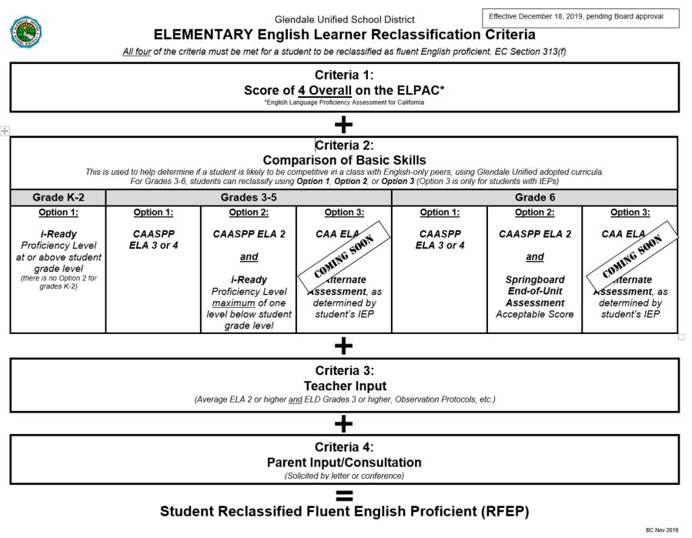

Slide 20
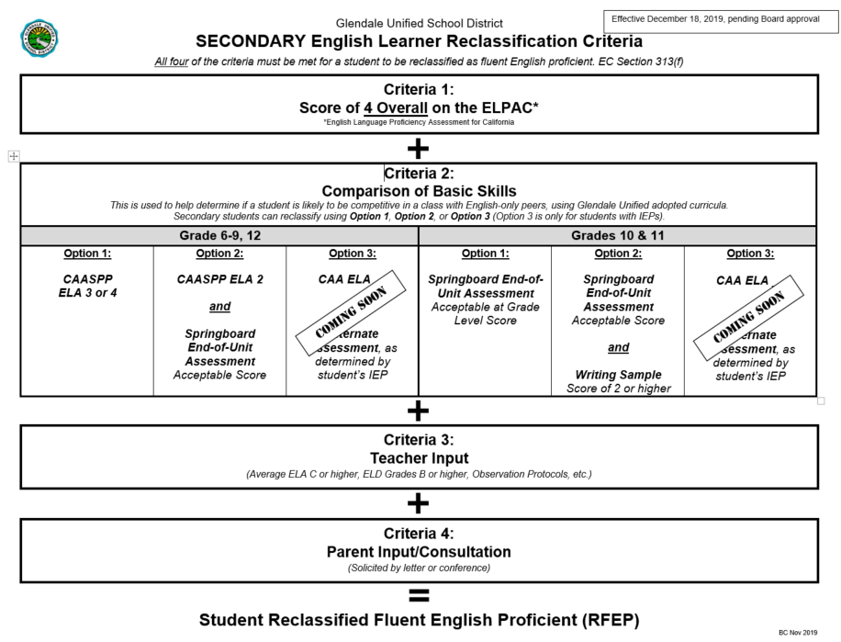

Slide 21
Reclassification TIMELINE
GOALS:
-Approximately every 10 weeks, or every trimester.
-Before ELPAC testing window
-Before the end of the school year (especially for matriculating students)
-Can be done on rolling basis, once student has shown readiness based on established criteria

Slide 22
reclassified students
-District must monitor for four years following reclassification
-District administration and site teacher specialist work together
-Every semester (secondary), after 2nd trimester (elementary)
-If student is showing signs of struggle, we must intervene

Slide 23
SUMMATIVE ELPAC
-Administered Feb 3-May 31
-All students who are English Learners must take this exam
-Very similar format to CAASPP
-Almost entirely online

Slide 24
Practice elpac exams
-Open a Chromebook (you may have to share)
-Browse as guest
-go to elpac.org

Slide 25
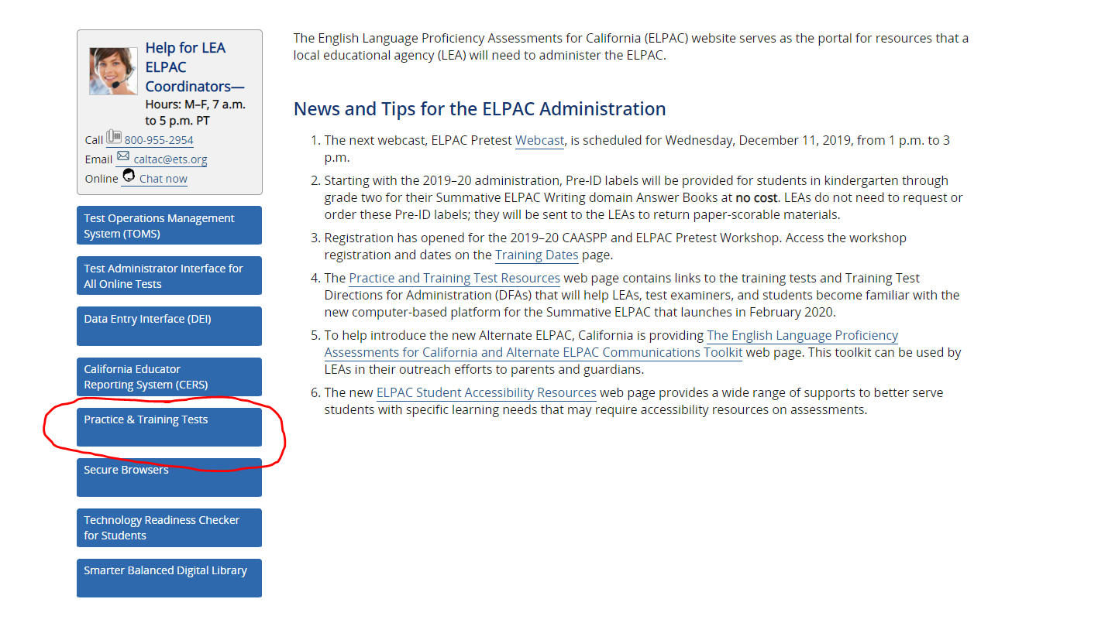

Slide 26
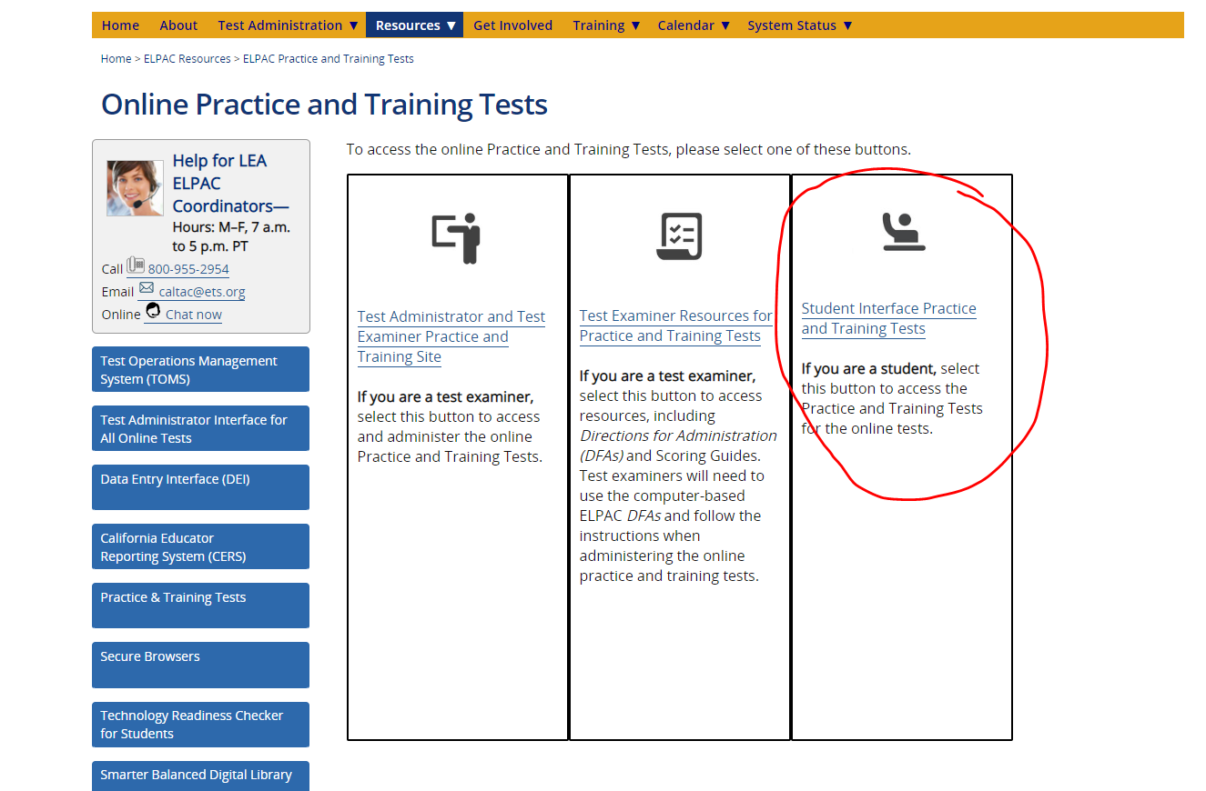

Slide 27
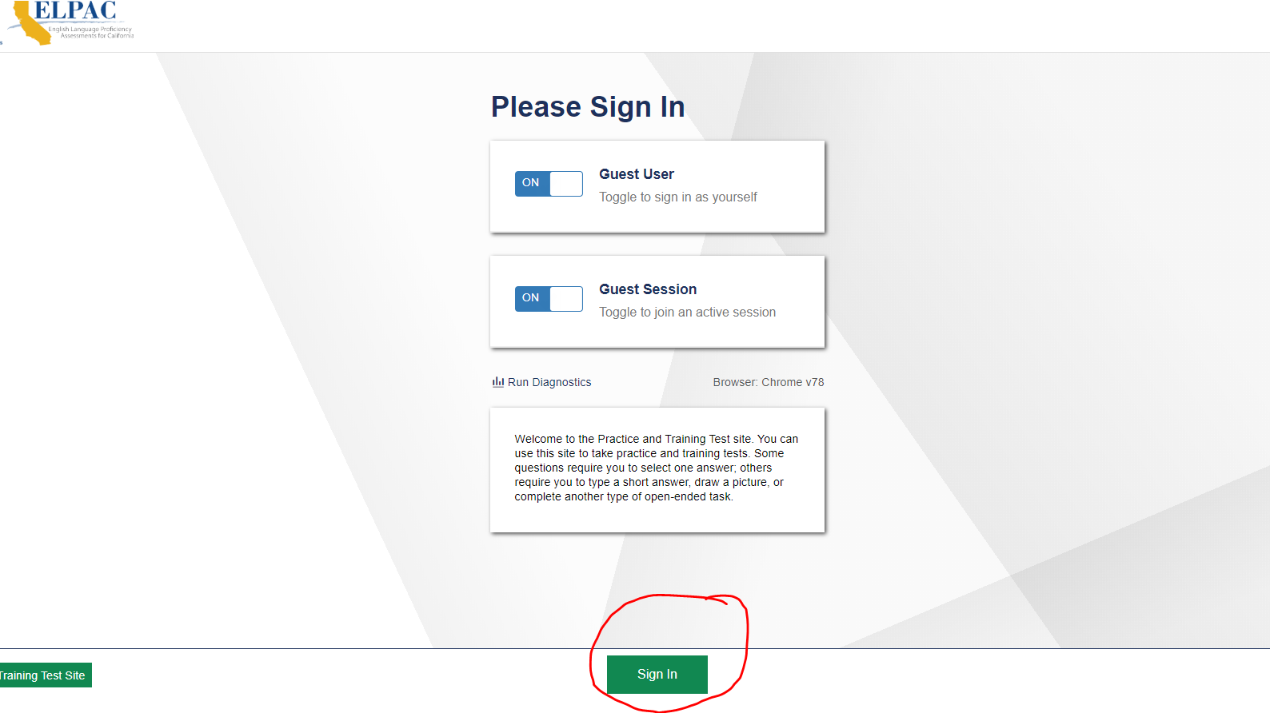

Slide 28
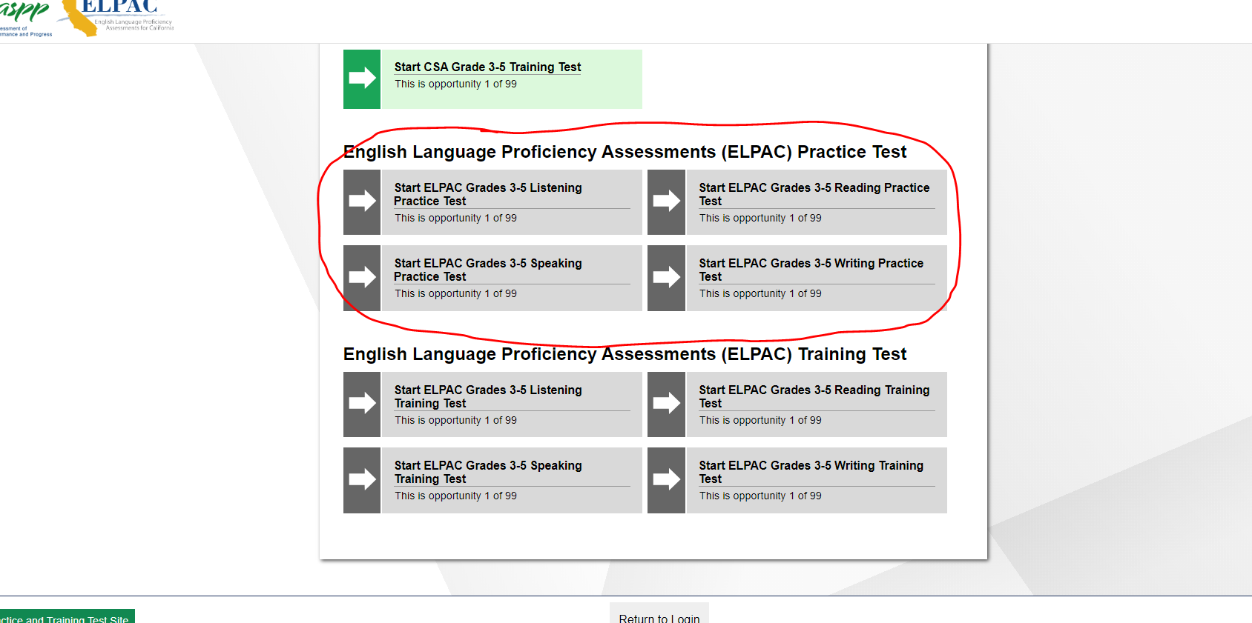

Slide 29
Please take some time to explore the practice tests
What questions do you have?

Slide 30
Other topics from the floor
Is there anything else you’d like to know more about?

Slide 31
Future meetings
-Next DELAC Meeting is January 27, 2019 at 5:30PM

Slide 32
Thank you for being here!
Dr. Lena richter
director
categorical programs
lrichter@gusd.net
Bonnie Cervantes
Coordinator
categorical programs
bcervantes@gusd.net

