Slide 1

District English Learner Advisory Committee (DELAC) Meeting
May 8, 2023
5:30PM - 6:30PM
Equity, Access, and Family Engagement
Dr. Oscar Macias, Director
Sandra Espinoza, Coordinator
Veronica Rubalcava, Teacher Specialist
Anita Arjoyan, Teacher Specialist
DELAC Board Members
Annie Samuelian, President
Maribel Hernando, Secretary

Slide 2
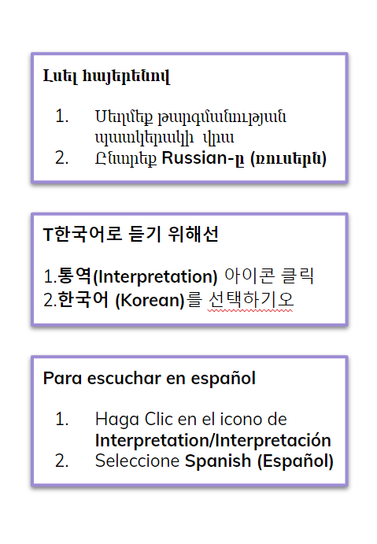
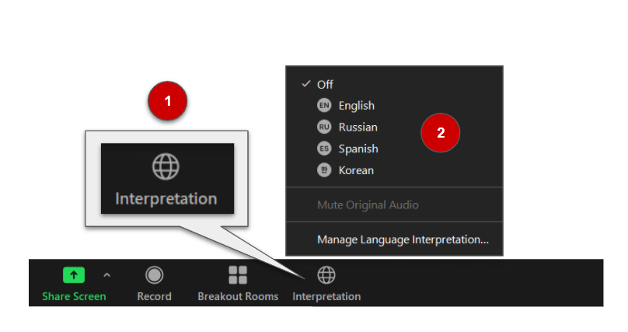
INTERPRETATION

Slide 3
AGENDA
Welcome and Introductions
Approval of March Minutes
Teacher and Instructional Assistants Requirements
English Learner Services
  Bilingual Competency Exam (BCE) Updates
  Summative ELPAC Updates
  Annual Parent Notification Letter
  Summer School Information
  Parent Resources for Summer Learning
Local Control and Accountability Plan (LCAP)
  2023-24 Draft Review
  Education Partner Input
Family Engagement Learning Opportunities
Glendale Library Presentation
Questions and Parent Input
2023-24 Tentative Dates
DELAC Feedback Form
Notes:
Link Feedback form
https://docs.google.com/document/d/1x3m6XIkQ9AE8lebjlnAqLUl8TypIrlx5/edit?usp=sharing&ouid=101061034975805515926&rtpof=true&sd=true

Slide 4

Meeting Protocols
Mute your microphone when not speaking
Sign in to the meeting by typing in the Chat:
  your first and last name, and
  your child’s first and last name and school
Type your questions in the Chat (in English or your preferred language)
The DELAC Meeting is being recorded.
Chat
Notes:
Videos will be recorded .

Slide 5
Welcome
Introductions
Call To Order
Notes:
Anie-

Slide 6

Approval of March Meeting Minutes
Notes:
LINK TRANSLATED MINUTES
Turn to chairperson for approval of minutes

Slide 7
English Learner Services
Ms. Sandra Espinoza
Notes:
Sandra- 5:40 - 5:55

Slide 8


State Seal of Biliteracy & Bilingual Competency Exam
The State Seal of Biliteracy (SSB) program recognizes high school graduates who have, in addition to English, attained a high level of proficiency in speaking, reading, and writing in one or more languages, in addition to English.
Proficiency in one or more languages, other than English can be demonstrated in one of the following ways:
  Passage of a world language Advanced Placement (AP) examination with a score of 3 or higher, or an International Baccalaureate (IB) examination with a score of 4 or more.
  District-approved test (BCE)
  Successful completion of a four-year high school course of study in a world language
BCE Languages in GUSD:
Arabic, Armenian, Korean,
Spanish, Russian, Tagalog

Slide 9
Purpose of the State Seal of Biliteracy
To encourage students to study languages
To certify attainment of biliteracy
To provide employers with a method of identifying people with language and biliteracy skills
To provide universities with a method to recognize and give academic credit to applicants
To prepare students with twenty-first century skills
To recognize and promote language instruction in public schools
To strengthen intergroup relationships
To affirm the value of diversity and honor the multiple cultures and languages of the community

Slide 10
Summative ELPAC Update
100% of English Learners must complete the annual Summative ELPAC per state and federal requirements by May 31st.
About 80% of students have completed the Summative ELPAC.
About 70% of English Learners with severe cognitive disabilities have completed the Alternate Summative ELPAC.
Scores will be released between May and September 2023 and will be shared with parents electronically.

Slide 11
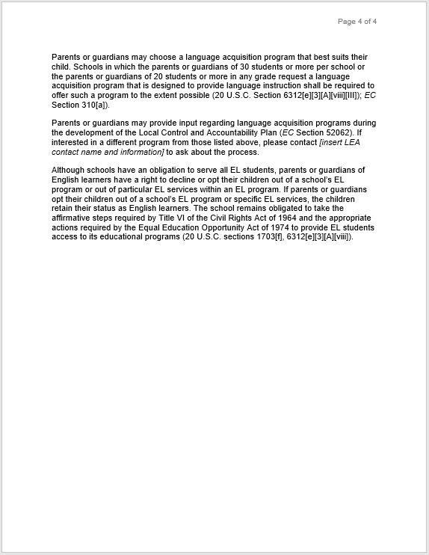
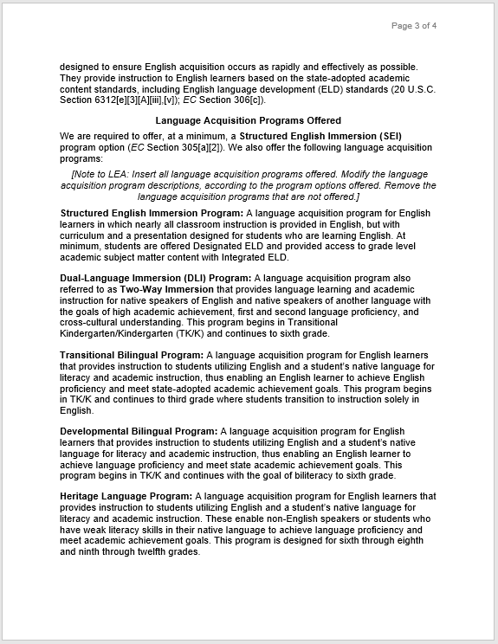
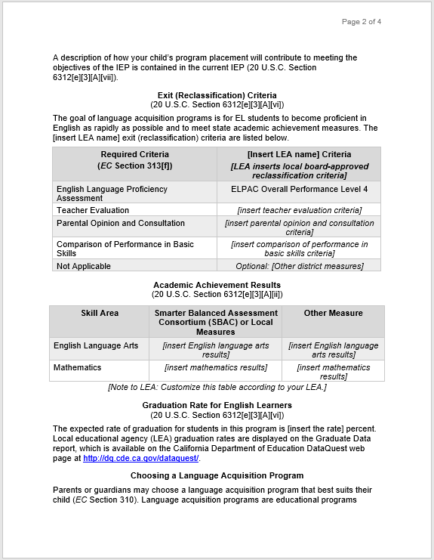
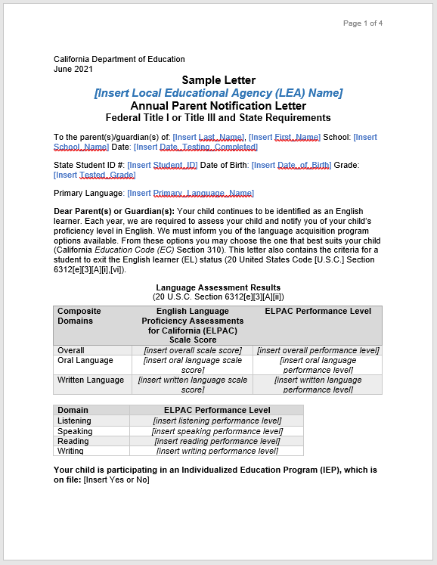
Annual Parent Notification Letter
California Department of Education Template
CDE provides districts a template for the annual notification to inform parents of their child's continued identification as an English learner in a California school, and provide all the required information to meet Federal Title I or Title III requirements:
CDE Sample Annual Parent Notification (DOCX)
CDE Available Translations of the Sample Annual Parent Notification
GUSD schools mail notifications home within 30 days of the beginning of the school year.
When you receive the letter, please review it carefully and contact the teacher specialist at your child’s school if you have any questions.

Slide 12
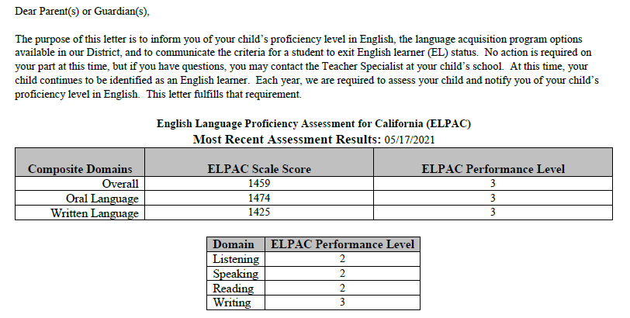
GUSD Annual Parent Notification Letter
Notes:
Overall 4 that is one of the criteria for reclassification which triggers for the specialist to look at the remaining criteria

Slide 13
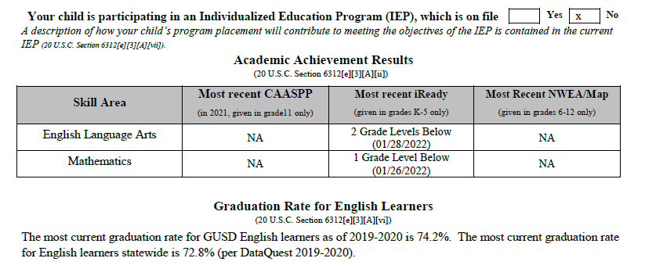
GUSD Annual Parent Notification Letter
Notes:
Tool to talk to teachers at parent conferences

Slide 14
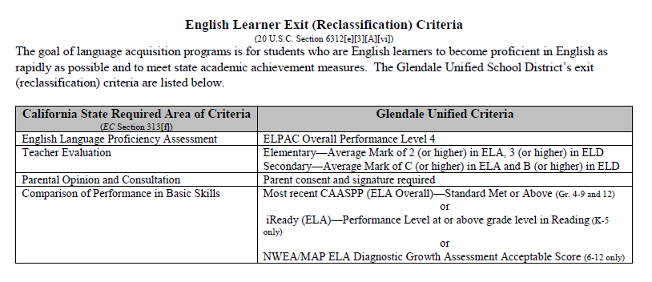
GUSD Annual Parent Notification Letter

Slide 15
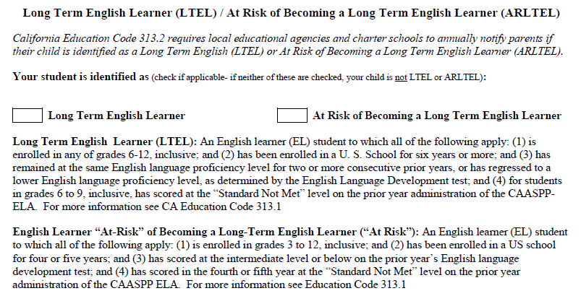
GUSD Annual Parent Notification Letter
Notes:
Any questions, any input - poll - this is clear, confused
Questions- when am I getting this letter? Beginning of the school year, look for it,
When you receive it and review it, you can contact the teacher specialist who will be happy to go over it with you

Slide 16
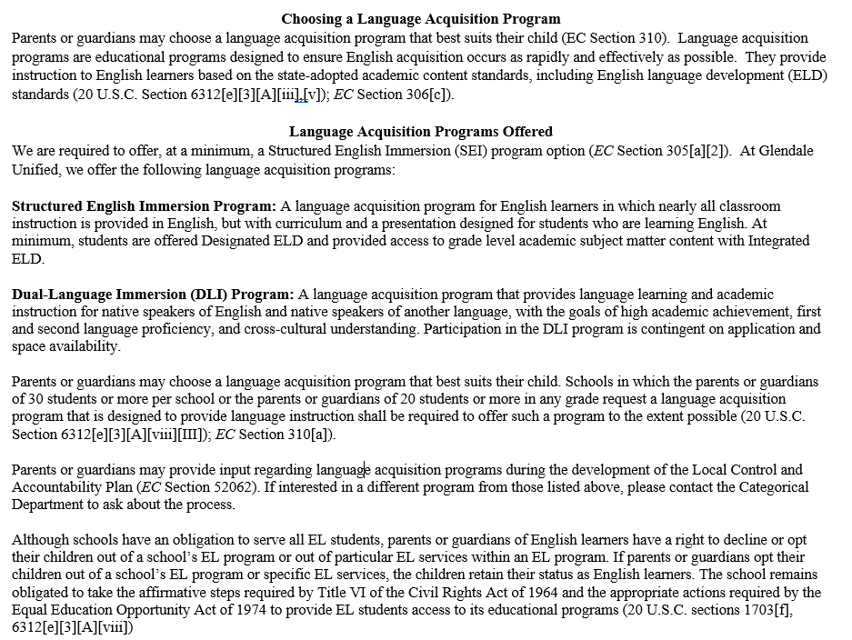
GUSD Annual Parent Notification Letter

Slide 17

English Learner Services (Title III)
Veronica Rubalcava
Notes:
Veronica- 5:55-6:00

Slide 18
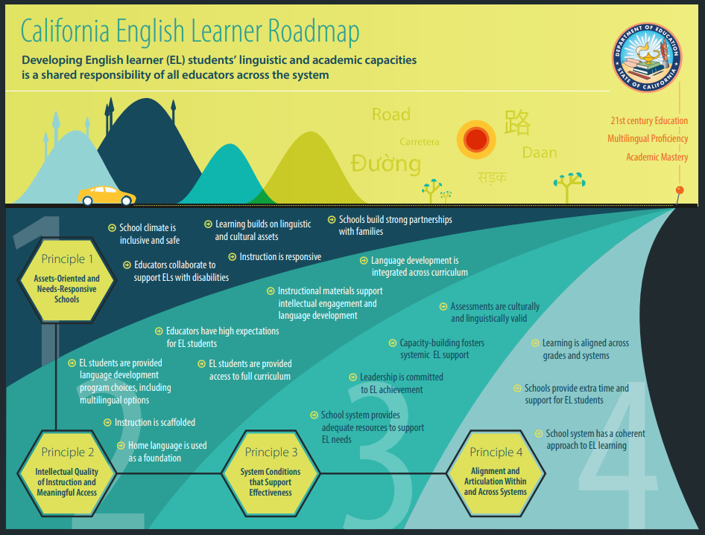
Notes:
The California EL Roadmap provides policies that support effective instruction for English Learners. The roadmap has four key principles that support instruction for our ELs.
Today, I will focus on Principle #3: System Conditions that Support Effectiveness. As our district offers Summer School to our ELs in Middle and High School. This is an extended learning opportunity that would fall under Principle #3 of the California EL Roadmap.
* With that said…

Slide 19

Summer School Information
Dates: June 12- July 17, 2023
Middle and High Schools
Classes are in person
ELD classes are offered
Session 1 - 1st Semester:
  June 12 - June 28
  Monday, June 19th is a holiday/no school
Session 2 - 2nd Semester:
  June 29 - July 17
  Tuesday, July 4th is a holiday/no school
Notes:
Here we have our Summer School Information (June 12-July 17, 2023).

Slide 20

Resources for Summer Learning
Educational Websites:
GUSD Enrichment Resources
National Geographic for Kids
TumbleBooks Library- ebooks for kids
Cool Math 4 Kids
Epic Books
ABCya
Educational Games
Khan Academy
PBS Kids
Encourage your child to have a summer of fun and learning with these five free and easy things to do.
Five Free and Easy Tips for Summer Learning
Notes:
Here we have some great educational websites that your child can access during the summer to keep their minds active!
GUSD provides Enrichment Resources, to name a few, we have Elementary Resources, Middle School Resources, High School Resources, and English Language Development Resources.
I highly recommend checking out our resources and the others listed on this slide.

Slide 21
2022-23 Local Control Accountability Plan (LCAP)
Dr. Oscar Macias, Director, Equity, Access, and Family Engagement

Slide 22
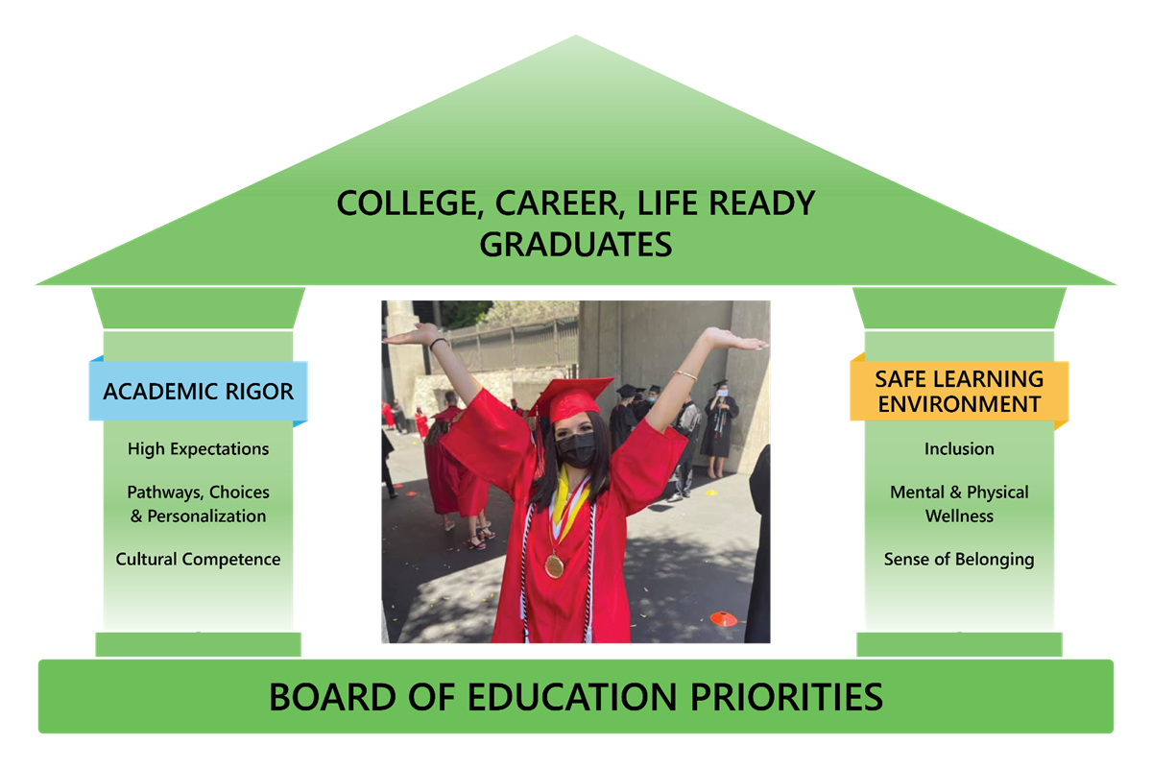

Slide 23
Board Priorities & LCAP Goals
GUSD Roadmap to Success for Educating the Whole Child
GOAL 1
Maximize
Student
Achievement
GOAL 2
Foster a Positive Culture of Learning
GOAL 3
Ensure the Health and Safety of Students and Employees
Maintain District Financial Responsibility

Slide 24
Purpose
Reflection on 2022-23 LCAP
Review of 2023-24 Draft LCAP
Education Partner Feedback and Input
LCAP approval timeline
Notes:
2021-22 LCAP reflections
2022-23 LCAP Draft
education partner
opportunities and input
how these have contributed to the LCAP goals/actions
data/survey results
approval timeline
Feedback and Input
we need to include Supplement to the LCAP for the Board approval on June 24

Slide 25
Guiding Prompts for the Update
2022- 23 LCAP
A description of any substantive differences in planned actions and actual implementation of these actions.
An explanation of material differences between Budgeted Expenditures and Estimated Actual Expenditures and/or Planned Percentages of Improved Services and Estimated Actual Percentages of Improved Services.
An explanation of how effective the specific actions were in making progress toward the goal.
A description of any changes made to the planned goal, metrics, desired outcomes, or actions for the coming year that resulted from reflections on prior practice.
Notes:
we need to include Supplement to the LCAP for the Board approval on June 24

Slide 26
2022-23 LCAP Reflections
Goal 1: Maximize Student Achievement
Greatest Strengths:
All goals and actions implemented as specified in the plan
Dunsmore Elementary, Fremont Elementary, Monte Vista Elementary, Mountain Avenue Elementary, and Valley View Elementary were recognized as the 2023 California Distinguished Schools by the California Department of Education.
Graduation rate for 2022 was up to 94.1% from 91.7%
All schools are providing Tier I & II academic support/intervention during and after school.
EL Reclassification rate remains high at 11%
Implementation of Standards using the LCAP self-reflection average is up to 3.72 from 3.69
Block schedules developed at all Middle and High Schools and 7-period day changes beneficial for ELs, Low Income, and Foster Youth because the added period enables additional elective opportunities and engagement in courses that build connections to school community.
Notes:
Stepan
DRAFT LCAP 22-23 https://docs.google.com/document/d/1XT5dt05kj2ZVKR_Oyd8iX_OobtXdCuYPAzWH_y9ZG1U/edit#
Slide 7 (Goal 1) - template pages 30-34
Slide 8 (Goal 2) - template pages 41-44
Slide 9 (Goal 3) - template pages 46-48
22-23 Metrics spreadsheet https://docs.google.com/spreadsheets/d/1_tKgw66dLdr1w0qtSDcuqw-GfVQi6K1S2-QhXmHQad4/edit#gid=2052780345

Slide 27
2022-23 LCAP Reflections
Goal 2: Foster a Positive Culture of Learning
Greatest Strengths:
All goals and actions implemented as specified in the plan
% of parents who express satisfaction with their child’s safety at school: 76% agree/strongly agree
% of parents who express satisfaction with their opportunities to participate in decision making processes and programs: 61% agree/strongly agree
% of parents who express satisfaction that their child’s school promoted inclusion regardless of their race, ethnicity, language, physical or mental disability, sexual orientation, gender, gender identity, or gender expression: 80% agree/strongly agree
Sense of Safety: Students: 64% favorable (4-5), 55% favorable ; Staff: 75% favorable
Sense of Connectedness: Parents: 69.2% favorable; Students: 63% favorable (4-5), 41% favorable (6+); Staff: 70% favorable
Student Wellness Services has provided these services for foster youth and referred families: Counseling services - 39 students, Tutoring - 31 referrals, Uniforms/clothing & shoes - 142 students, School Supplies/Backpack - 174 students, Food - 134 families, Transportation - 47 students.
Notes:
Stepan
DRAFT LCAP 22-23 https://docs.google.com/document/d/1XT5dt05kj2ZVKR_Oyd8iX_OobtXdCuYPAzWH_y9ZG1U/edit#
Slide 7 (Goal 1) - template pages 30-34
Slide 8 (Goal 2) - template pages 41-44
Slide 9 (Goal 3) - template pages 46-48
22-23 Metrics spreadsheet https://docs.google.com/spreadsheets/d/1_tKgw66dLdr1w0qtSDcuqw-GfVQi6K1S2-QhXmHQad4/edit#gid=2052780345

Slide 28
2022-23 LCAP Reflections
Goal 2: Foster a Positive Culture of Learning
Greatest Strengths: Continued
70% stated that their child receives the social and emotional support they need when they are at school
71% stated that there is at least one adult that their child trusts to talk to when they are at in need at school
76% stated that their child feels safe at school
89% stated that the staff at the school treat them with respect
75% stated that the school takes their concerns seriously
82% stated that the school responds to requests in a timely manner
78% stated that their child’s school has clean facilities
61% stated that the school seeks input before making important decisions
83% stated that the school encourages parents to participate in school or district events
84% stated that the school encourages parents to participate in groups like PTA, school foundations, site
Notes:
Stepan
DRAFT LCAP 22-23 https://docs.google.com/document/d/1XT5dt05kj2ZVKR_Oyd8iX_OobtXdCuYPAzWH_y9ZG1U/edit#
Slide 7 (Goal 1) - template pages 30-34
Slide 8 (Goal 2) - template pages 41-44
Slide 9 (Goal 3) - template pages 46-48
22-23 Metrics spreadsheet https://docs.google.com/spreadsheets/d/1_tKgw66dLdr1w0qtSDcuqw-GfVQi6K1S2-QhXmHQad4/edit#gid=2052780345

Slide 29
2022-23 LCAP Reflections
Goal 3: Ensure the Health and Safety of Students and Employees
Greatest Strengths:
All goals and actions implemented as specified in the plan
Fully credentialed and appropriate assigned teachers: 96%
Access to standards- aligned instructional materials: 100%
Percentage of schools in "good repair" (Facility Inspection Tool - FIT): 96.74%
Since the start of the school year, we have added two school nurses. All of our new staff members have been participating in the Los Angeles County Office of Education (LACOE) School Nurse Orientation and Review trainings. Additionally, the school nurses along with the health clerks have been active participants in the weekly and monthly updates from the Los Angeles County Department of Public Health regarding changes in COVID-19 guidelines.
Since the start of the school year all secondary schools are staffed with security guards.
Raptor Technologies system
GUSD collaborates with community partners such as Vital Medical Services, MAXIM, Kids Dental, Comprehensive Community Health Centers (CCHC), the Lions Club to ensure that our students are provided the best health care available, UCLA Sound Body
Hazel Health (a LACOE contracted therapy service) will be available to provide telehealth opportunities for students whose parents/ guardians refer for services (parent/guardian permission required).
Notes:
Stepan
DRAFT LCAP 22-23 https://docs.google.com/document/d/1XT5dt05kj2ZVKR_Oyd8iX_OobtXdCuYPAzWH_y9ZG1U/edit#
Slide 7 (Goal 1) - template pages 30-34
Slide 8 (Goal 2) - template pages 41-44
Slide 9 (Goal 3) - template pages 46-48
22-23 Metrics spreadsheet https://docs.google.com/spreadsheets/d/1_tKgw66dLdr1w0qtSDcuqw-GfVQi6K1S2-QhXmHQad4/edit#gid=2052780345

Slide 30
What is the
Local Control Accountability Plan (LCAP)?
The LCAP is a three-year plan that describes the goals, actions, services, and expenditures to support positive student outcomes that address state and local priorities. The LCAP provides an opportunity for local educational agencies (LEAs) to share their stories of how, what, and why programs and services are selected to meet their local needs. Once approved, the components of the LCAP for the 2023 - 2024 LCAP year must be posted as one document assembled in the following order:
LCFF Budget Overview for Parents
2023-24 LCAP Template
  Plan Summary
  Engaging Educational Partners
  Goals and Actions
  Increased or Improved Services for Foster Youth, English Learners, and Low-income students
Action Tables
  23-24 Total Planned Expenditures Table
  23-24 Contributing Actions Table
  22-23 Annual Update Table
  22-23 Contributing Actions Annual Update Table
  22-23 LCFF Carryover Table
Notes:
Stepan

Slide 31
Local Control Accountability Plan:
8 State Priorities
Priority 1: Appropriate teacher assignment, sufficient instructional
materials, and facilities in good repair
Priority 2: Implementation of academic content and performance
standards adopted by State Board of Education
Priority 3: Parental Involvement and Family Engagement
Priority 4: Pupil Achievement
Priority 5: Pupil Engagement
Priority 6: School Climate
Priority 7: Course Access
Priority 8: Other Pupil Outcomes
https://www.cde.ca.gov/eo/in/lcff1sys-resources.asp
Notes:
Stepan

Slide 32
LCAP Requirements to Ensure Equity
LCFF requires districts to provide a description to demonstrate how the the district is increasing or improving services for students who are low income, English learners, or foster youth as compared to the services provided to all pupils.
Services must be increased or improved in proportion to the increase in funds apportioned on the basis of the number and concentration of low income, English learners, or foster youth students.
To improve services means to grow services in quality and to increase services means to grow services in quantity.
Notes:
Stepan

Slide 33
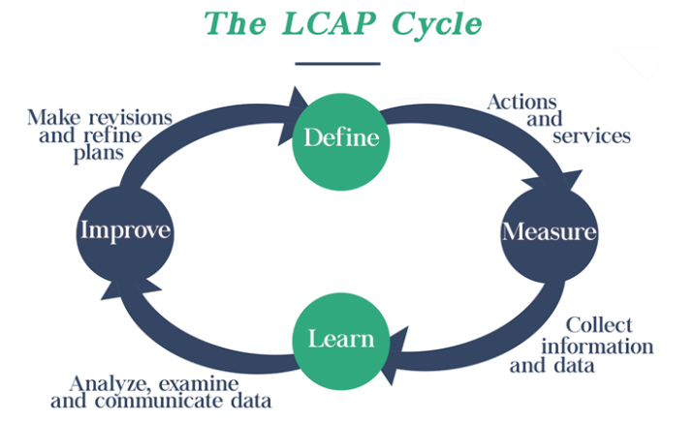
Notes:
Brook

Slide 34
Educational Partner Engagement & Feedback
GUSD has utilized a variety of formats to solicit feedback from educational partners for the 2023-2024 LCAP. These included representation from diverse groups.
Superintendent's Parent Advisory Committee and Council PTA Meetings
DELAC Meetings
Board of Education Meetings
LCAP Town Hall Meetings
Principals and District Administrators Meetings
Bargaining Units (CSEA, GSMA, and GTA)
SELPA
Student Voice Panels
Surveys (Students, Parents, Classified and Certificated Staff)
Notes:
Brook

Slide 35
LCAP Recommendations
based on all the Educational Partner Input
Areas of need that continue to be highlighted in the input provided by educational partners:
expanding the support for mental health and social emotional learning
culturally relevant and responsive education
targeted academic interventions
targeted focus on early literacy
enrichment opportunities
increased professional development
maintaining block schedules at the secondary
extended day kindergarten
blended learning
increased teacher collaboration time
reduction to combination classes
smaller class sizes/decreasing adult to student ratios
summer and Saturday school opportunities
increased family engagement opportunities
Notes:
Brook

Slide 36
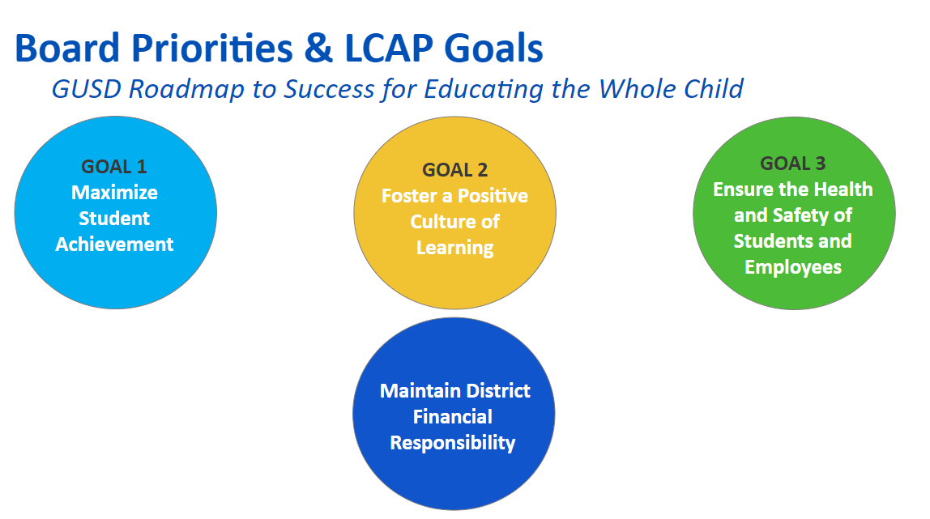
Goal 1: Maximize Student Achievement
Students will receive high impact instruction to make academic progress on the California State Standards in order to prepare for college, career, and life.
Notes:
Brook

Slide 37
Goal 1 Actions
Instruction and Professional Development
  Continue providing quality instruction and targeted interventions for all students supported through high quality professional development, instructional coaching and resources that are culturally relevant and responsive, ensuring equitable access for all learners.
Instruction-related services for special education
  Continue implementation of appropriate instruction and support that is aligned to IEP goals to assist in students’ continuous progress. Supported through ongoing professional development and resources, continue to implement programs that serve the specifically identified academic and behavioral needs of students with special needs.
English Learner Support
  Continue to implement daily Designated ELD instruction in a protected block of time and Integrated ELD embedded in all content for all English Learners based on assessed needs and supported through ongoing professional development and resources.
College, Career, and Life Readiness
  Continue the efforts of trained staff creating and promoting CTE programs and facilitating the Individual College and Career Learning Plans for middle and high school students. Continue the effective implementation and expansion of CTE pathway programs.
Notes:
Brook

Slide 38
Goal 1 Actions
Educational Technology
  Maintaining the 1:1 student to device ratio and providing timely technology device maintenance and professional development.
Gifted and Talented Education (GATE)
  Continue the development and redesign of GATE services which include the process for identification using a tool for universal screening, effective instructional strategies for differentiation, and professional development to support the teachers.
Instructional Support - School Level (Contributing to Increased/Improved Services)
  Continue supporting schools in the development and implementation of carefully designed targeted interventions in addition to core instruction to close the achievement gap. All schools will continue to provide evidence-based academic interventions in ELA and Math to unduplicated students (English learners, low income, and foster youth) based on ongoing data analysis of multiple measures. Continue providing collaboration time and resources for teachers to analyze assessment results, examine the data, and plan the targeted intervention services.
Instructional Support - Elementary (Contributing to Increased/Improved Services)
  Maintain and decrease adult/student ratios to increase teacher and student interaction which supports all students, and especially English learners, low income, and foster youth, and allows the focus on small group instruction and individualized assistance, differentiated instruction, and timely targeted interventions.
Notes:
Brook

Slide 39
Goal 1 Actions
Instructional Support - Secondary (Contributing to Increased/Improved Services)
  Continue implementation of the block scheduling at the middle and high school levels to increase student access to courses and to expand the instructional time for English learners, low income, and foster youth. Continue providing education assistants to help students access the curriculum through small group instruction, differentiated instruction and primary language support.
Academic and Behavioral Support (Contributing to Increased/Improved Services)
  Continue the implementation of strategies and services that increase the individualized support and engage students in the learning experiences through small group and individualized behavioral support strategies. Continue the use of instructional assistants with specialized training to increase and improve services related to academic and behavioral needs to increase access, attendance, engagement, and student achievement. Support the use of resources to develop and implement intervention plans that incorporate multi-tiered systems of support (MTSS).
Expanded Learning Opportunities (Contributing to Increased/Improved Services)
  Continue providing expanded learning opportunities in the form of extended-day kindergarten, Saturday school, summer learning camps, and before and after school tutoring. Maintain the greater access to teachers and support staff through small group, personalized instruction using supplemental evidence-based resources. Continue to focus on acceleration and enrichment, while strengthening students' sense of connection and belonging to school.
Notes:
Brook

Slide 40
Goal 1 Actions
Elementary Extracurricular Opportunities (Contributing to Increased/Improved Services)
  Continue to provide before and after school learning opportunities at the elementary level through extracurricular activities such as, music and chorus, sports, and technology to increase student connectedness to school.
Elementary Library/Media Education (Contributing to Increased/Improved Services)
  Continue to provide library aides and multimedia technology specialists create learning opportunities that offer access to a literacy and technology rich environment. Maintain the ample access and direct support to obtain information and resources that best support learning immediately.
Instructional Technology Support (Contributing to Increased/Improved Services)
  Continue to provide Teacher Specialists in ETIS to support parents and families with access and use of technology and the internet, to present at parent engagement events, and for one-on-one support as needed.
Instructional Support - English learner (Contributing to Increased/Improved Services)
  Continue the use of high-quality designated curriculum and professional development to provide academic and social emotional support to engage newcomer ELs in rigorous, grade-level academic learning. Enhance and expand the rigorous academic language development instruction for Long-Term English Learners to increase the rate of language acquisition.
English Learner support in Dual Immersion (Contributing to Increased/Improved Services)
  Continue to provide ELs in dual immersion the necessary support for developing skills in English as well as the target language. Maintain the coordinator and teacher specialists assigned to support the dual language immersion programs who closely monitor student achievement towards linguistic and academic goals.
Notes:
Brook

Slide 41
Goal 1 Actions
Expanded Opportunities - Advanced Placement Exams (Contributing to Increased/Improved Services)
  Continue to fund the cost of the Advanced Placement tests to maximize low income students’ opportunity to earn college credit.
Instruction-related services for Daily HS (Contributing to Increased/Improved Services)
  Continue with individualized interventions to accelerate the progress towards closing the achievement and the credit gaps. Maintain reduced student/teacher ratios and instructional support staff to increase individualized support. Expand the counseling service providers to address academic and social-emotional needs and to provide additional alternative programs and opportunities for credit recovery, including extended learning during summer.
Expanded Opportunities - Transportation for Clark Magnet HS (Contributing to Increased/Improved Services)
  Continue providing transportation for qualifying low income students to increase access to attend Clark Magnet High School and take advantage of the opportunities offered.
Intervention Support - Elementary Schools
  Continue providing intensive intervention support for students in TK-6 who are demonstrating academic gaps based on the grade level expectations, as measured by local and state assessments. Support the targeted intervention plans developed at the school incorporating evidence-based strategies to close the academic gaps.
Instructional Support - Secondary Schools
  Continue implementation of the Super Tutor Program to provide a team of academic tutors who can support their peers in various content areas before and after school, as well as during lunch. Maintain the certification training for Super Tutors on effective tutoring and teaching practices and compensation for Super Tutors for services.
Notes:
Brook

Slide 42
Goal 2: Foster a Positive Culture of Learning
Schools will be safe, inviting, engaging, supportive, and culturally responsive and relevant environments for students, parents, and staff.
Notes:
Brook

Slide 43
Goal 2 Actions
Student Services (Contributing to Increased/Improved Services)
  Continue implementing early interventions to reduce chronic absenteeism, and monitor attendance to identify students who need support in improving their attendance. Maintain the systems of support through weekly phone calls home for support, providing food resources to meet basic needs, connecting with agencies in the community for interventions and supports to address all needs.
Health and Wellness Services (Contributing to Increased/Improved Services)
  Maintain the use of social work supervisors to provide guidance, training, and assistance to social work interns, providing individual and group counseling, parent support groups, social emotional support through psychological service providers are offered based on identified needs. Maintain the use of psychological service providers at schools with individual and group counseling and parent support groups and parent workshops to ensure the families are empowered with skills and supported alongside their child.
Parent Engagement/Outreach (Contributing to Increased/Improved Services)
  Maintain the Welcome Center services to include parent orientation to identify and share resources with families, and provide districtwide translation services. Maintain the Student Wellness Services (SWS) intake process to identify their specific needs, personal, academic, and social-emotional. Maintain the counselors assigned to schools to support the continuous progress of the foster youth. Continue the development and offering of a robust family engagement program using the California Department of Education's Framework and Toolkit for Family Engagement.
Notes:
Brook

Slide 44
Goal 2 Actions
Restorative Justice and PBIS
  Continue offering learning opportunities for students to ensure students' safety and security, including the comprehensive rollout of the Positive Behavior Interventions and Supports (PBIS) program. Continue the training in restorative practices to provide all adults and students on campus the opportunity for dialogue.
Health and Wellness Services - Special Education
  Maintain the Special Education Department counseling services for students per their IEPs. Continue with the school psychologists who support students and schools in addressing the social emotional needs of students. Maintain the psychological service providers who provide counseling services to students with IEPs in order to access their educational/academic program.
Communication and Surveys
  Continue the use of the Q student information system for access to timely student information, the Panorama Survey and other surveys for engaging education partners, and maintain the District and school websites for centralized location for information and resources.
Guidance and Counseling
  Continue to provide a multi-tiered system of support that includes culturally-inclusive practices to address the academic, college/career, and personal/social development of all students. Continue to facilitate the comprehensive school counseling program in collaboration with students, parents, teachers, school/district staff and community. Continue to support students in finding their purpose and effectively managing future challenges. Expand the support through the use of wellness facilitators at each secondary campus to provide ongoing support to children and families.
Notes:
Brook This is the addition here: 2.7 Expand the support through the use of wellness facilitators at each secondary campus to provide ongoing support to children and families.

Slide 45
Goal 3: Ensure the Health and Safety of Students and Employees
Students will receive basic services, including qualified teachers, standards-aligned instructional materials, and appropriately maintained school facilities.
Notes:
Brook

Slide 46
Goal 3 Actions
Qualified Staff
  Maintain fully credentialed and appropriately assigned teachers and qualified administrators and support staff.
Instructional Materials
  Continue to provide instructional materials to remain Williams compliant.
Plant/Maintenance Services
  Continue to provide Facility and Support Operations (FASO) staff, including custodians to provide a clean, safe, and secure learning environment for all students.
Safety and Security
  Continue to provide campus security guards at secondary schools, two Glendale Police Department School Resource Officers (SRO) and one Los Angeles Sheriff's Department SRO, and Youth programs such as the Explorer program and TAPP.
Health Services
  Continue implementation of all the health services across the district overseen by district nurse and school nurses, and Licensed Vocational Nurses for medically fragile students.
Notes:
Brook

Slide 47
Approval Timeline
DELAC - May 8
Council PTA/SPAC - May 12
Town Hall - May 30
Board Hearing - June 6
Board Approval - June 20 (by July 1)
Submit to LACOE for approval within 5 days of Board approval
Notes:
Stepan

Slide 48
Questions?
Contact:
Dr. Oscar Macias
Omacias@gusd.net
Notes:
Stepan

Slide 49
Family Engagement
Anita Arjoyan
Notes:
Anita - 6:15-6:30

Slide 50

Parent Resources (Summer Learning Places)
Recommended Places to Visit:
Glendale Library Arts & Culture - Kids Event
Glendale City Summer Camps - Visit
The Cabrillo Marine Aquarium - Visit
Southern California Children’s Museum - Visit
USS Midway Museum (San Diego) - Visit
Discovery Cube - Visit
Kidspace Children’s Museum - Visit
California Science Center - Visit
Natural History Museum - Visit
Griffith Observatory - Visit
Notes:
Update the highlighted resource! DELAC Meeting Slide 5/8

Slide 51

City of Glendale Activities for Families
Youth and Family Service Resource Guide
City of Glendale - Teen Night Out
Please CLICK HERE to access site.

Slide 52
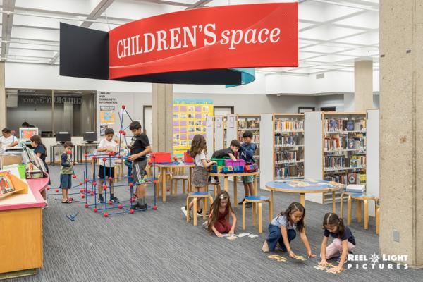
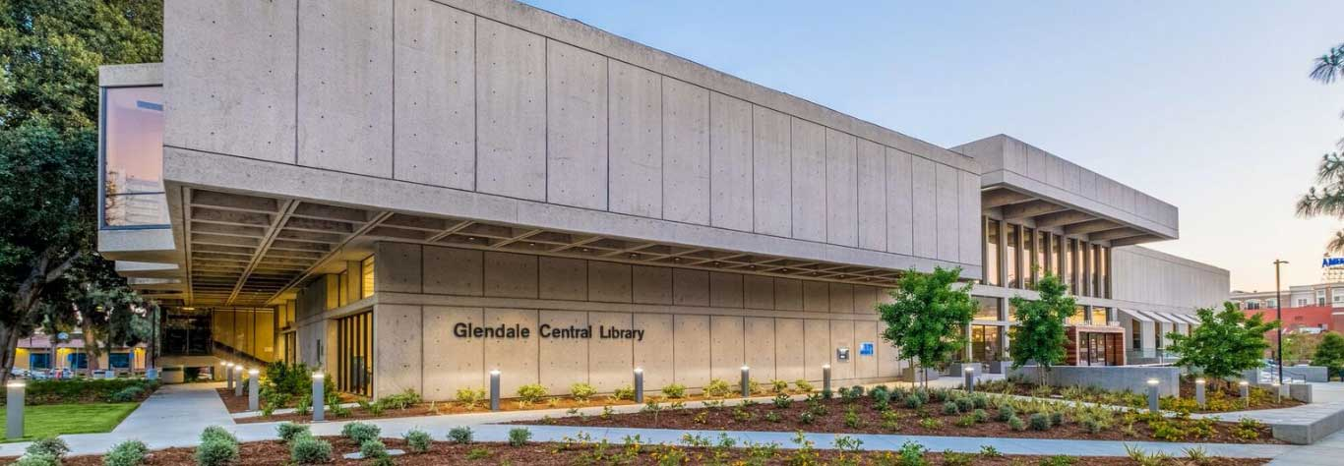
Glendale Library Presentation
Glendale Central Library
222 E. Harvard St.
Glendale, CA 91205
Central Library
Monday - Thursday
9am - 9pm
Friday & Saturday
9am - 6pm
Sunday
1pm - 6pm
Contact Information:
(818) 548-2021
EVENTS AT CENTRAL LIBRARY

Slide 53

2023-2024 DELAC Meetings
Tentative
5:30 - 6:30 pm
October 2, 2023
December 11, 2023
February 6, 2024
March 4, 2024
May 6, 2024

Slide 54

Questions * Input* Feedback
Notes:
6:50

Slide 55
GUSD DELAC Meeting Feedback
To ensure that all members have an opportunity to provide input on all DELAC matters, we invite you to share your feedback following each meeting.
Որպեսզի ապահովենք, որ բոլոր անդամները հնարավորություն ունենան իրենց ներդրումն ունենալ DELAC-ի հետ կապված հարցերում, մենք հրավիրում ենք ձեզ կիսվել ձեր կարծիքներով յուրաքանչյուր ժողովից հետո:
모든 멤버가 모든 DELAC 문제에 대한 의견을 제공할 수 있도록 각 회의 후에 귀하의 의견을 공유해 주시기 바랍니다.
/Para asegurar que todos los miembros tengan la oportunidad de proporcionar aporte sobre todos los asuntos del DELAC, los invitamos a compartir sus opiniones después de cada reunión.
https://forms.gle/Mkqp5MghDnGdKUFf9

Slide 56
Adjournment
THANK YOU!

