Slide 1

District English Learner Advisory Committee (DELAC) Meeting
October 11, 2021
5:30PM-6:30PM
Equity, Access, and Family Engagement
Dr. Marine Avagyan, Director
Ms. Sandra Espinoza, Coordinator
Dr. Narineh Hakopian, Teacher Specialist
DELAC Board Members
Annie Samuelian, President
Maribel Hernando, Secretary

Slide 2
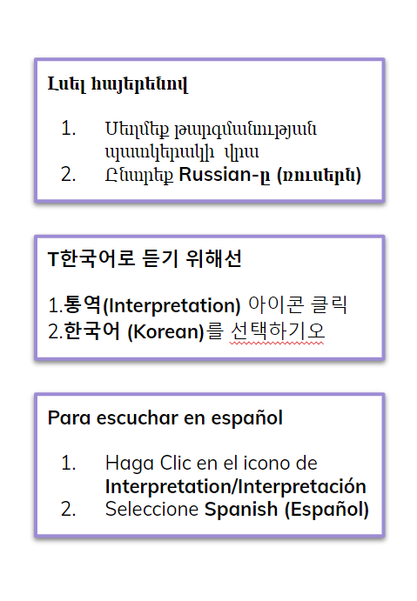
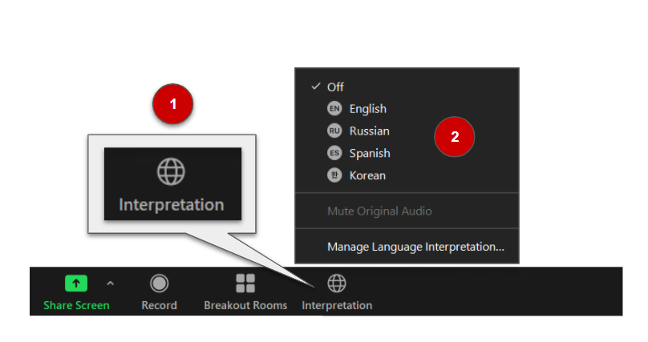
INTERPRETATION

Slide 3
Meeting Protocols
Mute your microphone unless speaking to the group
Sign in to meeting by typing your first and last name in the Chat, along with your child’s first and last name and school
Type questions in the chat (in English or your preferred language)
The DELAC Meeting is being recorded.
Notes:
Videos will be recorded .

Slide 4
Welcome
Introductions
Call To Order

Slide 5
Elementary Teacher Specialists
Balboa Martha Dreyfus mdreyfus@gusd.net
Cerritos Sylvia Galvez-Grado sgalvez-grado@gusd.net
Columbus Houri Keuroghlian hkeuroghlian@gusd.net
Dunsmore Christine Aroyan caroyan@gusd.net
Edison Wendy Rios wrios@gusd.net
Franklin Roxanne Ouweleen rouweleen@gusd.net (Assistant Principal)
Fremont Tiffany Hirdler thirdler@gusd.net
Glenoaks Francesca Silva fsilva@gusd.net
Jefferson Ben Dionisio bdionisio@gusd.net
Keppel Christine Aroyan caroyan@gusd.net

Slide 6
Elementary Teacher Specialists Continued…
La Crescenta Martha Dreyfus mdreyfus@gusd.net
Lincoln Francesca Silva fsilva@gusd.net
Mann Chris Burt cburt@gusd.net
Marshall Natalie Yahiayan nyahiayan@gusd.net
Monte Vista Elizabeth Tamez etamez@gusd.net
Mountain Avenue Elizabeth Tamez etamez@gusd.net
Muir Patricia Anderson panderson@gusd.net
Valley View Tiffany Hirdler thirdler@gusd.net
Verdugo Woodlands Joseph Yi josephyi@gusd.net (Assistant Principal)
R.D. White Monica Hilario mhilario@gusd.net

Slide 7
Middle School Teacher Specialists
Roosevelt Anita Arjoyan aarjoyan@gusd.net
Rosemont Anne Reinhard areinhard@gusd.net
Toll Tamara Johnson tjohnson@gusd.net
Wilson Hasmik Simonyan hsimonyan@gusd.net
High School Teacher Specialists
Clark Magnet Estine Shahverdian eshahverdian@gusd.net
Crescenta Valley Anne Reinhard areinhard@gusd.net
College View- Corkie O’Rourke ko'rourke@gusd.net
Daily Jamie Alarcon jalarcon@gusd.net
Glendale Sarah Kleinberg skleinberg@gusd.net
Hoover Naeiri Policky npolicky@gusd.net

Slide 8
Approval of May Meeting Minutes
Notes:
LINK TRANSLATED MINUTES

Slide 9
AGENDA
Welcome and Introductions
DELAC Scope and Purpose
English Learner Services Overview
DELAC Representative Training
Family Engagement Updates
State and Federal Programs Update
Questions and Parent Input
Next Meeting - December 13, 2021 via Zoom
Notes:
District English Learner Advisory Committee (DELAC) Scope & Purposes
Glendale English Learner Services Overview
Purpose
Identification
English Language Development Instruction
ELPAC Assessment
Reclassification
Monitoring
English Learner Advisory Committee (ELAC) Representative Training
DELAC Elections
Family Engagement Updates
State and Federal Programs Update
Other Topics from the Floor
Future Meetings

Slide 10
DELAC Scope and Purpose
The DELAC’s purpose is to advise on the development and implementation of the educational programs and services for English Learner students at the District level.
Development of master plan for English learners
Conduct a district-wide needs assessment on a school-by-school basis
Establish a district program, goals and objectives for programs and services for ELs
Develop a plan to ensure compliance with teacher and instructional aide requirements
Review and comment on GUSD’s reclassification procedures
Review and comment on written notifications required to be sent to parents & guardians
Review and comment on development or annual update of LCAP
Training for DELAC members
Consolidated Application developed with review and advice of DELAC

Slide 11
English Learner Services Overview
Purpose:
Support students as they acquire both conversational and academic English language proficiency
Honor heritage, language, and culture
  Dual Immersion
  World Language Programs
Ensure student success in core academic classes
Ensure student competitiveness in college admissions and world employment markets

Slide 12
English Learner Services Overview
Identification:
Home Language Survey
  To be completed only once in a student’s TK-12 career
Welcome Center
Initial ELPAC
  Novice-EL Program
  Intermediate-EL Program
  Initially Fluent-No EL Program
Students who are identified as EL are administered the Summative ELPAC annually in the Spring
Identified EL until all Reclassification Criteria are met

Slide 13
English Learner Services Overview
Parent Notifications:
Initial Parent Notification Letter
  to inform parents of their child's identification as an English learner or initially fluent-English proficient student
Annual Parent Notification Letter
  to inform parents of their child's continued identification as an English learner
Please connect with the teacher specialist at your school site. He/she will be happy to go over the information with you.

Slide 14
English Learner Services Overview
English Language Development (ELD) Instruction:
Designated ELD Time
  Based on English Language Development Standards
  Emphasis on Academic Language
  Benchmark (K-5)
  Springboard (6-12)
Integrated ELD Time
  Throughout the day and across all disciplines
  Teachers use strategies to support language acquisition as well as content knowledge

Slide 15
English Learner Services Overview
ELPAC Assessment:
Initial ELPAC
  Taken only once in student’s TK-12 career
Summative ELPAC
  Taken annually by all students identified EL
  Based on English Language Development standards
  Monitors language acquisition progress of our ELs
  Computer-based

Slide 16
English Learner Services Overview
Reclassification (GUSD Board Approved):
Four criteria for reclassification are required by state and federal policy. A student must meet all 4 criteria to be eligible for reclassification.
Summative ELPAC
Overall score of 4 (required by State Board of Education)
Comparison of Basic Skills
CAASPP
i-Ready
MAP Growth Assessment
SOLOM
Teacher Evaluation
Grades
ELD Descriptors
Parental Consultation
Consultation/Input
Signature
Notes:
Students in the Dual Immersion program may take longer to acquire English fluency in the primary grades, but research shows that their fluency evens out by 4th or 5th grade.

Slide 17
English Learner Services Overview
Monitoring:
RFEP Monitor Progress for 4 years
Recent data analysis (i-Ready) shows reclassified students demonstrate higher growth performance in Reading and Math than their non-EL peers

Slide 18
DELAC Representative Training
What is a DELAC?
It stands for District English Learner Advisory Committee.
It is an advisory group of parents/guardians of English learners in a district with 51 or more English Learners.
The DELAC representatives from each school’s ELAC.
DELAC Responsibilities
The committee advises the governing board on:
Revision of the district’s master plan for English Learners.
Conduct or review district-wide needs assessment.
Establishment of district programs, goals, and objectives.
Developments of a plan to ensure compliance with any teacher and instructional aide requirements.

Slide 19
DELAC Representative Training Continued
Essential DELAC Criteria
Parent/Guardians of English Learners not employed by the district must constitute a majority of the membership.
Each school ELAC must have the opportunity to elect at least one parent member to DELAC.
DELAC Officer Duties
The chairperson shall: Preside over meetings, Represent DELAC at district parent meetings,Sign communications from DELAC to the local boards
The vice-chairperson shall: Represent Chairperson, Substitute for the chairperson in their absence
The secretary shall: Keep minutes of the meetings

Slide 20
DELAC Representative Training Continued
DELAC Requirements
California ED Code/Section 35147:
1. Meeting must be open to allow for public input.
2. Meeting notice must be posted at least 72 hours before the meeting.
3. Notice and agenda must be posted at an appropriate place accessible to the public.
4. Notice of meeting and agenda must include date, time, and location of meeting.
5. Actions cannot be taken on items NOT posted on the agenda.
6. The public must be provided access to all materials discussed and/or distributed at the meeting.

Slide 21
Newcomer Family Resources
Family Engagement Update
California Department of Education
Family Engagement Toolkit
2 Critical Dimensions of Family Engagement:Building trusting relationships & connecting to student learning.
Laying the foundation for a District Family Engagement Team,Identifying the Districts current strengths and challenges, “Plan, Do, Reflect, Adjust”
California Department of Education
Family Engagement Framework
District- Build Capacity, Demonstrate Leadership, Allocate Resources and Staff,Access and Equity
Family Involvement- Ways families can get involved -at home, in the classroom, at school, and at the District

Slide 22
State and Federal Program Updates
Local Control Accountability Plan (LCAP)
  2021-2024
Expanded Learning Opportunities (ELO) Grant
Elementary and Secondary School Emergency Relief (ESSER III) Fund

Slide 23
Expanded Learning Opportunities (ELO) Grant
Districtwide services to address the instructional strategies include:
- summer learning opportunities for elementary schools
- support for early literacy and acceleration through certificated and classified staffing
- use of paraprofessionals (Education Assistants) to provide targeted support to identified students, including English learners and individuals with exceptional needs
- use of parent/community liaisons to support schools in building partnerships with families to support the whole child
- allocating funds to schools for site level planning and decision making
School level services will be collaboratively planned locally and may include services such as:
- RtI Academic interventions
- On-site licensed SEL support (coordinated with Student Wellness Services)
- Support for language classes
- Support for English learners, students who are socio-economically disadvantaged, foster-homeless and/or have special needs
- Afterschool homework help
- Increased and extended Afterschool/Saturday School/School Year planned and structured opportunities
- Other enrichment opportunities (if aligned to intent of funding and intended student groups):
- GATE/Enrichment programs
- Art/Music Classes
Grant Information and Guidance

Slide 24
Local Control Accountability Plan (LCAP) 2021-2024
Local Control Accountability Plan (LCAP) Goals 2021-22:
1. Maximize Student Achievement
Close the digital and equity gap
Provide effective instruction to accelerate academic achievement for all students
Provide students access to evidence-based interventions and supports
Prepare students to be college, career, and life ready upon graduation
Provide teachers with training and tools for effective instruction
2. Foster a Positive Culture of Learning
Support the social, emotional, behavioral, and physical needs of all students
Engage students in a safe and positive school community
Engage families and the community to support student learning
3. Ensure the Health and Safety of Students and Employees
Provide health and wellness services to all students
Maintain clean, safe, and secure learning environment for all
Board Priorities for 2021-2022
1. Maximize Student Achievement
Close the digital and equity gap
Offer robust in-person and independent study learning programs
Accelerate learning and improve attendance and engagement
2. Foster a Positive Culture of Learning
Ensure equitable teaching and learning opportunities led by excellence
Support culturally relevant curriculum that emphasizes inclusion
Increase school connectedness for students, parents, and families
3. Ensure the Health and Safety of Students and Employees
Strengthen mental health support and programs
Ensure best practices for safe and healthy learning environments
Support physical, social, and emotional wellbeing
4. Maintain District Financial Responsibility
Ensure the fiscal health of the district
Implement a fiscal plan to preserve the district resources
Plan for the district’s future educational and facility needs

Slide 25
Elementary and Secondary School Emergency Relief (ESSER III) Expenditure Plan
Grant funds may be used for:
Strategies for Continuous and Safe In-Person Learning
Provide a description of the action(s) the LEA will implement using ESSER III funds for prevention and mitigation strategies that are, to the greatest extent practicable, in line with the most recent CDC guidance, in order to continuously and safely operate schools for in-person learning.
Addressing the Impact of Lost Instructional Time
Provide a description of the action(s) the LEA will implement using ESSER III funds to address the academic impact of lost instructional time through the implementation of evidence-based interventions, such as summer learning or summer enrichment, extended day, comprehensive afterschool programs, or extended school year programs. At least 20 percent of the ESSER III funds to address the academic impact of lost instructional time.
Use of Any Remaining Funds
Provide a description of any additional action(s) the LEA will implement to address students’ academic, social, emotional, and mental health needs, as well as to address opportunity gaps, consistent with the allowable uses.
GUSD Board Approval on October 12, 2021

Slide 26
Federal Funding in 2021-22
GUSD receives:
Title I, Part A - Improving Basic Programs
Title II, Part A - Supporting Effective Instruction
Title III- Part A - Program for English Learner
Title IV, Part A - Student Support and Academic Enrichment

Slide 27

Questions * Input* Feedback
*Next DELAC Meeting*
December 13,2021 Via Zoom
5:30-6:30PM

Slide 28
GUSD DELAC Meeting Feedback
To ensure that all members have an opportunity to provide input on all DELAC matters, we invite you to share your feedback following each meeting.
Որպեսզի ապահովենք, որ բոլոր անդամները հնարավորություն ունենան իրենց ներդրումն ունենալ DELAC-ի հետ կապված հարցերում, մենք հրավիրում ենք ձեզ կիսվել ձեր կարծիքներով յուրաքանչյուր ժողովից հետո:
모든 멤버가 모든 DELAC 문제에 대한 의견을 제공할 수 있도록 각 회의 후에 귀하의 의견을 공유해 주시기 바랍니다.
/Para asegurar que todos los miembros tengan la oportunidad de proporcionar aporte sobre todos los asuntos del DELAC, los invitamos a compartir sus opiniones después de cada reunión.
https://forms.gle/B4iHp9V2oeNV9dSQ9

Slide 29
Adjournment
THANK YOU!

