Slide 1
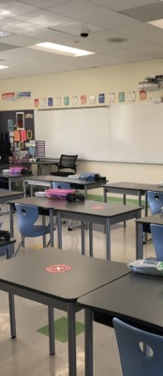





Mountain Avenue
Opening and Safety Guide
2307 Mountain Avenue
La Crescenta, CA 91214
mountainavenue@gusd.net
https://www.gusd.net/mountainavenue

Slide 2
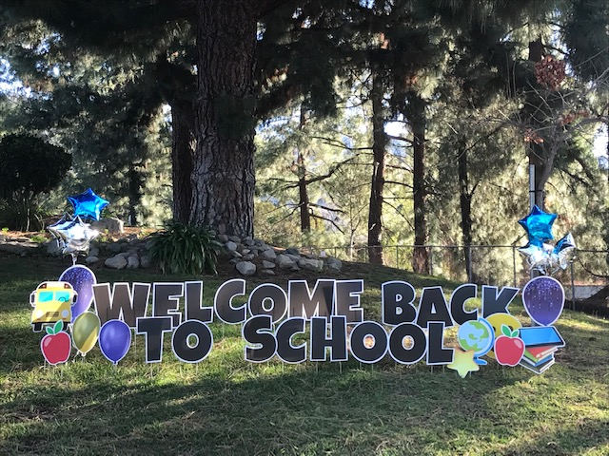
A Message from
Principal Scott
Bear Family,
We are so glad to have the opportunity to re-open our classrooms and give the opportunity for students to return for the remainder of the 2020-2021 school year. Our teachers, staff, and I have been working hard to ensure that all students, either in-person or at home, have the opportunity to learn in a safe and respectful learning environment. Students that are returning to campus are asked to wear their masks while on campus, social distance (keep 6 feet distance from each other), and wash their hands extra well and frequently. For all students we continue to show B.E.A.R.S. expectations.
Be kind
Encouraging
Accept responsibility
Respect others and be
Safe!
We are a school community that champions diversity and creativity within a kind, safe, responsible and respectful environment.
We are #MountainAveStrong!
Go Bears!
Principal Scott

Slide 3
Every Day Before School
Daily Pre-Screening for Symptoms
Everyone who will be on campus must complete a health screening process. The link for our online health screen will be sent to families via email or text message each morning.
The daily health screen can be completed online or upon entering campus. The screen asks about contact with individuals with confirmed COVID-19 or COVID-19 symptoms and requires a check for the following symptoms:
Fever of 100.4°F or higher
Cough
Shortness of breath or difficulty breathing
New loss of taste or smell
Chills, fatigue, muscle or body aches
Sore throat
Congestion or runny nose
Nausea
Vomiting or diarrhea
New headache
Students and Families
Students and adults experiencing the symptoms listed above MUST NOT attend school. This includes anyone with a fever of 100.4°F or higher.
Student absences related to personal illness, quarantine, and COVID-19 illness or symptoms will be excused.
Students seeking testing due to exposure or symptoms of illness MUST stay home until they receive their results.
If a family member is awaiting results or being tested for COVID-19, student MUST stay home.
Families should contact the school office about their child’s absence.
Employees
Employees must take their temperatures prior to beginning work.
Employees must contact their school administrators regarding their absences.
Employees seeking testing due to exposure or symptoms of illness MUST stay home until they receive their results.
For additional health and safety information, view our Glendale Unified School Opening and Safety Guide at www.gusd.net/SafetyGuide

Slide 4

          Arrival Times
          Your child must arrive at school between 8:00 - 8:20. A Health Check will be completed upon your child's arrival. We do not have staff to supervise students before 8:00 am.
          Pick-up Times
          TK and K = 11:30
          1st - 3rd = 12:30
          4th - 6th = 12:40
Dismissal
Support staff will escort students to their dismissal area near the dismissal gate and monitor the release of students to their parents/guardians.
Parents/guardians need to remain in their car for the student to come to them.
Early Dismissal: If a student needs to be picked up early, parents/guardians must call the office with the time and reason for the early dismissal and the front office staff will notify the teacher. The student will be responsible for gathering their belongings before heading to the front office. Parents/guardians will need to allow extra time for this process when picking up students for doctor appointments and early dismissal. At least 15 minutes is recommended.
Health and Safety
  Students and employees are required to wear masks and must complete a health screening process before arrival.
  Gate monitors will check temperatures and confirm positive health screenings before students can enter the campus.
  If a student or employee has a fever of 100.4°F or higher or is demonstrating COVID-19 symptoms, they will not be allowed to enter campus and will be provided recommendations and further instructions.
  Once students enter campus, they will walk directly to their classroom.
We strongly encourage students to arrive at school on time. If a student is late to school, they must be brought to the front office where staff will take a temperature and confirm a positive health screening. Parents/guardians will not be able to enter the front office. The student will receive a late pass and be escorted/sent to class. Please avoid being late as we would like to avoid mixing cohorts of students.
Arrival / Dismissal
What Can Students Bring to School?
Backpack
Jacket, sweatshirt, sweater
Water bottle
Extra face masks
Snack (grab-and-go lunch will be provided upon dismissal)

Slide 5
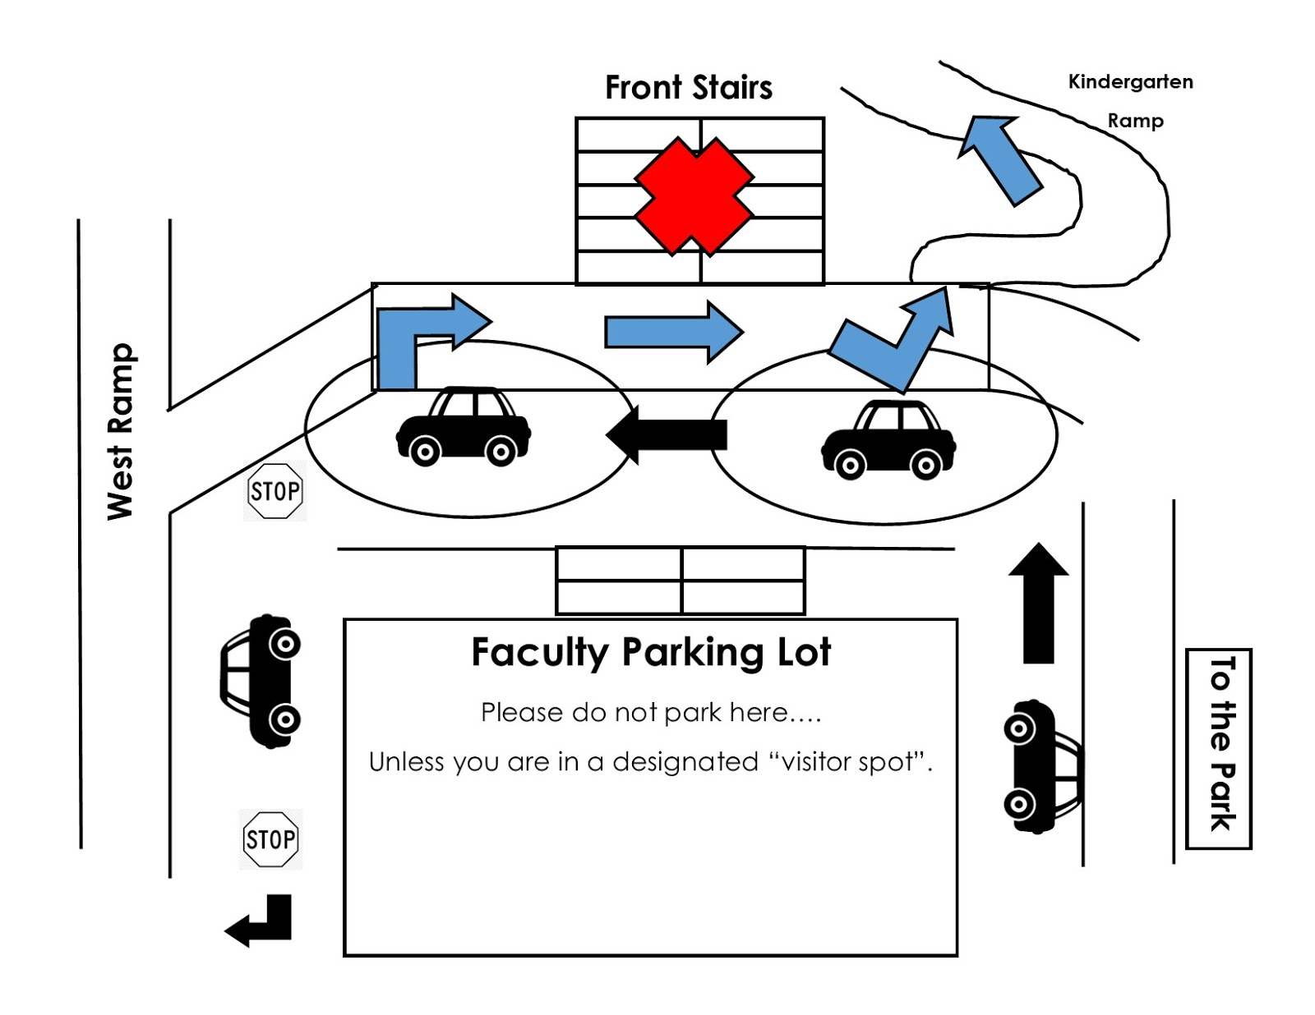
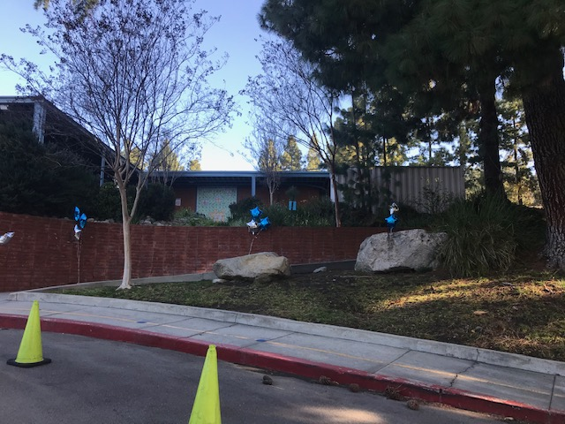
Drop Off & Pick Up Map
Arrival to School
A safety lane exists for student drop-off and pick-up. Please remember to pull up as far as you can along the safety lane and when dropping off or picking up your child(ren). There will be kiosks with staff where you will complete your health check. The health check must be completed before exiting the car.
Students will enter up the Kindergarten ramp.
Dismissal From School
When picking up, be prepared to share your child’s name and teacher’s name. We will call for your child to come to the car. Staff will help direct traffic and assist students getting into and out of their cars. Please give these staff your courtesy and respect. For safety reasons the parking lots are not to be used. While waiting, students should stand on a blue dot, 6 feet apart from others.

Slide 6

Health
Office
          Staff must always contact the health clerk before sending a student to the health office.
          Staff will be asked to call and then send students to the health clerk if they have any of the following symptoms. Staff will use their best judgement.
Fever or looks flushed
New cough
Chills/constant shaking/sweating
Sore throat
Shortness of breath or trouble breathing
Fatigue
Headache
Runny nose or congestion
Body or muscle aches
Abdominal pain
Nausea, diarrhea, or vomiting
New loss of taste or smell
The health clerk will assess the student and determine if the student needs to be sent home and the length of time the student is to remain at home. The school will have a low threshold for sending students home. The school health office has an isolation room to use if students are showing symptoms. Parents/guardians will be asked to pick up their child in a timely manner.
If your student requires to have necessary or emergency use medications on campus, please have their doctor complete the following form: https://drive.google.com/file/d/0B6KBHGhmgtBGcGgzUlVSbThFdGc/view?usp=sharing
  Please note that all medication must be in its original packaging, labeled clearly with the student's name and birthdate and the original prescription label (if applicable). No expired medications will be accepted. Once completed, please call the Mountain Ave Office (818) 248-7766 or email Ms. Elizabeth Salcedo (esalcedo@gusd.net ) to set up an appointment to turn in your form along with all necessary medication.
Protocols

Slide 7
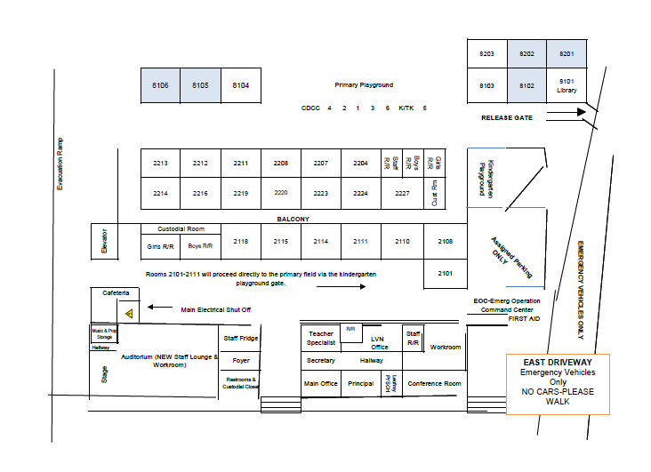
Campus Map

Slide 8
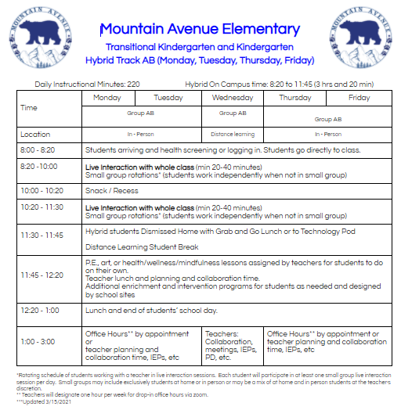
Mountain Avenue
Instructional Schedule

Slide 9
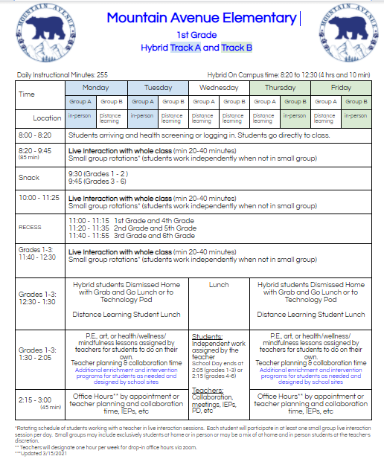
Mountain Avenue
Instructional Schedule

Slide 10
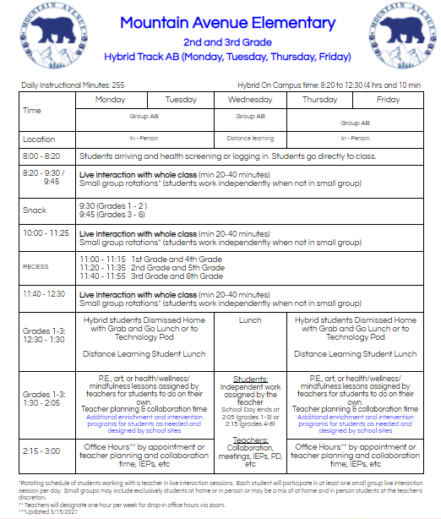
Mountain Avenue
Instructional Schedule

Slide 11
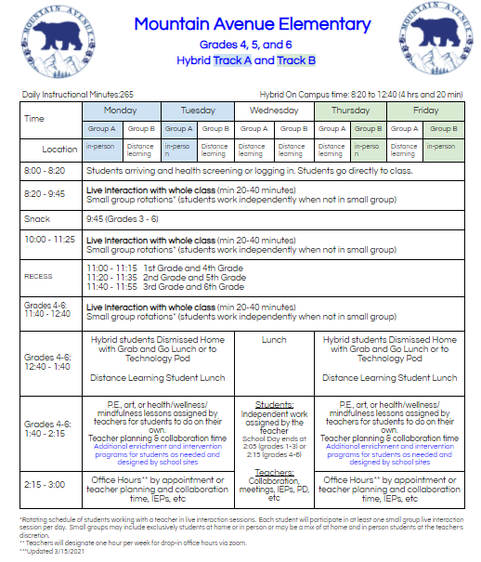
Mountain Avenue
Instructional Schedule

Slide 12
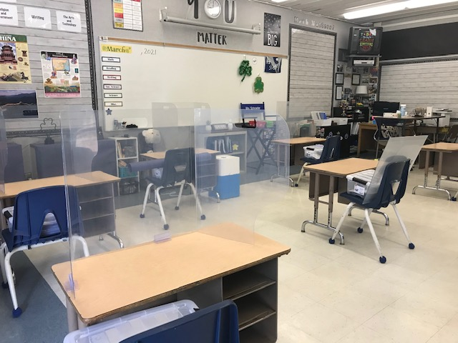
Classroom
Inside the
Masks are required for all students, employees, and essential visitors. We request that parents/guardians provide their child with a labeled Ziploc bag that contains two extra masks in case their child loses their mask or it becomes soiled. The school will provide masks as needed.
Frequent handwashing/sanitizing are required, especially prior to transitioning away from desks or to other areas of campus.
Seats will be assigned to ensure students are limiting their interactions with others, as well as to help with contact tracing.
6 feet of distance will be maintained between students at all times.
Each student will be assigned their own materials, supplies, textbooks, and technology.
Classroom windows and/or doors will be open, if possible, to increase airflow.
Recess/snack breaks will be scheduled both inside and outside the classroom and physically distanced.
Backpacks, snacks, water bottles, jackets, and other personal items will stay at the students’ desks. Outdoor hooks can be used at the teachers’ discretion.
Students, teachers, and staff will wash/sanitize their hands when entering and exiting the classroom.
If manipulatives are utilized as part of a lesson or activity, they will be allocated per student and sanitized between use.
Small group instruction may occur if 6 feet of distance between each participant is maintained.
Instruction may take place outside of the classroom at times.
Volunteers will not be allowed on campus at this time.
Teachers and staff may wear face shields in addition to a cloth mask.
Student and teacher desks will have plexiglass shields.
FERPA privacy guidelines regarding students that are sick or at home will be followed.

Slide 13
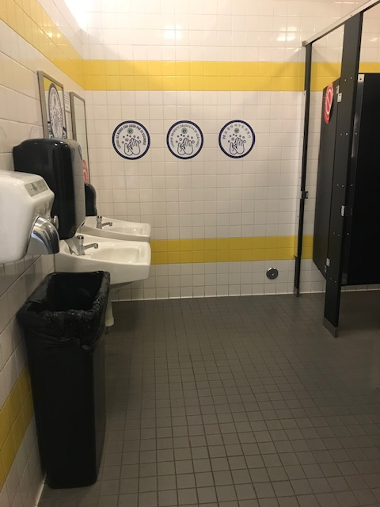
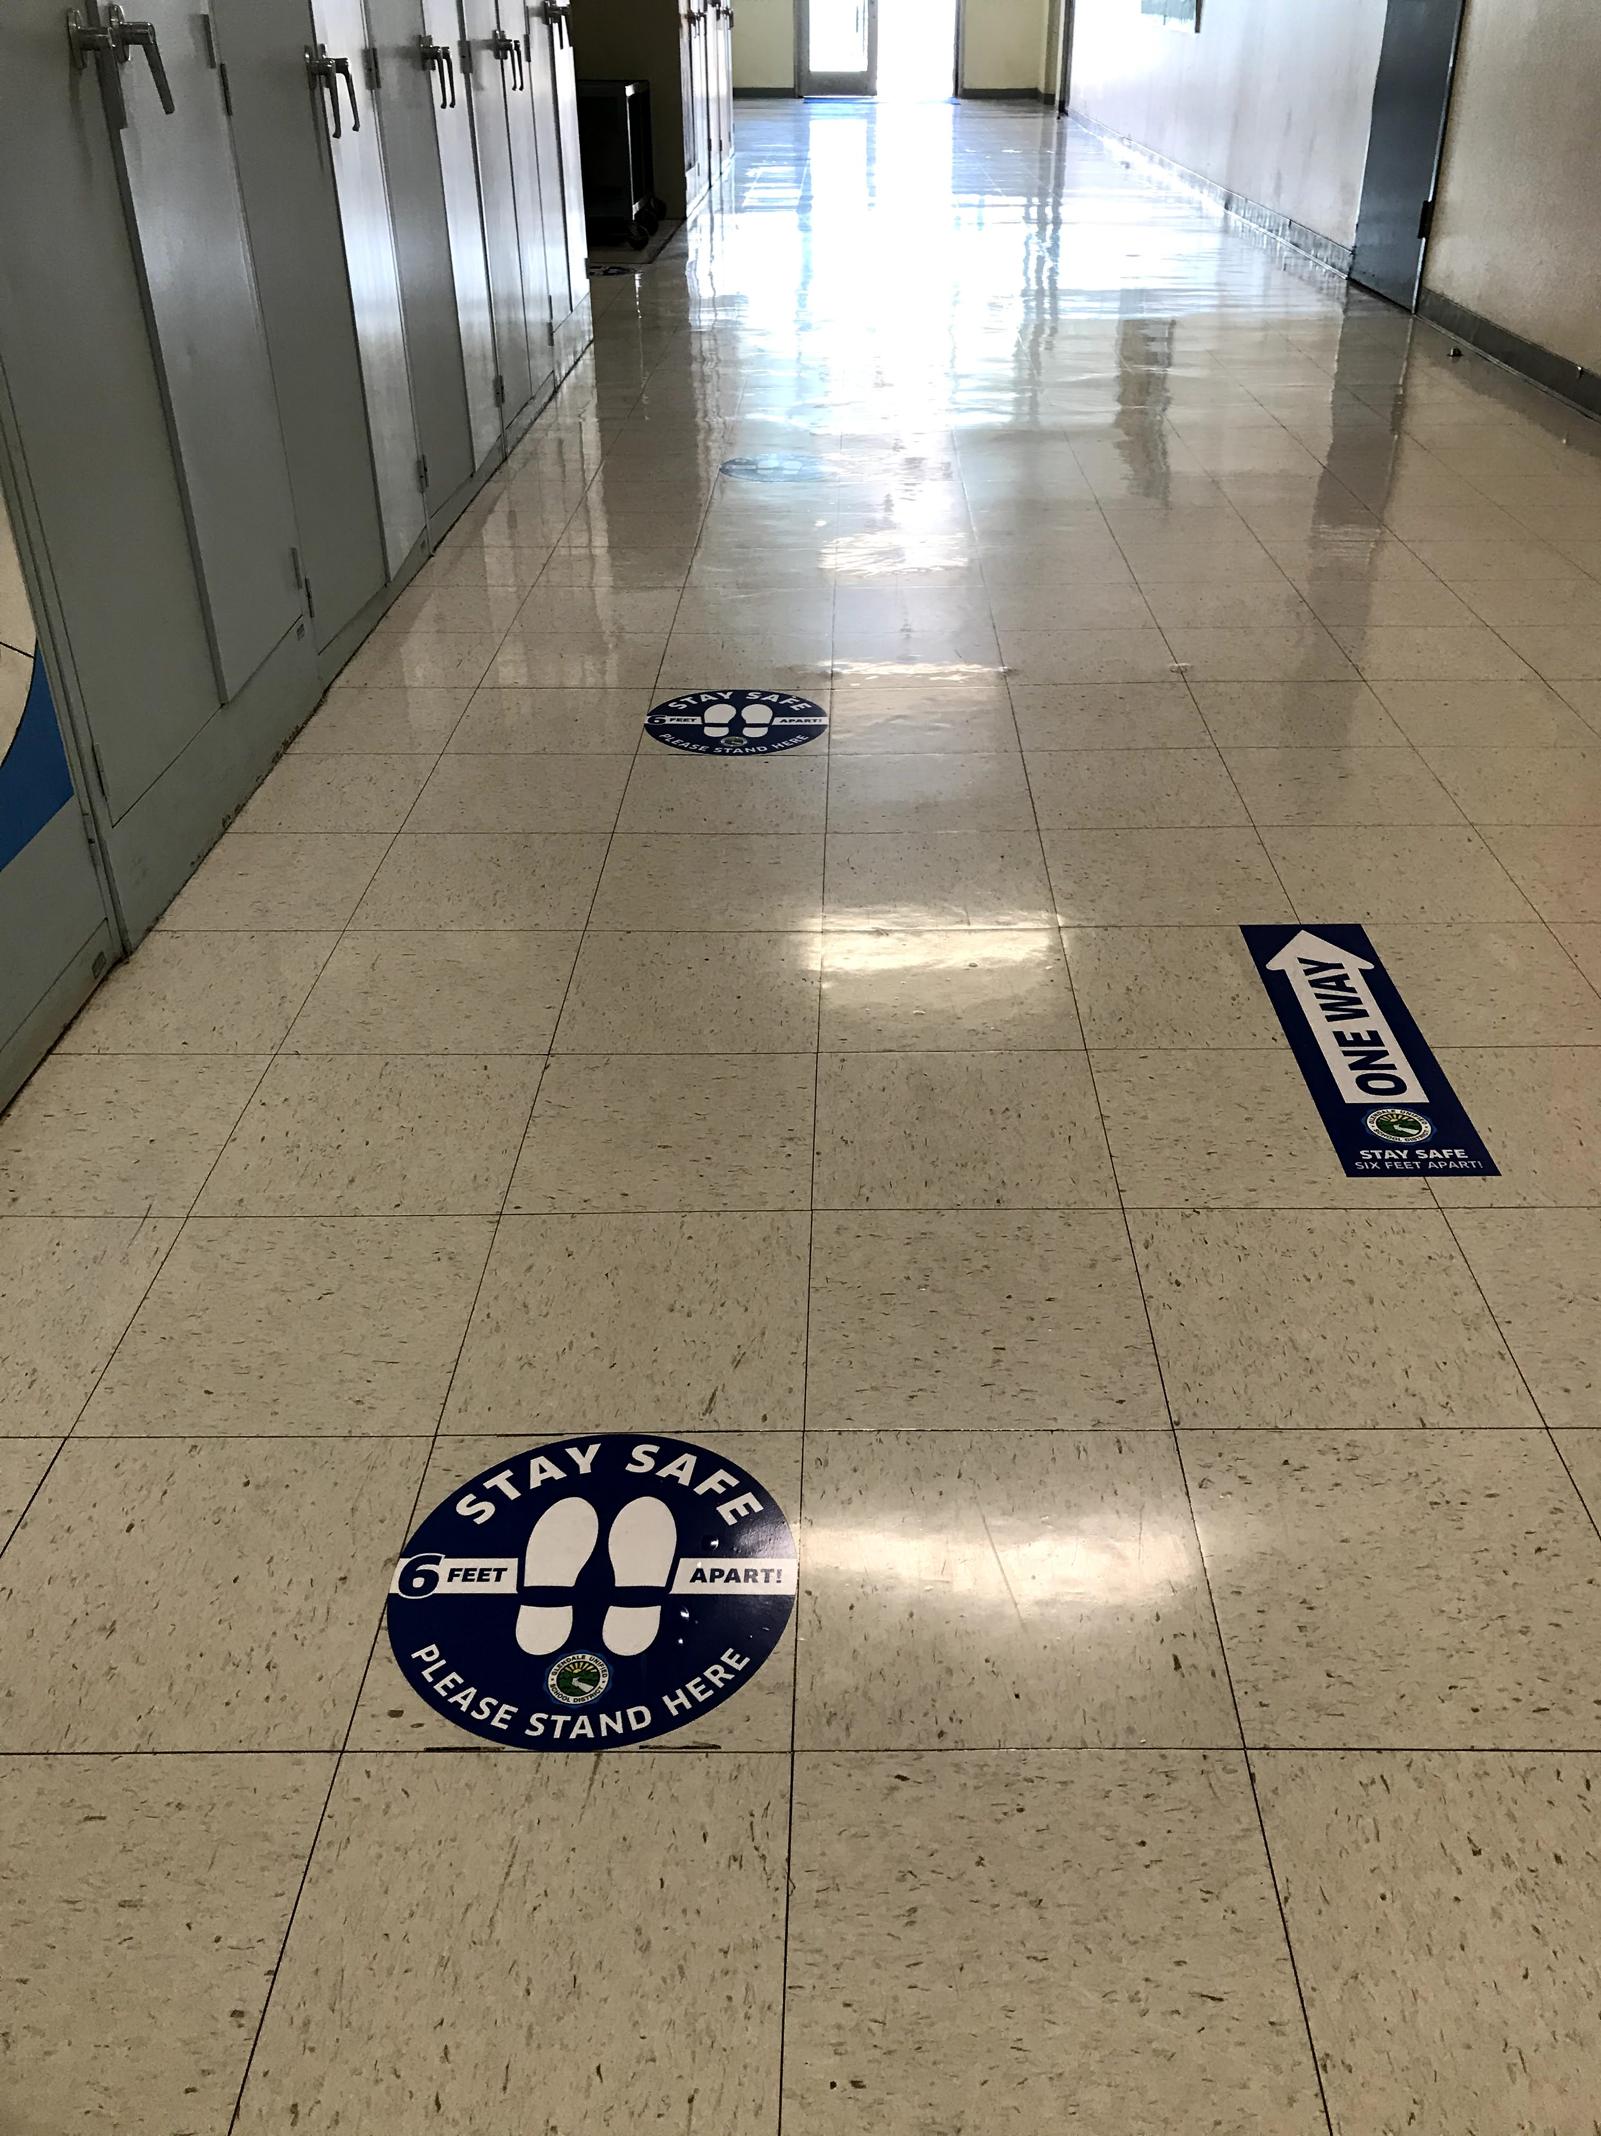
Restrooms
Number of students allowed in the restroom at one time will be limited based on physical distancing protocols. Specific stalls and urinals will be locked/ covered for proper distancing.
Teachers should only send one student at a time to the restroom.
Upon entering the restroom, students will move move the vacant sign to occupied.
Students are encouraged to wash their hands before using the restroom and after.
As students exit, they are to move the occupied sign to vacant.
Transitions & Hallways
Directional arrows have been placed in the hallways. Hallways will look like roads, with students spaced as far apart as possible. Students and staff will travel in the direction of the posted arrows.
Teachers will educate students on the importance of following directional arrows in the hallways, as well as keeping distance between students while in line.
Teachers will emphasize the need for students to keep their hands to themselves and to not touch nearby surfaces while passing by (walls, desks, etc.).
Health and safety signage has been placed throughout the campus.
Recess
Masks will be worn by students during recess unless they are eating their snack.
Each classroom will be assigned to a specific play zone. Play zones will be rotated daily. Teachers will escort their students to and from their designated play area.
Recess equipment will be available for individual play and sanitized between use.
Students are not allowed to bring equipment from home to use at school.
Students will wash/sanitize their hands before and after recess.
Playground structures will be disinfected after each recess time or as often as needed.

Slide 14
GO BEARS!

