Slide 1
Using GUSD Wi-Fi to Improve Cell Phone Functionality
Intended for:
All GUSD Staff

Slide 2
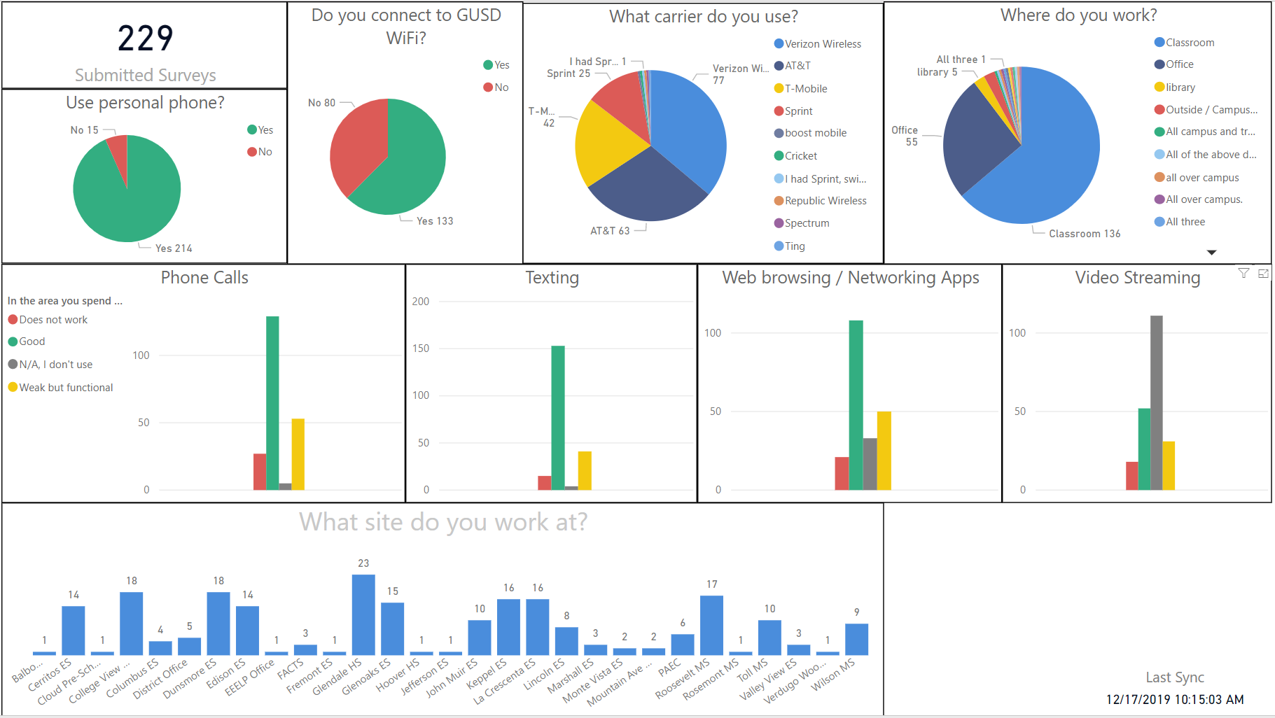
Areas With Poor Coverage
Reports from staff and survey results indicate locations within GUSD with poor coverage for personal cell phones.

Slide 3
Benefits of Connecting to GUSD Wi-Fi
Use Wi-Fi instead of your carrier data for:
  texting
  web browsing
  networking apps
  video streaming
Now both iOS and Android phones support Wi-Fi Calling to improve quality of:
  phone calls

Slide 4
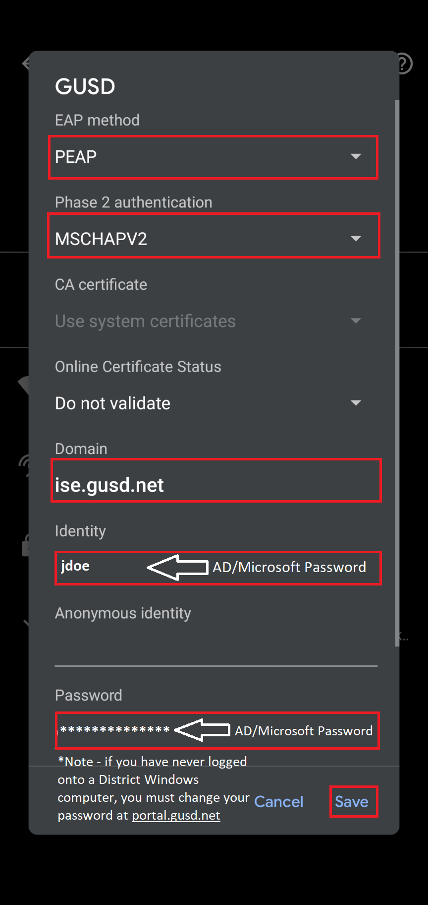
How to Connect to GUSD Wi-Fi
District Staff or Students Connecting with a Personal Device:
  Connect to the GUSD wireless network
  Enter Microsoft AD (computer login) Username and Password
  For Andriod devices, use the settings in the image to the right to properly connect
  Login is required only one time and is valid at all GUSD sites

Slide 5
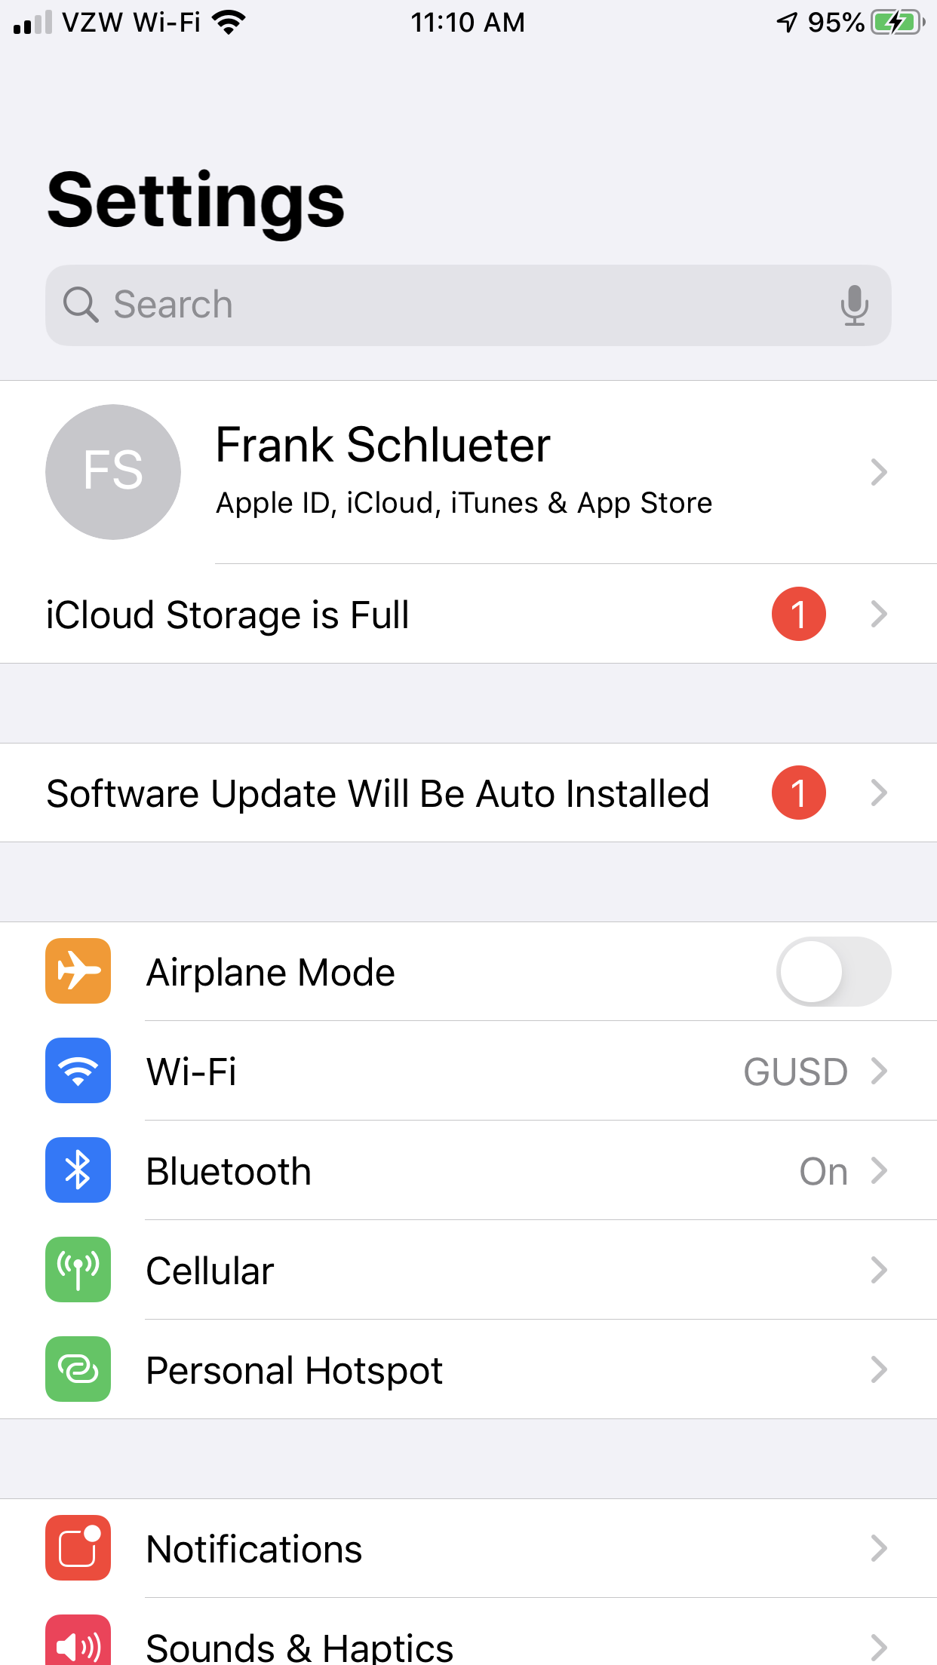
Turning On Wi-Fi Calling: iPhone
Within the Settings app, select [Cellular]
Notes:
Wi-Fi calling was first made available on T-Mobile's service, originally named "Hotspot Calling," and rebranded to "Wi-Fi Calling" in 2009.

Slide 6
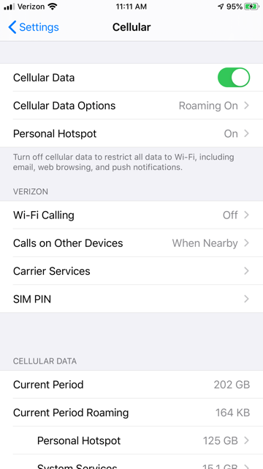
Turning On Wi-Fi Calling: iPhone (cont.)
Within the Cellular menu, set Wi-Fi Calling to :On

Slide 7
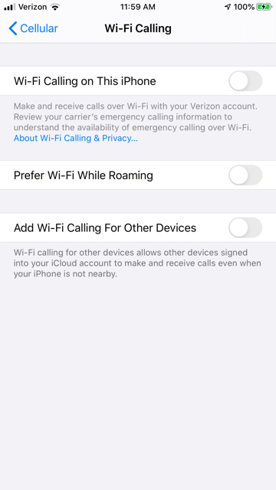
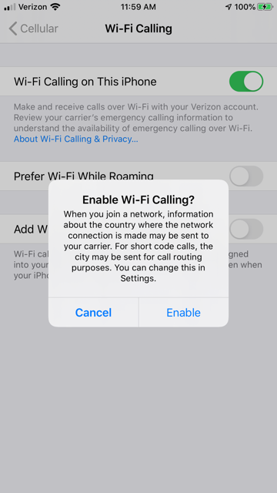
Turning On Wi-Fi Calling: iPhone (cont.)
Within the Wi-Fi Calling menu, toggle the Wi-Fi Calling on This iPhone to “On”
Enable Wi-Fi Calling when the pop-up message appears
Enter your desired information for 911 calls

Slide 8
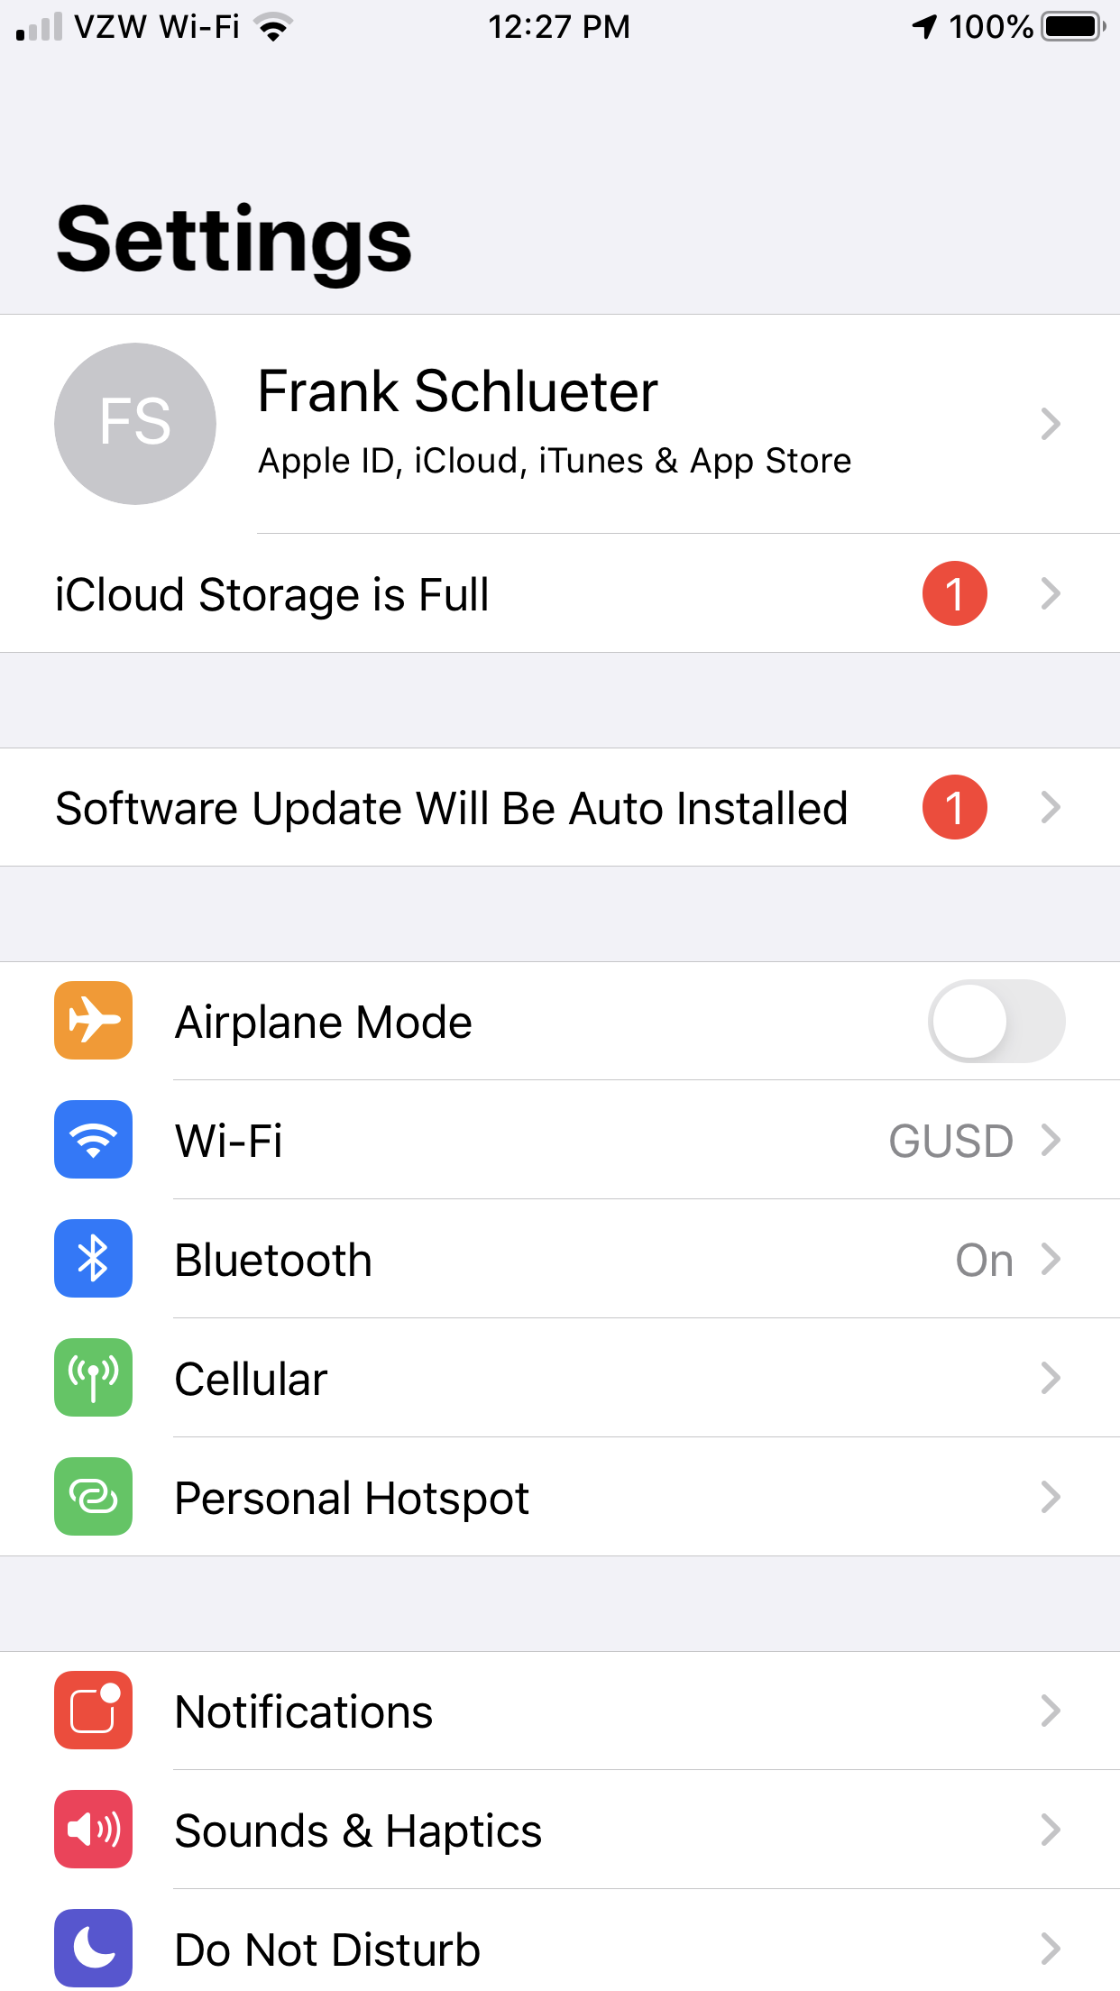
Turning On Wi-Fi Calling: iPhone (cont.)
The carrier indicator will change to indicate you are using Wi-Fi calling when you are in a weak cell signal area.

Slide 9
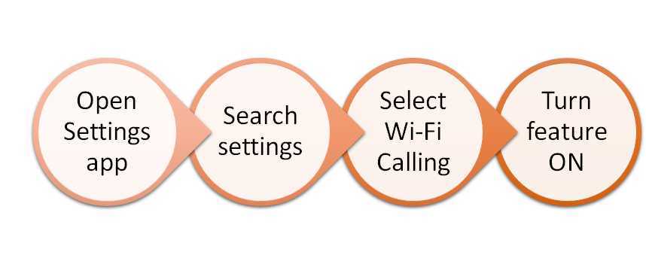
Turning On Wi-Fi Calling: Android
Summary of Steps

Slide 10
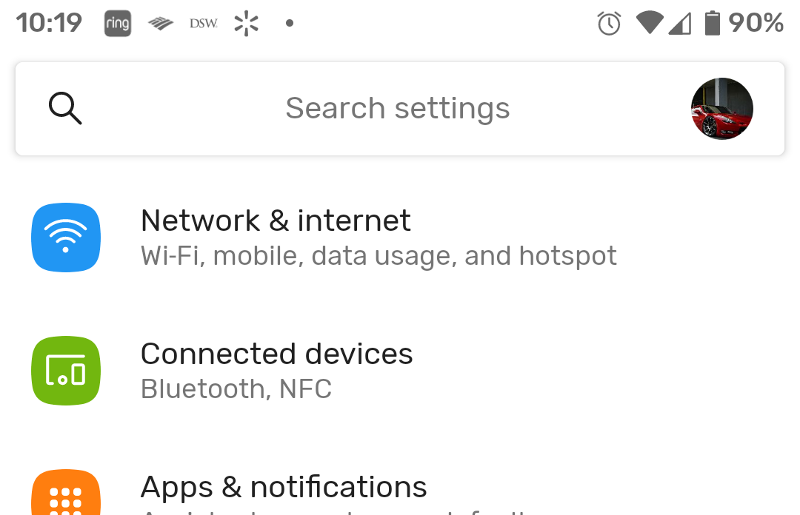

Turning On Wi-Fi Calling: Android (cont.)
Open Phone Settings
Search Settings
Type wifi calling in the Search field.

Slide 11
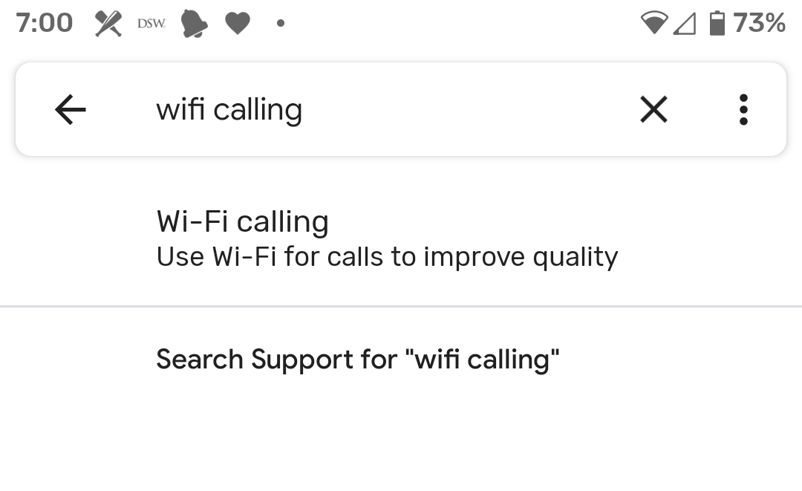
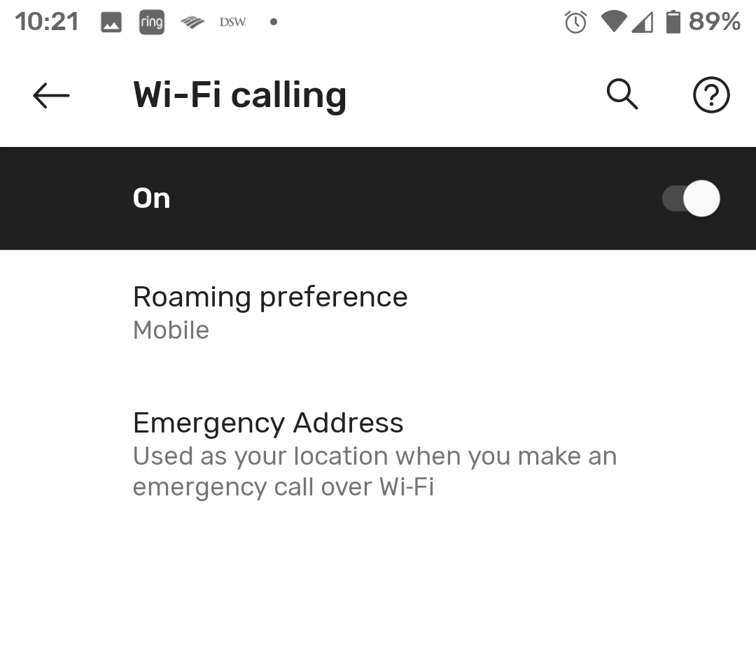
Turning On Wi-Fi Calling: Android (cont.)
Select Wi-Fi Calling
Turn Feature ON

Slide 12
Does my carrier offer Wi-Fi Calling?
Verizon Wireless
To turn on Wifi calling, follow the directions on Verizon's Wi-Fi Calling FAQs page.
T-Mobile
Go to Device Support
Select your phone
Under Browse by categories, choose Calling, Contacts & Calendar
Select Turn on/off Wi-Fi calling and follow the instructions
Sprint
Go to Device Support
Select your phone
Scroll to Calls and choose Activate Wi-Fi Calling
AT&T
Go to Device Support
Select your phone
Select View All Tutorials
Select Calling
Select Wi-Fi Calling to view the instructions

