Slide 1

Review of 2010-11and the
On-going Structural Budget Deficit
Glendale Unified School District Board Meeting – October 18, 2011
Discussion Report No. 2
Eva Rae Lueck
Chief Business and Financial Officer

Slide 2
Review of 2010-11and the On-going Structural Budget Deficit
2010-11 Ending Fund Balance
Structural Budget Deficit
Multi-Year Budget Plan

Slide 3
Budget Cycle
State Requirement
  Adopt Budget June 30
  1st Interim Report December 15
  2nd Interim Report March 15
  Unaudited Actuals September 15
Revenue Assumption Provided by
Los Angeles County Office of Education

Slide 4
2010-11 Actual Ending Fund Balance
June 30, 2011
$48.5 M
What Happened??
$20.8 M
2010-11 Projected Ending Fund Balance – June 2010

Slide 5
2010-11 Unrestricted General Fund Balance
Ending Fund Balance | In Millions
2010-11 Budget Adoption (June) Projected Ending Balance | $ 20.8
What Changed?
Revenue Limit | 7.4
Other State Revenue | 3.5
Local Revenue | 4.0
Federal Revenue | 12.8
Final 2010-11 Ending Fund Balance | $ 48.5
Projection to Actual $27.7 Million Change

Slide 6
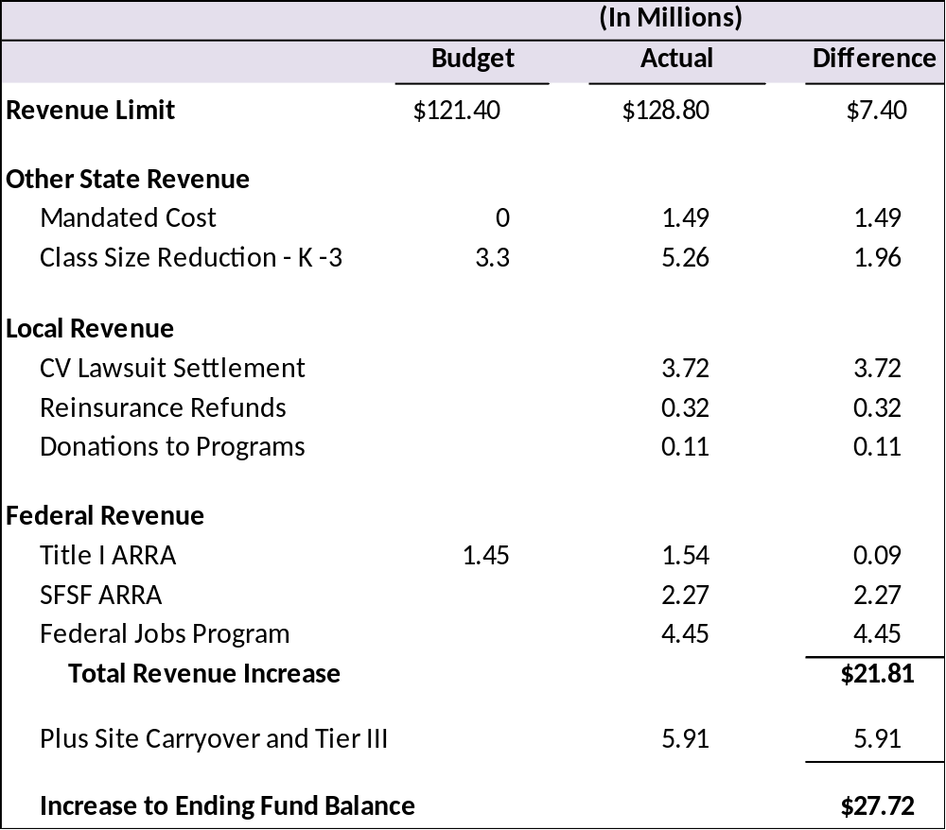
Why was 2010-11 Ending Balance Higher than Projected?
State Budget
Sept. 2010
$270/ADA
30:1 June
K-3
25:1 Aug.
Eliminated 2
  Furlough days
Eliminated Layoffs
Restored Staffing
  K-3 25:1
Revenue Limit – Only On-Going Revenue Increase

Slide 7
Utilization of One-Time Revenue Mask Future “Funding Cliff”
Deficit Spending - This occurs when expenditures exceed revenues in the budget year.
Structural Deficit - This occurs when on-going expenditures exceed on-going revenues in the budget year.

Slide 8
Multi-Year Projection
 |  |  | 2010-11 |  | 2011-12 |  | 2012-13 |  | 2013-14
 |  |  | Unaudited |  | Adopted |  | Projected |  | Projected
 |  |  | Actuals |  | Budget |  | Budget |  | Budget
Revenues |  |  | In Millions
Revenue Limit |  |  | $ 128.8 |  | $ 128.8 |  | $ 127.7 |  | $ 127.1
Federal Revenue (MAA,ROTC,Misc) |  |  | 0.7 |  | 0.2 |  | 0.2 |  | 0.2
State Revenue |  |  | 23.1 |  | 19.7 |  | 19.6 |  | 19.6
Local Revenue |  |  | 11.2 |  | 5.8 |  | 5.8 |  | 5.8
Total Revenues |  |  | $ 163.8 |  | $ 154.5 |  | $ 153.4 |  | $ 152.7
Expenditures
Certificated Salaries |  |  | 75.8 |  | 79.4 |  | 79.4 |  | 82.0
Classified Salaries |  |  | 15.3 |  | 16.7 |  | 16.6 |  | 17.0
Employee Benefits |  |  | 30.2 |  | 35.5 |  | 39.0 |  | 41.0
Books & Supplies |  |  | 2.1 |  | 1.2 |  | 1.2 |  | 1.2
Contracted Services |  |  | 10.2 |  | 11.9 |  | 12.2 |  | 12.5
Capital Outlay |  |  | 0.1 |  | 0.1 |  | 0.1 |  | 0.1
Other Outgo |  |  | 0.1 |  | 0.1 |  | 0.1 |  | 0.1
Direct Support / Indirect Support |  |  | -1.5 |  | -1.1 |  | -1.1 |  | -1.1
Total Expenditures |  |  | $ 132.2 |  | $ 143.8 |  | $ 147.5 |  | $ 152.8
Other Financing Sources/Uses |  |  | -22.6 |  | -12.4 |  | -16.8 |  | -21.5
Net Increase/Decrease in Fund Balance |  |  | $ 9.0 |  | $ -1.7 |  | $ -10.9 |  | $ -21.6
Deficit Spending

Slide 9
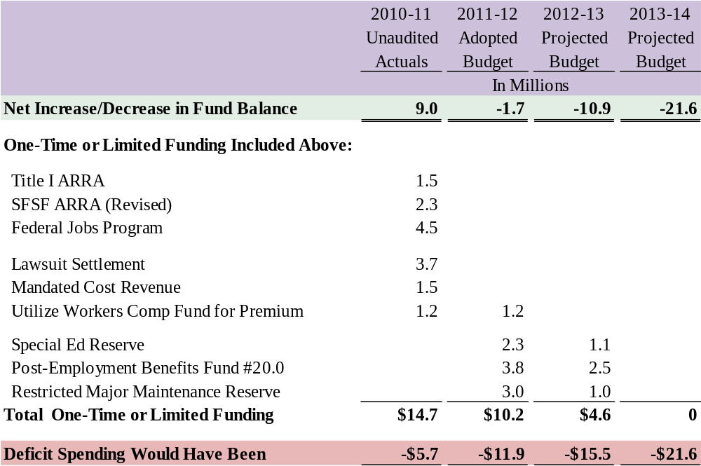
Multi-Year Projection
Structural Deficit

Slide 10

Caution!
Structural Deficit Creates a “Funding Cliff”
When one-time revenue and reserves are depleted huge budget reductions are needed if:
  Planned reductions are not systematically implemented over multiple years
or
  Additional one time resources are not found to push out the “cliff”
or
  On-going State revenues do not become available

Slide 11
Superintendent’s Priorities
  No Additional Layoffs to Staffing – Excluding Categorical Programs
GOALS
  Reduce/Eliminate Furlough Days in Future Years
Maintain K-3 Staffing at 24 Students Per Class
Goals Continue to Be the Same.

