Slide 1
2021-22 Unaudited Actuals and 2022-23 Adopted Budget
September 13, 2022
Information Report No. 1
Presented by: Santhasundari Rajiv
Chief Financial Officer
Budget Report No. 3

Slide 2


Slide 3
2021-22 UNAUDITED ACTUALS
2021-22 Unrestricted General Fund Balance
Unrestricted General Fund | Estimated Actuals 2021-22 | Unaudited Actuals 2021-22
Designated for Economic Uncertainty | $ 11,265,375 | $ 12,497,035
Revolving Cash, Warehouse & Prepaid Expense/GASB 87 | 253,810 | 1,180,429
Reserve for School Site, Program Carry Overs, MAA, ETIS Instructional Computer & Title I Hold Harmless | 13,577,809 | 15,636,998
Unassigned Reserve | 15,054,483 | 11,514,497
Total Unrestricted General Fund Balance | $ 40,151,477 | $ 40,829,959
BLUE
YELLOW
$3,539,986 Decrease
Note: The Decrease of $3,539,986 in Unassigned Reserve is primarily due to the increase of Designated for Economic Uncertainty which is calculated based on total General Fund expenditures, increase in reserve for Warehouse and new GASB 87 reserve, increase in Program Carry Over and reserve for Instructional computers, all of which lowered the Unassigned Reserve.
3

Slide 4
2022-23 Adopted Budget
TOTAL REVENUES & EXPENDITURES – GENERAL FUND
Be aware of
annual carryover process
Rev $344.29m
-Exp $331.42m
Current Excess = $12.87m
Total Revenues $344,290,345
Total Expenditures $ 331,420,076
4

Slide 5
2021-22 Adopted Budget and 2021-22 Unaudited Actuals
COMPARATIVE TOTAL REVENUES – GENERAL FUND
2021-22 Bud $306.11m
2021-22 Act $410.78m
Variance ($104.67)m
2021-22 Budgeted Total Revenues $306,111,620
2021-22 Unaudited Actual Total Revenues $410,779,836
5

Slide 6
2021-22 Adopted Budget and 2021-22 Unaudited Actuals
COMPARATIVE TOTAL EXPENDITURES – GENERAL FUND
2021-22 Bud $326.88m
2021-22 Exp $413.18m
Variance ($86.3)m
2021-22 Adopted Budget Total Expenditures $326,876,290
2021-22 Unaudited Actuals Total Expenditures $413,183,401
6

Slide 7
Unaudited Actuals 2021-22
Summary of General Fund Ending Fund Balances
Actuals
Projections
Starting 22-23, this amount is Committed
In Million Dollars
$53.53
3% REU grows in proportion to total budget
13.46% 14.25% 9.24% 10.36% 9.22% 8.86% 5.81% 5.74% 5.61% 5.04% 5.68% 5.01%
Note: The percentages above represents the ratio of Undesignated/Committed Reserve and the 3% Reserve for Economic Uncertainties to the total General Fund Expenditures.
7

Slide 8
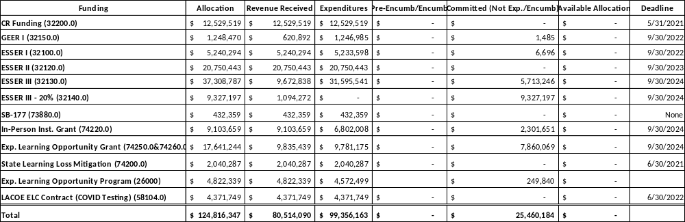
Federal and State COVID-19 Funding Update as of June 30, 2022
Note: Also utilized FEMA reimbursement for COVID-19 expenses of $22,964,870.74

Slide 9
Considerations
Future Funding – Unstable COLA%, UPP, and Enrollment
Covid-19 Expenses Reimbursement from FEMA of $23 million
Ongoing Impact of COVID-19 on 2022-23 and future budgets
Highly complex financial reporting for next several years

Slide 10
Next Steps
Continue to monitor all COVID-19 Related Expenditures and Revenues
2022-23 First Interim Report – December 2022
Governor’s January 2023-24 Budget Proposal

Slide 11
Questions or more information:
WWW.GUSD.NET/BUDGET
WWW.ED100.ORG

