Slide 1
Governor’s Budget Proposal for 2015-16
Glendale Unified School District
Board Of Education Meeting – February 3, 2015
Discussion Report No. 2
Robert McEntire, Chief Business & Financial Officer
Karineh Savarani, Director, Financial Services

Slide 2
Governor’s Budget Proposals For 2015-16
Annual Budget Cycle
2015-16 Budget Overview
Summary of Educational Funding
Budget Concerns (CalSTRS and CalPERS Rate Increase)
Next Steps

Slide 3
Annual Budget Cycle
Adopted Budget (2014-15) July
1st Interim Financial Report (December)
Governor’s Budget Proposal (January)
2nd Interim Financial Report (March)
Preliminary Report April
May Revise
Adopted Budget (2015-16)
Revised Adopted Budget (45 Days)
We are here!
3

Slide 4
2015-16 Budget Overview
California is riding the same resurgent economic trends that are improving the national economy
The combination of Proposition 30 (2012) and a stronger economy is driving state General Fund toward the previous highs of 2007-08
  Stock Market is fully recovered
  Real Estate has recovered
  Personal Income is increasing
  Manufacturing has past previous highs
  Low gas prices are spurring short term spending
Governor stays the course with LCFF and LCAP
Replaces the Wall of Debt with a Rainy Day Fund
We tend to see the past and present more clearly than the future

Slide 5
2015-16 Budget Overview – Cont.
The improving economy has boosted the Proposition 98 minimum funding guarantee
  State revenues are up in the current year and moderate growth is projected for 2015-16
  In turn, the state’s obligation to K-12 education and community colleges increases
For the current year, the minimum guarantee increases by $2.3 billion to $63.2 billion from the level adopted in the 2014-15 State Budget Act
From this revised level, the Governor’s State Budget proposes a 2015-16 Proposition 98 guarantee of $65.7 billion, an increase of $2.5 billion, or 4.1%.

Slide 6
Summary of Educational Funding
Deferrals - $1.0 billion to completely eliminate the rest of the cash deferrals for K-12 schools
Local Control Funding Formula (LCFF) - $4.0 billion of additional funding, an average increase of $675 per ADA → 32.19%
  When combined with the 2013-14 and 2014-15 LCFF funding, implementation progress would cover almost 58% of the gap in just three years
Cost of Living Adjustment (COLA) - $71.1 million to fund a 1.58% COLA for Categorical programs that remain outside of the LCFF (Special Education, Foster Youth, and Child Nutrition)
Energy Efficiency Projects - $320 million to support Proposition 39
Common Core State Standards (CCSS) – No proposed increase to the money received by LEAs.

Slide 7
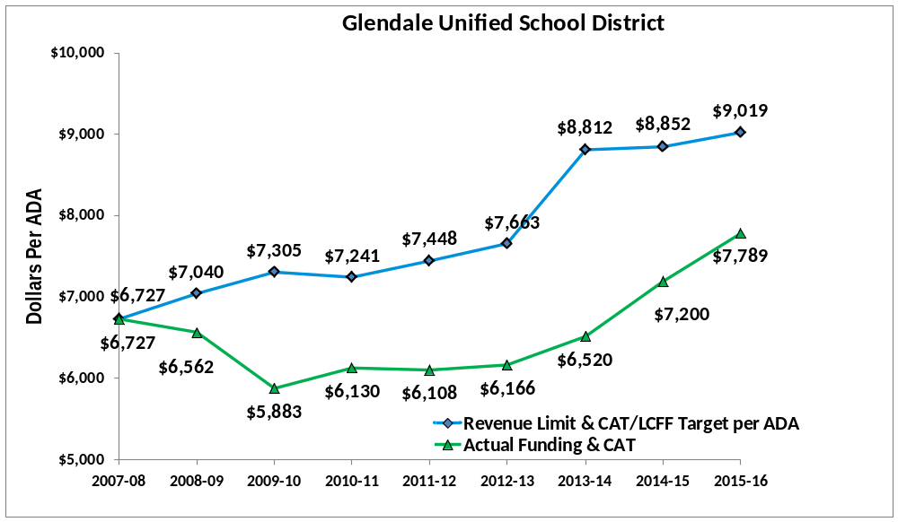
Local Control Funding Formula (LCFF)
Historical Funding – Per ADA
2012-13 ADA 25,394
2013-14 ADA 25,278
2014-15 ADA 25,255
2015-16 ADA 25,255
Note: 2013-14 to 2015-16 – LCFF Funding

Slide 8
Local Control Funding Formula (LCFF)
Base Grant – varies by grade level
K-3…4-6…7-8…9-12
Governor’s Goal - 2021
Factors | K-3 | 4-6 | 7-8 | 9-12
Grade Span Base Grant per ADA (includes COLA @ 1.58%) | $7,122 | $7,228 | $7,444 | $8,625
CSR, CTE amounts | $741 | _ | _ | $224
Adjusted Grant Per ADA | $7,863 | $7,228 | $7,444 | $8,849

Slide 9





Local Control Funding Formula (LCFF)
Supplemental and Concentration
Supplemental and concentration grant increases are calculated based on the percentage of total enrollment accounted for by English learners, free and reduced-price meal (FRPM) program eligible students, and foster youth
Factors | K-3 | 4-6 | 7-8 | 9-12
Adjusted grant per ADA | $7,863 | $7,228 | $7,444 | $8,849
20% supplemental grant | $1,573 | $1,446 | $1,489 | $1,770
50% concentration grant (for eligible students exceeding 55% of enrollment) | $3,932 | $3,614 | $3,722 | $4,425

Slide 10
Local Control Funding Formula (LCFF)
Glendale Unified’s Projected Eligible Student Population is Approximately 57% 56% for 2015-16
Factors | K-3 | 4-6 | 7-8 | 9-12
Adjusted grant per ADA | $7,863 | $7,228 | $7,444 | $8,849
% Enrollment eligible | 56% | 56% | 56% | 56%
56% of Supplemental | $881 | $810 | $834 | $991
1% of Concentration (percentage above 55%) | $39 | $36 | $37 | $44
Total 2015-16 LCFF target grant per ADA | $8,783 | $8,074 | $8,315 | $9,884

Slide 11
Local Control Funding Formula (LCFF)
Each grade span amount is multiplied by the District’s ADA for the corresponding grade span
Factors | K-3 | 4-6 | 7-8 | 9-12
2015-16 LCFF target grant/ADA | $8,783 | $8,074 | $8,315 | $9,884
Average daily attendance | 7,629 | 5,619 | 3,668 | 8,339
Base Total – by grade span (Includes K-3 CSR & 9-12 CTE) | $59.9 M | $40.6 M | $27.3 M | $73.8 M
Supplemental/Concentration | $7.0 M | $4.8 M | $3.2 M | $8.6 M
Total – by grade span | $66.9 M | $45.4 M | $30.5 M | $82.4 M
Transportation and TIIG | $.80 M and $1.1 M
Total – District LCFF target | $227.1 M

Slide 12
Local Control Funding Formula (LCFF)
(Full Implementation in 2020-21)Target
$227 M
Base
$194 M
K-3 (CSR)
$5.7 M
9-12 (CTE)
$1.9 M
Supplemental
$22.6 M
Concentration
$1.0 M
Transportation
$.80 M
TIIG
$1.1 M
2015-16 LCFF Current Projection (Hold Harmless)
$181.9 M
GAP
$45 M
2015-16
32.19%
GAP Funding
$14.5 M
2015-16 PROJECTED TOTAL FUNDING
$196.4 M

Slide 13
Local Control Accountability Plan (LCAP)
  Community Meetings: 1/20/15, 3/31/15, 4/28/15

Slide 14
Budget Concerns
Regional Occupational Program (ROP) - Previously funded through County Office of Education (COE) Categoricals; now swept to solve the COE’s budget shortfall
Approximately $1 Million in Special Education Assistant Intensive Support
Mandated Costs/Common Core double dip
Class Size Reduction (CSR) still “all or nothing”
Prop 2 Rainy Day Fund could be triggered
The employer contribution costs for both CalSTRS and CalPERS will more than double
  CalSTRS – From 8.25% in 2013-14 to 19.1% in 2020-21
  CalPERS – From 11.442% in 2013-14 to 20.4% in 2020-21
The Great Budget Squeeze – the new “Hidden Deficit”

Slide 15
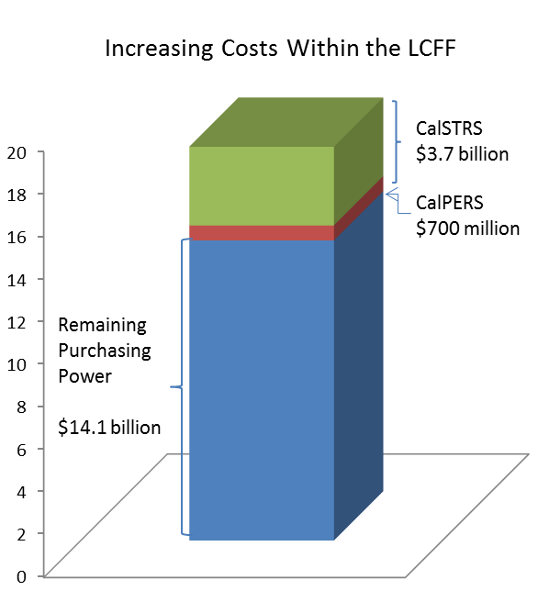
CalSTRS and CalPERS Rate Increase
The 2015-16 State Budget proposal does not address these cost increases for school districts or county offices of education
When promoting the LCFF, the Governor promised a return to 2007-08 purchasing power
    A modest goal, but the high water mark for California education funding
It will take an estimated $18.5 billion to reach that goal
Increasing costs such as CalSTRS and CalPERS erode that promise and make it difficult for districts to achieve the goals of the LCFF

Slide 16
LCFF Implementation Promise
LCFF Implementation Promise
$18.5 B
Promise
Added CalSTRS/CalPERS Costs
$14.1 B
Actual Purchasing Power
16

Slide 17
Recognizing Higher Retirement Costs
Recognizing Higher Retirement Costs
$22.9 B
Separate CalSTRS/CalPERS Funding
Added CalSTRS/CalPERS Costs
$18.5 B
Purchasing Power

Slide 18
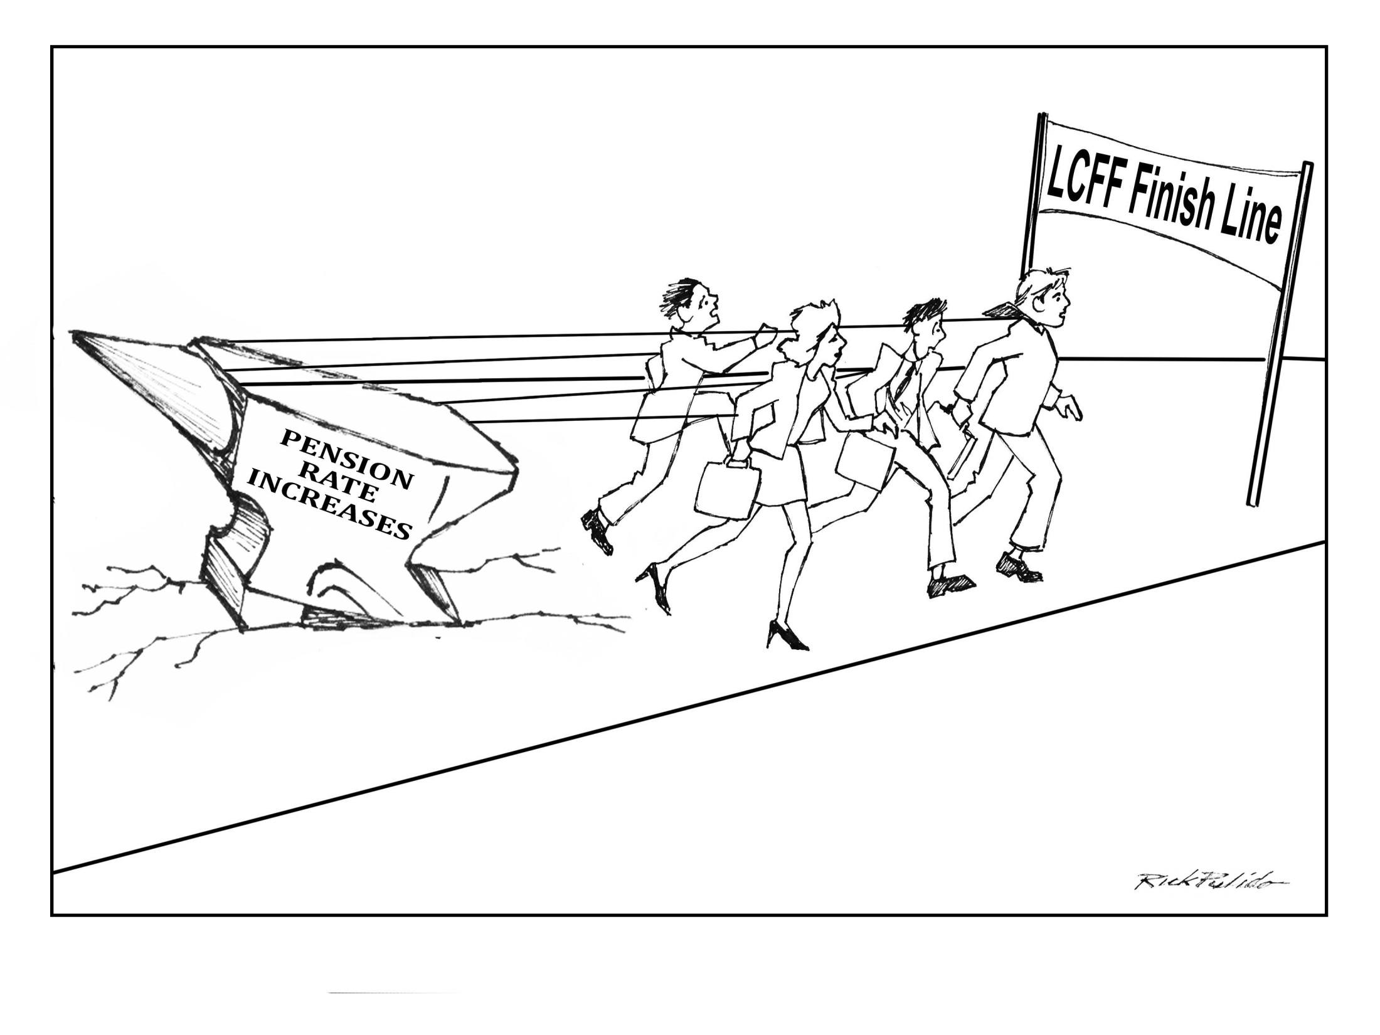
School Services of California, Inc.
18

Slide 19
Cap on School District Reserve
The passage of Proposition 2 and enactment of SB 858 resulted in a hard cap on school districts’ reserves.
  The combined assigned and unassigned balances should not exceed twice the minimum reserve in the year following a contribution to the Proposition 98 reserve.
Four triggering conditions:
  Maintenance Factor
  Test 1 Funding
  Full funding for Enrollment Growth and COLA
  Capital gains reserves must exceed 8% of State General Fund reserves

Slide 20
Cap on School District Reserve – Cont.
The Legislative Analyst’s Office (LAO) notes specific risks to school districts that lower their reserves in accordance with the SB 858 cap
  For most districts, the cap allows for only a couple weeks of payroll.
  Emergency facility repairs and unexpected costs will place the districts in a precarious position.
  Districts with the reserve below the cap are more likely to be flagged for fiscal intervention.
  Districts with lower reserves could have their credit rating reduced, increasing the cost of borrowing money.
LAO’s recommendation is:
  “We recommend the Legislative repeal the reserve cap.”
Future Board Resolution?

Slide 21
Next Steps
Second Interim Budget Report – March 15, 2015
Allocation of Supplemental/Concentration
Evaluate State May Revise Budget Impacts
Board Adoption of 2015/16 District Budget on June 16, 2015

