Slide 1

The Importance of Setting Routines
John Marshall Elementary School
Presented by Monika Grabowski

Slide 2
Icebreaker
What makes it hard for you as a parent to get your child or children to school every day?

Slide 3
Bringing Attendance Home:
A Video for Parents
https://vimeo.com/101425388

Slide 4
A Summary of the Research
Elementary School-Only 17% of chronically absent students scored proficient in reading by the 3rd grade
High School-61% of students chronically absent in early grades will drop out of HS by their Senior year.
College-Only 11% of chronically absent high school students stayed in college during their 2nd year
Beyond-Poor Attendance is the #1 reason workers get fired!

Slide 5
School Specific Concerns
Lates and Tardies
Early Pick Up
Rainy days, Hot days, 3 day weekends, Special Days (ex. Halloween)
Illnesses
Teacher Concerns

Slide 6
What Does It Take To Get a Child To School Every Day?
1. Family Practices
Families nurture a habit of attendance at home
2. Social Capital
Helpers who are relatives, friends, neighbors
4. Community Services
Availability of services like transportation, health services, affordable stable housing, etc.
3. Schools
Teachers, nurses, counselors, administrators, etc.

Slide 7
1. Family Practices-Routines
  Set a regular bedtime and morning routine to make sure children get enough sleep and wake up ready for school. Routines elimate power struggles because you are not bossing the child around. The activity (ex. Brushing teeth at 8pm, going to bed at 8:30pm) is just what we do at this time of the day. The parent stops being the bad guy, and nagging is greatly reduced.
  Routines help reduce anxiety and stress because everyone knows what comes next.
  Routines help children be in charge of themselves and feel independant. Independent children are less oppositional or rebellious.
  Kids learn the concept of “looking forward” to things they enjoy since they are in their schedule as well.
  Routines help kids sleep better.
  Routines help parents build in precious connection moments (tucking them into bed or reading a book together at a certain time)

Slide 8
1. Family Practices
  Make medical appointments when school is not in session.
  Avoid taking vacation when school is in session
  Send your child to school every day unless they are truly sick
  Develop backup plans for getting your child to school if something comes up

Slide 9
2. Social Capital
What are some ways you can think of to call on friends or other families to help you get your children to school? Who can you call on to consistently help? To occasionally help?
How can you help other families?

Slide 10
3. Schools
What are some ways our schools can help families with attendance?
-We offer breakfast at 7:45am
Pizza with the principal

Slide 11
4. Community Services
Lack of reliable transportation or housing and health concerns are barriers that families cannot easily tackle alone. Do families in your school face these barriers to good attendance?
What are some other barriers that families in our school face?
What organizations offer services that can help address these barriers?

Slide 12

TOOLS

Slide 13
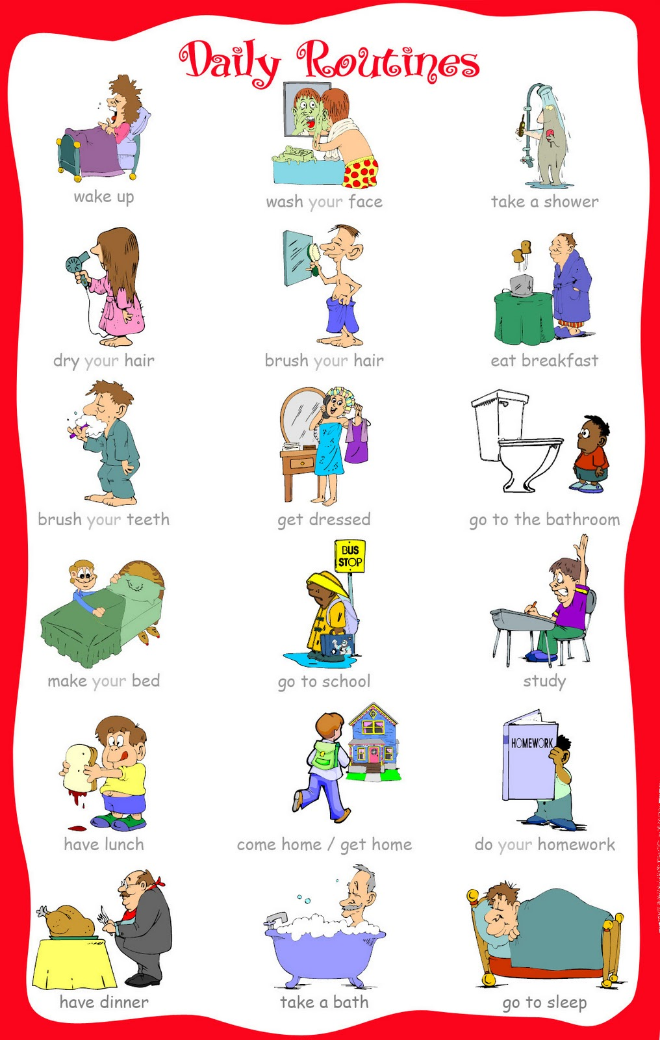

Slide 14
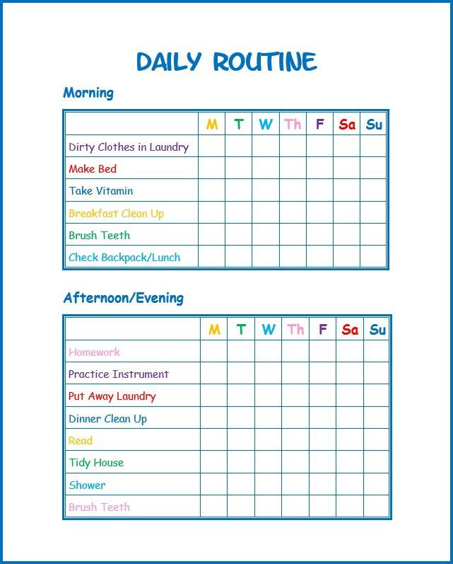

Slide 15
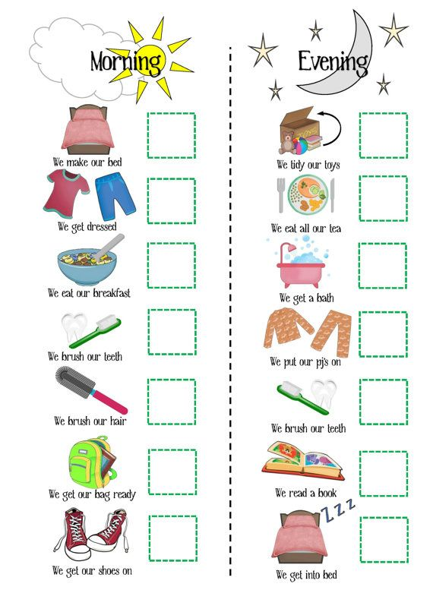

Slide 16


Slide 17
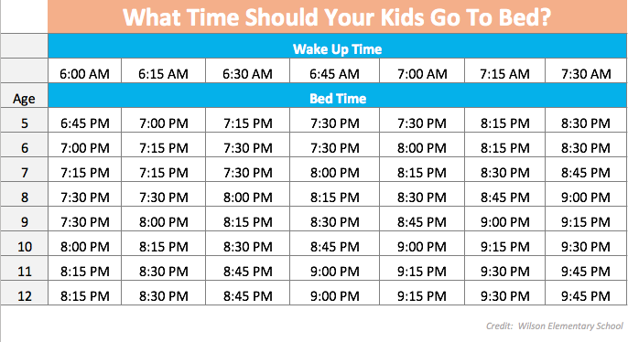

Slide 18


