Slide 1

Healthful Habits
with MyPlate
Glendale USD
Nutrition Services Department
Notes:
Good morning everyone! My name is Kody.
I am interning at GUSD, and I am completing my masters in nutrition at Loma Linda University.
So, how many of you are familiar with MyPlate?
Ok, awesome!

Slide 2
Choose MyPlate!
Overall healthy habits for you, your children, and your family.
  MyPlate and its components
  Physical Activity
  Snacks
  Eating out
Notes:
“What MyPlate is is a reminder to find your healthy eating style and the build it throughout your lifetime.”
MyPlate Kids' Place has resources that can help kids (6-11 yrs) and their parents build healthy meals and maintain or achieve a healthy weight. MyPlate Kids' Place provides online resources and tools for children to help them make wise choices in a fun and appealing way.
MyPlate Parents & Educators
https://www.choosemyplate.gov/kids-parents-educators
MyPlate Kids’ Place
https://www.choosemyplate.gov/kids-parents-educators

Slide 3
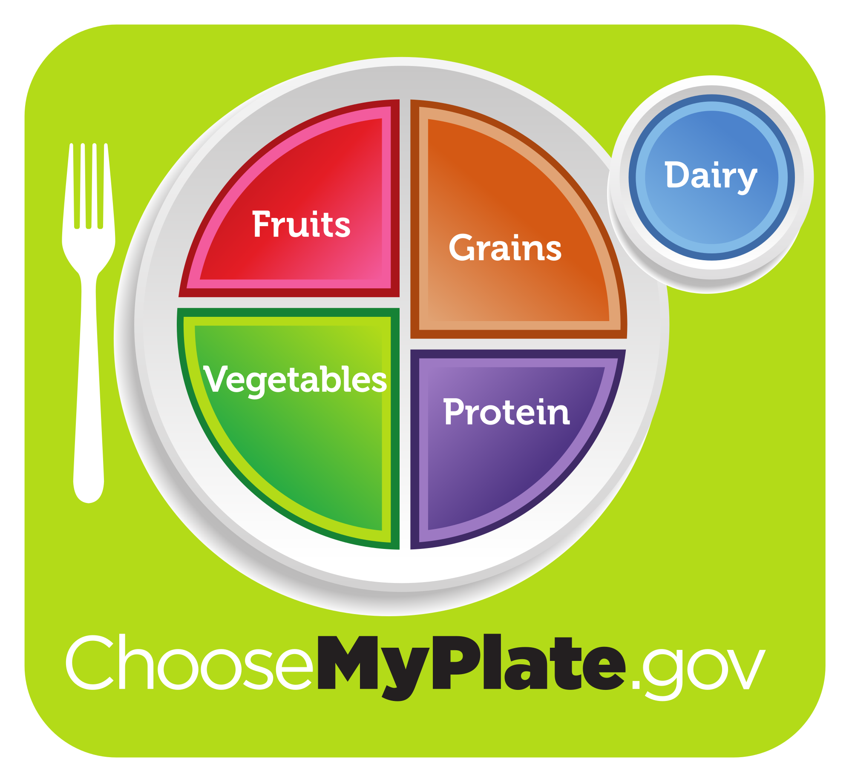
All Parts Count
5 parts:
Fruits
Veggies
Grains (at least ½ whole grains)
Protein
Low fat/fat-free dairy
Notes:
MyPlate is a very robust and powerful resource and tool.
This plate is kind of like a template for how you’d want to design a balanced meal.
Now, a lot of you might thinking “Okay, cool. Easier said than done…”
It’s not as simple to just make a balanced meal every single day - parents have one of the busiest schedules.
So, let’s make it easy.

Slide 4

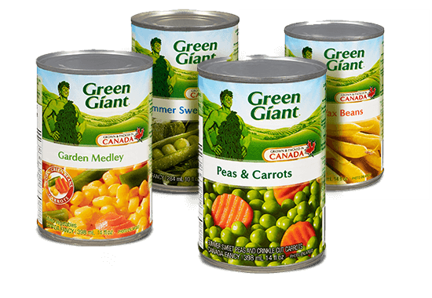

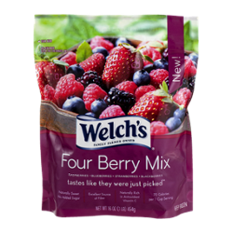
Fruits & Veggies
Aim for fresh, but also consider frozen or canned!
Notes:
Fresh may be best, but there’s nothing wrong with frozen or canned.
They’re fast and they keep longer - good for stocking up and keeping as backup
Frozen or canned at the height of their season - able to preserve nutrients equal or better than fresh fruits and veggies
You still want to remember to include a variety of colors of fruits and veggies, as different vegetables contain different vitamins and minerals

Slide 5
The Proteins
Focus on a variety of proteins - don’t forget about beans and peas
Choose lean meats and poultry
Nuts and Seeds
Soy products
Eggs
Notes:
Beans and peas pack a lot of protein and are a great alternative if you want to add more fiber and cut the excess calories.
They also usually come in the canned variety, so they’re a fast option if you’re low on time.

Slide 6

The Grains!
- Make sure half your grains are whole grains.
- Endosperm, bran, AND germ = whole grain
Notes:
The next slide is going to say ‘make sure half your grains are whole grains’, but...can someone tell me what a whole grain is?

Slide 7

Whole Grain
- Look for the stamp
- Look for the word “whole” in the ingredient list
- brown rice
- whole-grain barley
- whole oats
- oatmeal
- Look out for artificial coloring, especially in the ingredient list
Notes:
But what if there is no stamp??
Make sure they are 1st or 2nd ingredient
Some examples of whole grain ingredients are…
Some ingredients may say “wheat flour, durum wheat, organic flour”...but these are just describing the contents, not the amount of whole wheat.
Don’t rely on the color of the grain product - manufacturers can easily color any food.

Slide 8
No Two People Are Alike
- One’s requirements are not the same as another
- Consider male or female, age, weight, and physical activity
- MyPlate Daily Checklist

Slide 9
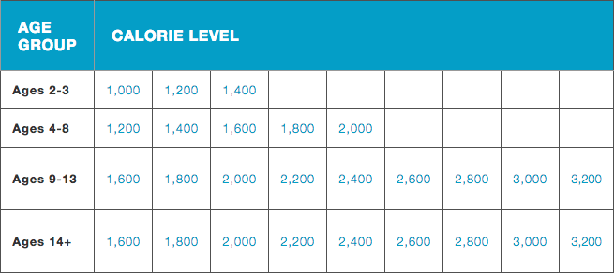
MyPlate Daily Checklist

Slide 10

Be An
Active Family
- Start slowly
- Less TV time
- Include kids in the planning
- Work around the house
- Community

Slide 11
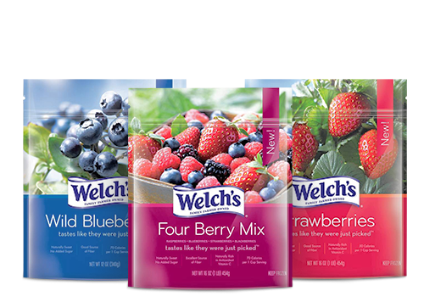

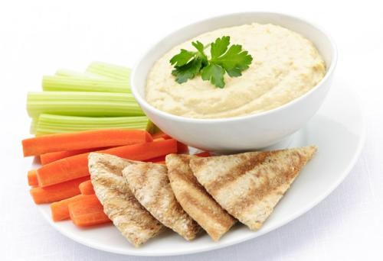
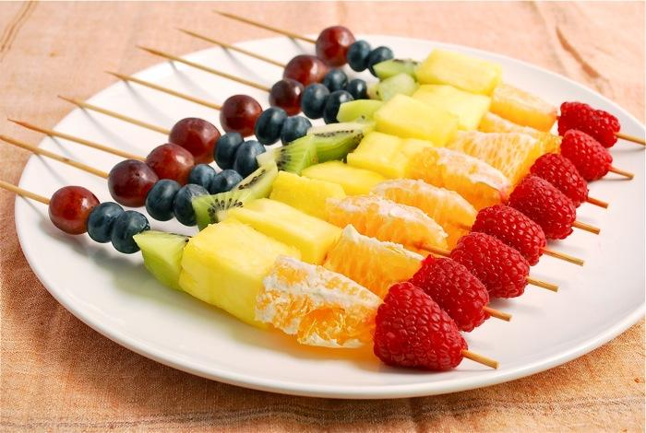
Snack Time!
- Make them fun!
- Fresh and frozen fruits and veggies are your friends
- Kids like to dip
- Include a protein with a whole grain/fiber-rich food
Notes:
Snacks can be easy and healthy!

Slide 12
Eating Out
- Load up on vegetables, fruits, and fiber-rich foods
- Try to stay away from fried foods or heavy sauces
- Look for whole grain foods
- Choose lean meats, poultry, and proteins
- Don’t eat too fast and enjoy your meal

Slide 13
Resources
MyPlate (www.ChooseMyPlate.gov)
MyPlate Daily Checklist (https://www.choosemyplate.gov/MyPlate-Daily-Checklist)
MyPlate Kids’ Place(https://www.choosemyplate.gov/kids)
MyPlate Parents & Educators (https://www.choosemyplate.gov/kids-parents-educators)
The Whole Grains Council (https://wholegrainscouncil.org/)

Slide 14


Thank you!
Presented by
Glendale Unified School District
Nutrition Services Department

