Slide 1

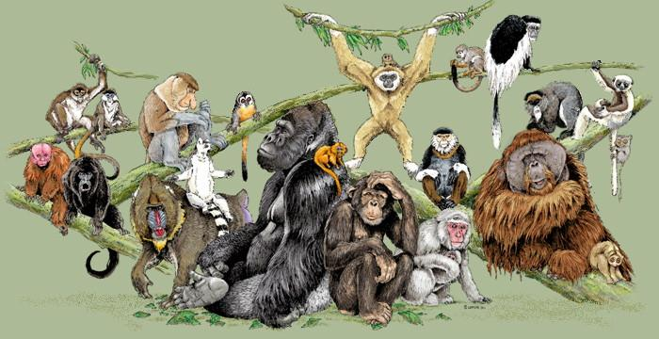
Los Angeles Zoo
Interdisciplinary Primate Research Project
Ms. E. Ohanian
San Fernando High School
Spring 2017

Slide 2

Table of Contents
Introduction: What are Primates?
Primate Taxonomic Classification
Primate Hands Family Tree
Prosimians
New World Monkeys
Old World Monkeys
Apes
Theory of Evolution: Charles Darwin
Field Research: Jane Goodall
Pictures of Primates at the Zoo

Slide 3
Introduction: What are Primates?

Slide 4
Introduction: What are Primates?
According to Webster’s Dictionary, a primate is any of an order (Primates) of mammals that are characterized especially by advanced development of binocular vision resulting in stereoscopic depth perception, specialization of the hands and feet for grasping, and enlargement of the cerebral hemispheres and that include humans, apes, monkeys, and related forms.

Slide 5
Primate Taxonomic Classification

Slide 6
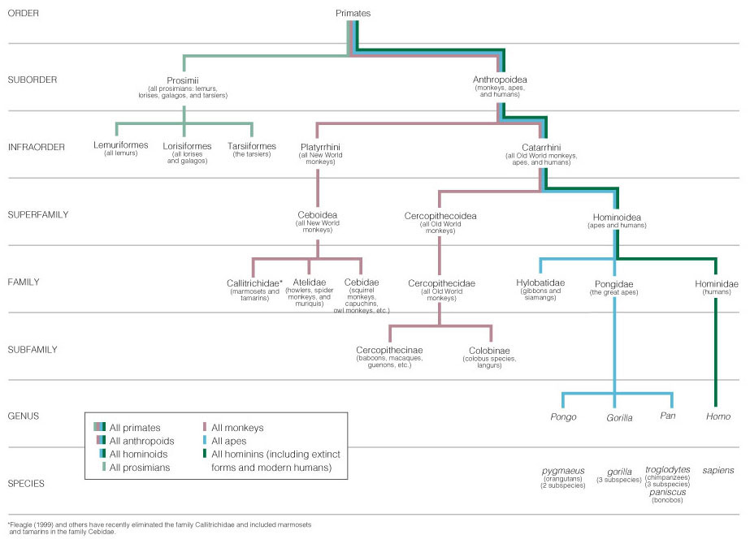
Primate Taxonomic Classification

Slide 7
Primate Hands Family Tree

Slide 8
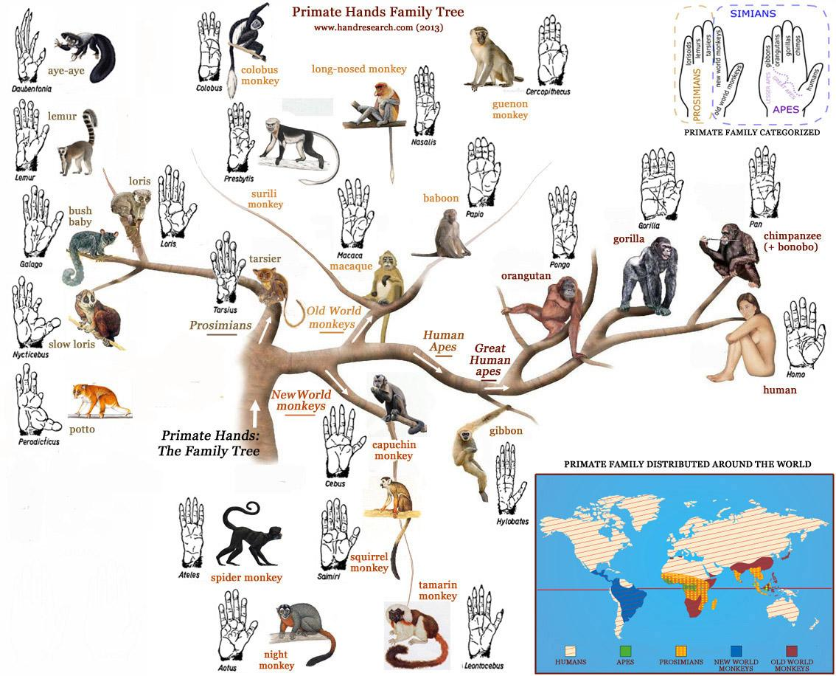
Primate Hands Family Tree

Slide 9
Prosimians

Slide 10
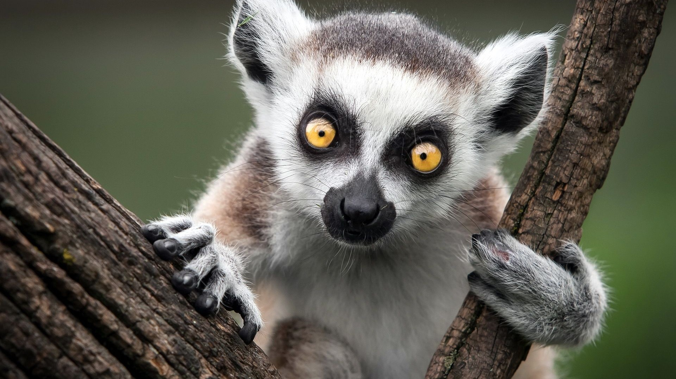
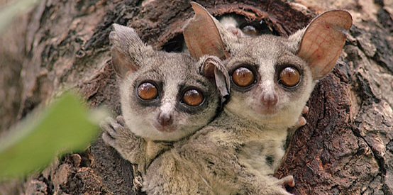
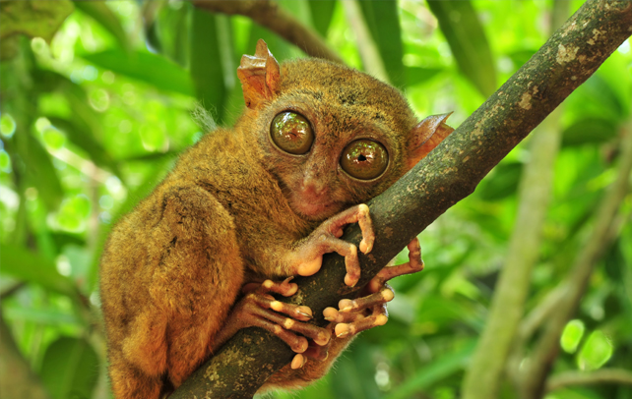
Prosimians
Lemur
Loris
Galago
Tarsier
Tree Shrew

Slide 11
Example of a Prosimian: Ring Tailed Lemur
Common Name: Ring Tailed Lemur
Genus + species: Lemur + L. catta
Suborder: Strepsirrhini
Infraorder: Lemuriformes
Distribution/Range: The only place where members of the Superfamily Lemuroidea, including ring-tailed lemurs, can be found in the wild is Madagascar.
Notes:
http://www.lazoo.org/animals/mammals/ring-tailed-lemur/
http://pin.primate.wisc.edu/factsheets/entry/ring-tailed_lemur
http://animaldiversity.org/accounts/Lemur_catta/

Slide 12
Example of a Prosimian: Ring Tailed Lemur
Habitat: These mammals can be found living in the southwestern highlands of Madagascar. They usually inhabit forest areas with trees and plants that have shed their leaves or environments where few trees grow. Ring-tailed lemurs require forest habitats that have undisturbed by human activity.
Social Organization: They live in small groups that move around with each other. These family groups have females that are dominate over the males.
Conservation Status: Near Threatened by the International Union for Conservation of Nature (IUCN), due to habitat destruction by various causes such as man-made fires.
Diet: They are known to prefer fruits, but also eat leaves, seeds, flowers, and various other parts of plants such as the bark and sap of trees. Lemurs are capable of raiding crops to eat watermelons and leaves of sweet potatoes.
Notes:
http://www.lazoo.org/animals/mammals/ring-tailed-lemur/
http://pin.primate.wisc.edu/factsheets/entry/ring-tailed_lemur
http://www.lemurworld.com/lemur-social-structure/
http://animaldiversity.org/accounts/Lemur_catta/

Slide 13
Example of a Prosimian: Ring Tailed Lemur
Fun Facts:
Scientific name comes from the Latin word “lemures” meaning ghosts or spectators and catta, meaning cat.
Carl Linnaeus, who is responsible for their Latin name, was inspired by Lemurs in Ancient Rome, which were specters or ghosts.
A festival called the Lemuria were held to exorcise this spirits.
The name lemur is from the Latin lemurs, meaning spirits of the dead. This name was selected for the lemur’s silent movement.
Notes:
http://www.lazoo.org/animals/mammals/ring-tailed-lemur/
http://pin.primate.wisc.edu/factsheets/entry/ring-tailed_lemur
http://animaldiversity.org/accounts/Lemur_catta/

Slide 14
New World Monkeys (NWM)

Slide 15
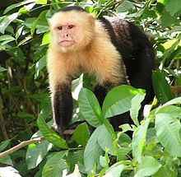
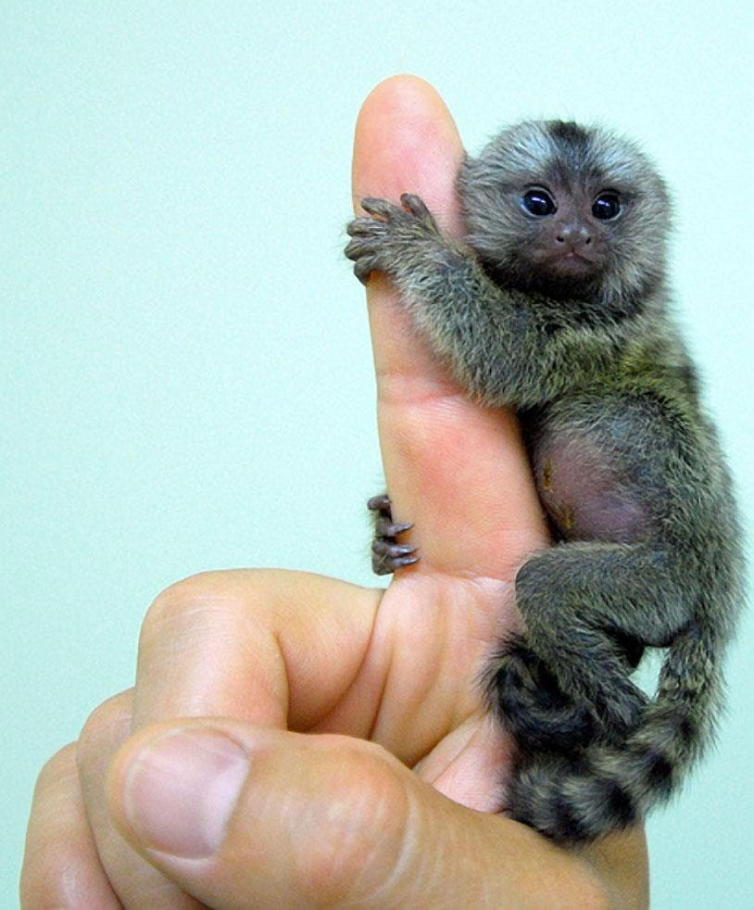
New World Monkeys (NWM)
Muriqui
Uakari
Capuchin
Squirrel Monkey
Howler Monkey
Spider Monkey
Golden Lion Tamarin
Marmoset
Callithnx
Atelidae
Mico

Slide 16
Example of a New World Monkey: Geoffroy’s Black-Handed Spider
Common Name: Geoffroy’s Black-Handed Spider
Genus + species: Ateles + A. paniscus
Suborder: Haplorrhini
Infraorder: Simiiformes
Distribution/Range: Black spider monkeys are found in eastern South America in Brazil, French Guiana, Guyana, Surinam, and possibly in Venezuela
Notes:
http://www.lazoo.org/animals/mammals/spidermonkey/
http://animaldiversity.org/site/accounts/information/Ateles_geoffroyi.html
http://animaldiversity.org/accounts/Ateles_geoffroyi/

Slide 17
Example of a New World Monkey:
Geoffroy’s Black-Handed Spider
Habitat: While black-handed spider monkeys live in Central America from southeast Mexico (Veracruz) to western Panama, Geoffroy’s subspecies is restricted to the mainland of Costa Rica and Nicaragua. Spider monkeys make their homes in emergent trees, in the upper levels of tropical and subtropical rain forests. Sometimes they are found in evergreen, semi-deciduous, and deciduous forests.
Social Organization: Spider monkeys are extremely social animals. In fact, if one is kept alone in captivity, it can easily die of loneliness unless its owner gives it a great deal of attention. In the wild, these monkeys tend to congregate in groups of 40–50, although they break up into smaller groups during the course of the day. Each large group has its own territory, and members of the group patrol it daily on specific paths. Spider monkeys rarely enter neighboring territories. Whenever spider monkey territories over-lap, the monkeys somehow readjust them over time.
Notes:
http://www.lazoo.org/animals/mammals/spidermonkey/
http://pin.primate.wisc.edu/factsheets
http://science.jrank.org/pages/6378/Spider-Monkeys-Social-behavior.html
http://animaldiversity.org/accounts/Ateles_geoffroyi/

Slide 18
Example of a New World Monkey:
Geoffroy’s Black-Handed Spider
Conservation Status: Geoffroy’s black-handed spider monkey is currently listed as Endangered on the IUCN Red List; mainly due to habitat loss. The L.A. Zoo’s black-handed spider monkeys are part of a Species Survival Plan breeding program to help conserve the species
Diet: Black-handed spider monkeys use their wonderful color vision to select the ripest fruits which comprise most of their diet. Sometimes they also eat young leaves and flowers.
Notes:
http://www.lazoo.org/animals/mammals/spidermonkey/
http://pin.primate.wisc.edu/factsheets
http://science.jrank.org/pages/6378/Spider-Monkeys-Social-behavior.html
http://animaldiversity.org/accounts/Ateles_geoffroyi/

Slide 19
Example of a New World Monkey:
Geoffroy’s Black-Handed Spider
Fun Facts:
When spider monkeys communicate, they are quite noisy. They send forth a variety of loud calls which are easy to hear for about 1000m on the ground and 2000m above the canopy. These loud calls and screeches are used to alert members of the troop.
Like other monkeys and apes, black-handed spider monkeys have opposable big toes on their feet that can grab onto branches easily. However, they only have “vestigial” thumbs with hinge joints. (they don’t have complete thumbs – over many thousands of years, the thumb has evolved away). Most scientists think this has improved the monkey’s hook grip used when swinging through the trees.
Notes:
http://www.lazoo.org/animals/mammals/spidermonkey/
http://animaldiversity.org/accounts/Ateles_geoffroyi/

Slide 20
Old World Monkeys (OWM)

Slide 21
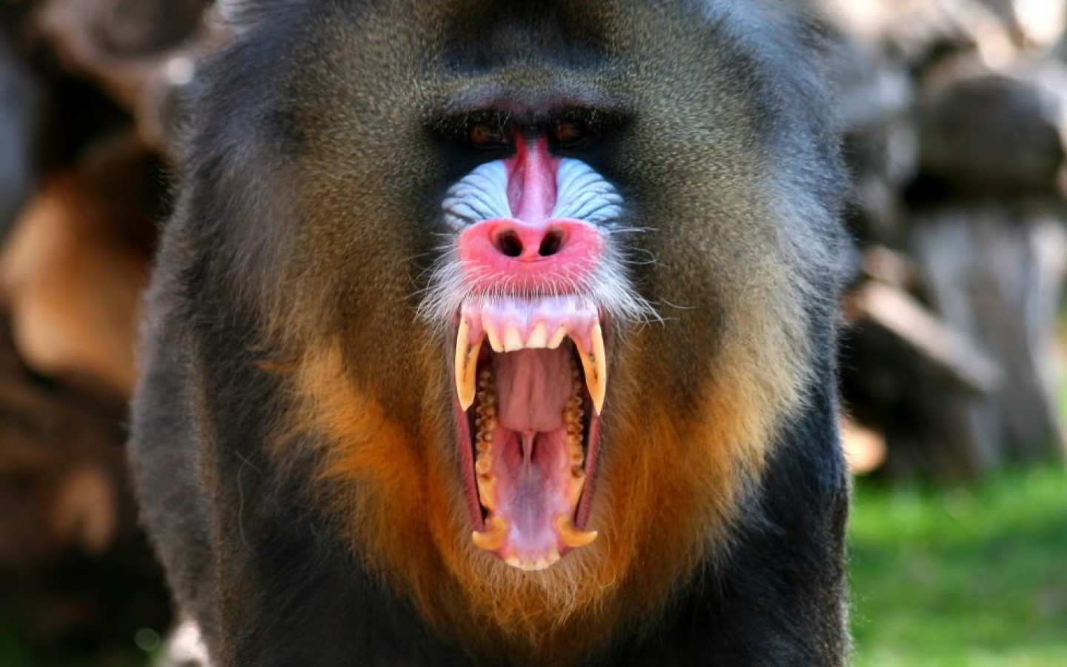
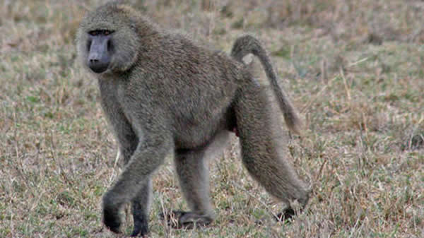
Old World Monkeys (OWM)
Mandrill
Baboon
Macaque
Guenon
Langur
Colobus
Gelada
Douc
Mangabey
Grivet
Drill
Simia
Kipunji

Slide 22
Example of an Old World Monkey: Mandrill
Common Name: Mandrill
Genus + species: Mandrillus + M. leucophaeus, M. sphinx
Suborder: Haplorrhini
Infraorder: Simiiformes
Distribution/Range: The range is incompletely known, but spans the region between southern Congo and eastern Nigeria, separated by the Sanaga River in Cameroon. M. sphinx occur in Cameroon, Republic of Congo (not DRC), mainland Equatorial Guinea, and Gabon. As one moves south from the Sanaga River, they range in Equatorial Guinea, Gabon, and the Republic of Congo as far south as the Congo River, but not east of it. In the east, M. sphinx are limited in Gabon by the Ivindo and Ogooue Rivers, in Cameroon by the Dja River, and in the southeast of their distribution by savannah.
Notes:
http://www.lazoo.org/animals/mammals/mandrill/
http://pin.primate.wisc.edu/factsheets/entry/drill

Slide 23
Example of an Old World Monkey: Mandrill
Habitat: Mandrills live in the remaining primary and secondary rainforests of western Africa in Cameroon, Gabon and southwestern Congo. They are both terrestrial, spending time on the ground, and arboreal, spending time in the trees where they sleep every night.
Social Organization: Mandrills travel in multi-male and multi-female groups called troops, which range from 20 animals to, on occasion, more than 200. The leader of the troop is a single dominant male, usually the monkey with the brightest and boldest colors.
Conservation Status: Mandrills are listed as Vulnerable by the International Union for Conservation of Nature (IUCN).
Diet: They are omnivores, eating a variety of foods, with fruits and seeds making up over 90 percent of their diet. They also eat bark, leaves, palm nuts, ants, termites, dung beetles, spiders, tortoises, duikers (small antelopes), birds, mice, frogs, crabs, and bird eggs. They often raid farmers’ crops and plantations.
Notes:
http://www.lazoo.org/animals/mammals/mandrill/
http://pin.primate.wisc.edu/factsheets/entry/drill

Slide 24
Example of an Old World Monkey: Mandrill
Fun Facts:
Although the character Rafiki from The Lion King is often referred to as a baboon, the colors on his face indicate that he is actually a mandrill.
Mandrills live in small social units, but often join up with other small groups to form larger ones called hordes.
The male mandrill is the largest living monkey.
Notes:
http://www.lazoo.org/animals/mammals/mandrill/
http://pin.primate.wisc.edu/factsheets/entry/drill
http://animals.sandiegozoo.org/animals/mandrill

Slide 25
Apes

Slide 26
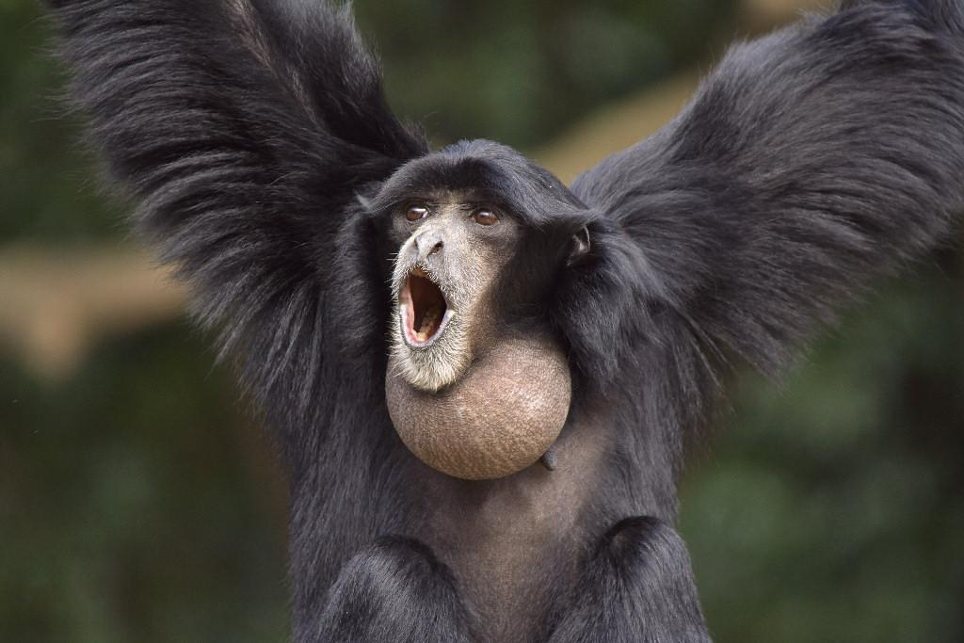
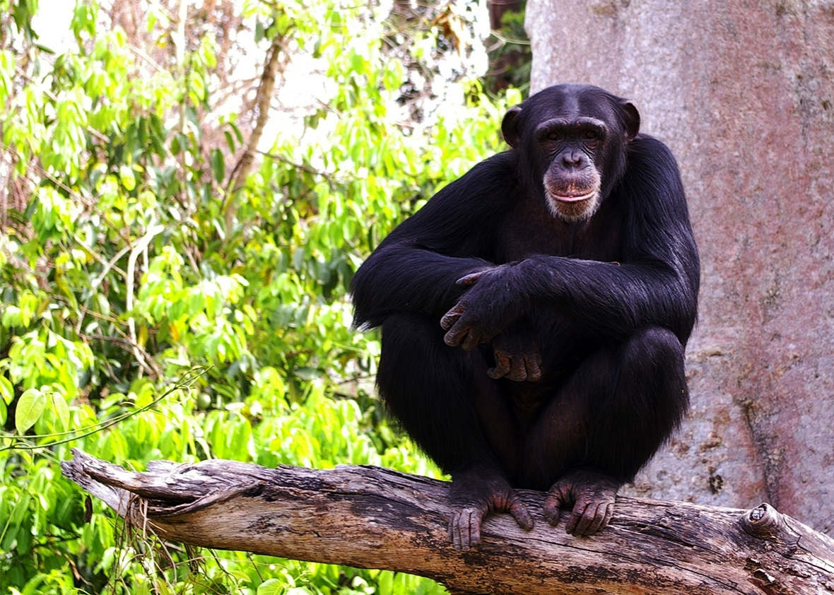
Apes
“Lesser” Apes
  Gibbon
  Siamang
Great Apes
  Bonobo
  Orangutan
  Gorilla
  Chimpanzee

Slide 27
Example of an Ape: Chimpanzee
Common Name: Chimpanzee
Genus + species: Pan trogloytes
Suborder: Haplorrhini
Infraorder: Simiiformes
Distribution/Range: Chimpanzees are found across a west-east belt in equatorial Africa. Their range spans 22 countries: Angola, Burkina Faso, Burundi, Cameroon, Central African Republic (CAR), Congo, Côte d'Ivoire, Democratic Republic of Congo (DRC), Equatorial Guinea, Gabon, Ghana, Guinea, Guinea Bissau, Liberia, Mali, Nigeria, Rwanda, Senegal, Sierra Leone, Sudan, Tanzania, and Uganda. The majority (about 77%) of the total estimated population can be found in only two countries, Gabon and Congo. Researchers roughly estimate the wild population of chimpanzees to be between 100,000 and 200,000. There are approximately 250 animals in zoos and another 1,200 in research facilities.
Notes:
http://www.lazoo.org/animals/mammals/chimpanzee/
http://pin.primate.wisc.edu/factsheets/entry/chimpanzee
http://animaldiversity.org/accounts/Pan_troglodytes/

Slide 28
Example of an Ape: Chimpanzee
Habitat: Chimpanzees can be found all over Africa, from Senegal and Gambia to Uganda and Tanzania. They easily adapt to a variety of habitats including grasslands, tropical rain forests, and riverine and montane forests.
Social Organization: They are social animals and live in communities of up to 80 individuals. Under natural conditions, chimpanzees live in what behaviorists call a fusion-fission society. The entire community splits into small parties, which frequently travel alone. These subgroups come together from time to time. The composition of subgroups is flexible, so that individuals may travel together sometimes, and at others times travel separately. All members of a community of chimpanzees rarely, if ever, are found in the same place at the same time. The most frequently observed party across all chimpanzee communities is the mixed-sex party, though Taï males are the most inclined to associate with females, and Gombe males are the least inclined to do so. A high number of females relative to males means the most common party composition there is mother-infant.
Notes:
http://www.lazoo.org/animals/mammals/chimpanzee/
http://pin.primate.wisc.edu/factsheets/entry/chimpanzee
http://animaldiversity.org/accounts/Pan_troglodytes/

Slide 29
Example of an Ape: Chimpanzee
Conservation Status: Unfortunately, chimpanzees are currently on the endangered species list. Populations have decreased because of foresting, hunting, commercial exportation, and collection for scientific research. Although chimpanzees are protected in 34 national parks and reserves, laws can be difficult to enforce in remote regions.
Diet: The chimpanzee is omnivorous, but its diet depends on its habitat. Chimps that live in the rain forest tend to eat more fruit and leaves, while chimps in grasslands prefer to dine on insects and other animals.
Notes:
http://www.lazoo.org/animals/mammals/chimpanzee/
http://pin.primate.wisc.edu/factsheets/entry/chimpanzee
http://animaldiversity.org/accounts/Pan_troglodytes/

Slide 30
Example of an Ape: Chimpanzee
Fun Facts:
Chimpanzees are highly intelligent and complex creatures.
They are nomadic creatures, meaning that they sleep in a different place each night within a designated range of territory.
Chimpanzees spend their days searching for food, and at night they build individual nests high up in the forest canopy.
They have highly developed hearing and sight, and like all apes, color vision.
Notes:
http://www.lazoo.org/animals/mammals/chimpanzee/
http://pin.primate.wisc.edu/factsheets/entry/chimpanzee
http://animaldiversity.org/accounts/Pan_troglodytes/

Slide 31
Example of an Ape: Chimpanzee
Fun Facts:
Chimpanzees are capable of a wide variety of facial expressions that can reveal many emotions. These expressions, along with numerous gestures and at least 34 identified vocalizations, help chimpanzees communicate to other group members.
Chimpanzees are not only gifted communicators, but they are also skilled craftsmen. They create tools from natural objects and have been observed using rocks to smash nutshells, sticks as weapons, and even leaves as sponges. This fascinating behavior, however, is not instinctual, but is culturally acquired through observation. Their talent with tools can be attributed to their large brain, which enables them to exhibit a type of intelligence more like that of a human than does any other mammal.
Notes:
http://www.lazoo.org/animals/mammals/chimpanzee/
http://pin.primate.wisc.edu/factsheets/entry/chimpanzee
http://animaldiversity.org/accounts/Pan_troglodytes/

Slide 32
Theory of Evolution: Charles Darwin

Slide 33
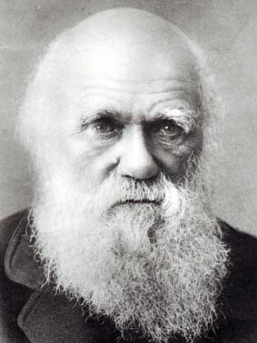
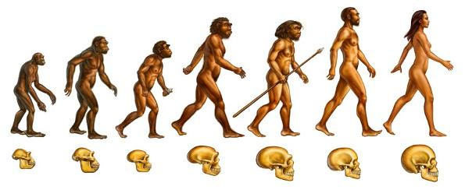
Theory of Evolution: Charles Darwin
Natural Selection
Evolution
“Light will be thrown on the origin of man and his history.” - Charles Darwin

Slide 34
Theory of Evolution: Charles Darwin
“As many more individuals of each species are born than can possibly survive; and as, consequently, there is a frequently recurring struggle for existence, it follows that any being, if it vary however slightly in any manner profitable to itself, under the complex and sometimes varying conditions of life, will have a better chance of surviving, and thus be naturally selected. From the strong principle of inheritance, any selected variety will tend to propagate its new and modified form.” - Charles Darwin
“There is grandeur in this view of life, with its several powers, having been originally breathed into a few forms or into one; and that, whilst this planet has gone cycling on according to the fixed law of gravity, from so simple a beginning endless forms most beautiful and most wonderful have been, and are being, evolved.” - Charles Darwin

Slide 35
Theory of Evolution: Charles Darwin
Naturalist, geologist, and biologist
He first made people aware of their place in the evolutionary process when the most powerful and intelligent form of life discovered how humanity had evolved
He established that all species of life have descended over time from common ancestors
In a joint publication with Alfred Russel Wallace introduced his scientific theory that this branching pattern of evolution resulted from a process that he called natural selection, in which the struggle for existence has a similar effect to the artificial selection involved in selective breeding
The theory of evolution by natural selection was first put forward by Darwin in On the Origin of Species, published in 1859

Slide 36
Theory of Evolution: Charles Darwin
Resources:
The Origin of Species

Slide 37
Field Research: Jane Goodall

Slide 38
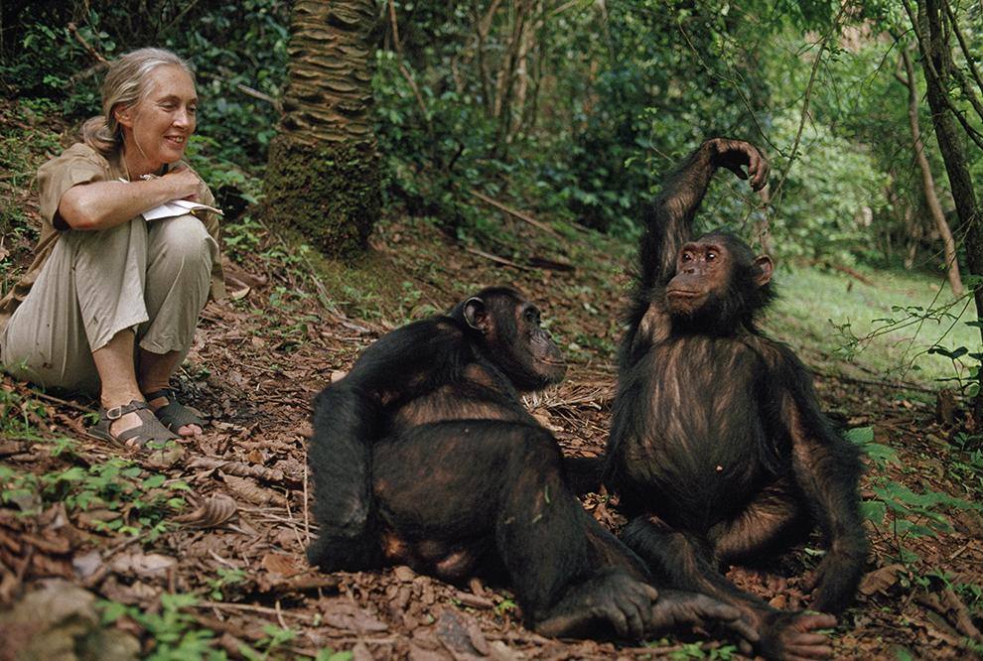
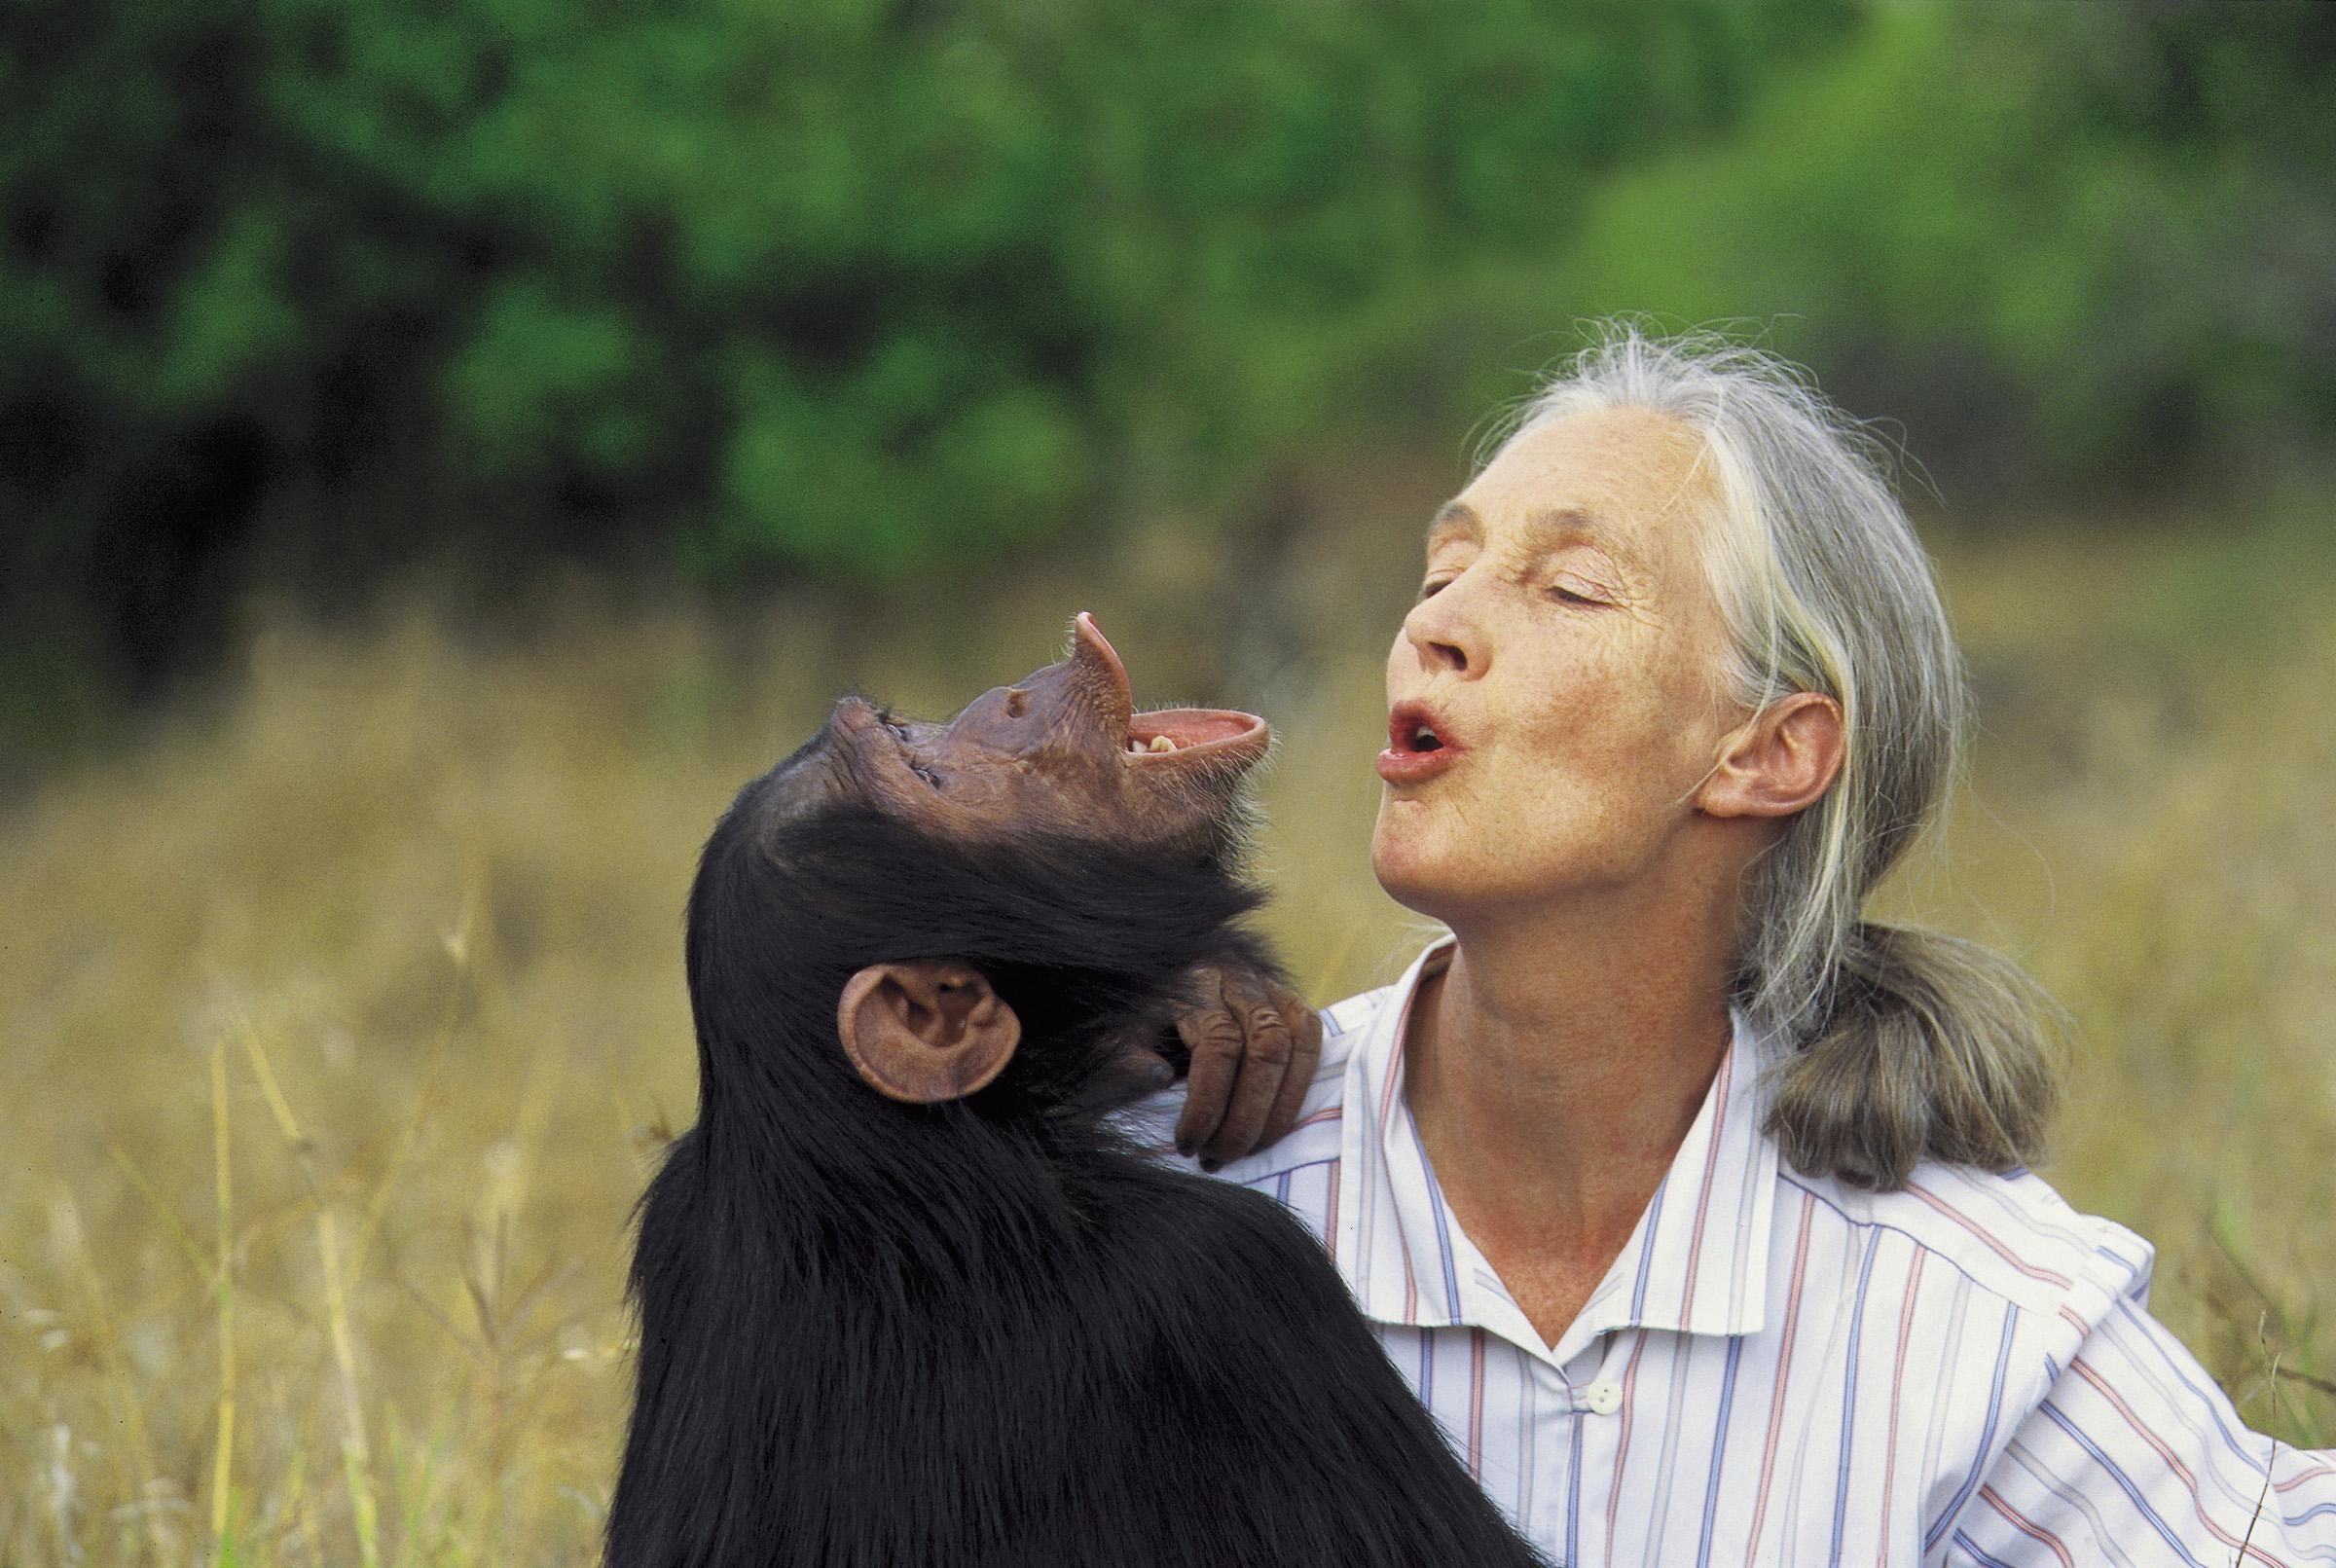
Field Research: Jane Goodall
55-year study of family and social interactions of chimpanzees in the wild
“Only if we understand, will we care. Only if we care, will we help. Only if we help, shall all be saved.” - Jane Goodall

Slide 39
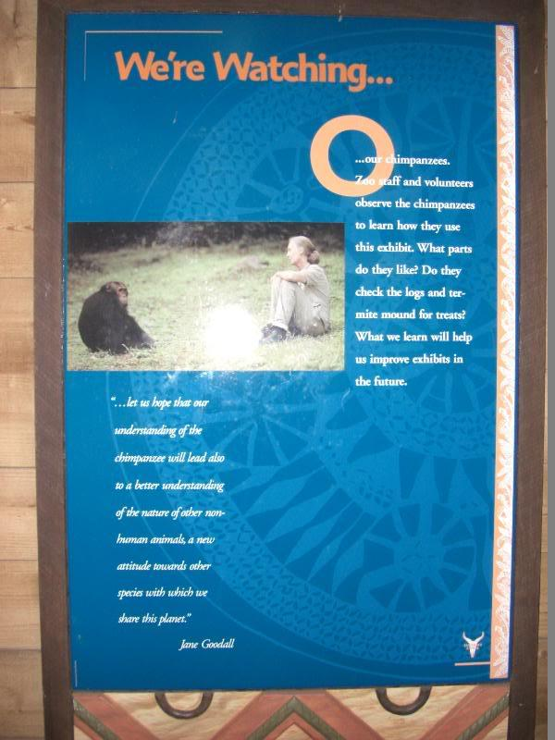
Field Research: Jane Goodall

Slide 40
Field Research: Jane Goodall
Primatologist, ethologist, and anthropologist
She is the considered the world's foremost expert on chimpanzees
Spent 55 years studying social and family interactions of wild chimpanzees in Gombe Stream National Park, Tanzania
She is the founder of the Jane Goodall Institute and the Roots & Shoots program
Jane Goodall has worked extensively on conservation and animal welfare issues
She has served on the board of the Nonhuman Rights Project since its founding in 1996

Slide 41
Field Research: Jane Goodall
Resources:
YouTube: Jane Goodall’s Study of Chimpanzees
TED Talk (Jane Goodall): What Separates Us from Chimpanzees
The Jane Goodall Institute

Slide 42
Pictures of Primates at the Zoo

Slide 43
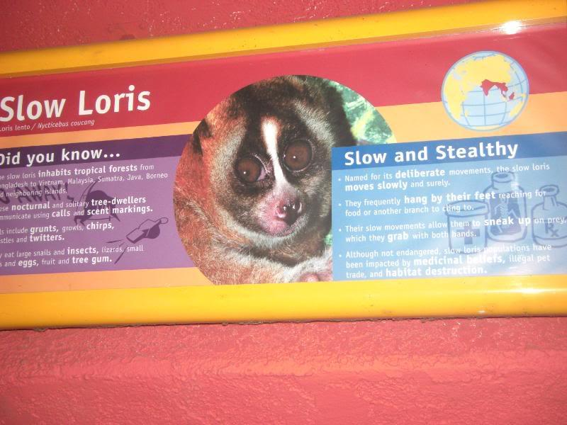
Pictures of Primates at the Zoo

Slide 44
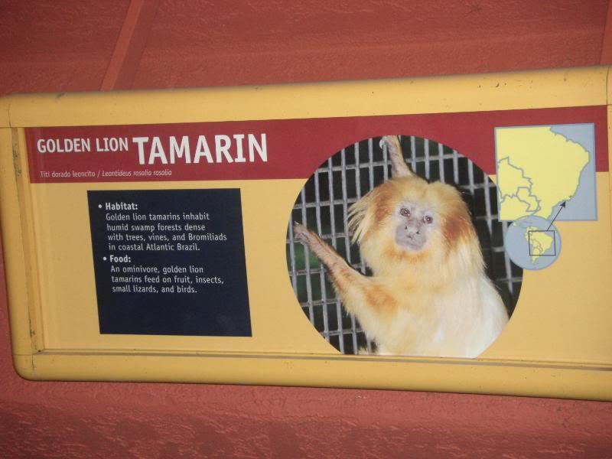
Pictures of Primates at the Zoo

Slide 45
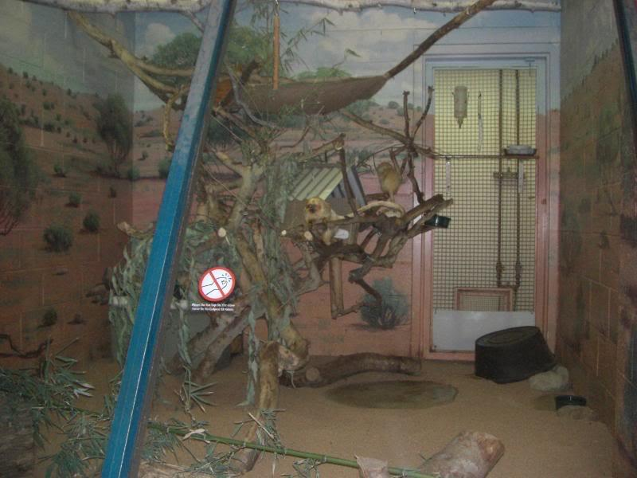
Pictures of Primates at the Zoo

Slide 46
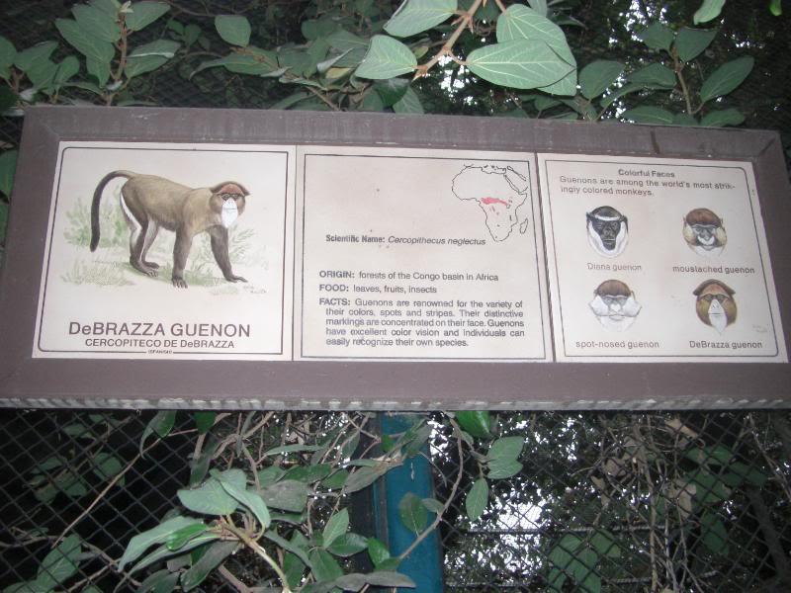
Pictures of Primates at the Zoo

Slide 47
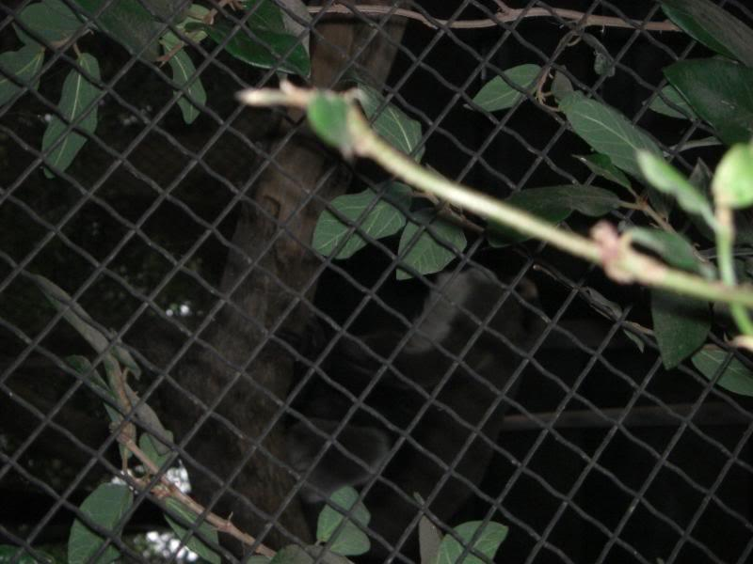
Pictures of Primates at the Zoo

Slide 48
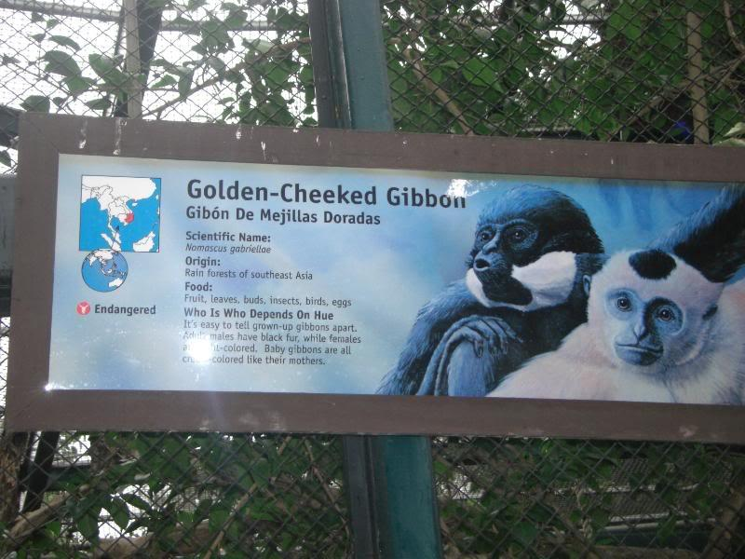
Pictures of Primates at the Zoo

Slide 49


Pictures of Primates at the Zoo

Slide 50
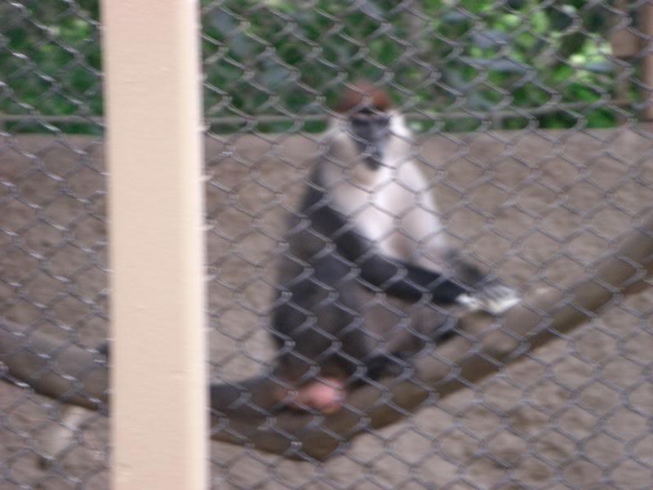
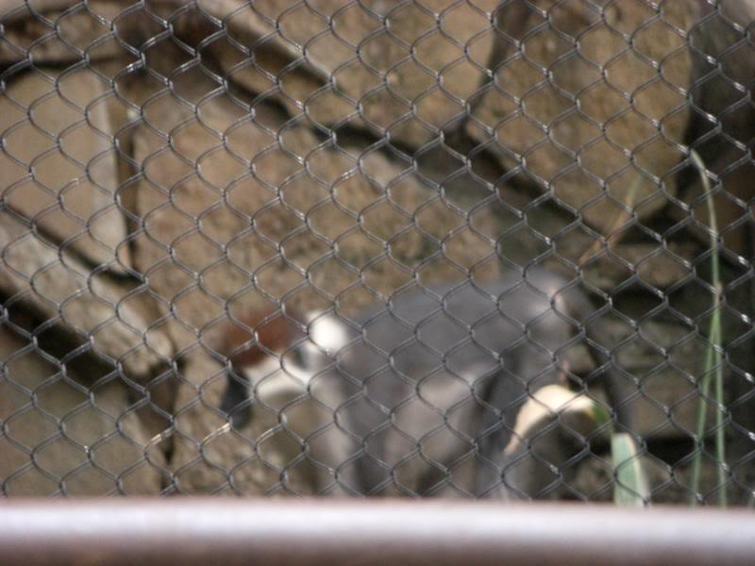
Pictures of Primates at the Zoo

Slide 51
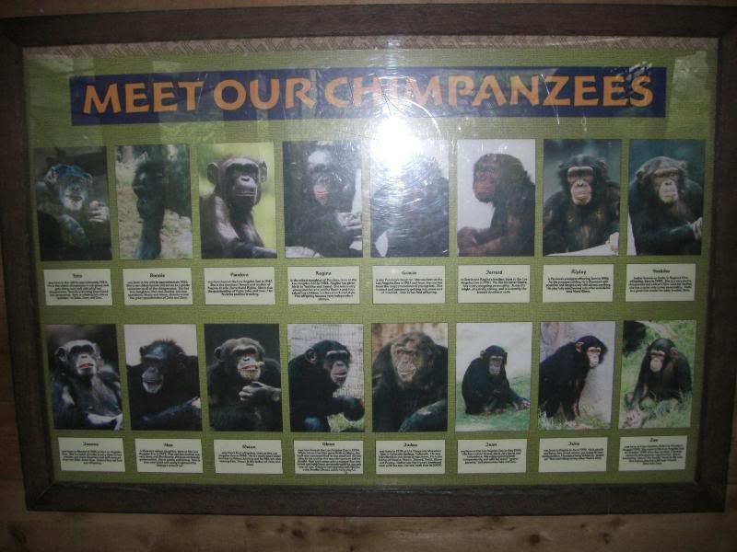
Pictures of Primates at the Zoo

Slide 52
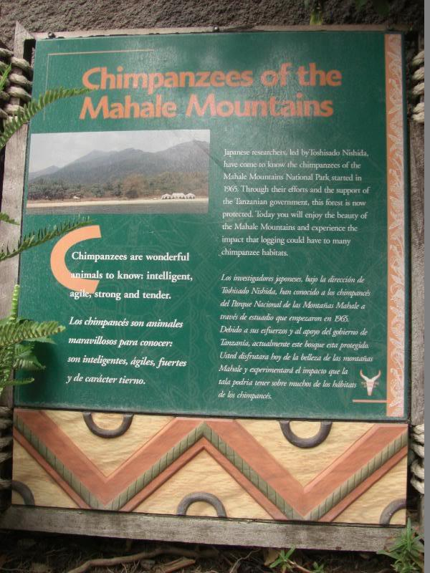
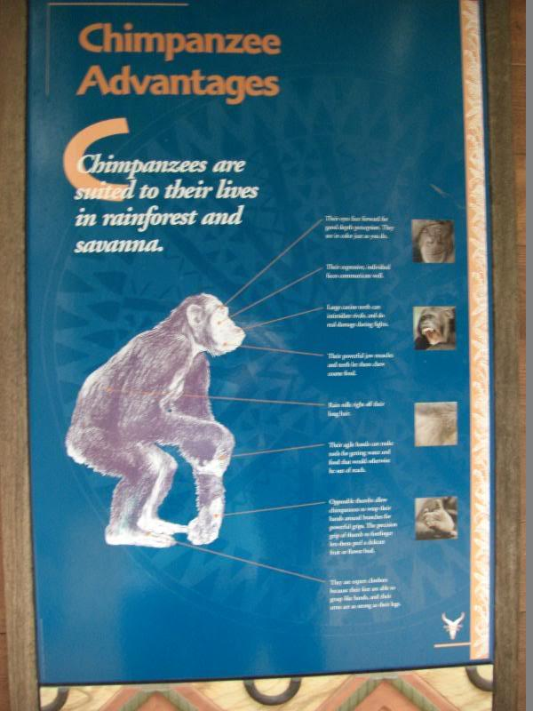
Pictures of Primates at the Zoo

Slide 53
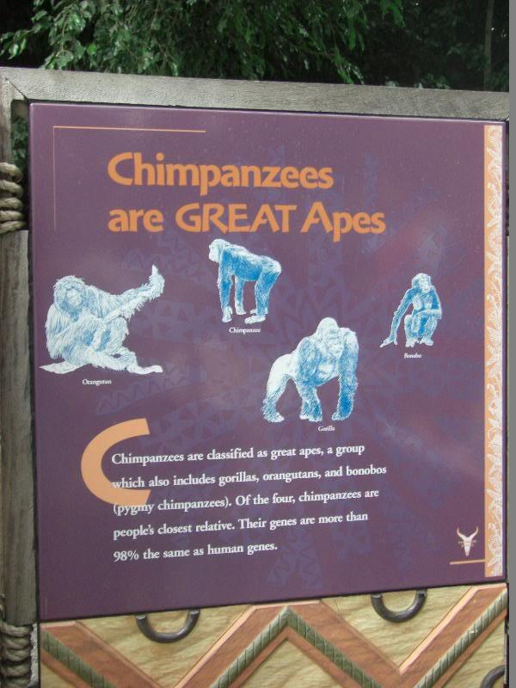
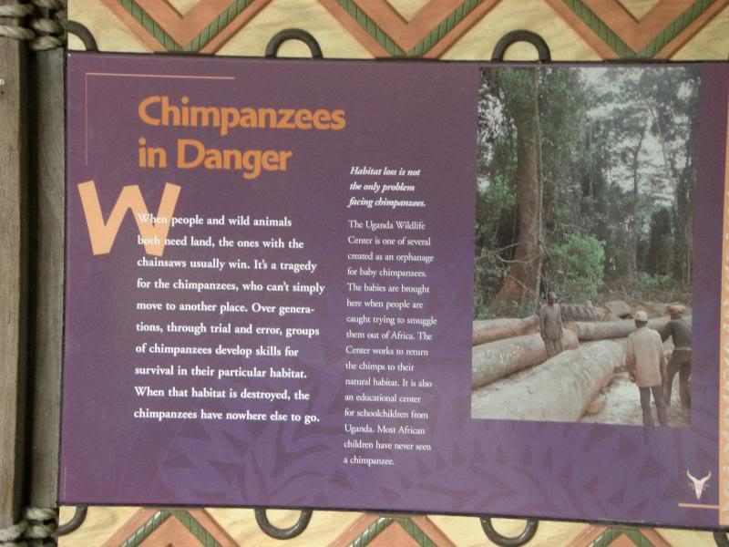
Pictures of Primates at the Zoo

Slide 54
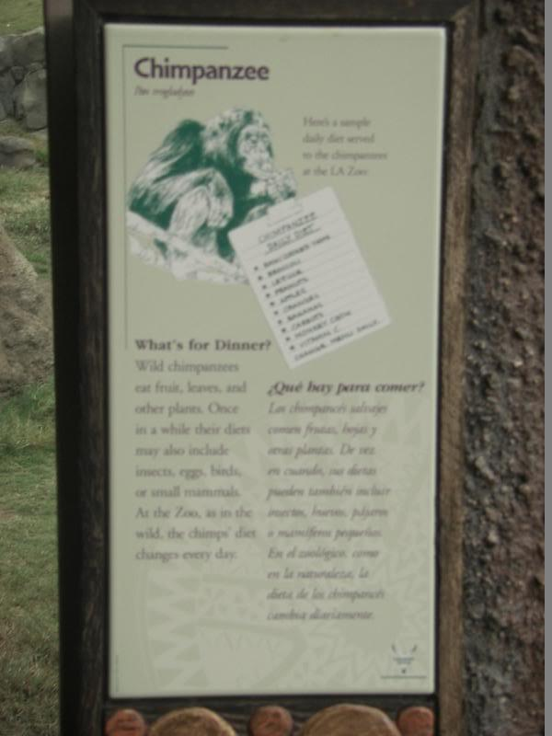
Pictures of Primates at the Zoo

Slide 55
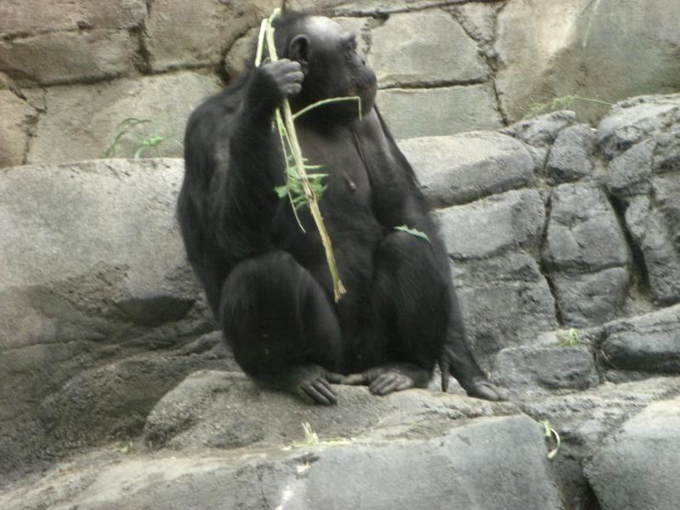
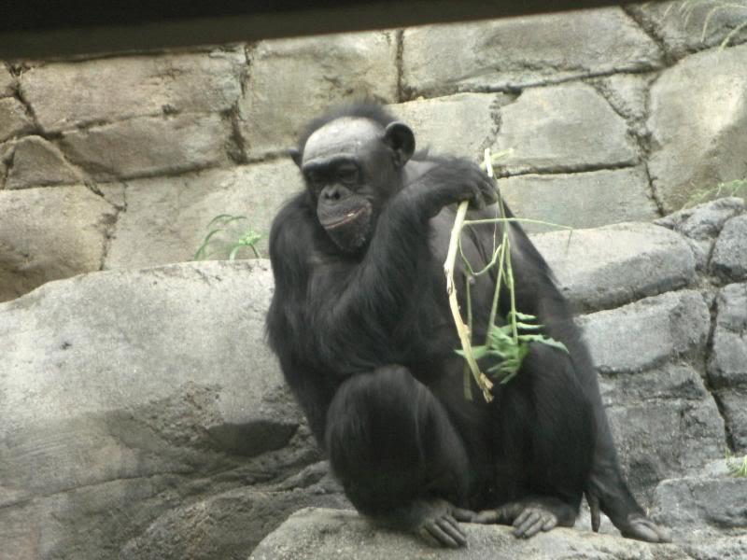
Pictures of Primates at the Zoo

Slide 56
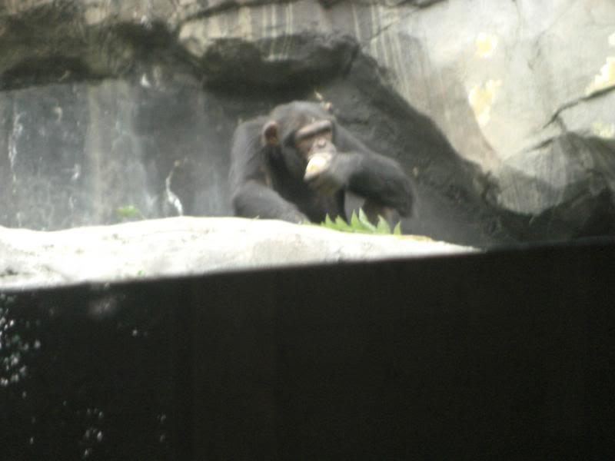
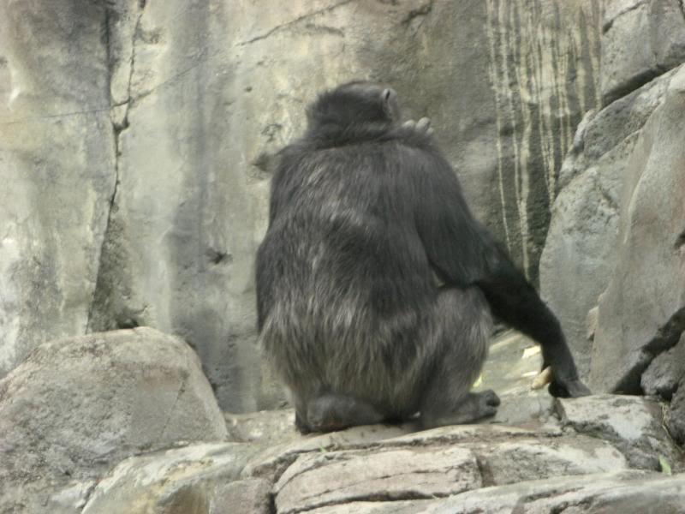
Pictures of Primates at the Zoo

Slide 57
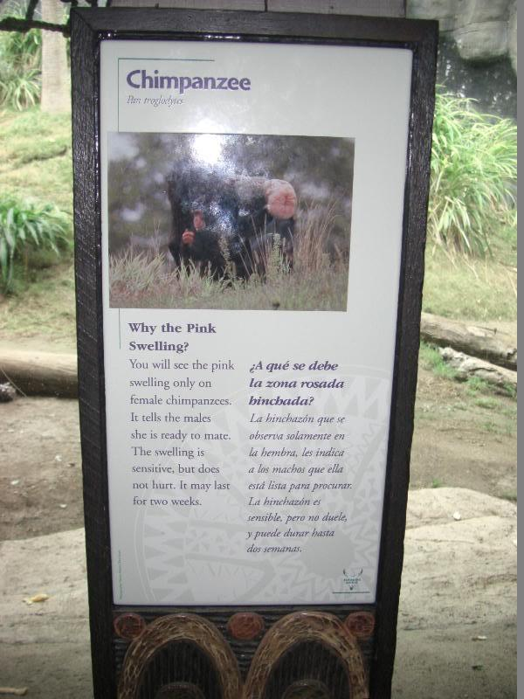
Pictures of Primates at the Zoo

Slide 58
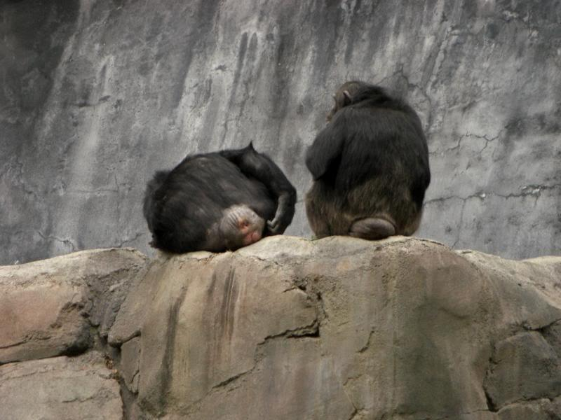
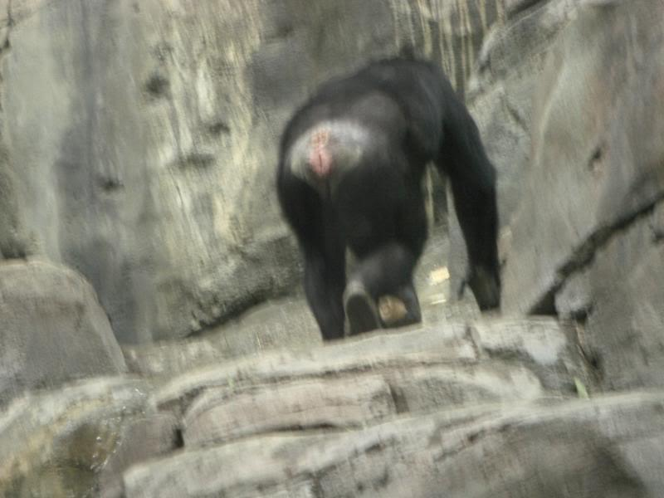
Pictures of Primates at the Zoo

Slide 59
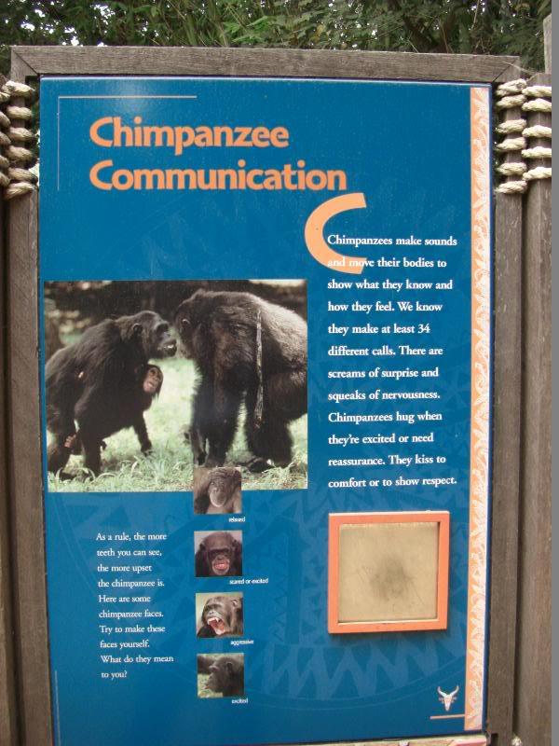
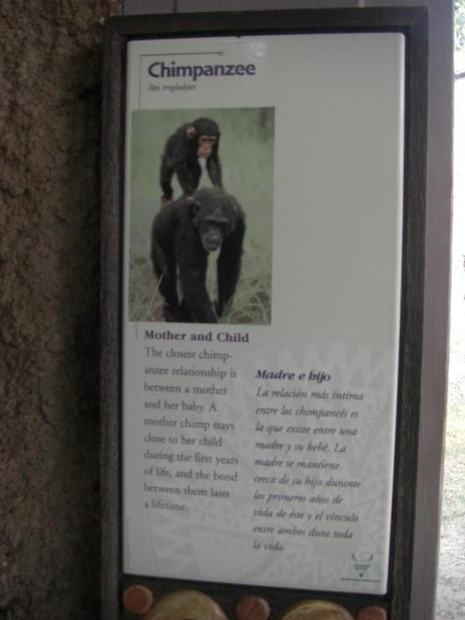
Pictures of Primates at the Zoo

Slide 60
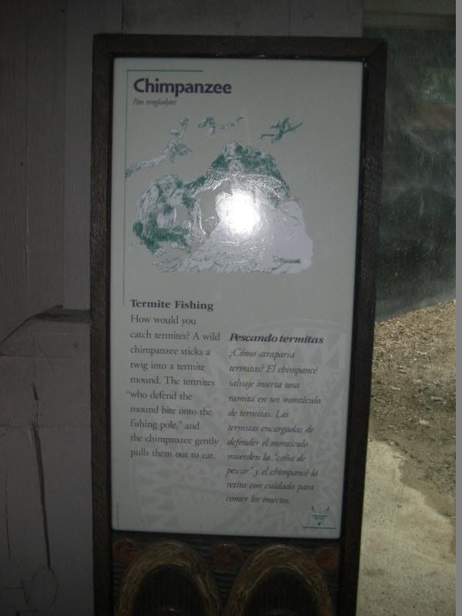
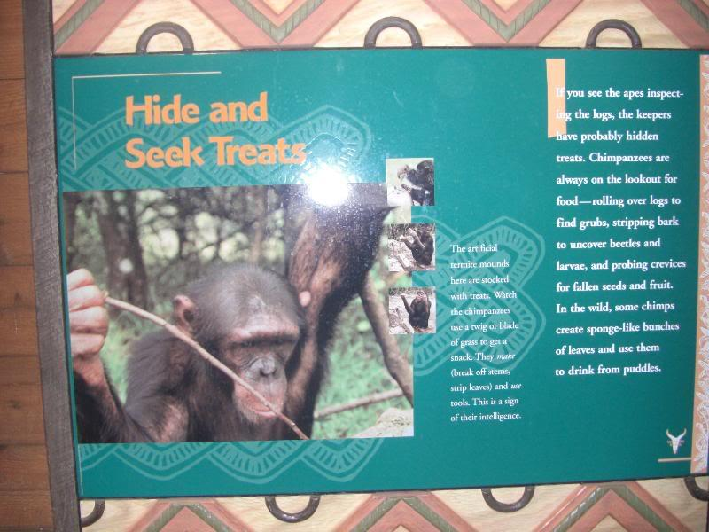
Pictures of Primates at the Zoo

Slide 61
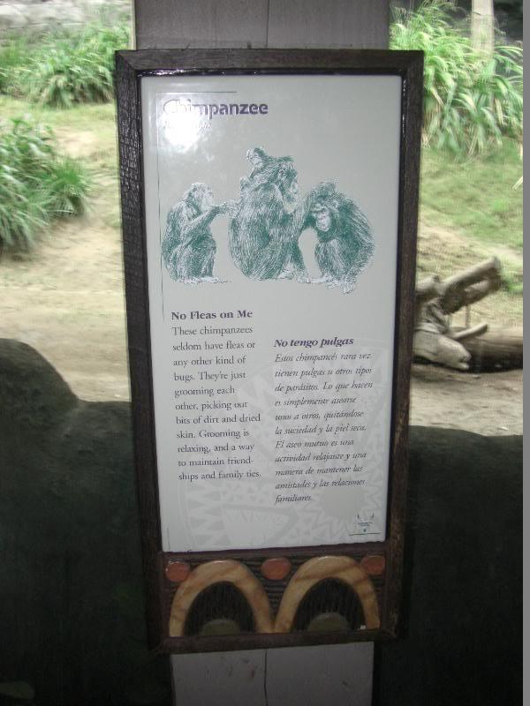
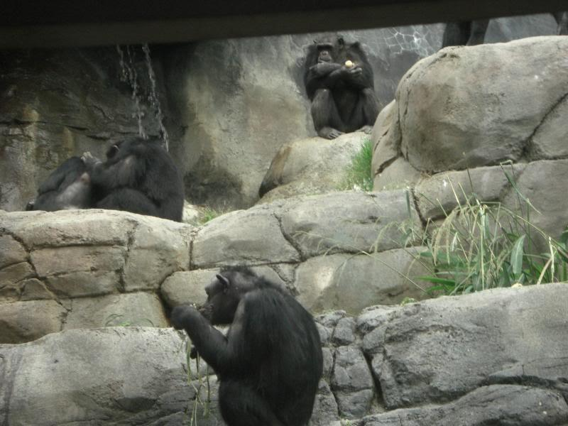
Pictures of Primates at the Zoo

Slide 62
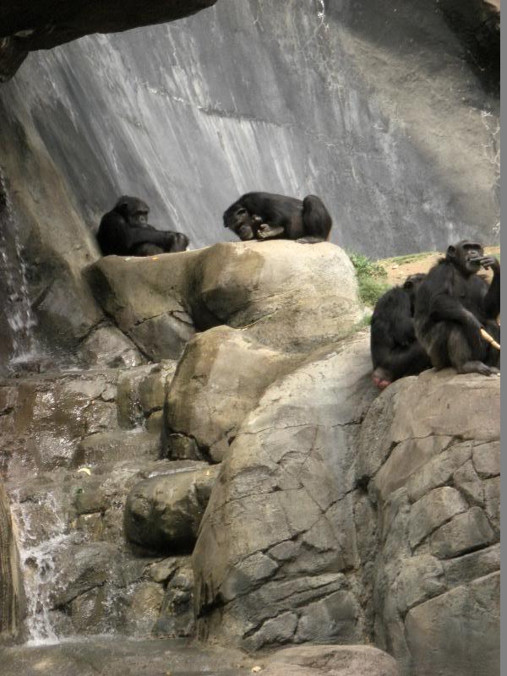
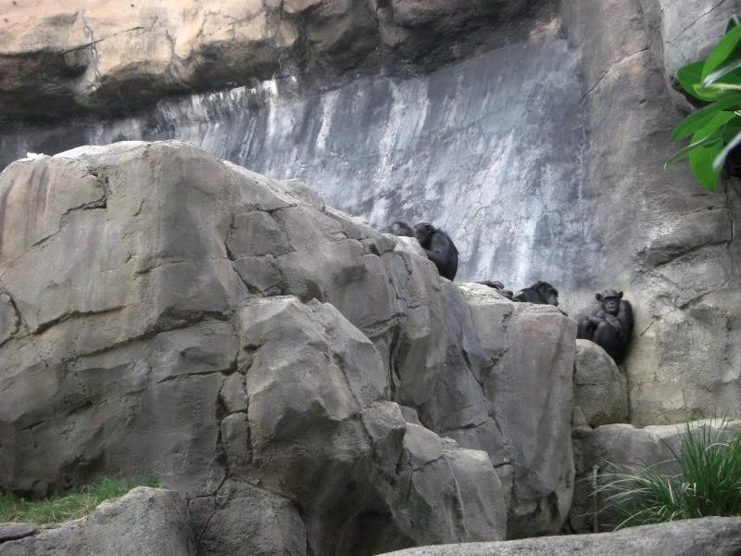
Pictures of Primates at the Zoo

Slide 63
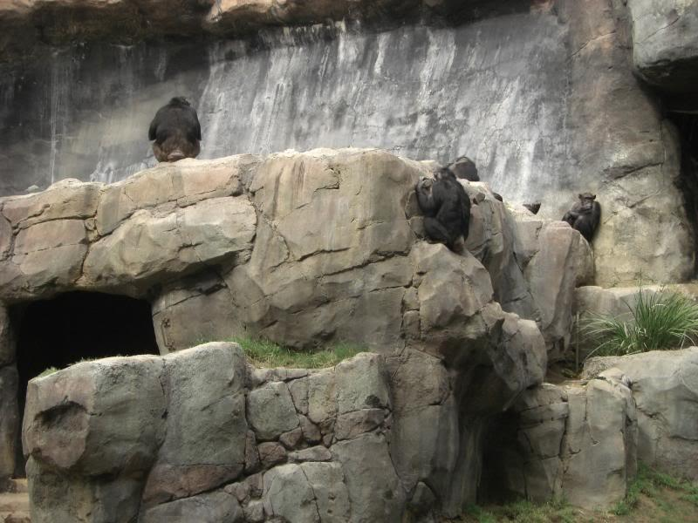
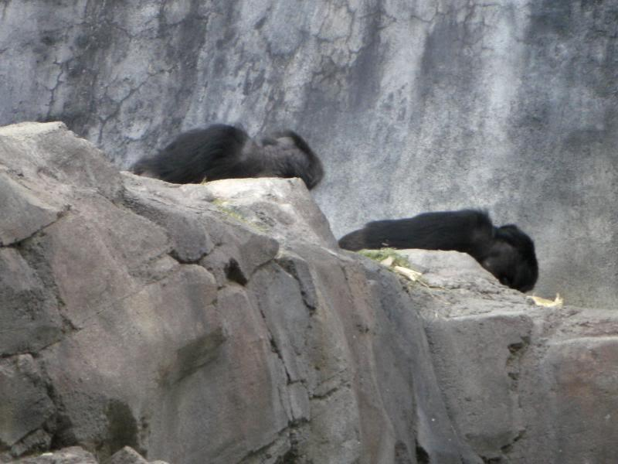
Pictures of Primates at the Zoo

Slide 64
Pictures of Primates at the Zoo
Questions? :)

