Slide 1
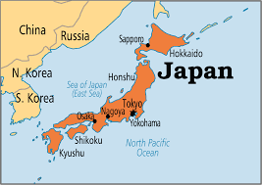
Geography

Slide 2
Video Notes
Mr. Zoller's Podcast

Slide 3
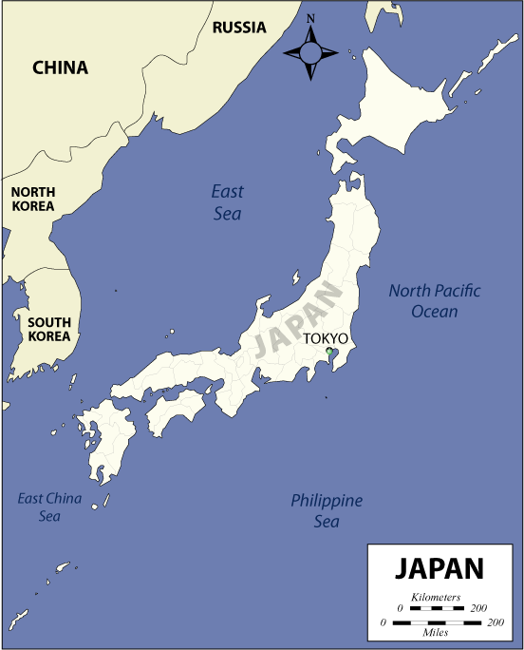
Where is it located?
Neighbors:
China, North Korea, and
South Korea and Russia
Japan is an island country in East Asia in the Pacific Ocean.
It is located east of China, Korea, and Russia.
It is called the “Land of the Rising Sun”

Slide 4
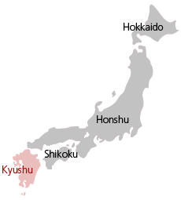
Label the four largest islands:
Hokkaido
Honshu
Shikoku
Kyushu
Japan consists of over 3,000 islands
•The 4 largest islands account for 97% of land area

Slide 5
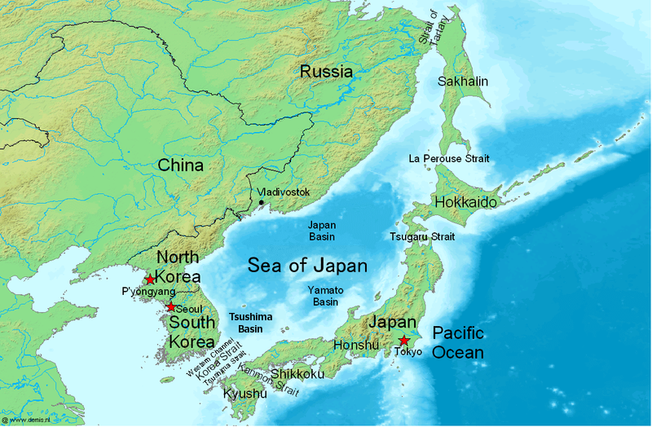
Label
The Sea of Japan
The Pacific Ocean

Slide 6
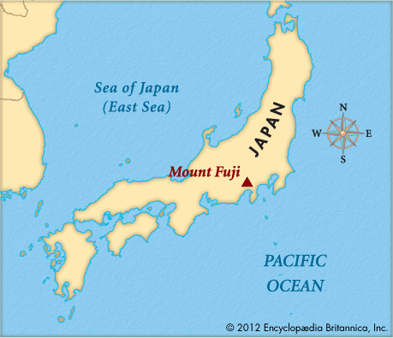
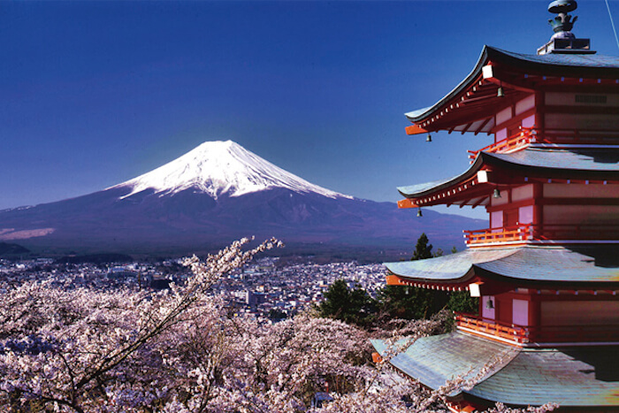
Label Mount Fuji:
Most islands are mountainous (many volcanic).

Slide 7
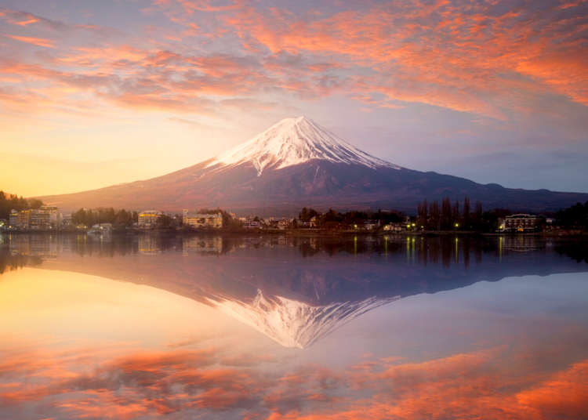

Slide 8
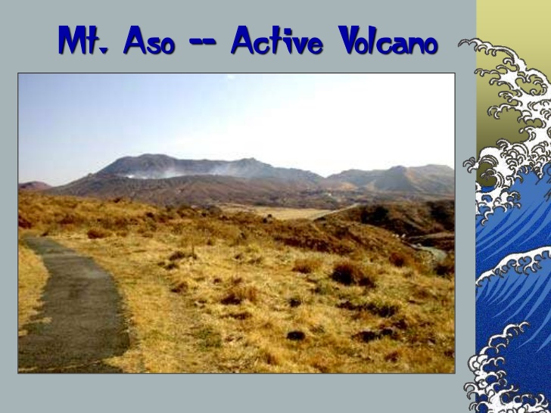

Slide 9
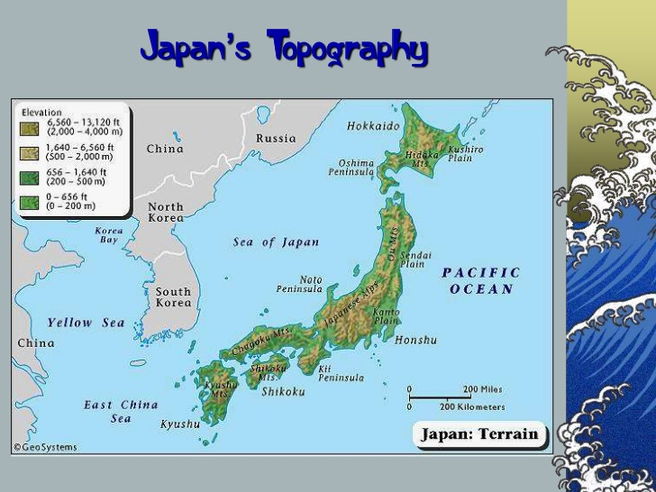

Slide 10
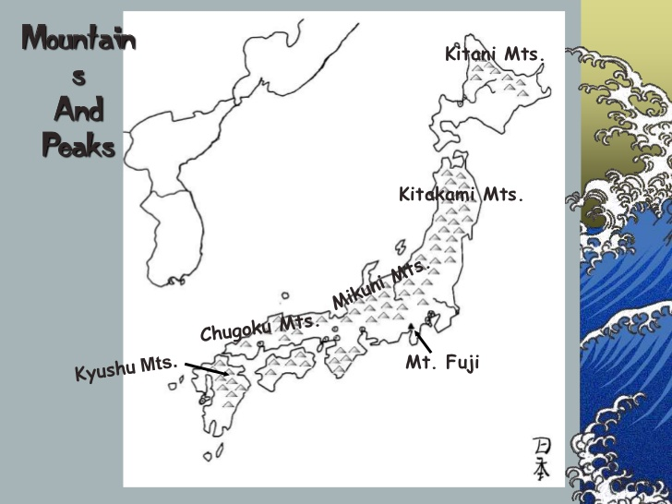
Most of Japan is Mountainous

Slide 11
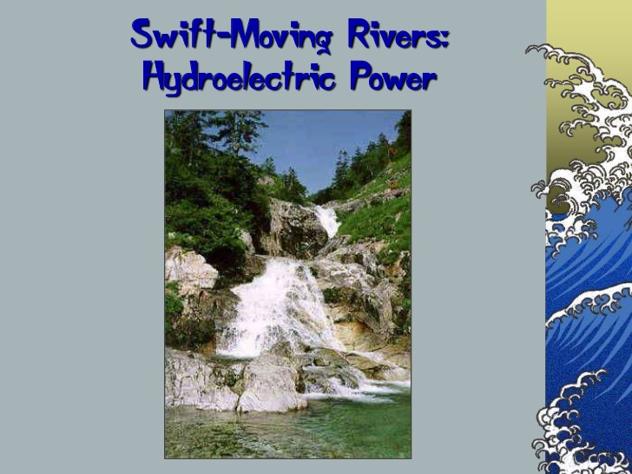

Slide 12
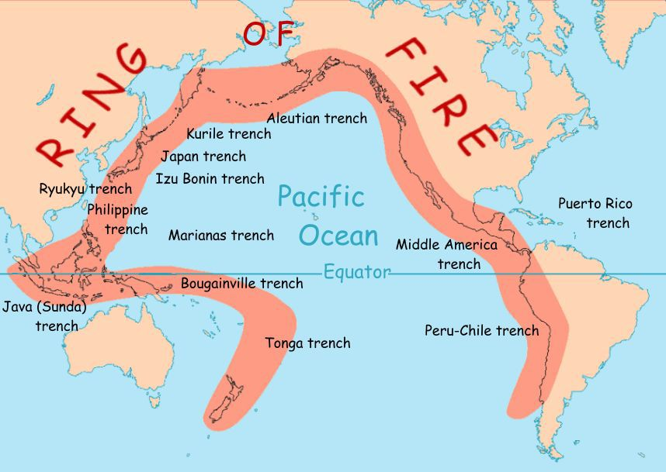
The Ring of Fire
The Pacific Ring of Fire is a belt of volcanoes.
The Pacific Ocean is surrounded by a belt of volcanoes
It is an area where there are a large number of earthquakes and volcanic eruptions.

Slide 13
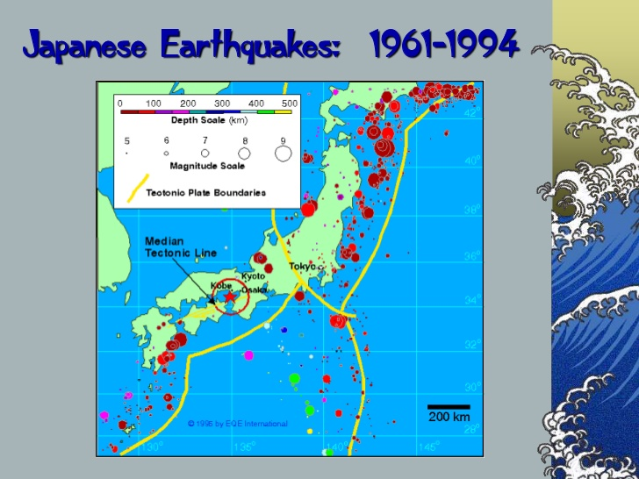

Slide 14
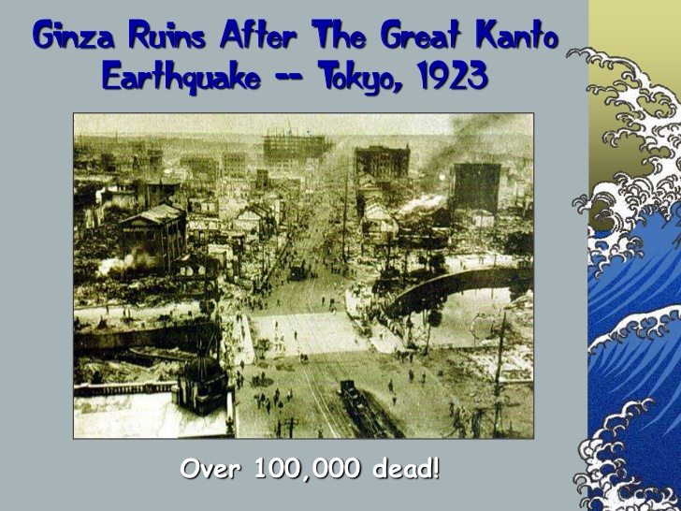

Slide 15
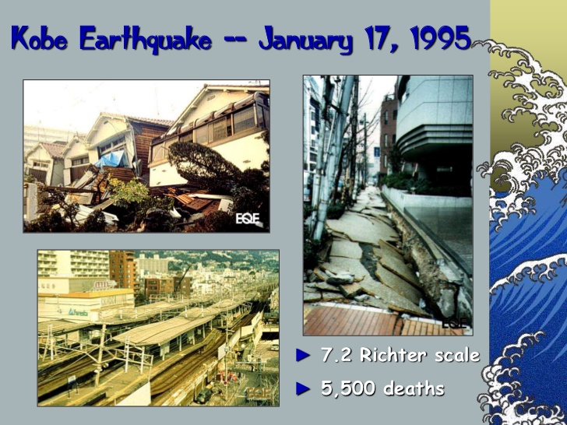

Slide 16
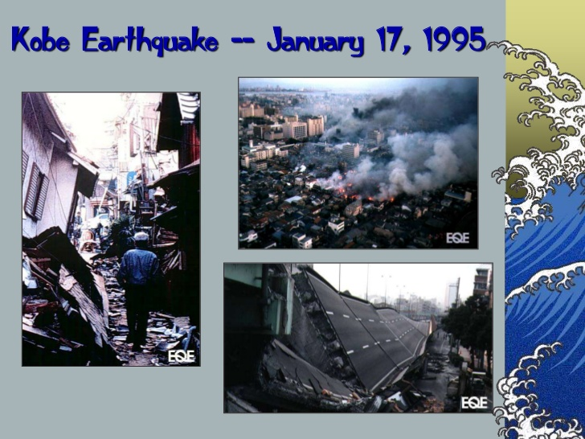

Slide 17
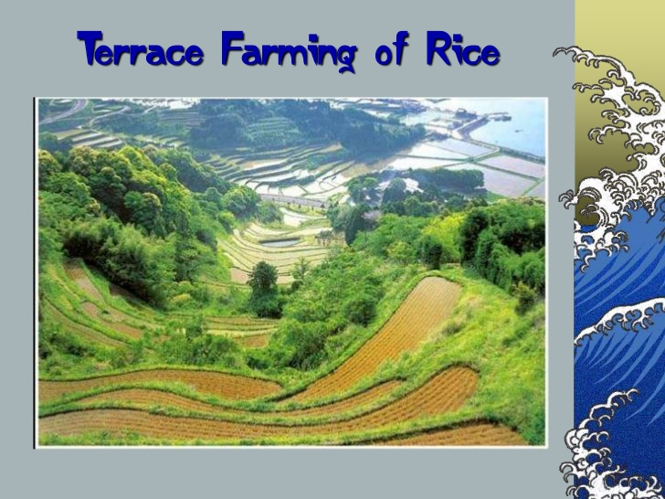

Slide 18
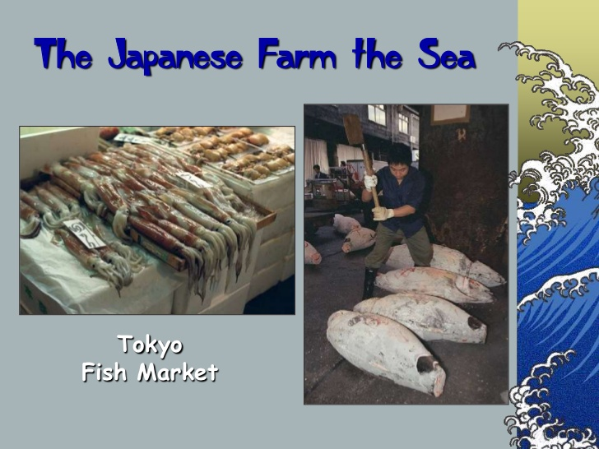

Slide 19
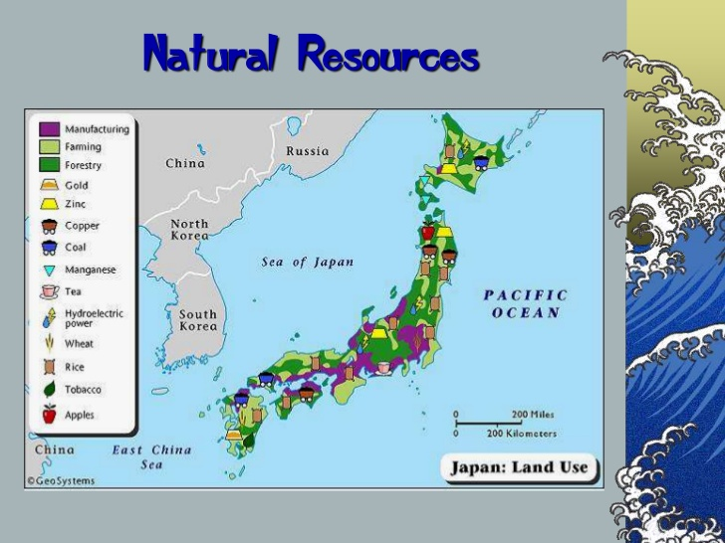

Slide 20
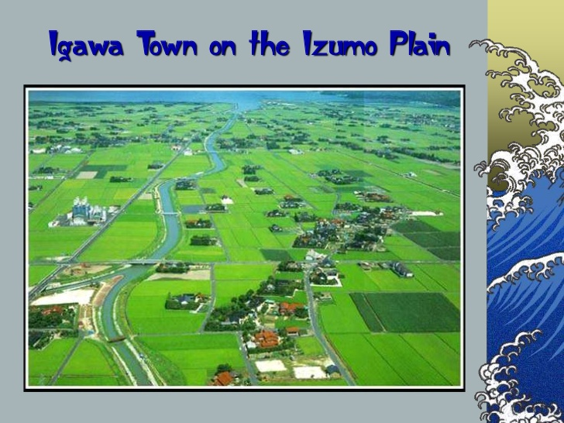

Slide 21
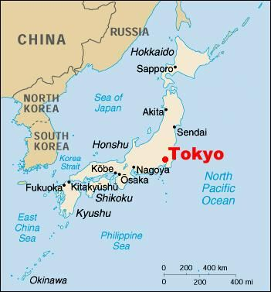
Cities
Tokyo is the star – it’s the capital of Japan
Label the rest of the cities on your map
Interactive Map of Japan

Slide 22
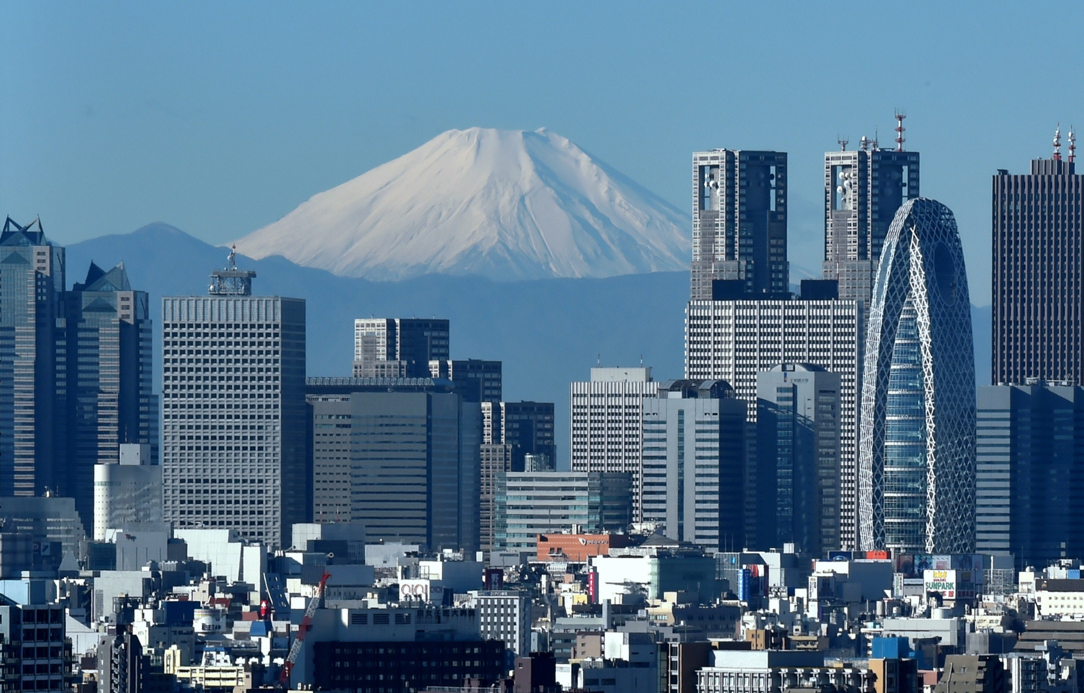
Tokyo

Slide 23
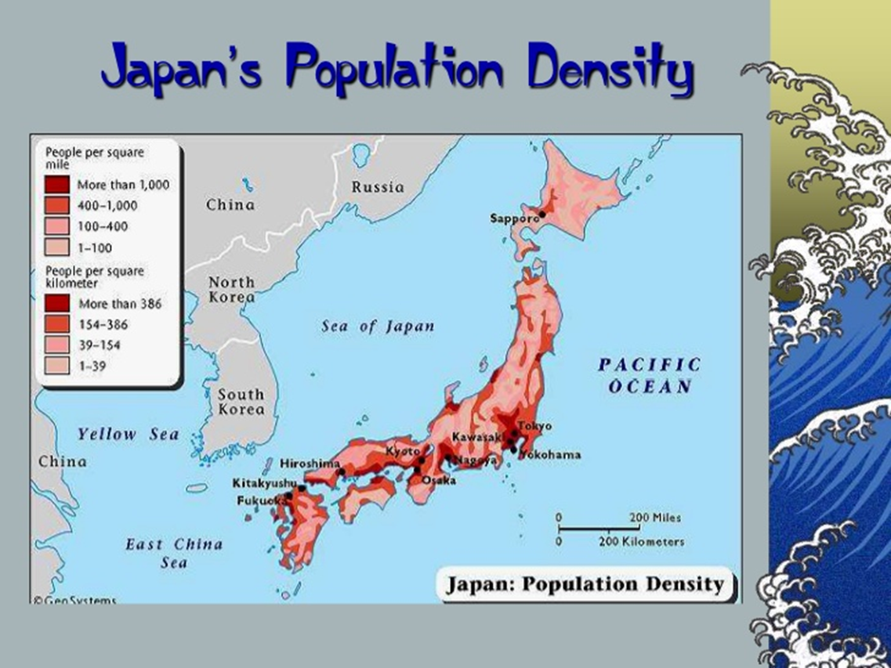

Slide 24
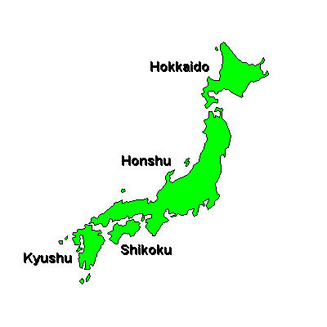
Color in the four biggest islands using a light color.

Slide 25
Now, you can complete your
Geo Themes assignment

